Slide 1



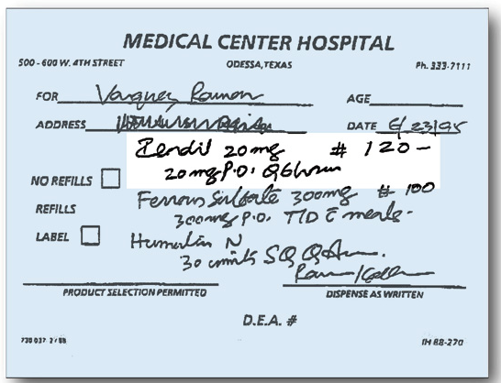
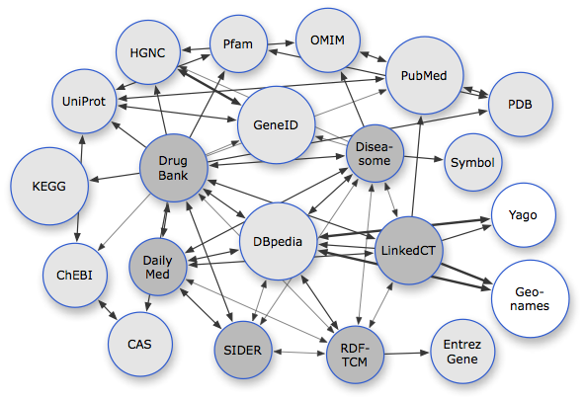

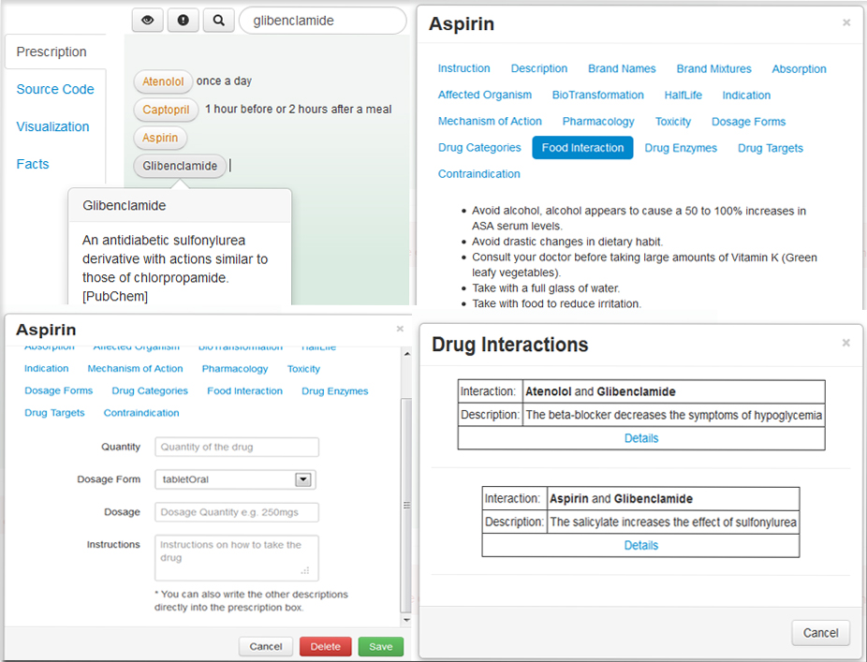
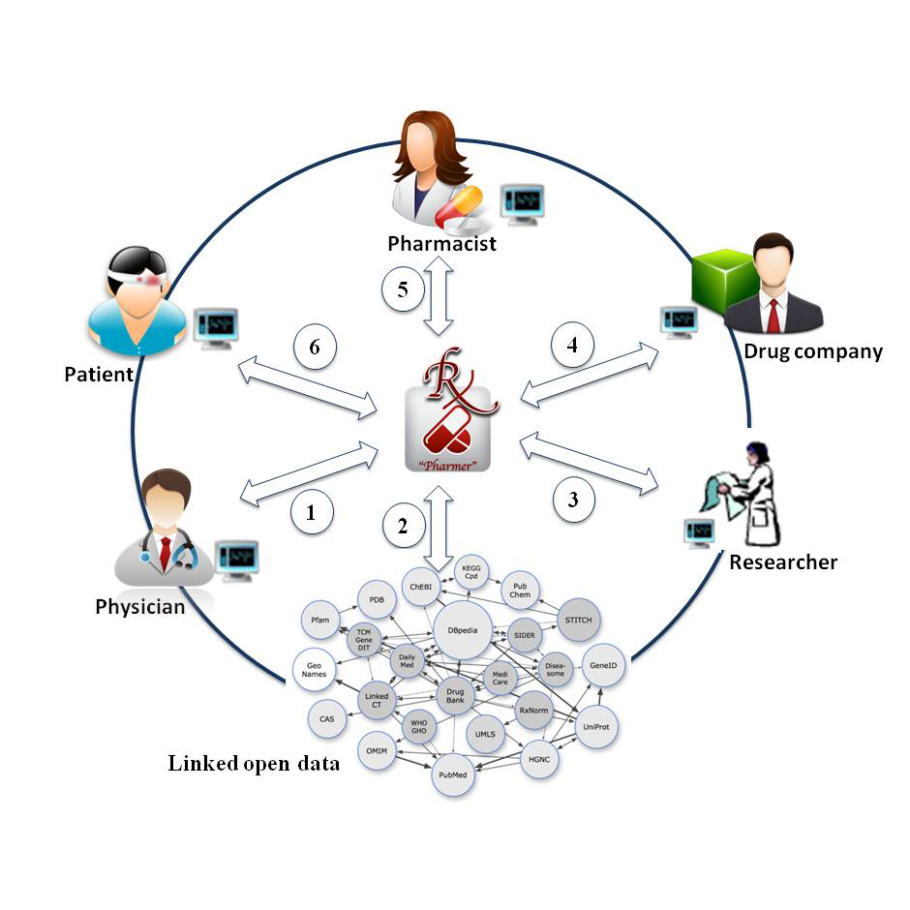


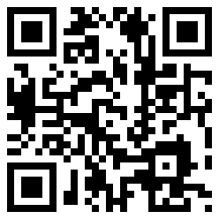

E-Prescriptions
PHARMER
Linked Open Data
★ Make your stuff available on the Web (whatever format) under an open license
★★ Make it available as structured data (e.g., Excel instead of image scan of a table)
★★★ Use non-proprietary formats (e.g., CSV instead of Excel)
★★★★ Use URIs to identify things, so that people can point at your stuff
★★★★★ Link your data to other data to provide context
✓
Linked Data
A recommended best practice for exposing, sharing, and connecting pieces of data, information, and knowledge on the Semantic Web.
X
Semantic Web
A collaborative movement aiming at converting the current web dominated by unstructured and semi-structured documents into a "web of data".
Semantic Medical Prescriptions
Semantic Prescriptions are intelligent e-prescription documents enriched by drug-related meta-data thereby know about their content and the possible interactions. They provide:
Linked Open Drug Data
Linked Data representations of the drug-related data sets together with interesting scientific and business questions that can be answered once the data sets are connected.
Linked Open Drug Data
Persistent connection to up-to-date drug information
coming from multiple dynamic data sources.
Drug interaction prevention→ Error free prescriptions.
http://bitili.com/pharmer
Connection of physicians, pharmacists, patients,
pharmaceutical researchers and drug companies
Machine understandable prescription.
Shared decision making.
Patient awareness.
Pharmer Prescription Writer
Providing Different Semantic Views.
Real-time Drug Tagging.
Drug Suggestion.
Automatic Drug Annotation.
The physician diagnoses the disease and writes the corresponding semantic prescription using the Pharmer. The patient's medication history is available to the physician as well.
Pharmer utilizes the Linked Open Data as its integrated information source.
The researcher can analyze the stored semantic prescriptions data.
Drug companies utilize the Pharmer data store in order to balance their production and distribution according to the market taste and demand.
The pharmacist verifies the prescription and hands in the medication to the patient.
The patient inquires drug information and can contact the related physician and pharmacist.
Ali Khalili
AKSW Research group
Institute of Informatics
khalili@informatik.uni-leipzig.de
Bita Sedaghati
Pharmaceutical Technology Research Group
Institute of Pharmacy
bita.sedaghati@uni-leipzig.de
http://www.aksw.org

