Slide 1


A New Approach to E-Prescribing: Semantic Medical Prescriptions
Dr. Behnam Sedaghati
Pharm.D

Slide 2
Agenda
E-Prescriptions
Linked Open (Drug) Data
Semantic Documents
Semantic E-Prescriptions
Advantages of Semantic E-Prescriptions
Pharmer: Writing Semantic E-Prescriptions
Pharmer: Ecosystem
Pharmer: Evaluation
Challenges of implementing Pharmer system in Iran

Slide 3
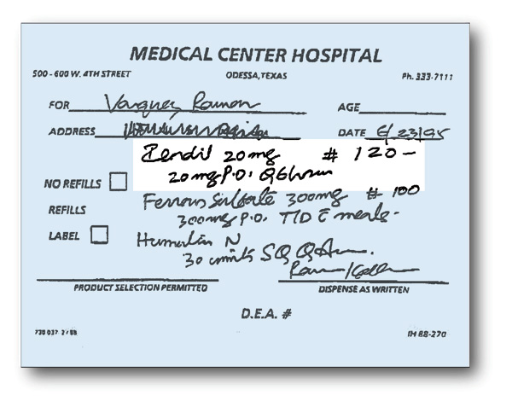

E-Prescriptions
✓

Slide 4
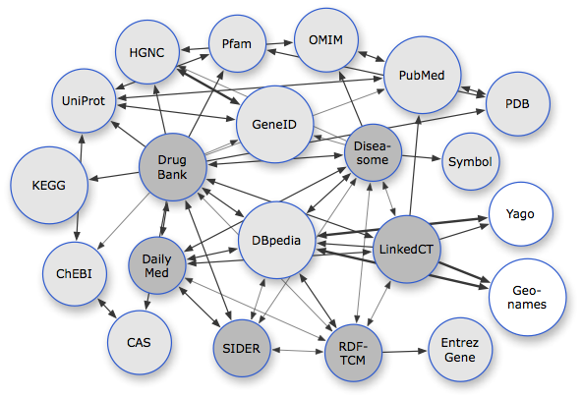
Linked Open (Drug) Data

Slide 5





Semantic Documents

Slide 6
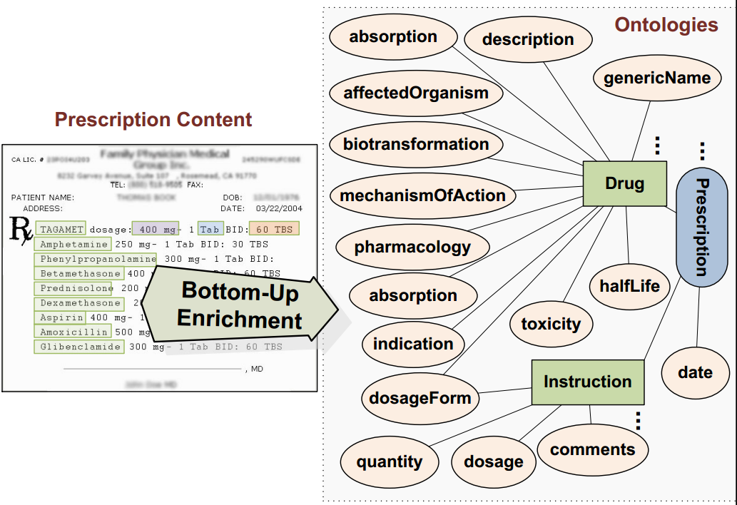
Semantic E-Prescription

Slide 7
Advantages of Semantic Prescriptions
Persistent connection to up-to-date drug information coming from multiple dynamic data sources.
Drug interactions prevention→ Error free prescriptions.
Machine understandable prescription.
Patient awareness.
Connection of physicians, pharmacists, patients, pharmaceutical researchers and drug companies.

Slide 8
Pharmer: Writing Semantic Prescriptions
An application created as a proof of concept for the authoring of semantic prescriptions.
Open-source: http://code.google.com/p/pharmer/
Features
- Providing Different Semantic Views
- Real-time Drug Tagging
- Drug Suggestion
- Automatic Drug Annotation

Slide 9
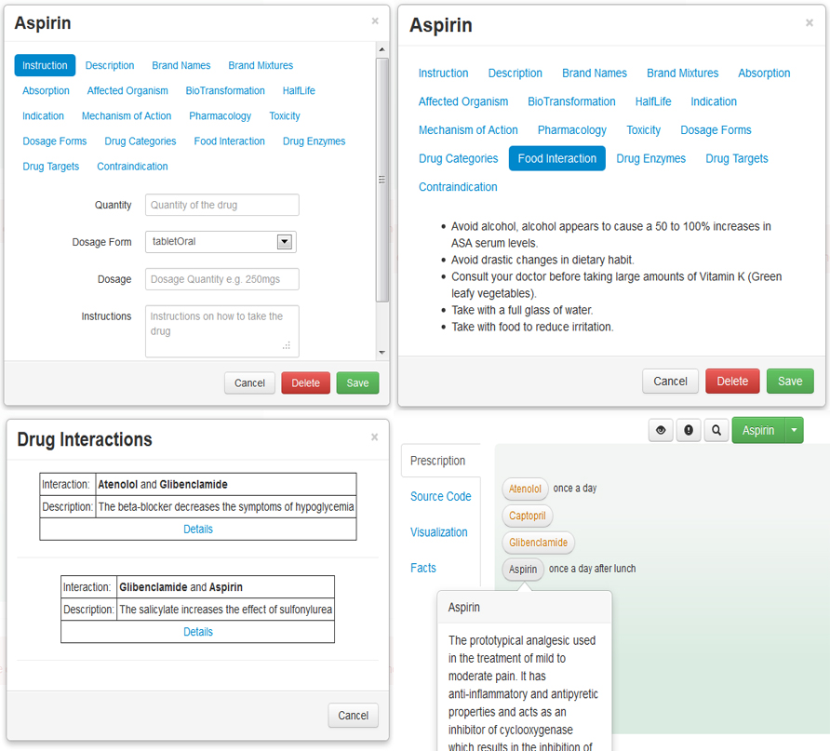
Pharmer: Demo
http://bitili.com/pharmer

Slide 10
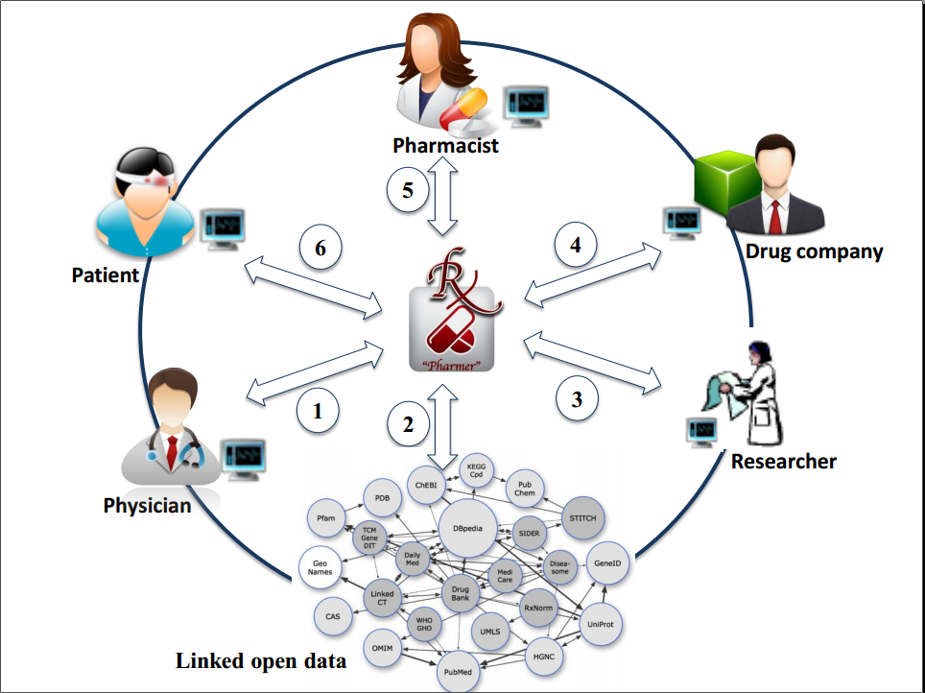
Pharmer: Ecosystem A Real Example

Slide 11
Pharmer: Evaluation
A usability user study with 12 subjects
3 physicians, 3 pharmacist, 3 pharmaceutical researchers and 3 students
Steps
A tutorial video of using different features of Pharmer
Participants were asked to create a prescription with Pharmer
A questionnaire addressing feature usage questions and usability experience questions.
Results
Usability score of 75 (System Usability Scale )

Slide 12
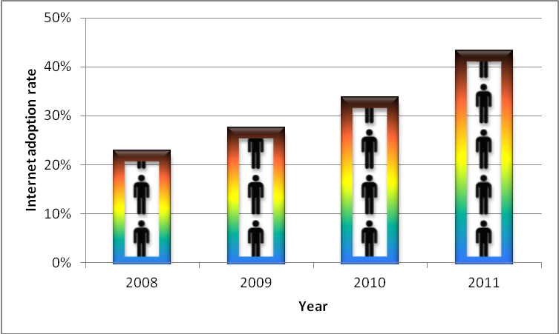
Challenges of implementing Pharmer system in Iran
Defining health record models based on Pharmer,
Educating people to get familiar to the new system and its advantages
Internet access limitation

Slide 13
Conclusion
Providing a consistent connection between patients, physicians, pharmacists, pharmaceutical researchers and drug companies is a crucial step towards enhancing the quality of knowledge management and thereby e-health services in the pharmaceutical domain.
We introduced Pharmer as an approach for implementation of Semantic Prescriptions as intelligent medical prescriptions to improve the integration and interoperability of e-prescribing systems with other e-health services.

Slide 14

Questions
?

