Slide 1
Easy Italian App
Jessica Doyle
Fabian Lema

Slide 2

Easy Italian App
This app helps people memorize the Italian language. The app will display words in Italian, and ask you to recall the corresponding word in English.

Slide 3
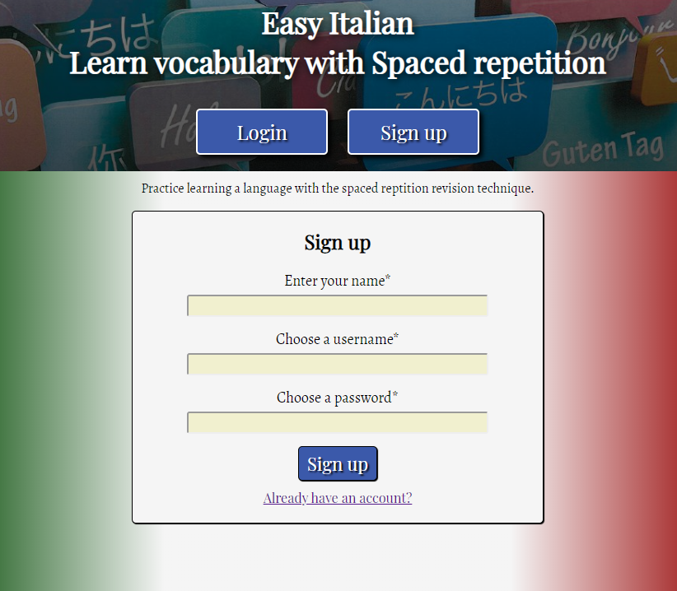
Easy Italian - Features
As a prospective user, I can register an account so that I can login and use the application.

Slide 4
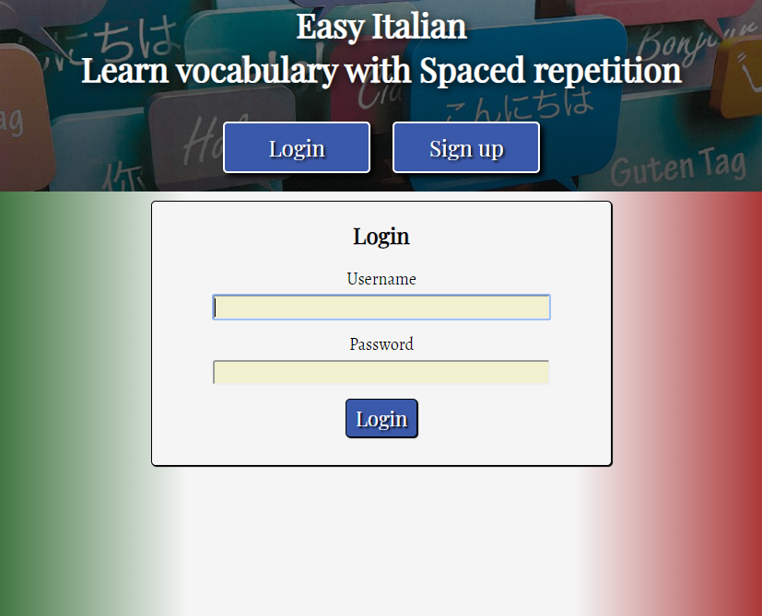
Easy Italian - Features
As a registered user, I can login to the application so that I can begin learning.

Slide 5
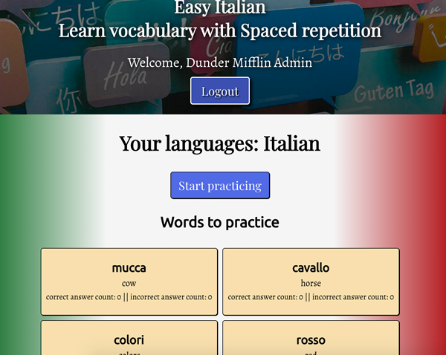
Easy Italian - Features
As a logged in user, I'm directed to a dashboard where I can see my progress learning my language.

Slide 6
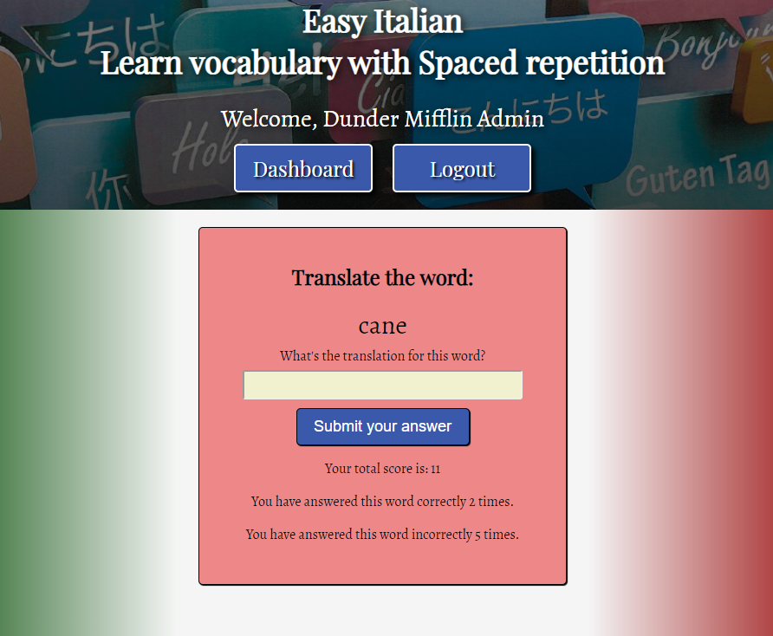
Easy Italian - Features
As a logged in user, I can learn words using spaced repetition.

Slide 7
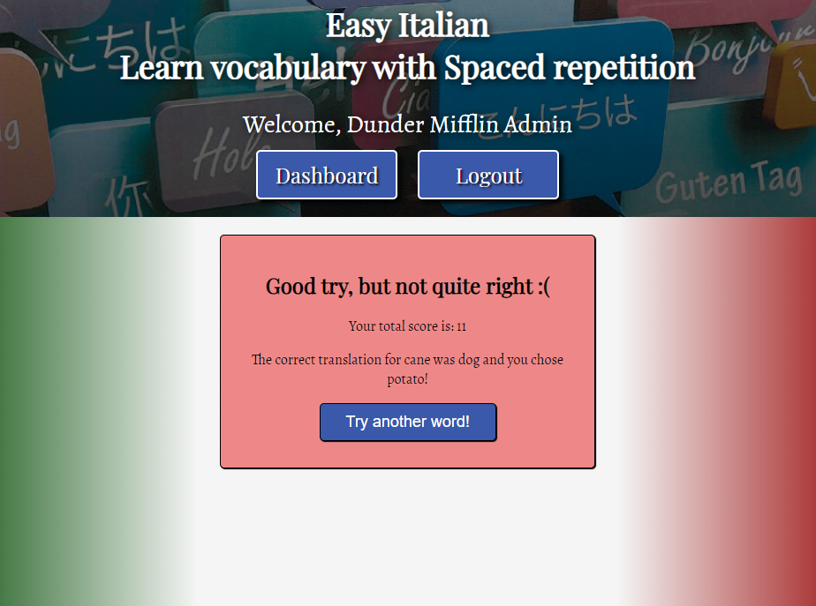
Easy Italian - Features
As a logged in user, I can see feedback on my submitted answers.

Slide 8
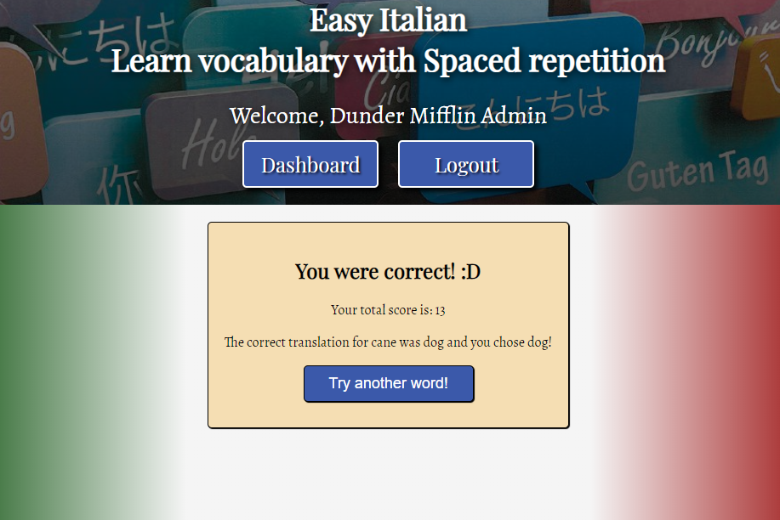
Easy Italian - Features
As a logged in user, I can learn another word after receiving feedback from my previous answer

Slide 9






Easy Italian - Technology
.

Slide 10
Easy Italian App
Demo …
https://easy-italian-app.now.sh

Slide 11
Easy Italian App
Code ...

Slide 12
Easy Italian App
Questions?

