Slide 1
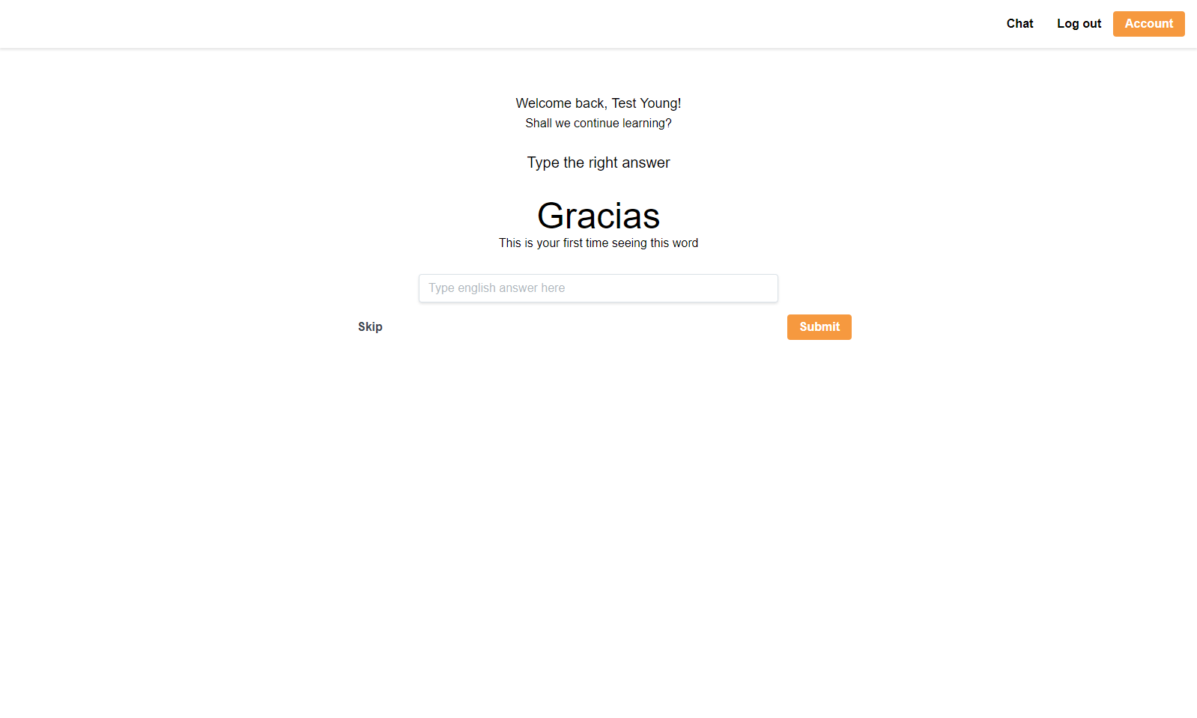
‘’
Learn Spanish
The “Learn Spanish” app uses spaced repetition to efficiently learn words in the Spanish language.

Slide 2

Dashboard
www.yourdomain.com
Pitch Deck Presentation
Word
User is presented with a Spanish word
Input
User can enter in the English translation of the word above.
Submit
When user is ready, they can press enter to submit answer. App will provide feedback on correct vs. incorrect.

Slide 3
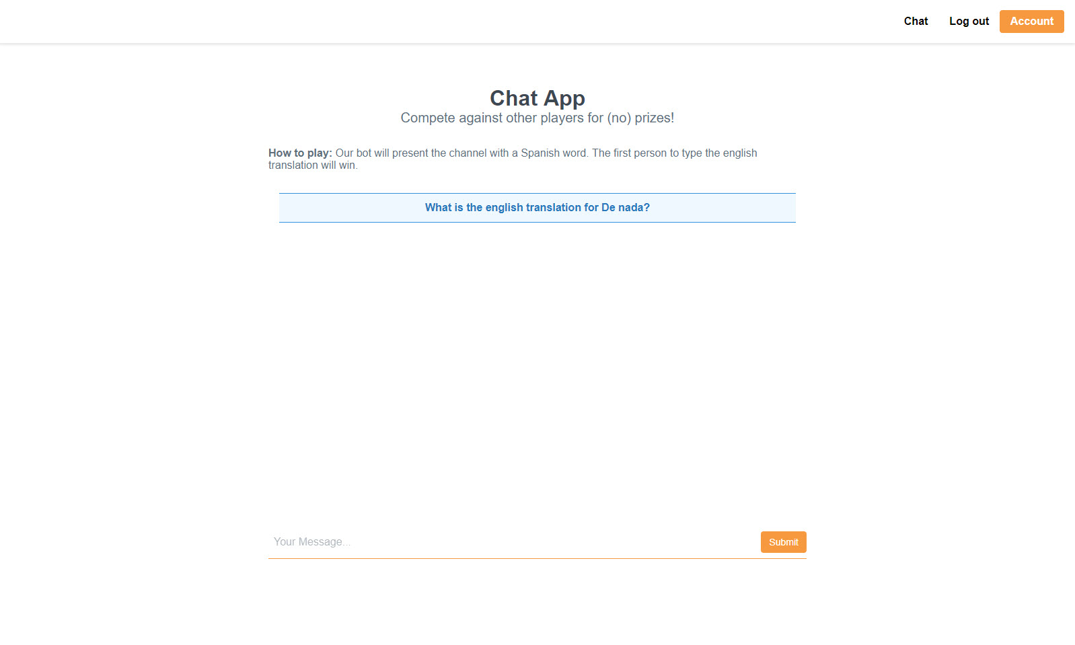
Chat App
www.yourdomain.com
Pitch Deck Presentation
Chat game
Be the first to answer the question correctly to increase your score!.
Message area
All messages will be contained in the message area.
Chat box
Users can talk to each other, as well as participate in the game.

Slide 4
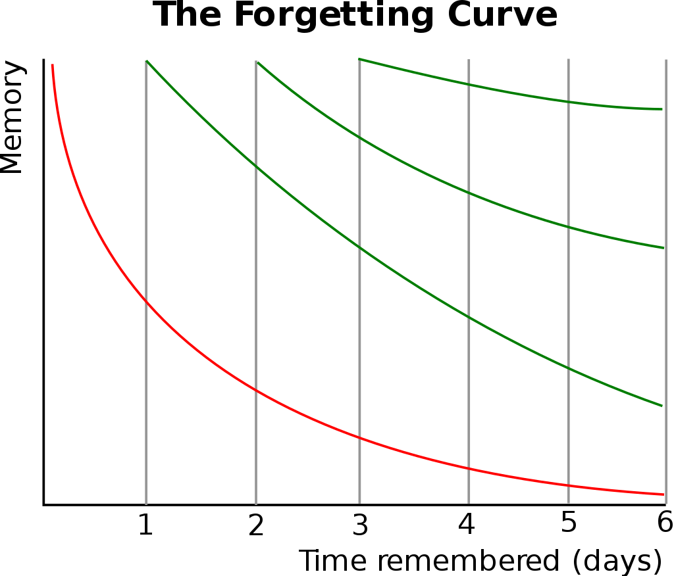
The Problems
Memory decay
The forgetting curve hypothesizes the decline of memory retention in time. This curve shows how information is lost over time when there is no attempt to retain it.
Learning can be expensive
Language learning apps can be pricey, and usually require a monthly subscription

Slide 5
The Solution – Spaced Repetition
FIRST | SECOND | THIRD | FOURTH | FIFTH | SIXTH
¡Hola!
Buenas tardes
Buenas noches

Slide 6







The Stack
React
Front end - Interface
Redux
Front end – State Management
React Router
Front end - Routing
SocketIO
Front end – Socket comm
NodeJS
Back end – JavaScript Runtime
Express
Back end – Web App Framework
MongoDB
Database
SocketIO
Back end – Socket comm

Slide 7
Lessons Learned
David Johnson
Always make a new branch!
When you’re in a group, rely on your strengths. When learning, work on your weaknesses.
‘’
Next Steps
Here are some next step features we have considered for implementation into version 2.0:
Slack integration
Making the interaction more ‘human’-like
‘Power of the crowd’ implementation
John Young
Constant merge checks are critical in the beginning to make sure everyone is on the same page
Having multiple outsiders test your app is the quickest way to find bugs and/or UX flaws

