Slide 1
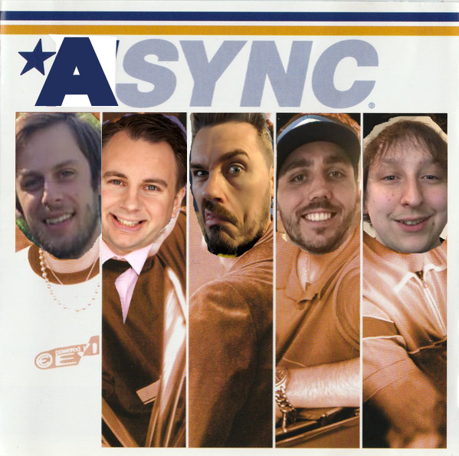
*ASYNC
- FINAL CAPSTONE -

Slide 2

‘’
War of the Games
War of the Games pits games from beloved classics to modern masterpieces against each other to determine the true greatest games of all-time. We then turn user choices into highly-curated game recommendations.

Slide 3
The Problems
Genres are too broad
While genres do a good job of quickly categorizing games, they are not good at capturing true user-intent.
Conclusion
Current methods of recommending games are too broad, and suffer with capturing user-intent. While a user can search for games, it becomes a daunting task when platforms have thousands of choices.
Way too many choices
Steam currently has over 30,000* games in their catalogue to choose from. This makes searching for games a battle of popularity.
Source: https://store.steampowered.com/search/?category1=998

Slide 4
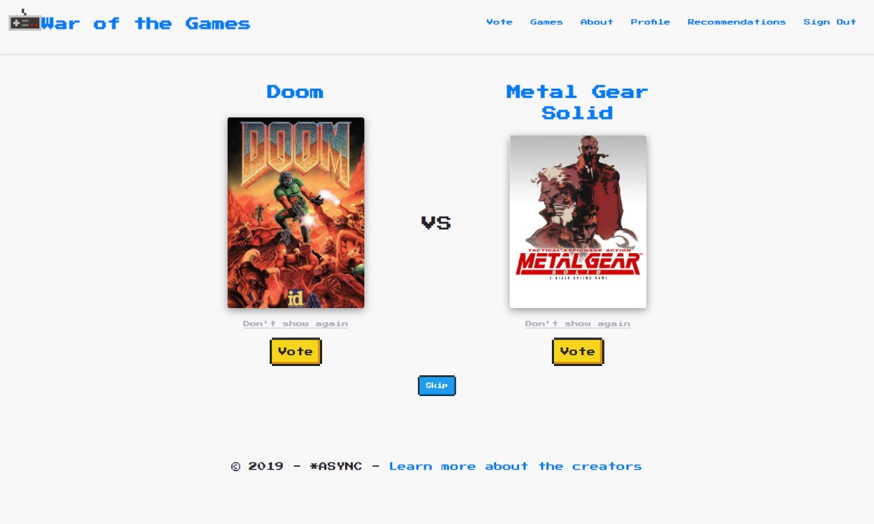

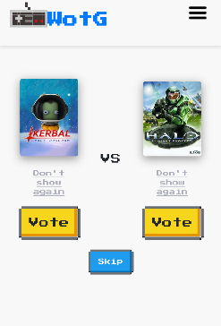
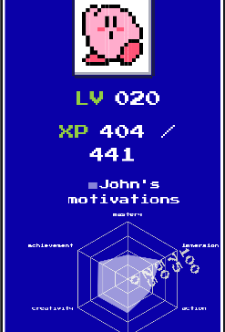
The Solution
https://www.warofthegames.com/
War of the games solves the recommendations issue through a unique ‘Battle’ system. We are able to extract the same motivations, through a game that is significantly more fun than taking surveys.

Slide 5
Recommendations Process
Extract Games
Identify the core, iconic games for each Submotivation
Tally Votes
As the user votes, we tally up their submotivation percentages
02
04
01
03
05
Motivations
Identify what drives gamers to like certain games
Identify Keywords
Establish keywords that define each submotivation to their core
Recommend
Search video game database for matching games and present recommendations

Slide 6
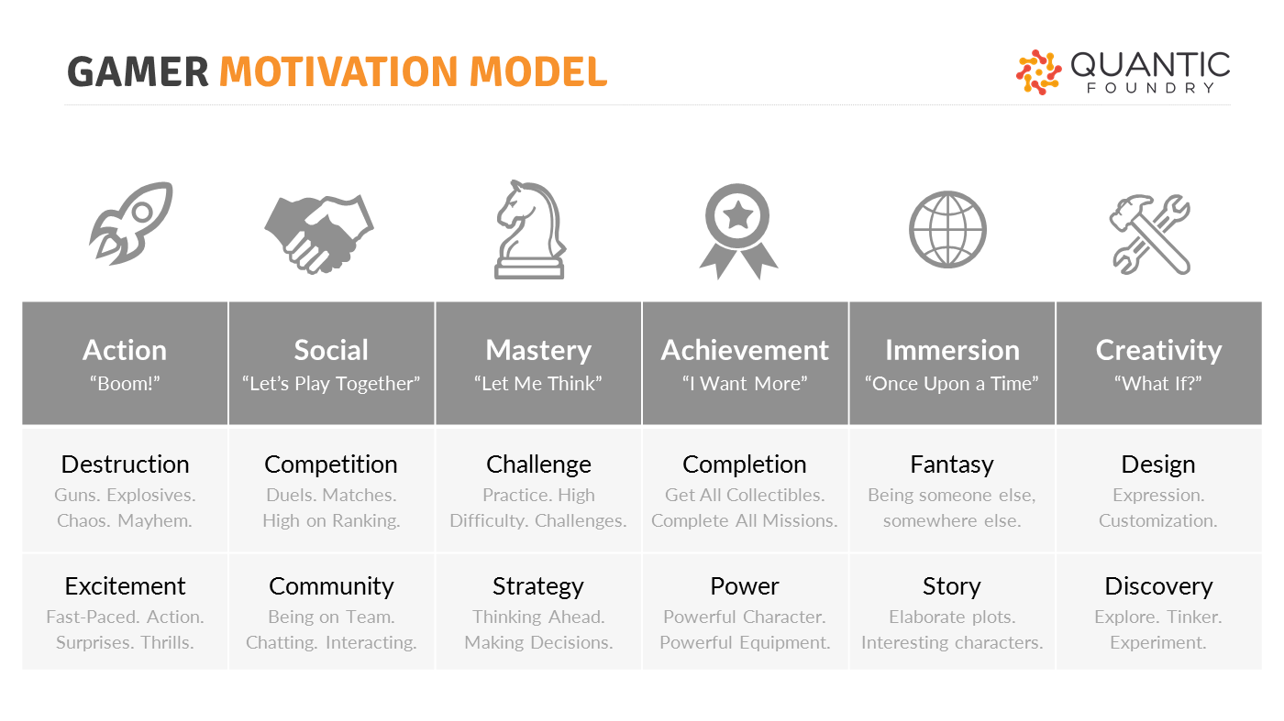
1. Motivations
www.warofthegames.com
Pitch Deck Presentation
Research-Driven
Our recommendations are heavily influenced by quanticfoundry.com
Motivations
In general, motivations within the same cluster tend to be positively correlated, while motivations between clusters tend to be statistically unrelated..
Submotivations
Our game recommendations are based on the top two submotivations per user.

Slide 7
2. Extract Games
In data from over 100,000 gamers, these are the most frequently mentioned games from gamers who score high in each category:
Strategy
Community
Discovery
Destruction
Europa Universalis 4, Crusader Kings 2, Civilization Series/5, EVE Online, XCOM, Starcaft Series/2, Fire Emblem, Age of Empires, Warcraft 3, Kerbal Space Program
Counter Strike Series/GO, Super Smash Bros. Melee, DoTA Series/2, League of Legends, Street Fighter, Heroes of the Storm, Starcraft 2, Call of Duty, Battlefield Series/3/4, FIFA
Elder Scrolls Series (Oblivion/Morrowind/Skyrim), Fallout Series/3/New Vegas, Fable, Legend of Zelda Series/Ocarina of Time, GTA Series/V, Minecraft, Earthbound, Kerbal Space Program, Metal Gear Solid 3, Metroid Prime
GTA Series/V, Battlefield Series/3/4, Destiny, Call of Duty, Gears of War, Halo, Borderlands Series/2, Doom, God of War, Counter Strike

Slide 8
3. Identify Keywords
Strategy
Tactical
Planning
Decision-making
Destruction
Chaos
Mayhem
Explosions
Community
Social
Collaboration
Multiplayer
Discovery
Exploration
Tinker
Experiment

Slide 9
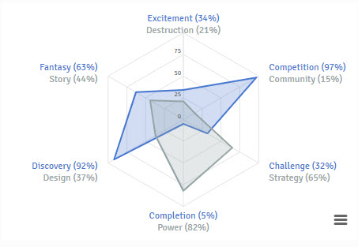
4. Tally Votes
Every user vote is recorded. From votes we can extract submotivations, and aggregate the results into a viewable radar chart.
Submotivations
90%
Competition
69%
Discovery
85%
Power
78%
Fantasy

Slide 10
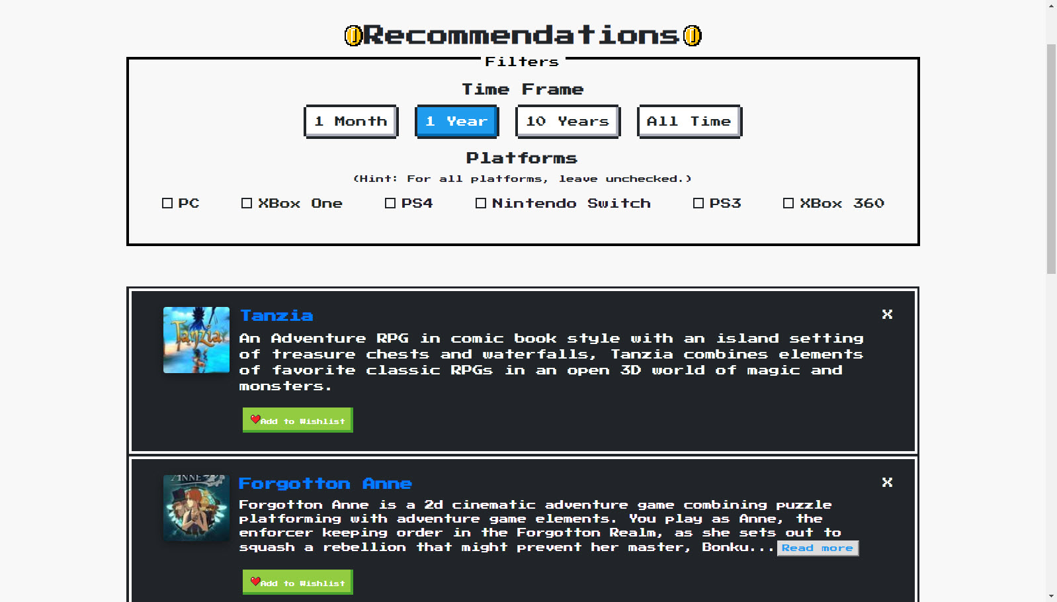
5. Recommend
www.warofthegames.com
Pitch Deck Presentation
Filters
Filter down by time frame, and by platform.
Returned games
Our recommendation engine will return games based on user submotivations, time frame, and platforms.

Slide 11







The Stack
React
Front end - Interface
Redux
Front end – State Management
React Router
Front end - Routing
Recharts
Front end – User Motivations
NodeJS
Back end – JavaScript Runtime
Express
Back end – Web App Framework
MongoDB
Database
Cloudinary
Back end – Images

Slide 12
Lessons Learned
Derek Houck
Definitely think of your endpoints before you use them
Keep PR size small
Tyler Crabb
Test…
Evan Guirino
Test…
Peter Ramos
Agile development and Scrum -- and how its awesome. I really like the daily iterations and reflections on the project. It allows for easy pivoting if need be and constant refocusing of goals and objectives, which helps the team
Setting up consistent standards in the beginning of your project for style guides, linting, git branching, naming conventions, your file tree, auto-formatting in your editor ...etc for everyone on team is extremely important and doing so keeps the work flow very efficient (helps a lot on code reviews) and agile
John Young
It can be valuable to slow down, re-assess, and tweak the vision vs. unbridled feature additions
Unclear goals and steps cause significantly more frustration than taking the time to plan...you just do not see the savings until later

Slide 13
‘’
Next Steps
Here are some next step features we have considered for implementation into version 2.0:
Affiliate links to buy games
Ability to change ‘Don’t show again’ games
Viewable user profiles
Game stats
IGDB Partner Program
Game credits + in-browser game demos
…many, many, more

Slide 14
Contact
We would love to hear from you!
Come find us on Slack!
https://github.com/thinkful-ei27/war-of-the-games

