Slide 1

Introduction to Corda

Slide 2
Core Idea
Corda has been designed to solve a specific business problem for regulated financial institutions and this is reflected in its architecture

Slide 3
Further Reading
Recommended reading:
Corda Non-Technical Whitepaper
Corda Technical Whitepaper
The Corda Way of Thinking blogpost
https://docs.corda.net/key-concepts.html

Slide 4
Why Corda?

Slide 5
An architecture that is open, enterprise-grade, shared platform for the immutable recording of financial events and execution of logic.

Slide 6
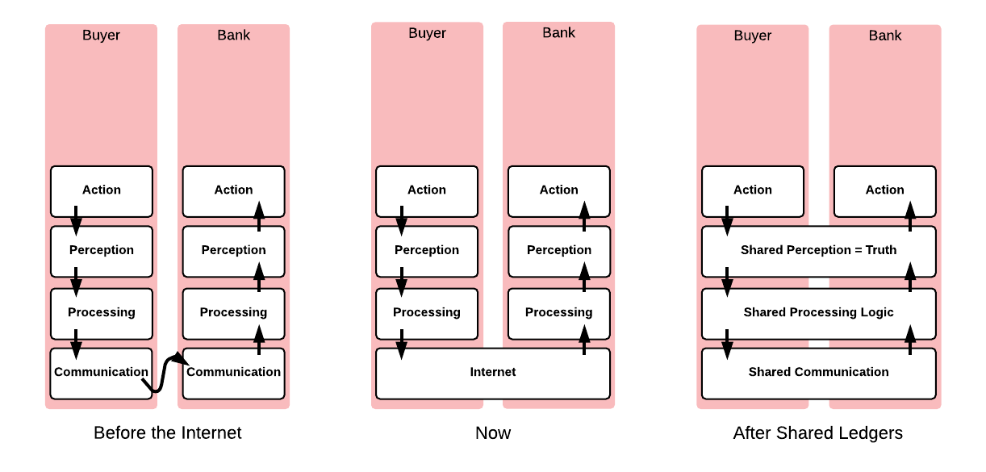


Back to basics
What problem Corda is trying to solve with distributed ledger technology?

Slide 7
Defining characteristics of distributed ledgers
Distributed ledgers are systems that enable parties who don’t fully trust each other to form and maintain consensus about the existence, status and evolution of a set of shared facts.
9

Slide 8
So what is Corda
Corda is a distributed ledger platform designed and built from the ground up to record, manage and synchronise agreements (legal contracts), designed for use by regulated financial institutions
p10.

Slide 9
Managing trade-offs
Designing the architecture of a distributed ledger platform is rooted in managing a set of trade-offs, primarily:
Privacy and confidentiality
Scalability
Security
Complexity
Among others…

Slide 10
You cannot have your cake and eat it!
Corda maintains the optimal balance of trade-offs for
the domain it is intended to operate within, and;
the business problems it is designed to solve
Meanwhile, Corda also provides flexibility for developers to tweak some of these trade-offs to suit their requirements
Example: pluggable consensus
There are no silver bullets!

Slide 11
Permissioned / Permissionless
Permissioned network
Permissionless networks are inappropriate for most scenarios involving regulated financial institutions

Slide 12
No blockchain / Blockchain
No blockchain
When considering permissioned networks, the use of a blockchain is not required to facilitate consensus
Is Corda a blockchain? ... So, by definition, Corda is a blockchain—with one key differentiator. Corda does not periodically batch up transactions needing confirmation — into a block — and confirm them in one go. Instead, Corda confirms each transaction in real-time.

Slide 13
Point-to-point/Broadcast
Point-to-point
On the grounds of confidentiality, Corda rejects the notion that data should be broadcast to all participants or cumbersome pre-defined groups

Slide 14
Message queues / RPC
Message queues
Messaging queues tend to be more robust at the cost of complexity and extra infrastructure

Slide 15
Reliance on existing judicial systems / “Code is law”
Legal Prose
A key requirement for financial institutions was the ability to rely on courts of law in the case of conflicts

Slide 16
UTXO / Account model
UTXO Model
To maintain true immutability of the ledger, and make it possible to apply transactions in parallel

Slide 17
Re-use/Build
Re-use
Wherever possible, we use industry standard bank friendly libraries and technology instead of “reinventing the wheel”.

Slide 18
But Corda also offers flexibility
Pluggable consensus
Flexible transaction model
States can contain arbitrary information
Databases and message brokers

Slide 19
Key concepts
Corda Key Concepts
The Corda ledger
States
Transactions
Contracts
Legal prose
Commands
Timestamps
Attachments
Flows
Consensus
Notary services
Oracles
The Corda node and CorDapps
A Corda network

Slide 20
The Corda Ledger

Slide 21



A Corda network
A Corda network is a fully connected graph
No global broadcast or gossip network
Communication occurs on a point-to point basis only
Peers communicate using AMQP/1.0 over TLS
Network map service publishes list of peers
Graph edges represent the potential to communicate, not persistent connections
Think Email and SMTP
CORDA NODE

Slide 22
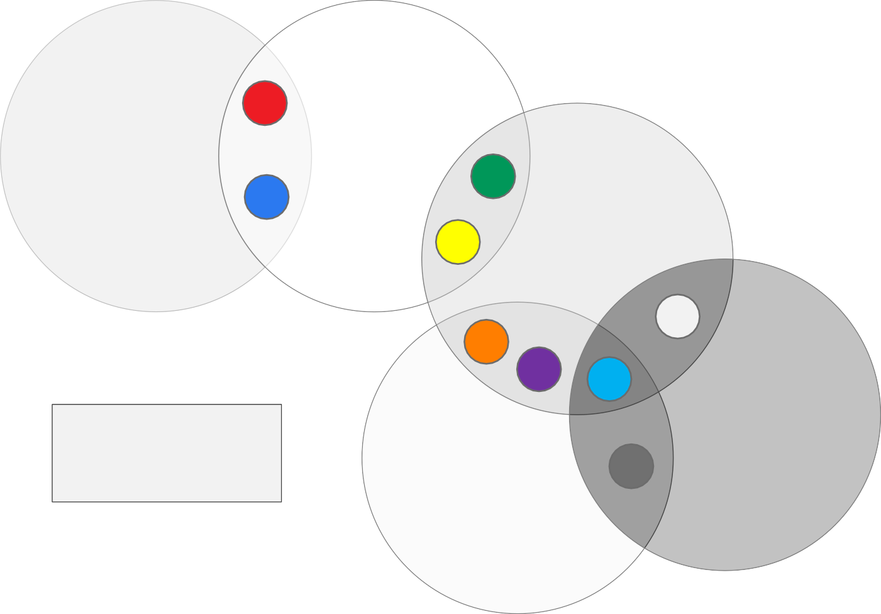
The Corda ledger
1
ALICE
BOB
6
7
5
CARL
2
9
4
3
Numbered circles represent unique shared facts
DEMI
ED
8

Slide 23
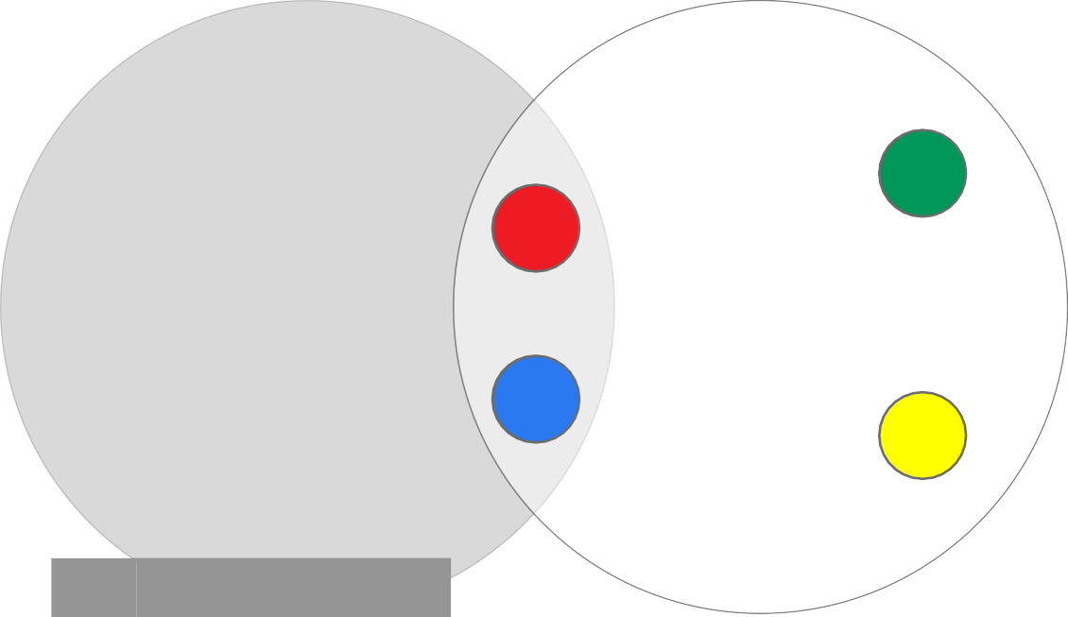
Anatomy of a bilateral ledger
There is no “central ledger”
Each network peer maintains a separate
vault of facts
Facts are like rows in a table
All peers to a shared fact store identical copies
Not all on-ledger facts have to be shared with other peers
The black square “11” is an example of a on-ledger fact not shared with any peers
6
1
11
ALICE
BOB
7
5
Id | Fact
1 | “Much consensus”
7 | “So bilateral”
11 | “Wow ledger”
Id | Fact
1 | “Much consensus”
6 | “Very fact”
7 | “So bilateral”
5 | “amaze network”

Slide 24
The Corda ledger is subjective from each peer’s perspective

Slide 25
States

Slide 26
States represent (shared) facts
ALICE (IOUs)
BOB (IOUs)
Id | From | To | Amt | By | Penalty | Paid
1 | Alice | Bob | £10 | 2017-03-31 | 20% daily | £0
Id | From | To | Amt | By | Penalty | Paid
1 | Alice | Bob | £10 | 2017-03-31 | 20% daily | £0
Alice Owes Bob £10 Payable by 01/03/17
Late settlement incurs 20% daily interest on remaining balance

Slide 27
Alice pays Bob £5
Alice settles £5 of a £10 IOU with Bob so she creates a new updated state to reflect this and marks the old one as historic
Alice Owes Bob £10 Payable by 2017-03-01
Late settlement incurs 20% daily interest on remaining balance
Alice Owes Bob £10 Payable by 2017-03-01
Late settlement incurs 20% daily interest on remaining balance
Alice paid £5

Slide 28
States can contain anything
In Corda, states don't just represent digital cash
The state model can be used to represent literally anything
States are statically typed – an IOU state is always an IOU state
Bonds, Syndicated Loans, CDOs, CLOs, Reference Data, Invoices, Letter of Credit, Pu Rate Swaps, Accounting Entries, Contract For Difference, Commercial Bank Credit, ntations, Collateral, KYC Data, Credit Default Swaps, Bids/Offers, Personal Informati

Slide 29
States are immutable objects that represent (shared) facts such as an agreement or contract at a specific point in time

Slide 30

State sequences
Alice Owes Bob £10 Payable by 2017-03-01
Late settlement incurs 20% daily interest on remaining balance
NO AGREEMENT
Alice Owes Bob £10 Payable by 2017-03-01
Late settlement incurs 20% daily interest on remaining balance
Alice paid £5
Alice borrows
£10 from Bob
Alice pays Bob £5
2017-02-01
TIMELINE
2017-02-24

Slide 31

State sequences
Alice Owes Bob £10 Payable by 2017-03-01
Late settlement incurs 20% daily interest on remaining balance
Alice Owes Bob £10 Payable by 2017-03-01
Late settlement incurs 20% daily interest on remaining balance
Alice paid £5
Alice paid £5
AGREEMENT EXPIRED
Alice incurs interest of £1
Alice pays Bob £6 (£5 principal and
£1 interest)
interest is charged!
2017-03-02
TIMELINE
2017-03-02

Slide 32
The life-cycle of a shared fact or agreement over time is represented by a state sequence

Slide 33
The vault tracks state sequence heads
Counterparty vaults
The vault tracks the heads of each state sequence
For states representing shared facts, each peer retains an identical copy
CONSUMED HISTORICAL STATES
UNCONSUMED
^{B}HEAD
^{B}HEAD
^{A}HEAD
B₀
B₁
VAULT
^{A}HEAD
A₀
A₁
A₂
A₃
^{C}HEAD
^{C}HEAD
S₀
S₁
S₂
^{S}HEAD
^{C}HEAD

Slide 34
The ledger from each peer’s point of view consists of all the state sequence heads (or non-historic states) tracked in the vault

Slide 35
Transactions

Slide 36
Transactions
We introduce transactions as atomic units of change to update the ledger
Transactions reference zero or more input states and create zero or more output states
The newly created output states replace the input states which are marked as historic
INPUT STATE
OUTPUT STATE

Slide 37
Types of Transactions
Issuances
Updates
Exits

Slide 38
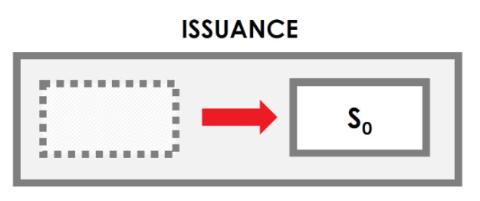
Issuances
Creates new states on the ledger. By nature, they do not contain any input state references. They can create one or more output states.

Slide 39
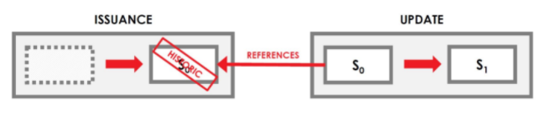
Updates
Updates are used to change state properties. Updates take one or more input state references and create one or more output states.

Slide 40
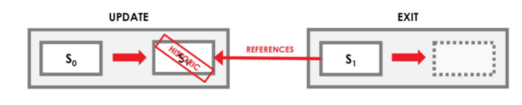
Exits
Exits remove states from the ledger by ending the state chain. Exits take one or more input state references and create zero output states

Slide 41
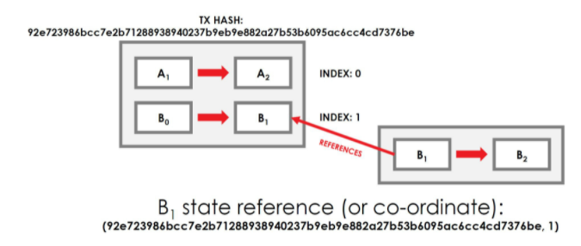
Input State References
Input state references comprise a pair of:
(Transaction ID, Index)
Transaction ID refers to the hash of the transaction which created the state. Index references the position of the state in the list of outputs.
Any on-ledger state can be referenced by a (transaction ID, index) coordinate.

Slide 42




Transactions can be arbitrarily complex
Transactions may combine issuances, updates and exits.
D₄
D₅
A₀
A₁
C₀
C₀
C₁
A₁
A₂
B₀
B₀
A₂

Slide 43
Transactions can be arbitrarily complex
Transactions can contain states of many types.
TRANSACTION
Or this transaction could represent a delivery versus payment of some cash for a bond
Cash is paid from the buyer to the seller
The bond is moved from the seller to the buyer
CASH₀
CASH₁
This transaction could represent a coupon payment on a bond:
Cash is paid from the bond issuer to the bond owner.
The bond shared fact is
updated to reflect the coupon payment
BOND₁
BOND₂

Slide 44
Transactions can split and merge states
Transactions can also split and merge states representing fungible assets.
8 GBP
REFERENCES
8 GBP
10 GBP
2 GBP
REFERENCES
2 GBP
30 GBP
REFERENCES
20 GBP

Slide 45


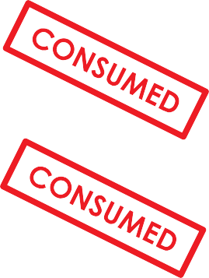


Transactions are atomic
A Transaction in Corda is an indivisible and irreducible set of changes such that either all occur, or nothing occurs.
C₀
C₀
C₀
C₀
A₁
A₂
A₁
A₂
B₁
B₁

Slide 46
Transactions are an atomic set of changes to update the ledger

Slide 47
Committing transactions
Example: Alice partially settles an IOU with Bob.
IOU₁ IOU₂ From: Alice From: Alice To: Bob To: Bob Amount: £10 Amount: £5 CASH₁ CASH₂ Owner: Alice Owner: Bob Currency: GBP Currency: GBP Amount: £5 Amount: £5
^{SIG}ALICE | SIG_{BOB}

Slide 48
Transactions are committed and update the ledger only when signed by all required peers
Uncommitted transactions are proposals to update the ledger
Committed transactions are immutable

Slide 49
Transactions are not instructions
Transactions are not instructions which require action.
Instead, transaction creators calculate an updated ledger which is reflected by the output states.
The output states are the updated ledger.
In other words, Corda transactions state what the updates are as opposed to how to calculate the updates.

Slide 50
Points to Note
Transactions are an atomic set of changes to update the ledger.
Transactions are committed and update the ledger only when signed by all required peers.
Uncommitted transactions are proposals to update the ledger.
Committed transactions enforce output state immutability because they are digitally signed.
Once a transaction is committed, it marks the input state references as historic and creates new output states reflecting an updated ledger.
Transactions are not instructions which require action.
Transaction proposals require verification which is performed separately to transaction creation.

Slide 51
Contracts

Slide 52
A closer look at state objects…
Properties reflect the state of an agreement or contract at a specific point in time
IOU STATE PROPERTIES
From: Alice
To: Bob Amount: £10 Due: 01/03/2017
Paid: £5
Penalty: 20%
Participants lists the peers who can consume this state in a transaction
PARTICIPANTS
Alice Bob

Slide 53
Transaction states
Contract ref point to a contract which defines the verification function
IOU CONTRACT REF
STATE

Slide 54
Contracts
Corda mandates that each state inside a transaction must reference a contract
TRANSACTION STATE
CONTRACT
IOU STATE PROPERTIES
IOU CONTRACT CODE
REFERENCES
IOU CONTRACT REF
PARTICIPANTS
Alice Bob
IOU LEGAL PROSE

Slide 55
Contracts
As transactions may contain multiple state types, multiple contracts can be referenced in a transaction
The Corda platform will use all referenced contract code to verify a (proposed) transaction
CASH CONTRACT
REFERENCES
REFERENCES
VALIDATES
CASH₀
CASH₁
BOND₁
BOND₂
REFERENCES
VALIDATES
REFERENCES
BOND CONTRACT

Slide 56
Contract code
The verification function is defined in the contract code.
The function takes a transaction as a parameter and either throws an exception if the transaction fails verification, or returns nothing if the transaction verifies.
In Kotlin, Unit is a type with only one value: the Unit object. This type corresponds to the void type in Java/C.
fun verify(tx: Transaction): Unit

Slide 57
Contract code
// Transaction must have zero inputs. tx.inputs.size() == 0
// Transaction must have one output. tx.outputs.size() == 1
// The lender cannot be the borrower. tx.outputs[0].lender != tx.outputs[0].borrower
// The output state must contain an amount > 0. tx.outputs[0].amount > 0

Slide 58
The contract code is a “pure” function executed in a deterministic environment, on a need-to-know basis which verifies transactions

Slide 59
Transactions are not instructions
Transactions are not instructions which require action
Instead, transaction creators calculate an updated ledger
which is reflected by the output states
The output states are the updated ledger!
In other words: Corda transactions state what the updates are as opposed to how to calculate the updates

Slide 60
Transaction proposals require verification which is performed separately to transaction creation

Slide 61
Transactions in summary
Any peer may create a transaction proposal
Transaction proposals are uncommitted by default
Before a transaction proposal is committed it must first be digitally signed and then verified by all required peers on a need-to-know basis
Once a transaction is committed it marks the input state
references as historic and creates new output states reflecting an updated ledger

Slide 62
Legal Prose

Slide 63
Legal prose
CONTRACT
IOU CONTRACT CODE
IOU LEGAL PROSE TEMPLATE
IOU LEGAL PROSE
This document binds
BORROWER to pay LENDER
the sum of AMOUNT by
DATE.
IOU LEGAL PROSE PARAMETERS
BORROWER LENDER AMOUNT DATE RATE PERIOD
ALICE BOB
£10
2017-03-01
20% DAILY
HASH
92e723du6d986bc…
If the full amount is not paid by DATE then BORROWER will incur RATE interest on a PERIOD basis until full payment is received.

Slide 64
Legal prose is referenced within Contracts and can be relied upon when the contract code alone is insufficient

Slide 65
Commands

Slide 66




States can evolve in multiple ways
IOU₁
From: Alice To: Bob Amount: £10
IOU₂
From: Alice To: Bob Amount: £5
IOU₂
From: Alice To: Bob Amount: £10
Defaulted: TRUE

Slide 67

Commands
INPUT STATES
COMMANDS
OUTPUT STATES
IOU₁ IOU₂ From: Alice From: Alice To: Bob To: Bob Amount: £10 Amount: £5 CASH₁ CASH₂ Owner: Alice Owner: Bob Amount: £5 Amount: £5
^{SIG}ALICE | SIG_{BOB}
Alice settles £5 of a
£10 debt with Bob, so creates a transaction proposal

Slide 68
Commands parameterise transactions hinting to their intent and specify the required signers via a list of public keys

Slide 69
Timestamps

Slide 70
Timestamps assert that a transaction happened within a specified time window

Slide 71
Attachments

Slide 72
Attachments
Transactions can also contain a number of attachments
Attachments are zip files and identified by hash
Attachments are referenced within a transaction, but not included in the transaction itself
Attachments are intended for data on the ledger that multiple peers may wish to reuse over and over again
A transaction creator chooses which files to attach

Slide 73
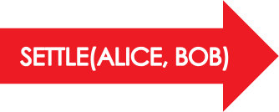
Attachments
IOU₁ IOU₂ From: Alice From: Alice To: Bob To: Bob Amount: £10 Amount: £5 CASH₁ CASH₂ Owner: Alice Owner: Bob Currency: GBP Currency: GBP Amount: £5 Amount: £5 TIMESTAMP ATTACHMENTS 57g43ig… 3hefwl7n…
^{SIG}ALICE | SIG_{BOB}
Attachments are added by transaction creators and identified by hash within the transaction

Slide 74
Attachments
Attachments may contain:
Contract code and associated state definitions (.class files)
Legal prose template and parameters
Data files which support the contract code e.g. currency definitions, public holiday calendars or financial data

Slide 75
Attachments are zip files referenced in a transaction by hash but not included in the transaction itself

Slide 76


Creating a transaction proposal
INPUT STATES COMMANDS
OUTPUT STATES
IOU₀
From: Alice To: Bob Amount: £10
(TX HASH, ID) REFERENCE
CASH₁
Owner: Alice
Amount: £10
CASH₂
Owner: Bob
Amount: £10
TIMESTAMP
ATTACHMENTS
4jg8493hgf…

Slide 77
Transactions summary
Transactions are an atomic set of changes
Transactions contain zero or more input and output states
States are grouped by type
Transactions contain one or more commands
Transactions can contain a timestamp
Transactions can contain zero or more attachments
Transactions are proposed and then subsequently signed and verified by the required peers

Slide 78
Flows

Slide 79

Alice and Bob agree upon an IOU
1. Alice creates a new
Transaction proposal and signs it.
2. Alice sends her proposal and signature to Bob
ALICE
3. Bob inspects the proposal, verifies it and signs it
4. Bob sends back to Alice his transactions and his signature
BOB
Uninvolved peers do not receive any of Alice’s or Bob’s transactions

Slide 80
You can write blocking code that never blocks!
Bob’s flow is check-pointed here
// Alice
tx = new Tx() peer = “Bob” sig = sign(tx)
// BOB
peer = “Alice”
Res = receive(peer) check(res.sigA) verify(res.tx)
sigB = sign(res.tx)
When calling the network Alice’s fibre is suspended and serialised to disk (or check- pointed). If Alice’s node fails or restarts, she can deserialise the fibre and continue the flow when her node reboots
payload = (tx, sig)
res = sendAndReceive(payload, peer)
check(res.sigB) verify(res.tx) commit(res.tx)
Check-pointed
payload = (res.tx, sigB)
send(payload, peer) commit(res.tx)
… and here

Slide 81
The two party deal flow
This is the flow Alice and Bob use to agree upon an IOU, in Corda it can be called as a sub-flow.
INITIATOR (ALICE)
GET DATA FROM INTERNAL SYSTEM
FLOW SUSPENDED
CREATE TX
SIGN TX
AND CHECKPOINTED
INSPECT AND
END
COMMIT TX
VERIFY TX
SEND(TX + SIG)
SEND(TX + SIG)
RESPONDER (BOB)
INSPECT AND VERIFY TX
SIGN TX
COMMIT TX
END

Slide 82
Flows are light-weight processes used to coordinate the complex multi-step, multi- peer interactions required for peers to reach consensus about shared facts. In other words flows contain “business logic along with entities and other services”

Slide 83
Consensus

Slide 84
Two types of consensus
Peers reach consensus over transactions in two ways:
Verification consensus
Uniqueness consensus

Slide 85
Verification consensus
In Corda, verification consensus involves peers reaching certainty that a transaction:
is signed by all required peers listed in the commands
satisfies the constraints defined by the contracts pointed to by the input and output states
However there is an additional step required…

Slide 86


Verification consensus
ALICE SWAPS A BOND WITH DAN FOR CASH
ALICE PAYS CASH TO BOB SETTLING THE £10 IOU
C_{D} C_{A}
PAY
Cash
Owner: Alice Amount: 10
Issuer: Charlie
Cash
Owner: Bob Amount: 10
Issuer: Charlie
B_{A}
SEND
B_{D}
PAY(A)
CHARLIE ISSUES CASH TO DAN
SIG_{A} SIG_{D}
IOU
From: Alice To: Bob
Amount: 10
Bob verifies the previous transaction
SETTLE(A, B)
ISSUE
C_{D}
SIG_{C}
Previous transaction is a issuance transaction
, signed by Charlie, hence Cash is a valid cliam

Slide 87
Verification consensus involves reaching certainty that a transaction (and all its dependencies) is signed by all required peers and satisfies the constraints in the contract code

Slide 88

Uniqueness consensus
By now you have probably realised that without uniqueness consensus a nefarious actor can use the same cash input state reference in multiple transactions. How do we stop this?
C_{B}
PAY
C_{C}
BOB SENDS CASH TO CHARLIE
ALICE ISSUES CASH TO BOB
SIG_{B}
ISSUE
C_{B}
SIG_{A}
C_{B}
PAY
C_{D}
BOB SENDS CASH TO DAN
SIG_{B}

Slide 89
Uniqueness consensus involves peers reaching certainty that the output states created in a transaction are the unique successors to the input states referenced by that transaction

Slide 90
Notary services

Slide 91
Notary services track used states
In simple terms, notaries maintain a map keyed with input state references:
Key: (Transaction ID, Output Index)
Value: (Transaction ID, Input Index, Requesting Peer)
The map values indicate the ID of the transaction which used the state as an input and marked it as historic, as well as the identity of the requesting peer.

Slide 92
Notary services workflow
When a proposed transaction is sent to a notary service the notary checks if any of the input state references are already in the map and one of two things may happen:
If any are in the map, the notary throws an Exception and notes that there is a conflict
If none are in the map then the notary adds each input state to the map and signs the proposed transaction

Slide 93
Notaries provide
uniqueness consensus

Slide 94
Oracles

Slide 95
Oracles
An oracle is a source of data or calculations, which has been accepted by multiple peers as authoritative,
binding and definitive for an agreed set of values or range of calculations
The oracle may source its data from external observations
or calculate its results based on inputs received from on- ledger states or attachments

Slide 96

Embedding external data in commands
CASH₁ Owner: Alice Amount: £10 CASH₁ Owner: Bob Amount: $12 |  |  | CASH₂ Owner: Bob Amount: £10 CASH₂ Owner: Alice Amount: $12
^{SIG}ALICE | SIG_{BOB} | ^{SIG}ORACLE

Slide 97

Embedding data in attachments
CASH₁
Owner: Alice
Amount: £10
CASH₂
Owner: Bob
Amount: £10
CASH₁
Owner: Bob
Amount: $12
CASH₂
Owner: Alice
Amount: $12
Static data required for transaction verification
ATTACHMENTS
4jg8493hgf…
^{SIG}ALICE
SIG_{BOB}
^{SIG}ORACLE

Slide 98
Oracles are an authority that attests to
(and may also provide) off-ledger facts needed to verify transaction proposals

Slide 99
The Corda Node

Slide 100
A Corda node
Contracts
State definition
Flows
Services
CorDapp
CorDapp
CorDapp
Client
RPC
Services Interface
Other peers
Messaging
Vault
Identity
Storage
...
Persistence
p100.

Slide 101
A Corda node implements a collection
of services required to participate in a Corda network
p101.

Slide 102
CorDapps

Slide 103
CorDapps
CorDapp
Contracts
States
Flows and Services
p103.

Slide 104
CorDapps are Corda node extentions which comprise the states, contracts and flows required to implement some specific business logic
p104.

Slide 105
A Corda Network

Slide 106
A Corda network
DISTRIBUTED NOTARY SERVICE
Name: Alice
Services: Cash Issuer, bond issuer
Address: 192.168.0.3:10005
Public key: 5h54h5wv632vhy55
NOTARY NODE
NODE
NODE
Name: Network Map
Services: Network map service
Address: 192.168.0.2:10005
Public key: t453wv84bvt3cj5w3h
NODE
PERMISSIONING SERVICE CERTIFICATE SIGNING
NODE
Name: Bob
Services: Cash Issuer, bond issuer
Address: 192.168.0.4:10005
Public key: 5hw03nnk43jknkj4n

Slide 107
A Corda network comprises:
A doorman
Two or more Corda nodes
Zero or more oracles
A network map service
One or more notary services
p107.

Slide 108
Summary
Corda Key Concepts
The Corda ledger
States
Transactions
Contracts
Legal prose
Commands
Timestamps
Attachments
Flows
Consensus
Notary services
Oracles
The Corda node and CorDapps
A Corda network

