Slide 1
Server Structure
유성오

Slide 2
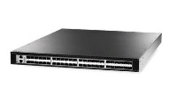

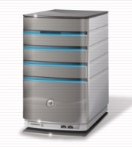


Server Structure
01
L4 (Optional)
02
4th try (Optional)
03
HubServer
4th try
04
3rd try
AuthServer
AuthServer
Second try
GameClient
MonitorServer
MasterServer
MasterServer
First try
MonitorClient
GameServer
GameServer
GameServer
GameServer
Server Structure

Slide 3
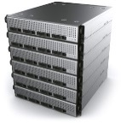

Database Structure
01
02
DataBase
03
04
AuthServer
AuthServer
MasterServer
MasterServer
DataBase
DataBase
GameServer
GameServer
GameServer
GameServer
Server Structure

Slide 4
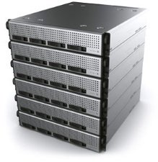
Game Data Flow
01
02
DataBase
DataBase
03
HubApp
AuthApp
MasterApp
ServerApp
04
GameLib
GameLib
GameLib
GameLib
DBLib
DBLib
DBLib
NetLib
NetLib
NetLib
NetLib
ClientApp
GameLib
Physical Flow
NetLib
Logical Flow
Server Structure

Slide 5
Monitor Data Flow
01
HubApp
AuthApp
MasterApp
ServerApp
02
MonLib
MonLib
MonLib
MonLib
03
NetLib
NetLib
NetLib
NetLib
04
MonSvrApp
MonLib
NetLib
MonCliApp
MonLib
NetLib
Physical Flow
Logical Flow
Server Structure

