Slide 1
Caching on PMEM: An Iterative Approach
Yao Yue† & Juncheng Yang†,‡
† Twitter Inc.
‡ Carnegie Mellon University

Slide 2
Caching on PMEM at Twitter
Basic Considerations
Iterations
Testing and modification in lab
Testing in prod
In-house development for PMEM
Lessons Learned

Slide 3
Incentives, Hypotheses, & Constraints

Slide 4
Caching @ Twitter
Clusters
>300 in prod
Hosts
many thousands
Instances
tens of thousands
Job size
2-6 core, 4-48 GiB
QPS
max 50M (single cluster)
SLO
p999 < 5ms*
Mission critical ⇒ availability
Large resource footprint ⇒ cost
Lots of instances ⇒ fast restart
A large scale analysis of hundreds of in-memory cache clusters at Twitter [OSDI’20]
Notes:
* Depends on request/response size

Slide 5
Why Put Cache on PMEM
Cache more data per instance
Reduce TCO if memory bound
Improve hit rate
Take advantage of data durability
Graceful shutdown and faster rebuild
Improve data availability during maintenance
Notes:
graceful shutdown and faster rebuild

Slide 6
Constraints
Maintainable
Same codebase
Retain high-level APIs
Operable
Flexible invocation and configuration
Predictable performance

Slide 7
An Iterative Approach

Slide 8
Principles
Show Progress
Be Flexible
Identify issues
Modify future plan
Be Confident
Verify hypotheses
Meet constraints
Notes:
It’s a simple statement which hides the fact that this is an open-ended exploration.

Slide 9
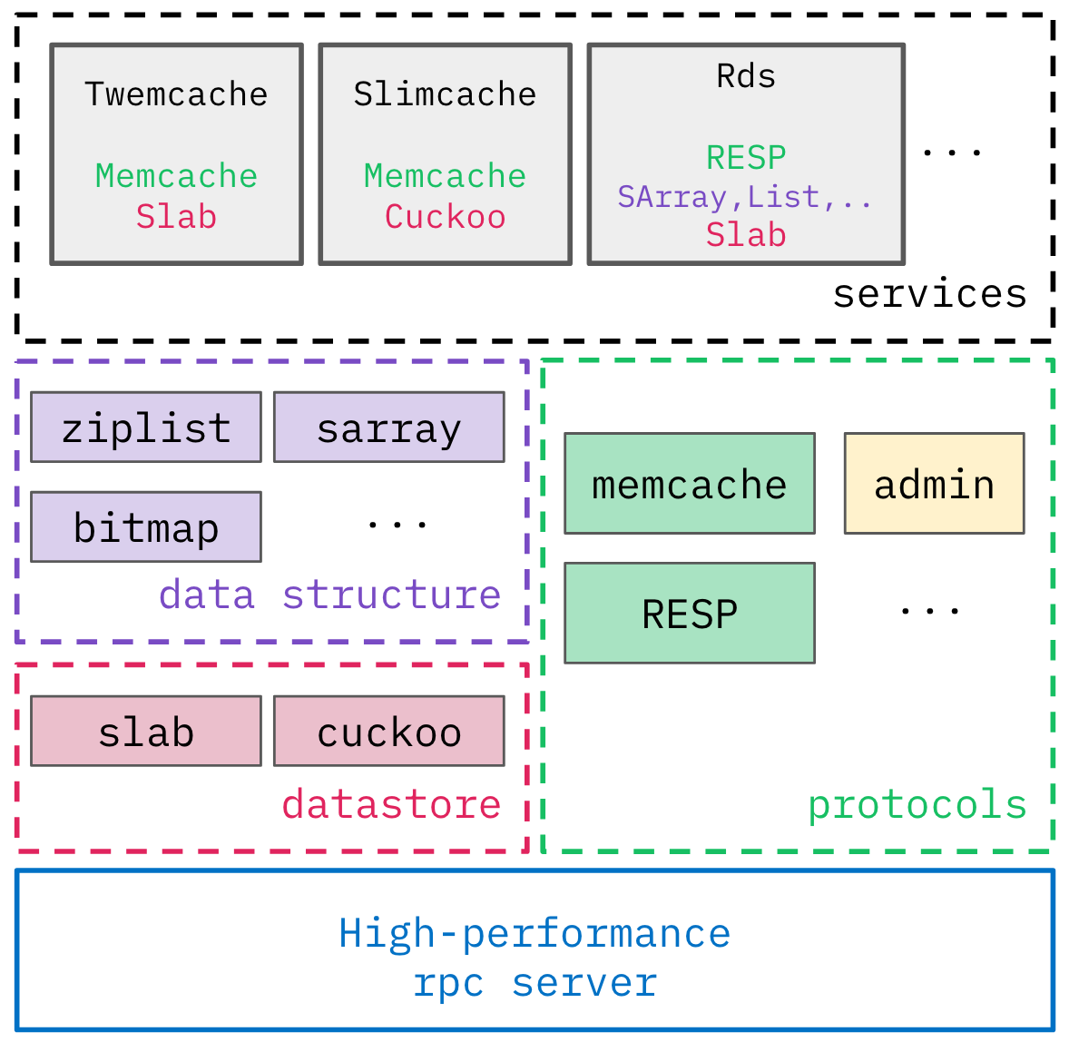
The Plan
Use a modular caching framework
PMEM with unaltered cache code (lab, prod)
PMEM with minimally altered cache (lab, prod)
Design for/with PMEM
Pelikan: A Modular Cache
Notes:
It’s a simple statement which hides the fact that this is an open-ended exploration.

Slide 10
Test Design
Instance density
18-30 instances / host
Object size
Between 64 and 2048 bytes
Dataset size
Between 4GiB and 32 GiB / instance
# of Connection per server instance
100 / 1000
R/W ratio
Read-only, read heavy, write heavy
Focuses
Throughput with latency constraints
PMEM vs. DRAM
Memory mode vs. AppDirect
Scalability with dataset size
Bottleneck analysis
Notes:
It’s a simple statement which hides the fact that this is an open-ended exploration.

Slide 11
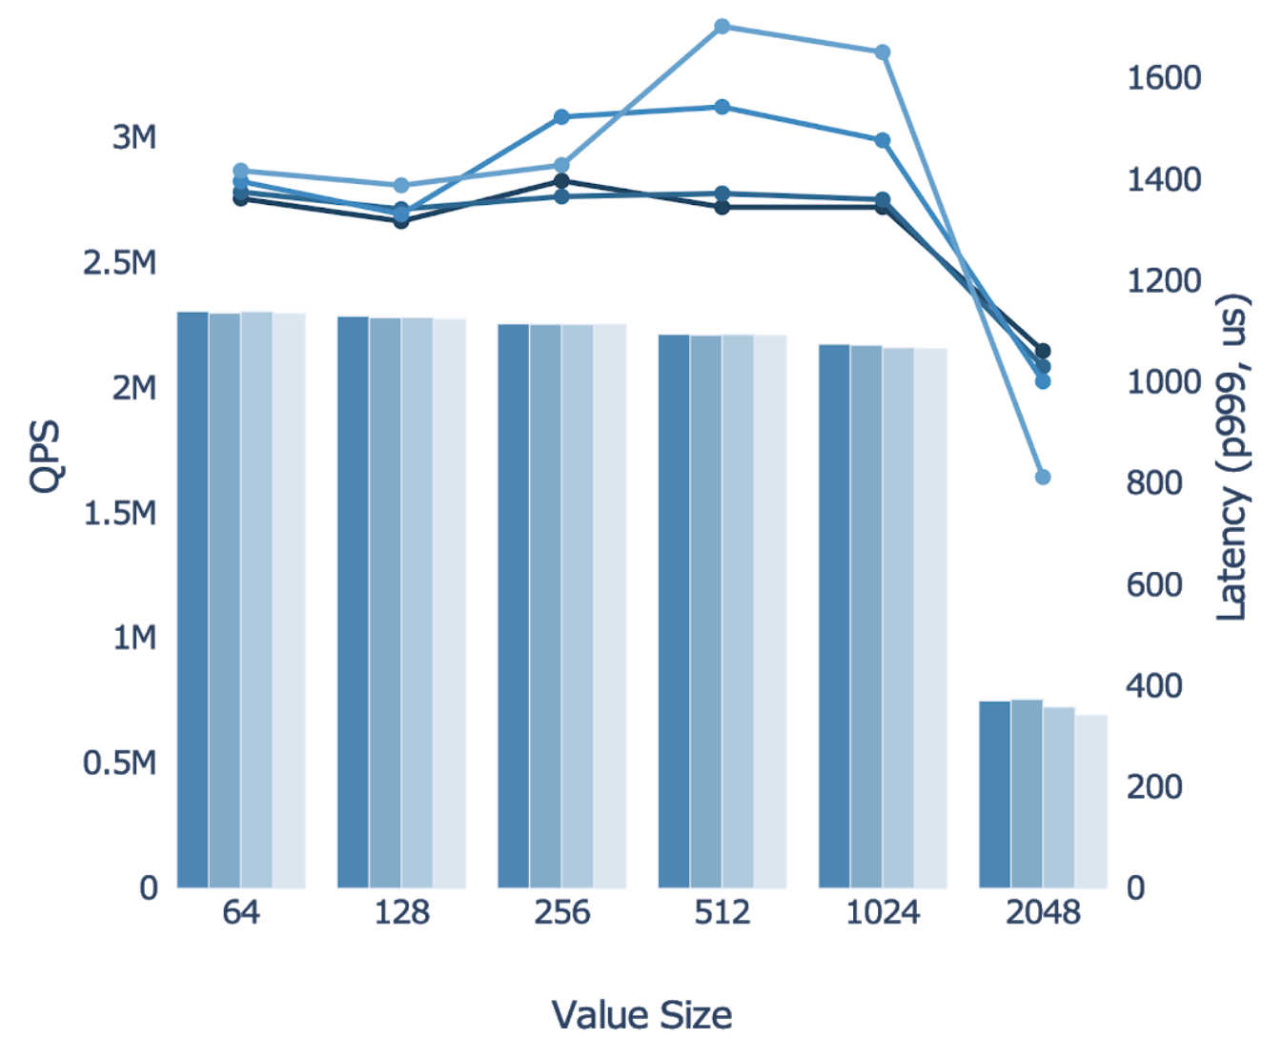
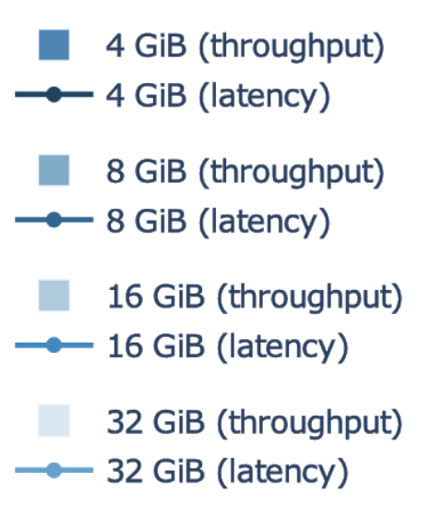
Hardware Config (Intel lab)
· 2 X Intel Xeon 8160 (24)
· 12 X 32GB DIMM
· 12 X 128GB AEP
· 2-2-2 config
· 1 X 25Gb NIC
Memory mode
Test Config
· 30 jobs/host
· key size 32B
· 100 conn/job
· 90R:10W

Slide 12
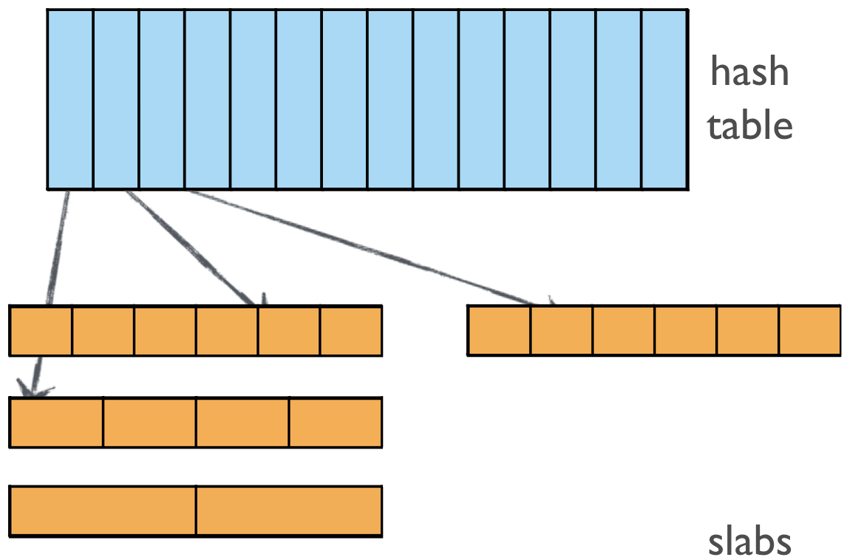
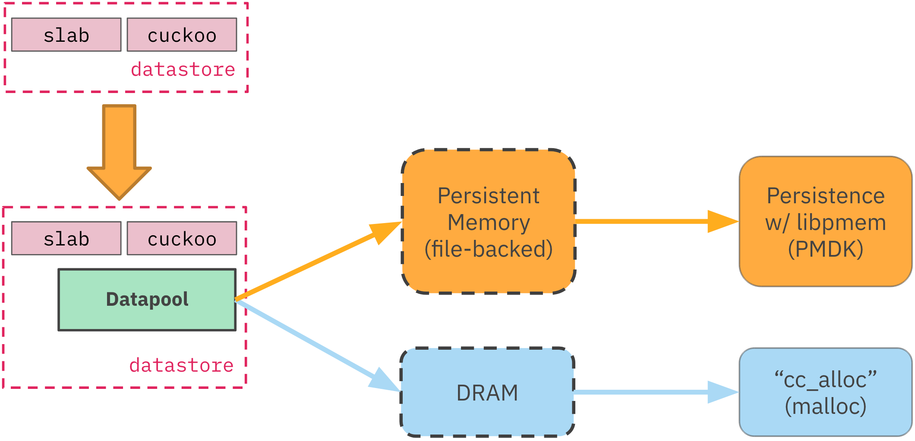
Datapool Abstraction with PMDK

Slide 13
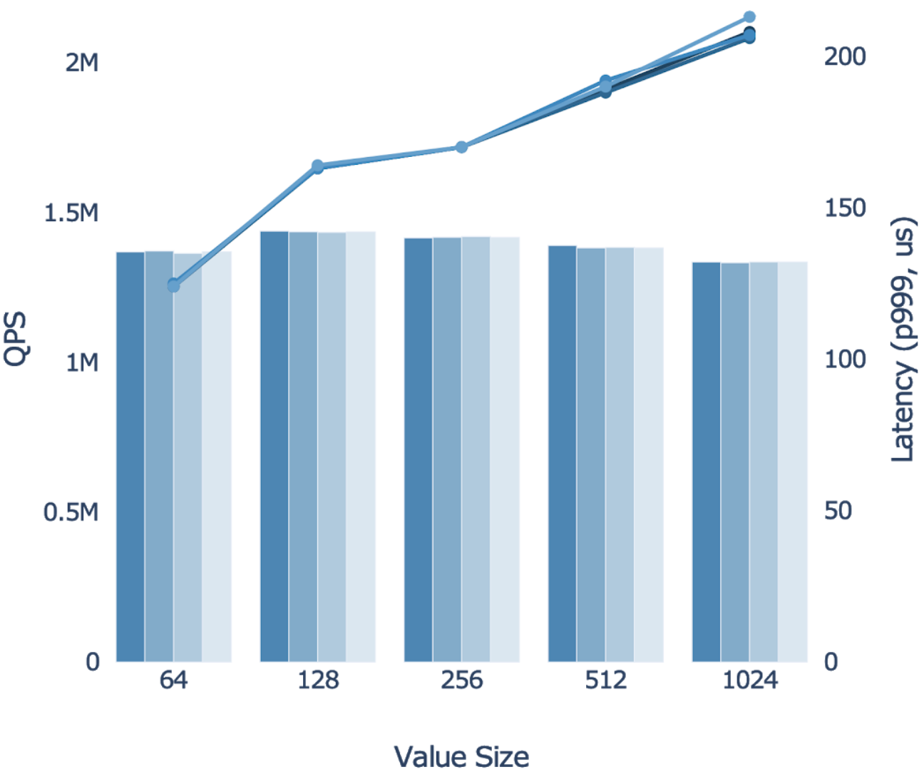
Hardware Config (Intel lab)
· 2 X Intel Xeon 8160 (24)
· 12 X 32GB DIMM
· 12 X 128GB AEP
· 2-2-2 config
· 1 X 25Gb NIC
AppDirect mode
Test Config
· 24 jobs/host
· key size 32B
· 100 conn/job
· 90R:10W

Slide 14
Rebuild Performance
Single instance
100 GiB of slab data
complete rebuild: 4 minutes
Concurrent
18 instances per host
complete rebuild: 5 minutes
Potential impact
Speed up maintenance by 1-2 orders of magnitude
But needs other changes for real adoption

Slide 15
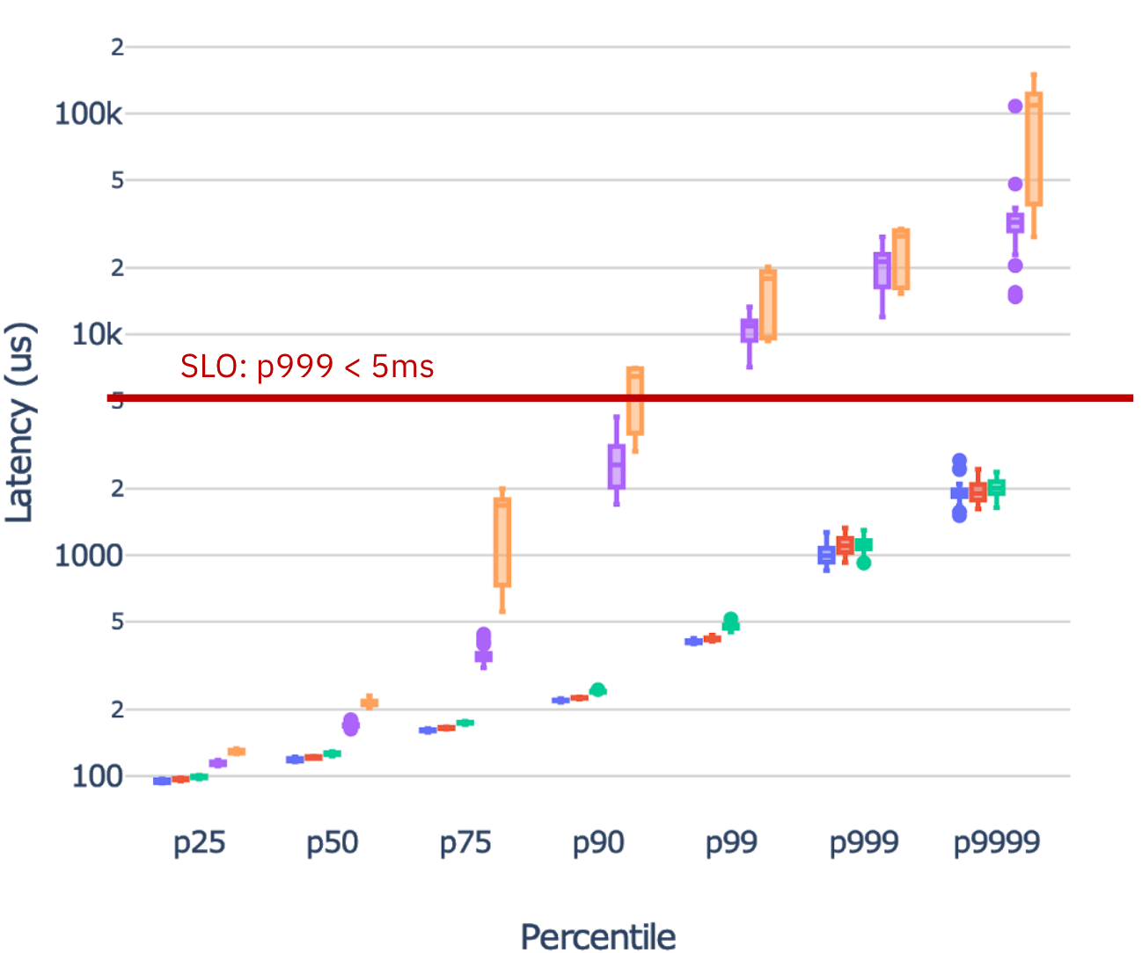
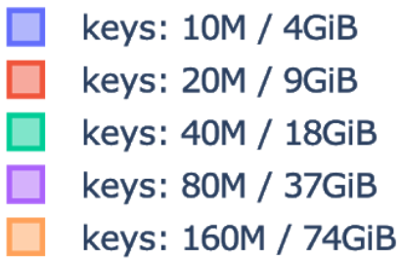
Hardware Config (Twitter prod)
· 2 X Intel Xeon 8160 (20)
· 12 X 16GB DIMM
· 4 X 512GB AEP
· 2-1-1 config
· 1 X 25Gb NIC
Memory mode: throughput 1.08M QPS
Test Config
· 20 jobs/host
· key size 64B
· 1000 conn/job
· read-only
p999 max = 16ms
p9999 max = 148ms

Slide 16
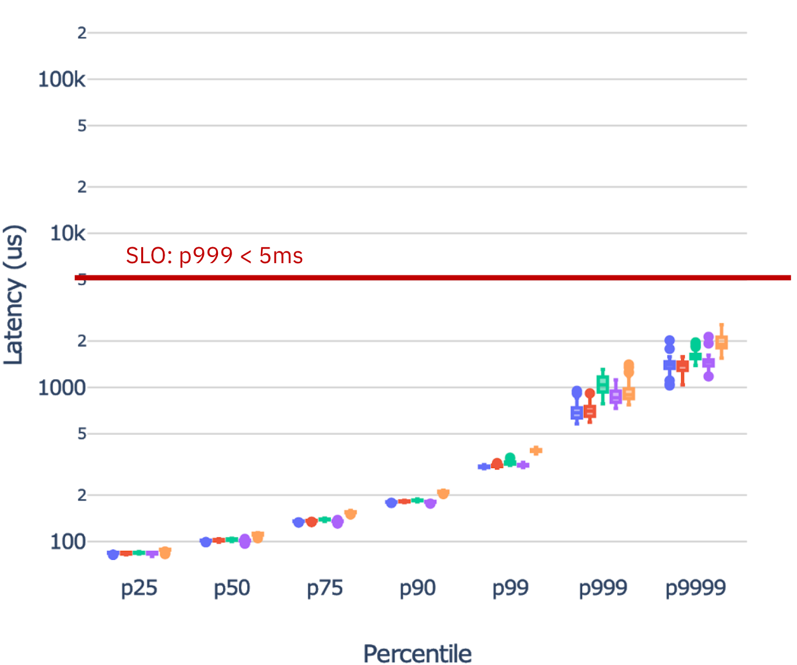
Hardware Config (Twitter prod)
· 2 X Intel Xeon 8160 (20)
· 12 X 16GB DIMM
· 4 X 512GB AEP
· 2-1-1 config
· 1 X 25Gb NIC
AppDirect mode: throughput 1.08M QPS
Test Config
· 20 jobs/host
· key size 64B
· 1000 conn/job
· read-only
p999 max = 1.4ms
p9999 max = 2.5ms
Notes:
This version of the code later ran in production canary successfully.

Slide 17
A “mid-term” Retrospective
What’s cache’s bottleneck?
Network stack
PMEM bandwidth, if channel number is small
Memory vs AppDirect perf
AppDirect far more predictable
Code change is modest
Can we improve things further?
Rethink metadata layout
Rethink direct use of pointers

Slide 18
Pelikan Storage Module Redesign
What is PMEM good/bad at?
Sequential and large accesses
What is a cache’s memory access pattern?
Random reads and random writes
Does this remind you of anything?

Slide 19
Pelikan Storage Module Redesign
Log-structured file system/key-value store
Can we use the same design here?
Not really
Multiple sources of random memory accesses
Where are the random memory accesses?
Hash table
Object storage

Slide 20
Source of Random Memory Access
Object chained hash table
Random read and random write
Slab memory allocation
Object write, expiration, deletion, and eviction*
Notes:
Pelikan is already much more PMEM-friendly compared to Memcached,

Slide 21
How Pelikan Slab Module Optimizes for PMEM
Slab eviction
Batched evictions without updating metadata for every object
Object writes are sequential
Not enough
Object expiration
Object delete
Notes:
Pelikan is already much more PMEM-friendly compared to Memcached,

Slide 22
Segcache: a Redesign of Storage Module
Segcache: segment-structured cache

Slide 23
Segcache Overview
Transform all random PMEM writes into sequential writes
Move small random metadata reads and writes into DRAM
Use PMEM only as object store
get request: read only once and no write
set request: write once sequentially
all bookkeeping: sequentially in batch
Moreover…
*Some of these have already been partially achieved by Pelikan slab module
the secret source why Pelikan is better than Memcached on PMEM

Slide 24
Segcache Overview
Better memory efficiency
Efficient removal of all expired objects
Small object metadata (38 bytes -> 5 bytes)
Merge-based segment eviction algorithm
=> 60% memory footprint reduction on Twitter’s largest cache cluster

Slide 25
Transform all random writes into sequential writes
Hash table

Slide 26
Transform all random writes into sequential writes
Segment: small log, append only
Segment headers: shared object metadata

Slide 27
Transform all random writes into sequential writes
Delete: remove hash table entry
Expire: one segment at a time

Slide 28
Move small random metadata operations into DRAM
Move shared segment header into DRAM
Notes:
PMEM Only as an Object Store

Slide 29
Segcache Microbenchmarks (AppDirect Mode)
Hardware Config (Twitter prod)
· 12 X 16GB DIMM
· 1 X 512GB AEP
· 2-1-1 config
· 64-byte object

Slide 30
What’s Next?
Segcache
Performance on real workloads
Recovery performance
Memory hierarchy
How to use PMEM
=> How to use PMEM + DRAM

Slide 31
Lessons Learned

Slide 32
Takeaway for Caching on PMEM
Avoid turning PMEM into new bottleneck
AppDirect is a clear winner
But Memory Mode served its purpose along the way
Due diligence pays off
Innovate as needed
Cache as a more durable service is an exciting but major undertaking

Slide 33
Takeaway for PMEM Adoption
What’s the bottleneck for system at runtime?
What are the business goals?
What are the (dev, ops) constraints?
Is there a path with incremental value gain?
What are the possible exits?
Transforming software takes time, too.

Slide 34
Q&A, and References
[1] Pelikan: http://pelikan.io
[2] A large scale analysis of hundreds of in-memory cache clusters at Twitter [OSDI’20]

