Slide 1
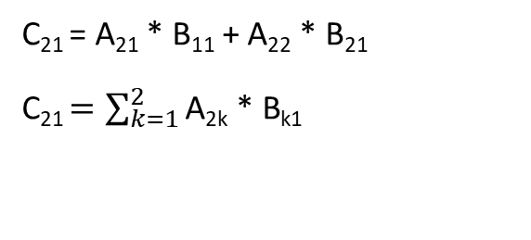
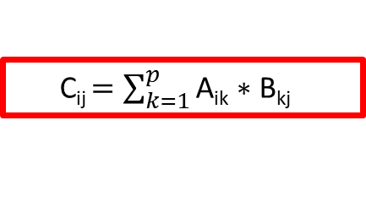
Multiplicação
C₂₁ = A₂₁ * B₁₁ + A₂₂ * B₂₁
C₂₁ $=\sum_{k=1}^{2}{{\text{A}\text{2}\text{k}\text{ * }\text{Bk}\text{1 }}^{}}$
C_{ij} $=\sum_{k=1}^{p}{{\text{A}\text{ik}\text{ ∗ }\text{Bkj}}^{}}$

