Slide 1
Chapter 24 - VBScript
Outline
24.1 Introduction
24.2 Operators
24.3 Data Types and Control Structures
24.4 VBScript Functions
24.5 VBScript Example Programs
24.6 Arrays
24.7 String Manipulation
24.8 Classes and Objects
24.9 Operator Precedence Chart
24.10 Internet and World Wide Web Resources

Slide 2
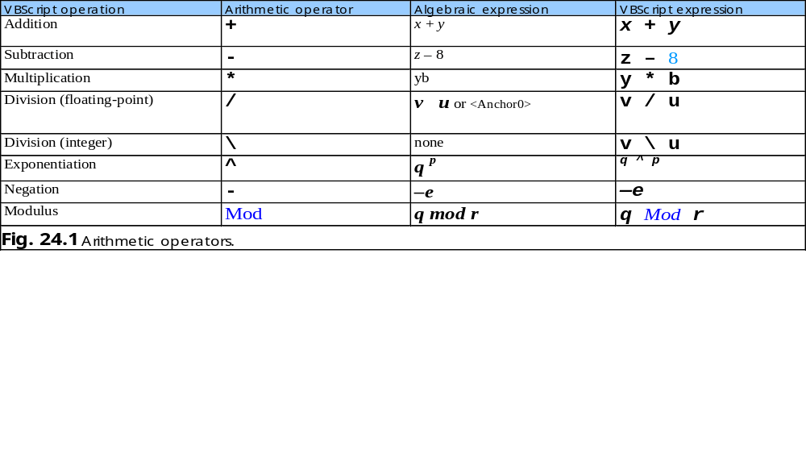
24.2 Operators

Slide 3
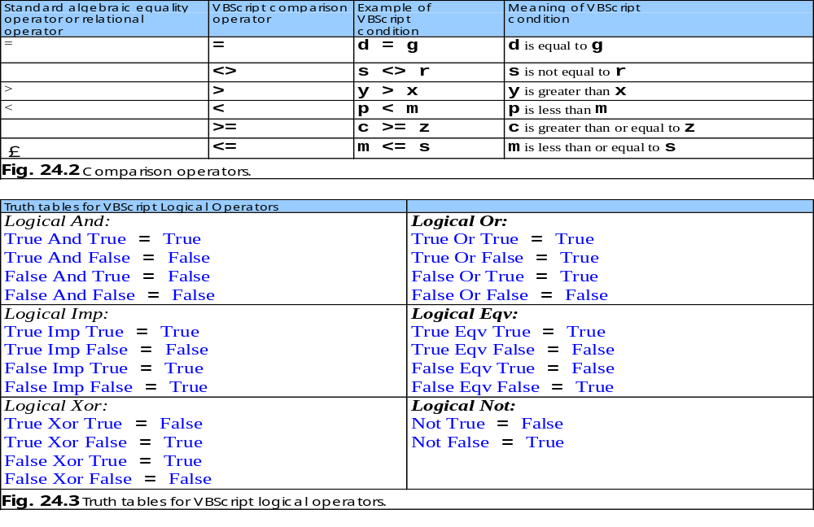
24.2 Operators

Slide 4
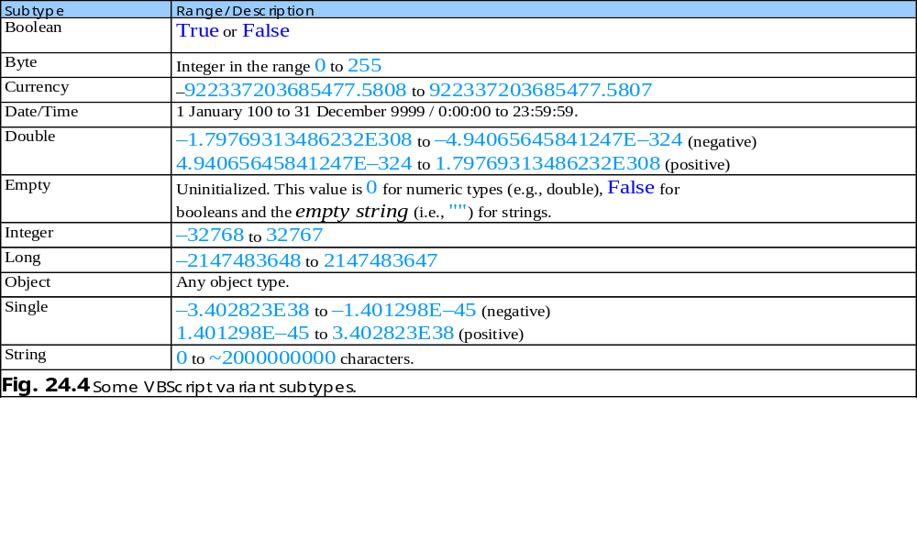
24.3 Data Types and Control Structures

Slide 5
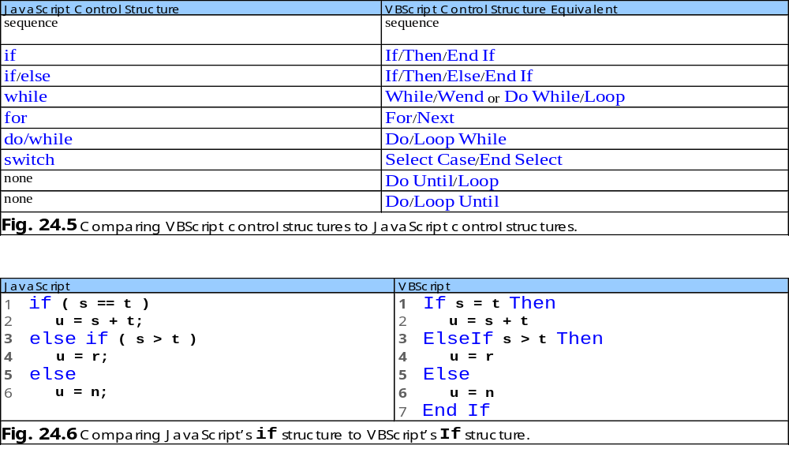
24.3 Data Types and Control Structures

Slide 6
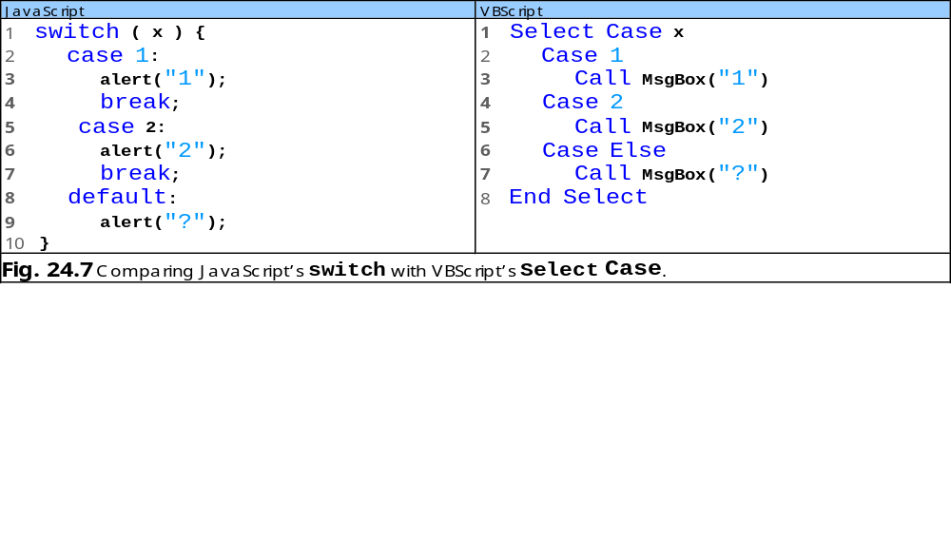
24.3 Data Types and Control Structures

Slide 7
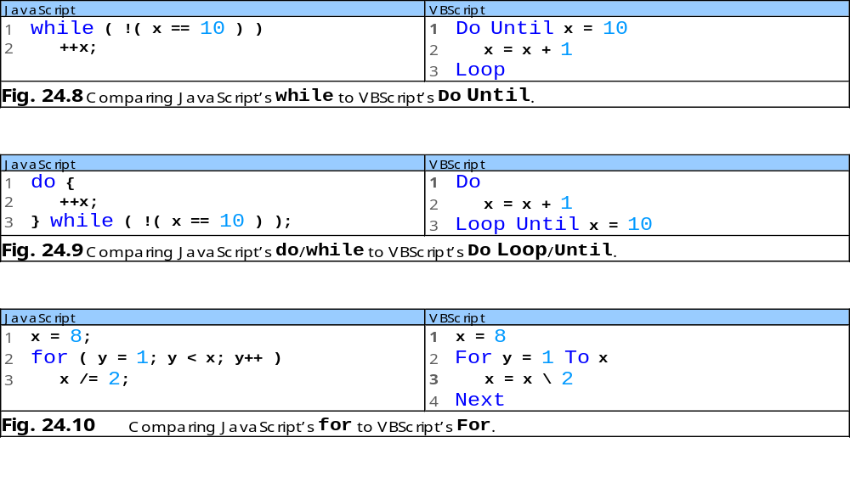
24.3 Data Types and Control Structures

Slide 8
1 ’ VBScript
2 For y = 2 To 20 Step 2
3 Call MsgBox( "y = " & y )
4 Next
Fig. 24.11 Using keyword Step in VBScript’s For repetition structure.
For repetition structure with keyword Step

Slide 9
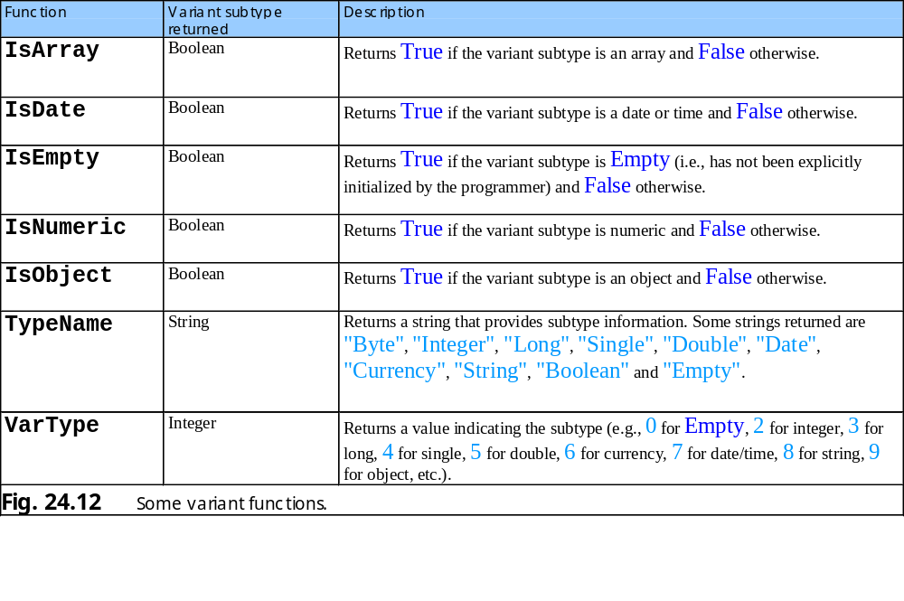
24.4 VBScript Functions

Slide 10
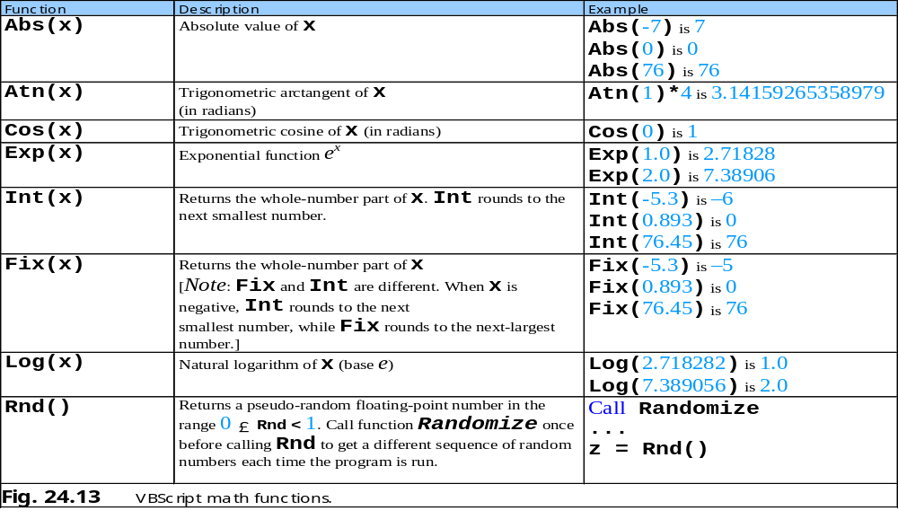
24.4 VBScript Functions

Slide 11
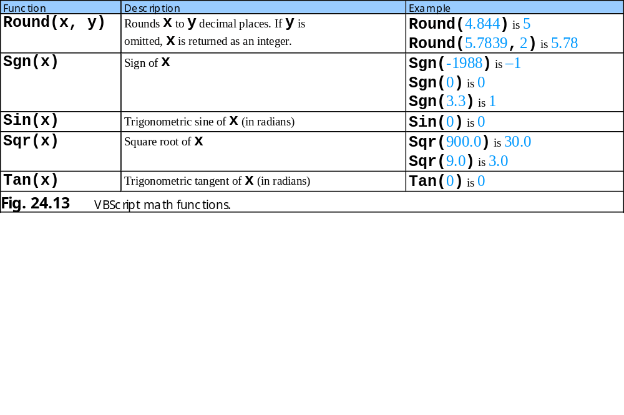
24.4 VBScript Functions

Slide 12
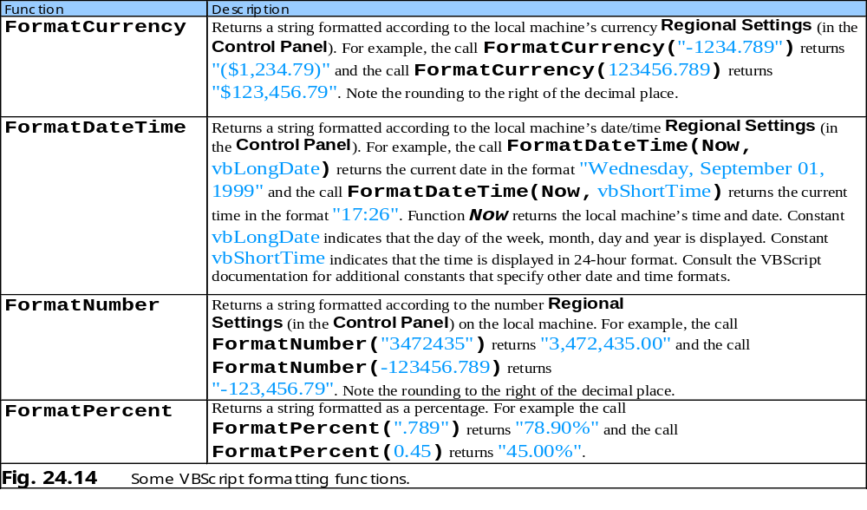
24.4 VBScript Functions

Slide 13
Addition.html
1 <?xml version = "1.0"?>
2 <!DOCTYPE html PUBLIC "-//W3C//DTD XHTML 1.0 Transitional//EN"
3 "http://www.w3.org/TR/xhtml1/DTD/xhtml1-transitional.dtd">
4
5 <!--Fig. 24.15: addition.html -->
6 <!--Adding Integers -->
7
8 <html xmlns = "http://www.w3.org/1999/xhtml">
9 <head>
10 <title>Our first VBScript</title>
11
12 <script type = "text/vbscript">
13 <!--
14 Option Explicit
15 Dim intTotal
16
17 Sub cmdAdd_OnClick()
18 Dim intValue
19
20 intValue = InputBox(_
21 "Enter an integer", "Input Box", , 1000, 1000)
22 intTotal = CInt( intTotal ) + CInt( intValue )
23 Call MsgBox("You entered " & intValue & _
24 "; total so far is " & intTotal, , "Results")
25 End Sub
26 -->
27 </script>
28 </head>
29
30 <body>
31 Click the button to add an integer to the total.
32 <hr />
33 <form action = "">
34 <input name = "cmdAdd" type = "button"
35 value = "Click Here to Add to the Total" />
Set type to VBScript.
Option Explicit statement.
Define procedure OnClick for the cmdAdd button.
Use CInt to convert input values from string subtype to integer subtype.

Slide 14
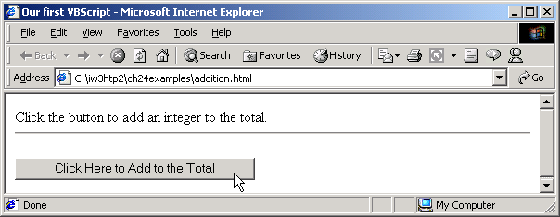

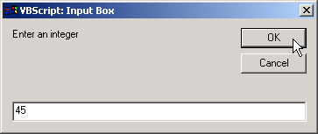
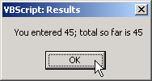


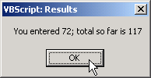
Addition.html
Program Output
36 </form>
37 </body>
38 </html>

Slide 15
Site.html
1 <?xml version = "1.0"?>
2 <!DOCTYPE html PUBLIC "-//W3C//DTD XHTML 1.0 Transitional//EN"
3 "http://www.w3.org/TR/xhtml1/DTD/xhtml1-transitional.dtd">
4
5 <!-- Fig. 24.16: site.html -->
6 <!-- Displaying a Web site -->
7
8 <html xmlns = "http://www.w3.org/1999/xhtml">
9 <head>
10 <title>Select a site to browse</title>
11 </head>
12
13 <body>
14 Select a site to browse<p>
15 <hr />
16 <form action = "">
17 <select name = "SiteSelector" size = "1">
18
19 <option value = "http://www.deitel.com">
20 Deitel & Associates, Inc.
21 </option>
22
23 <option value = "http://www.prenhall.com">
24 Prentice Hall
25 </option>
26
27 <option value = "http://www.phptr.com/phptrinteractive">
28 Prentice Hall Interactive
29 </option>
30
31 </select>
32
33 <!-- VBScript code -->
34 <script for = "SiteSelector" event = "onchange"
35 type = "text/vbscript">
Create form with select component.
The event attribute indicates the event to which the script responds (OnChange).
The <script> tag’s for attribute indicates the XHTML component on which the script operates (SiteSelector).
Script response to user’s selecting an option in the menu

Slide 16
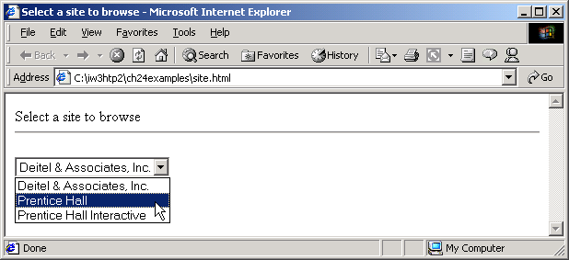
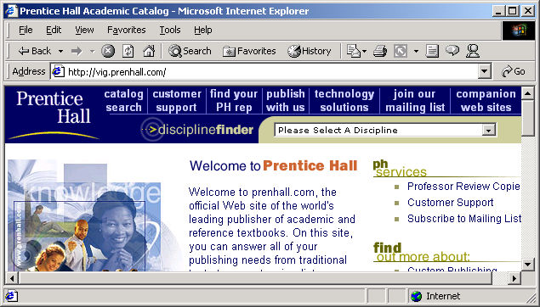
Site.html
Program Output
36 <!--
37 Document.Location = Document.Forms( 0 ).SiteSelector.Value
38 -->
39 </script>
40 </form></p>
41 </body>
42 </html>

Slide 17
Minimum.html
1 <?xml version = "1.0"?>
2 <!DOCTYPE html PUBLIC "-//W3C//DTD XHTML 1.0 Transitional//EN"
3 "http://www.w3.org/TR/xhtml1/DTD/xhtml1-transitional.dtd">
4
5 <!--Fig. 24.17: minimum.html -->
6 <!-- VBScript Procedures -->
7
8 <html xmlns = "http://www.w3.org/1999/xhtml">
9 <head>
10 <title>Using VBScript Procedures</title>
11
12 <script type = "text/vbscript">
13 <!--
14 Option Explicit
15
16 ' Find the minimum value. Assume that first value is
17 ' the smallest.
18 Function Minimum( min, a, b )
19
20 If a < min Then
21 min = a
22 End If
23
24 If b < min Then
25 min = b
26 End If
27
28 Minimum = min ' Return value
29 End Function
30
31 Sub OddEven( n )
32 If n Mod 2 = 0 Then
33 Call MsgBox( n & " is the smallest and is even" )
Define procedures Minimum and OddEven.
Single-line comment.
Use modulus operator to determine whether number odd or even.

Slide 18
Minimum.html
34 Else
35 Call MsgBox( n & " is the smallest and is odd" )
36 End If
37 End Sub
38
39 Sub cmdButton_OnClick()
40 Dim number1, number2, number3, smallest
41
42 ' Convert each input to Long subtype
43 number1 = CLng( Document.Forms( 0 ).txtBox1.Value )
44 number2 = CLng( Document.Forms( 0 ).txtBox2.Value )
45 number3 = CLng( Document.Forms( 0 ).txtBox3.Value )
46
47 smallest = Minimum( number1, number2, number3 )
48 Call OddEven( smallest )
49 End Sub
50 -->
51 </script>
52 </head>
53
54 <body>
55 <form action = ""> Enter a number
56 <input type = "text" name = "txtBox1" size = "5"
57 value = "0" />
58 <p>Enter a number
59 <input type = "text" name = "txtBox2" size = "5"
60 value = "0" /></p>
61 <p>Enter a number
62 <input type = "text" name = "txtBox3" size = "5"
63 value = "0" /></p>
64 <p><input type = "button" name = "cmdButton"
65 value = "Enter" /></p>
66
Define an event procedure for handling cmdButton’s OnClick event.
Call function Minimum.
Pass the smallest number to procedure OddEven.

Slide 19
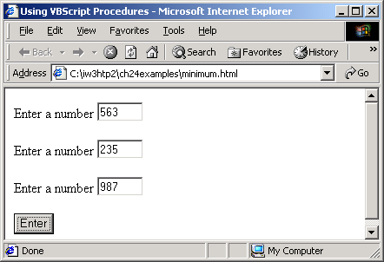
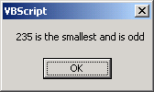
Minimum.html
Program Output
67 </form>
68 </body>
69 </html>

Slide 20
Arrays.html
1 <?xml version = "1.0"?>
2 <!DOCTYPE html PUBLIC "-//W3C//DTD XHTML 1.0 Transitional//EN"
3 "http://www.w3.org/TR/xhtml1/DTD/xhtml1-transitional.dtd">
4
5 <!--Fig. 24.18: arrays.html -->
6 <!--VBScript Arrays -->
7
8 <html xmlns = "http://www.w3.org/1999/xhtml">
9 <head>
10 <title>Using VBScript Arrays</title>
11
12 <script type = "text/vbscript">
13 <!--
14 Option Explicit
15
16 Public Sub DisplayArray( x, s )
17 Dim j
18
19 Document.Write( s & ": " )
20 For j = 0 To UBound( x )
21 Document.Write( x( j ) & " " )
22 Next
23
24 Document.Write( "<br />" )
25 End Sub
26
27 Dim fixedSize( 3 ), fixedArray, dynamic(), k
28
29 ReDim dynamic( 3 ) ' Dynamically size array
30 fixedArray = Array( "A", "B", "C" )
31
32 ' Populate arrays with values
33 For k = 0 to UBound( fixedSize )
34 fixedSize( k ) = 50 - k
35 dynamic( k ) = Chr( 75 + k )
Define procedure DisplayArray.
Function UBound returns the upper bound (i.e., the highest-numbered index).
Initialize arrays.
Statement ReDim allocates memory for array dynamic.
Function array takes any number of arguments and returns an array containing those arguments.

Slide 21
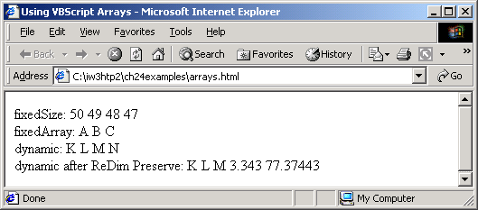
Arrays.html
Program Output
36 Next
37
38 ' Display contents of arrays
39 Call DisplayArray( fixedSize, "fixedSize" )
40 Call DisplayArray( fixedArray, "fixedArray" )
41 Call DisplayArray( dynamic, "dynamic" )
42
43 ' Resize dynamic, preserve current values
44 ReDim Preserve dynamic( 5 )
45 dynamic( 3 ) = 3.343
46 dynamic( 4 ) = 77.37443
47
48 Call DisplayArray( dynamic, _
49 "dynamic after ReDim Preserve" )
50 -->
51 </script>
52 </head><body></body>
53 </html>
Call procedure DisplayArray.
Reallocate dynamic’s memory to 5 elements. Keyword Preserve, when used with ReDim, maintains the current values in the array.

Slide 22
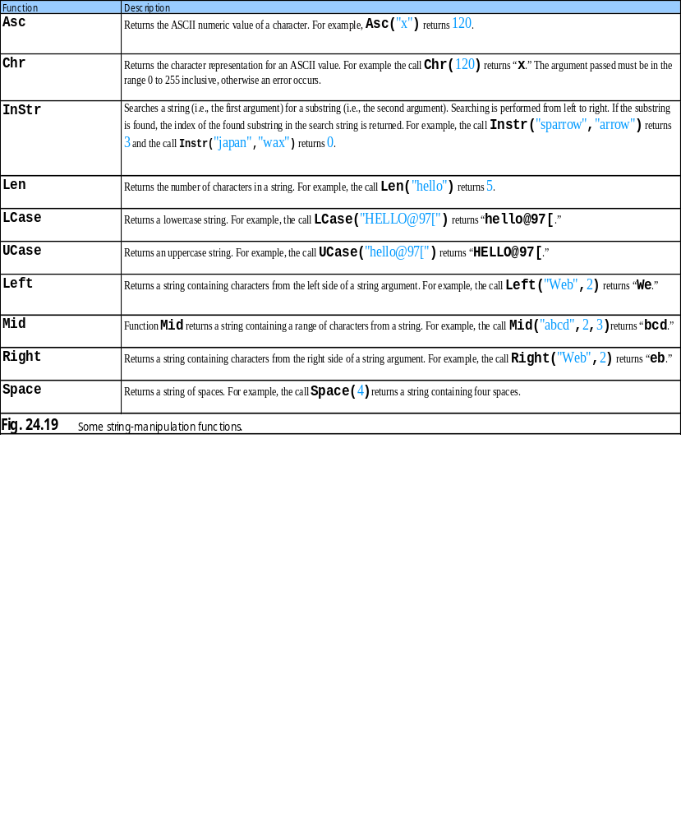
24.7 String Manipulation

Slide 23
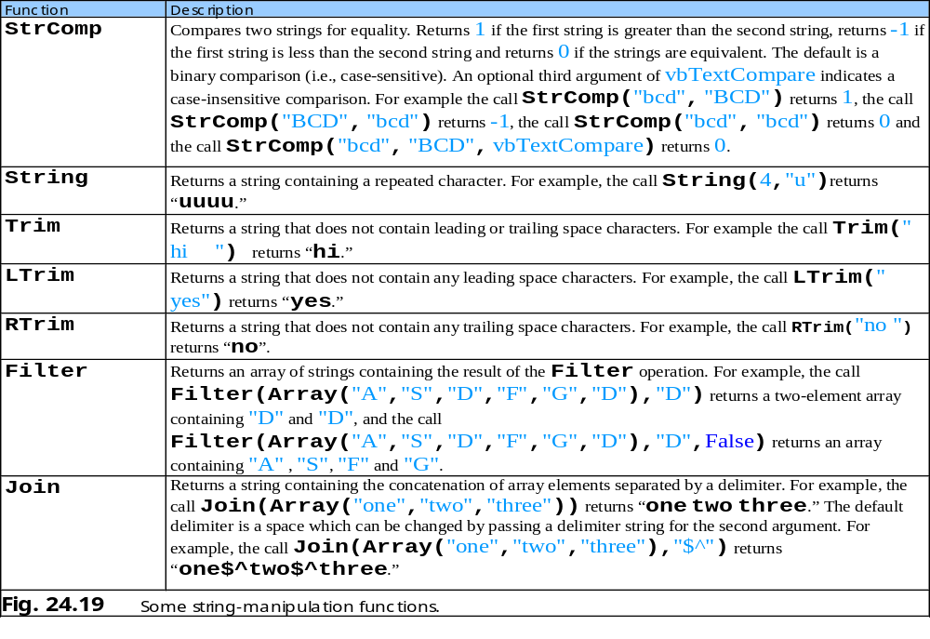
24.7 String Manipulation

Slide 24
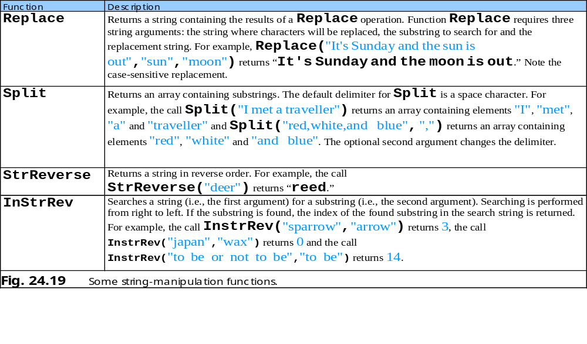
24.7 String Manipulation

Slide 25
Piglatin.html
1 <?xml version = "1.0"?>
2 <!DOCTYPE html PUBLIC "-//W3C//DTD XHTML 1.0 Transitional//EN"
3 "http://www.w3.org/TR/xhtml1/DTD/xhtml1-transitional.dtd">
4
5 <!--Fig. 24.20: piglatin.html -->
6 <!-- VBScript String Functions -->
7
8 <html xmlns = "http://www.w3.org/1999/xhtml">
9 <head>
10 <title>Using VBScript String Functions</title>
11
12 <script type = "text/vbscript">
13 <!--
14 Option Explicit
15
16 Public Function TranslateToPigLatin( englishPhrase )
17 Dim words ' Stores each individual word
18 Dim k, suffix
19
20 ' Get each word and store in words the
21 ' default delimiter for Split is a space
22 words = Split( englishPhrase )
23
24 For k = 0 To UBound( words )
25 ' Check if first letter is a vowel
26 If InStr( 1, "aeiou", _
27 LCase( Left( words( k ), 1 ) ) ) Then
28 suffix = "y"
29 Else
30 suffix = "ay"
31 End If
32
Define Function procedure TranslateToPigLatin
Split phrase into words
Convert each word to pig Latin
Function LCase returns a lowercase string.
Function InStr searches a string for a substring.

Slide 26
Piglatin.html
33 ' Convert the word to pig Latin
34 words( k ) = Right( words( k ), _
35 Len( words( k ) ) - 1 ) & _
36 Left( words( k ), 1 ) & suffix
37 Next
38
39 ' Return translated phrase, each word
40 ' is separated by spaces
41 TranslateToPigLatin = Join( words )
42 End Function
43
44 Sub cmdButton_OnClick()
45 Dim phrase
46
47 phrase = Document.Forms( 0 ).txtInput.Value
48
49 Document.forms( 0 ).txtPigLatin.Value = _
50 TranslateToPigLatin( phrase )
51 End Sub
52 -->
53 </script>
54 </head>
55
56 <body>
57 <form action = ""> Enter a sentence
58 <input type = "text" name = "txtInput" size = "50" />
59 <p>Pig Latin
60 <input type = "text" name = "txtPigLatin" size = "70" />
61 </p><p>
62 <input type = "button" name = "cmdButton"
63 value = "Translate" /></p>
64 </form>
65 </body>
66 </html>
Function Len returns the number of characters in a string.
Function Right returns a string containing characters from the right side of a string argument.
Function Left returns a string containing characters from the left side of a string argument.
Return translated phrase using Join function
Define an event procedure for cmdButton’s OnClick event.

Slide 27
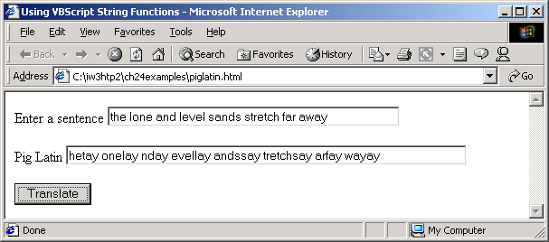
Program Output

Slide 28
1 Private mHour
2
3 Public Property Let Hour( hr )
4 If hr >= 0 And hr < 24 Then
5 mHour = hr
6 Else
7 mHour = 0
8 End If
9 End Property
Fig. 24.21 Simple Property Let procedure.
A simple Property Let procedure

Slide 29
1 Public Property Get Hour()
2 Hour = mHour
3 End Property
Fig. 24.22 Simple Property Get procedure.
A simple Property Get procedure

Slide 30
1 Class CTime1
2 Private mHour
3
4 Public Property Let Hour( hr )
5 If hr >= 0 And hr < 24 Then
6 mHour = hr
7 Else
8 mHour = 0
9 End If
10 End Property
11
12 Public Property Get Hour()
13 Hour = mHour
14 End Property
15 End Class
A simple Class definition
Fig. 24.23 Simple Class definition.

Slide 31
Classes.html
1 <?xml version = "1.0"?>
2 <!DOCTYPE html PUBLIC "-//W3C//DTD XHTML 1.0 Transitional//EN"
3 "http://www.w3.org/TR/xhtml1/DTD/xhtml1-transitional.dtd">
4
5 <!--Fig. 24.24: classes.html -->
6 <!-- VBScript Class -->
7
8 <html xmlns = "http://www.w3.org/1999/xhtml">
9 <head>
10 <title>Using a VBScript Class</title>
11
12 <script type = "text/vbscript">
13 <!--
14 Option Explicit
15
16 Class Person
17 Private name, yearsOld, ssn
18
19 Public Property Let FirstName( fn )
20 name = fn
21 End Property
22
23 Public Property Get FirstName()
24 FirstName = name
25 End Property
26
27 Public Property Let Age( a )
28 yearsOld = a
29 End Property
30
31 Public Property Get Age()
32 Age = yearsOld
33 End Property
34
35 Public Property Let SocialSecurityNumber( n )
Define Class Person
Define Property Let and Property Get procedures
Define Property Let SocialSecurityNumber

Slide 32
Classes.html
36
37 If Validate( n ) Then
38 ssn = n
39 Else
40 ssn = "000-00-0000"
41 Call MsgBox( "Invalid Social Security Format" )
42 End If
43
44 End Property
45
46 Public Property Get SocialSecurityNumber()
47 SocialSecurityNumber = ssn
48 End Property
49
50 Private Function Validate( expression )
51 Dim regularExpression
52 Set regularExpression = New RegExp
53
54 regularExpression.Pattern = "^\d{3}-\d{2}-\d{4}$"
55
56 If regularExpression.Test( expression ) Then
57 Validate = True
58 Else
59 Validate = False
60 End If
61
62 End Function
63
64 Public Function ToString()
65 ToString = name & Space( 3 ) & age & Space( 3 ) _
66 & ssn
67 End Function
68
69 End Class ' Person
70
Call function Validate
Define Function Validate
Use regular expression to check format
Define Function ToString.

Slide 33
Classes.html
71 Sub cmdButton_OnClick()
72 Dim p ' Declare object reference
73 Set p = New Person ' Instantiate Person object
74
75 With p
76 .FirstName = Document.Forms(0).txtBox1.Value
77 .Age = CInt( Document.Forms(0).txtBox2.Value )
78 .SocialSecurityNumber =_
79 Document.Forms(0).txtBox3.Value
80 Call MsgBox( .ToString() )
81 End With
82
83 End Sub
84 -->
85 </script>
86 </head>
87
88 <body>
89 <form action = "">Enter first name
90 <input type = "text" name = "txtBox1" size = "10" />
91 <p>Enter age
92 <input type = "text" name = "txtBox2" size = "5" /></p>
93 <p>Enter social security number
94 <input type = "text" name = "txtBox3" size = "10" />
95 </p><p>
96 <input type = "button" name = "cmdButton"
97 value = "Enter" /></p>
98 </form>
99 </body>
100 </html>
Provide an event procedure for cmdButton’s OnClick event.
Instantiate Person object.
Use the With/End With statement to set several property values for p and call p’s ToString method.

Slide 34
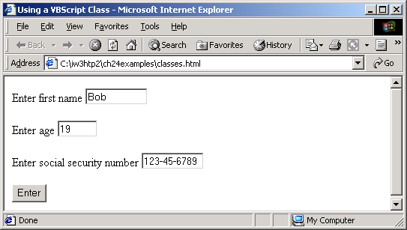
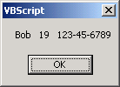

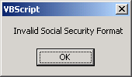
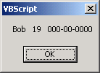
Program Output

Slide 35
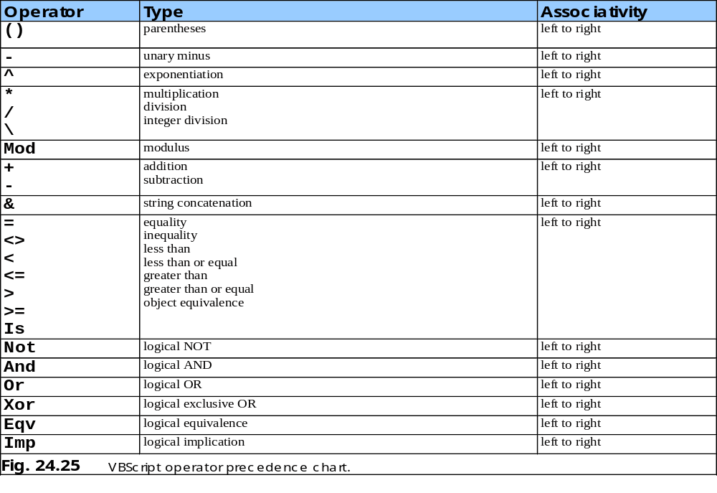
24.9 Operator Precedence Chart

