Slide 1



Dynamic Hyper text markup language

Slide 2


DHTML is NOT a W3C Standard
DHTML stands for Dynamic HTML.
DHTML is not a standard defined by the World Wide Web Consortium (W3C).
DHTML is a "marketing term" - used by Netscape and Microsoft to describe the new technologies the 4.x generation browsers would support.
DHTML is a combination of technologies used to create dynamic Web sites.
To most people DHTML means a combination of HTML 4.0, Style Sheets and JavaScript.

Slide 3
DHTML Technologies
With DHTML a Web developer can control how to display and position HTML elements in a browser window.
HTML 4.0
  With HTML 4.0 all formatting can be moved out of the HTML document and into a separate style sheet. Because HTML 4.0 separates the presentation of the document from its structure, we have got total control of presentation layout without messing up the document content.

Slide 4
Cascading Style Sheets
With CSS we got a style and layout model for HTML documents.
CSS was a breakthrough in Web design because it allowed developers to control the style and layout of multiple Web pages all at once.
As a Web developer you can define a style for each HTML element and apply it to as many Web pages as you want.
To make a global change, simply change the style, and all elements in the Web are updated automatically.

Slide 5
The Document Object Model (DOM)
DOM stands for the Document Object Model.
The HTML DOM is the Document Object Model for HTML.
The HTML DOM defines a standard set of objects for HTML, and a standard way to access and manipulate HTML objects.
"The W3C Document Object Model (DOM) is a platform and language neutral interface that allows programs and scripts to dynamically access and update the content, structure, and style of a document".
JavaScript (and VBScript)
Allows you to write code to control all HTML elements.

Slide 6

What is CSS?
CSS stands for Cascading Style Sheets
Styles define how to display HTML elements
Styles are normally stored in Style Sheets
Styles were added to HTML 4.0 to solve a problem
External Style Sheets can save you a lot of work
External Style Sheets are stored in CSS files
Multiple style definitions will cascade into one

Slide 7
Style Sheets Can Save a Lot of Work
Styles in HTML 4.0 define how HTML elements are displayed, just like the font tag and the color attribute in HTML 3.2.
Styles are normally saved in files external to your HTML documents.
External style sheets enable you to change the appearance and layout of all the pages in your Web, just by editing a single CSS document.
If you have ever tried to change the font or color of all the headings in all your Web pages, you will understand how CSS can save you a lot of work.

Slide 8
CSS is a breakthrough in Web design because it allows developers to control the style and layout of multiple Web pages all at once.
As a Web developer you can define a style for each HTML element and apply it to as many Web pages as you want. To make a global change, simply change the style, and all elements in the Web are updated automatically.

Slide 9
Multiple Styles Will Cascade Into One
Style Sheets allow style information to be specified in many ways.
Styles can be specified inside a single HTML element, inside the <head> element of an HTML page, or in an external CSS file.
Even multiple external Style Sheets can be referenced inside a single HTML document.

Slide 10
Cascading Order
Browser default
External Style Sheet
Internal Style Sheet
(inside the <head> tag)
Inline Style (inside HTML element)

Slide 11
Syntax
The CSS syntax is made up of three parts: a selector, a property and a value:
selector {property: value}
The selector is normally the HTML element/tag you wish to define, the property is the attribute you wish to change, and each property can take a value.
The property and value are separated by a colon and surrounded by curly braces:

Slide 12
body {color: black}
p {font-family: "sans serif"}
p {text-align:center;color:red}
To make the style definitions more readable, you can describe one property on each line, like this:
p {
text-align: center;
color: black;
font-family: arial
}

Slide 13
Grouping
You can group selectors. Separate each selector with a comma. In the example below we have grouped all the header elements. Each header element will be green:
h1,h2,h3,h4,h5,h6
{
color: green
}

Slide 14
The class Selector
With the class selector you can define different styles for the same type of HTML element.
Say that you would like to have two types of paragraphs in your document:
one right-aligned paragraph, and
one center-aligned paragraph.

Slide 15
Here is how you can do it with styles:
p.right {text-align: right}
p.center {text-align: center}
<p class="right">
This paragraph will be right-aligned.
</p>
<p class="center">
This paragraph will be center-aligned.
</p>

Slide 16
.center {text-align: center}
<h1 class="center">
This heading will be center-aligned
</h1>
<p class="center">
This paragraph will also be center-aligned.
</p>

Slide 17
The id Selector
The id selector is different from the class selector!
While a class selector may apply to SEVERAL elements on a page, an id selector always applies to only ONE element.
An ID attribute must be unique within the document.
The style rule below will match a p element that has the id value "para1":
p#para1
{
text-align: center;
color: red
}

Slide 18

CSS Comments
You can insert comments in CSS to explain your code, which can help you when you edit the source code at a later date.
A comment will be ignored by the browser. A CSS comment begins with "/*", and ends with "*/", like this:
/* This is a comment */
p {
text-align: center;
/* This is another comment */
color: black;
font-family: arial
}

Slide 19
External Style Sheet
An external style sheet is ideal when the style is applied to many pages.
With an external style sheet, you can change the look of an entire Web site by changing one file.
Each page must link to the style sheet using the <link> tag.

Slide 20
The <link> tag goes inside the head section:
  <head>
  <link rel="stylesheet" type="text/css" href="mystyle.css" />
  </head>
  mystyle.css
  hr {color: sienna}
  p {margin-left: 20px}
  body {background-image: url("images/back40.gif")}

Slide 21
Internal Style Sheet
An internal style sheet should be used when a single document has a unique style.
You define internal styles in the head section by using the <style> tag, like this:
<head>
<style type="text/css">
hr {color: sienna}
p {margin-left: 20px}
body {background-image: url("images/back40.gif")}
</style>
</head>

Slide 22
Inline Styles
An inline style loses many of the advantages of style sheets by mixing content with presentation.
Use this method sparingly, such as when a style is to be applied to a single occurrence of an element.
<p style="color: sienna; margin-left: 20px"> This is a paragraph </p>

Slide 23
Multiple Style Sheets
If some properties have been set for the same selector in different style sheets, the values will be inherited from the more specific style sheet.
h3 { color: red; text-align: left;
font-size: 8pt }
h3 { text-align: right; font-size: 20pt }
color: red; text-align: right; font-size: 20pt

Slide 24
CSS Background
The Background properties allow you to control the background color of an element, set an image as the background, repeat a background image vertically or horizontally, and position an image on a page.

Slide 25
The background property
body
{
background: #FF0000
}
body
{
background: url(stars.gif) no-repeat top
}
body
{
background: #00FF00 url(stars.gif) no-repeat fixed top
}

Slide 26
body
{
background-image: url(stars.gif);
background-attachment: scroll
}
p
{
background-color: #00ff00
}

Slide 27
The background-position property
body
{
background-image: url(stars.gif);
background-color: #000000
}
body
{
background-image: url(stars.gif);
background-repeat: no-repeat;
background-position: top left
}
body
{
background-image: url(stars.gif);
background-repeat: no-repeat;
background-position: 0% 0%
}

Slide 28
body
{
background-image: url(stars.gif);
background-repeat: repeat-x
}
Possible Values
Value | Description
repeat | The background image will be repeated vertically and horizontally
repeat-x | The background image will be repeated horizontally
repeat-y | The background image will be repeated vertically
no-repeat | The background-image will be displayed only once

Slide 29
CSS Text
Text properties allow you to control the appearance of text.
It is possible to change
the color of a text,
increase or decrease the space between characters in a text,
align a text,
decorate a text,
indent the first line in a text, and more

Slide 30
The color property sets the color of a text.
body
{
color: rgb(255,255,0)
}
The direction property sets the text direction.
div
{
direction: rtl
}
Value | Description
ltr | Text direction is left-to-right
rtl | Text direction is right-to-left

Slide 31
The letter-spacing property increases or decreases the white space between characters.
p
{
letter-spacing: 12px
}
p
{
letter-spacing: -0.5px
}
The text-align property aligns the text in an element.
p
{
text-align: center
}

Slide 32
The text-decoration property decorates the text.
p
{
text-decoration: underline
}
Value | Description
none | Defines a normal text
underline | Defines a line under the text
overline | Defines a line over the text
line-through | Defines a line through the text
blink | Defines a blinking text

Slide 33
The text-indent indents the first line of text in an element.
p
{
text-indent: 20px
}
p
{
text-indent: -12px
}
The text-transform property controls the letters in an element.
p
{
text-transform: uppercase
}
uppercase/lowercase/capitalize

Slide 34
CSS Fonts
The Font properties allow you to change the font family, boldness, size, and the style of a text.
The font property is, with exception of some system fonts, a shorthand property for setting all of the properties for a font in one declaration.

Slide 35
p
{
font: italic bolder
}
p
{
font: italic small-caps bold 12px arial
}
p
{
font: oblique small-caps 900 12px/14px arial
}
p
{
font: menu
}

Slide 36
Possible Values
Value | Description
font-style font-variant font-weight font-size/line-height font-family | Sets the properties for a font. The line-height value sets the space between lines. The value can be a number, a %, or a font size
caption | Defines the font that are used by captioned controls (like buttons, drop-downs, etc.)
icon | Defines the fonts that are used by icon labels
menu | Defines the fonts that are used by dropdown menus
message-box | Defines the fonts that are used by dialog boxes
small-caption
status-bar | Defines the fonts that are used by window status bars

Slide 37
Font-variant-style
body
{
font-style: italic
}
normal/italic/oblique
p
{
font-variant: small-caps
}
normal/small-caps

Slide 38
The font-weight property
p
{
font-weight: bold
}
Value | Description
Normal | Defines normal characters
bold | Defines thick characters
bolder | Defines thicker characters
lighter | Defines lighter characters
100 200 300 400 500 600 700 800 900 | Defines from thin to thick characters. 400 is the same as normal, and 700 is the same as bold

Slide 39
CSS Borders
The Border properties allow you to specify the style, color, and width of an element's border.
In HTML we use tables to create borders around a text
But with the CSS Border properties we can create borders with nice effects, and it can be applied to any element.

Slide 40
p
{
border: thin dotted #00FF00
}
span
{
border: solid #0000FF
}
border-width/border-style/border-color

Slide 41
table
{
border-bottom: thin dotted #00FF00
}
span
{
border-bottom: solid #0000FF
}
border-bottom-width/ border-style/ border-color
table
{ border-bottom-color: #ff3366 }
table
{ border-bottom-color: rgb(255,0,0) }

Slide 42
Four color
table {border-color: red}
all four borders will be red table {border-color: red green}
top and bottom border will be red, left an right border will be green
table {border-color: red green blue}
top border will be red, left and right border will be green, bottom border will be blue
table {border-color: red green blue yellow}
top border will be red, right border will be green, bottom border will be blue, left border will be yellow

Slide 43
The border-left-right property
table
{
border-left: thin dotted #00FF00
}
table
{
border-left: thick #0000FF
}
border-left-width
border-style
border-color

Slide 44
table
{
border-left-color: #ff3366
}
table
{
border-left-color: rgb(255,0,0)
}
table
{
border-left-style: solid
}
table
{
border-right-style: outset
}

Slide 45
table {border-style: dotted}
all four borders will be dotted table {border-style: dotted dashed}
top and bottom border will be dotted, left an right border will be dashed
table {border-style: dotted dashed solid}
top border will be dotted, left and right border will be dashed, bottom border will be solid
table {border-style: dotted dashed solid double}
top border will be dotted, right border will be dashed, bottom border will be solid, left border will be double

Slide 46
Value | Description
none | Defines no border
hidden | The same as "none", except in border conflict resolution for table elements
dotted | Defines a dotted border. Renders as solid in most browsers
dashed | Defines a dashed border. Renders as solid in most browsers
solid | Defines a solid border
double | Defines two borders. The width of the two borders are the same as the border-width value
groove | Defines a 3D grooved border. The effect depends on the border-color value
ridge | Defines a 3D ridged border. The effect depends on the border-color value
inset | Defines a 3D inset border. The effect depends on the border-color value
outset | Defines a 3D outset border. The effect depends on the border-color value

Slide 47
table
{
border-left-width: thin
}
table
{
border-left-width: 0.5cm
}
Value | Description
thin | Defines a thin left border.
medium | Defines a medium left border.
thick | Defines a thick left border.
length | Allows you to define the thickness of the left border.

Slide 48
The border-top property
table
{
border-top: thin dotted #00FF00
}
table
{
border-top-color: rgb(255,0,0)
}
table
{
border-top-style: solid
}
table
{
border-top-width: thin
}
thin, medium, thick, length

Slide 49
Border-Width
table {border-width: thin}
all four borders will be thin
table {border-width: thin medium}
top and bottom border will be thin, left and right border will be medium
table {border-width: thin medium thick}
top border will be thin, left and right border will be medium, bottom border will be thick
table {border-width: thin medium thick none}
top border will be thin, right border will be medium, bottom border will be thick, left side will have no border

Slide 50
<html>
<head>
<style type="text/css">
h1
{ border-style: solid double groove
border: medium double rgb(250,0,255)
}
h2
{ border-left: medium solid #ff0000 }
h3
{ border-right: medium solid #ff0000 }
h4
{ border-style: solid; border-right-width: 15px }

Slide 51
h5
{
border-style: solid;
border-color: #ff0000
#00ff00 #0000ff
rgb(250,0,255)
}
h6
{ border-top: medium solid #ff0000 }
</style>
</head>
<body>
<h1>Some text</h1>
<h2>Some text</h2>
<h3>Some text</h3>
<h4>Some text</h4>
<h5>Some text</h5>
<h6>Some text</h6>
</body>
</html>

Slide 52
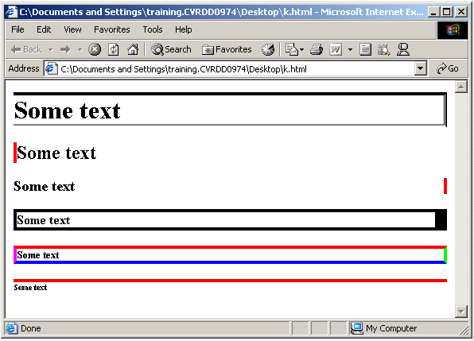

Slide 53
CSS Padding
The Padding properties define the space between the element border and the element content. Negative values are not allowed.
The top, right, bottom, and left padding can be changed independently using separate properties.

Slide 54
The padding property
h1 {padding: 10px}
the padding will be 10px on all four sides
h1 {padding: 10px 2%}
top and bottom padding will be 10px, left and right padding will be 2% of the width of the closest element.
h1 {padding: 10px 2% 15px}
top padding will be 10px, left and right padding will be 2% of the width of the closest element, bottom padding will be 15px
h1 {padding: 10px 2% 15px 20px}
top padding will be 10px, right padding will be 2% of the width of the closest element, bottom padding will be 15px, left padding will be 20px
padding-top, padding-right, padding-bottom, padding-left

Slide 55
<html>
<head><style type="text/css">
td {padding: 1.5cm}
td.twovalues {padding: 0.5cm 2.5cm}
</style></head>
<body>
<table border="1">
<tr><td>This is a tablecell with padding on each side</td></tr>
</table>
<br>
<table border="1">
<tr>
<td class="twovalues">
This is a tablecell with padding on each side. The top and bottom padding have the same value (0.5cm), while the left and right padding have another value (2.5)
</td>
</tr>
</table>
</body>
</html>

Slide 56
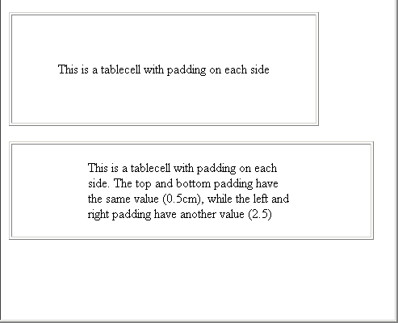

Slide 57
List Properties:
The List properties allow you to change between different list-item markers, set an image as a list-item marker, and set where to place a list-item marker.

Slide 58
The list-style property is a shorthand property for setting all the properties for a list in one declaration.
ul
{
list-style: disc outside
}
ol
{
list-style: decimal inside
}
list-style-type
list-style-position
list-style-image

Slide 59
<html>
<head>
<style type="text/css">
ul
{ list-style-type:square; list-style-position:inside;
list-style-image:url('arrow.gif')
}
</style></head>
<body>Drinks
<ul>
<li>Coffee</li>
<li>Tea</li>
<li>Coca Cola</li>
</ul>
</body>
</html>

Slide 60
ul{ list-style-type: disc }
Value | Description
none | No marker
disc | The marker is a filled circle
circle | The marker is a circle
square | The marker is a square
decimal | The marker is a number
decimal-leading-zero | The marker is a number padded by initial zeros (01, 02, 03, etc.)
lower-roman | The marker is lower-roman (i, ii, iii, iv, v, etc.)
upper-roman | The marker is upper-roman (I, II, III, IV, V, etc.)
lower-alpha | The marker is lower-alpha (a, b, c, d, e, etc.)
upper-alpha | The marker is upper-alpha (A, B, C, D, E, etc.)
lower-greek | The marker is lower-greek (alpha, beta, gamma, etc.)
lower-latin | The marker is lower-latin (a, b, c, d, e, etc.)
upper-latin | The marker is upper-latin (A, B, C, D, E, etc.)
hebrew | The marker is traditional Hebrew numbering
armenian | The marker is traditional Armenian numbering
georgian | The marker is traditional Georgian numbering (an, ban, gan, etc.)
cjk-ideographic | The marker is plain ideographic numbers
hiragana | The marker is: a, i, u, e, o, ka, ki, etc.
katakana | The marker is: A, I, U, E, O, KA, KI, etc.
hiragana-iroha | The marker is: i, ro, ha, ni, ho, he, to, etc.
katakana-iroha | The marker is: I, RO, HA, NI, HO, HE, TO, etc.

Slide 61
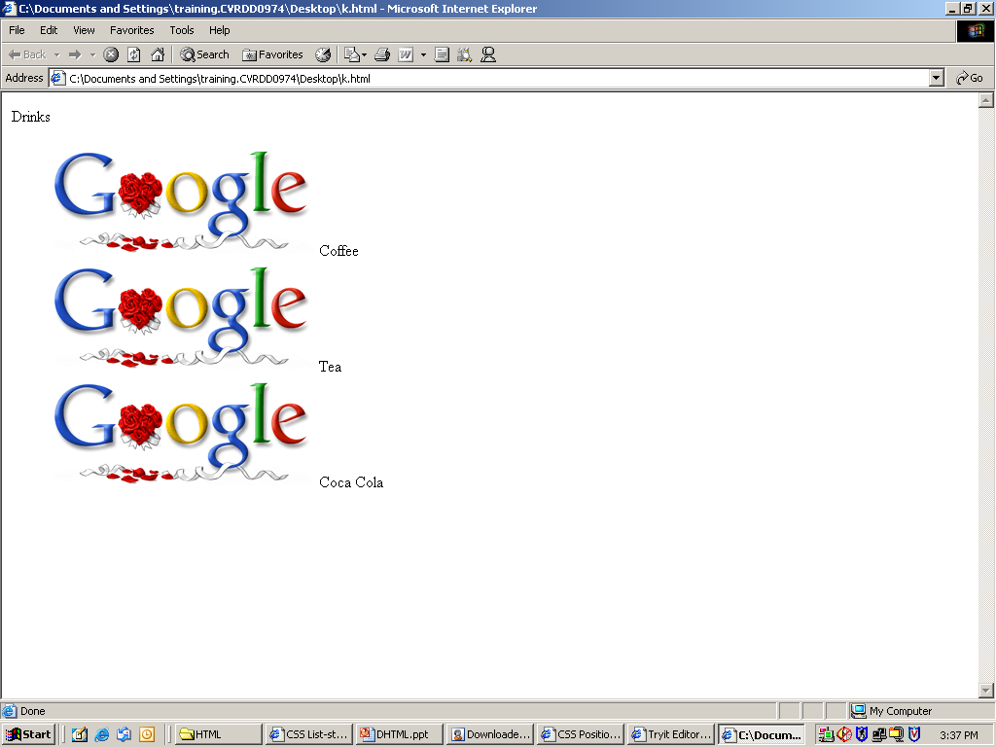

Slide 62
<html>
<head>
<style type="text/css">
img.normal
{ height: auto; width: auto }
img.big
{ height: 80px; width: 100px }
img.small
{ height: 30px; width: 50px }
</style>
</head>
<body>
<img class="normal" src="arrow.gif" width="72" height="40">
<br><br>
<img class="big" src="arrow.gif" width="72" height="40">
<br><br>
<img class="small" src="arrow.gif" width="72" height="40">
</body>
</html>

Slide 63
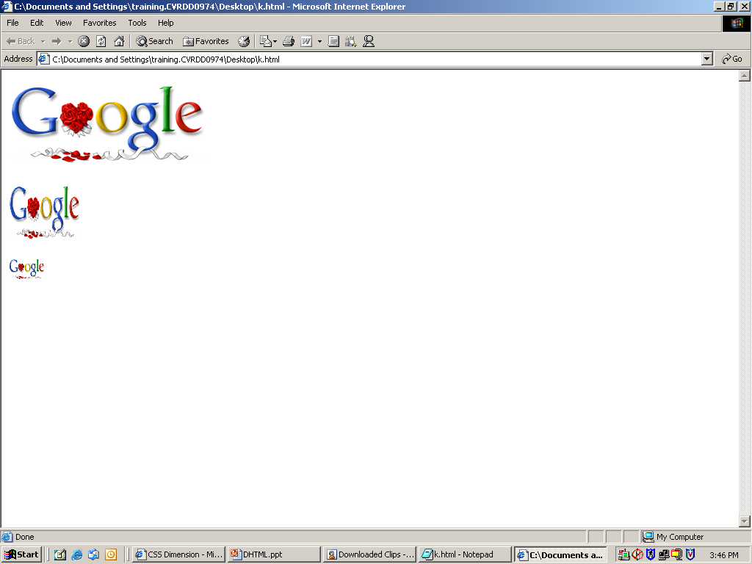

Slide 64
The display property
p { display: block }
Value | Description
none | The element will not be displayed
block | The element will be displayed as a block-level element, with a line break before and after the element
inline | The element will be displayed as an inline element, with no line break before or after the element
list-item | The element will be displayed as a list
run-in | The element will be displayed as block-level or inline element depending on context
compact | The element will be displayed as block-level or inline element depending on context
marker
table | The element will be displayed as a block table (like <table>), with a line break before and after the table
inline-table | The element will be displayed as an inline table (like <table>), with no line break before or after the table
table-row-group | The element will be displayed as a group of one or more rows (like <tbody>)
table-header-group | The element will be displayed as a group of one or more rows (like <thead>)
table-footer-group | The element will be displayed as a group of one or more rows (like <tfoot>)
table-row | The element will be displayed as a table row (like <tr>)
table-column-group | The element will be displayed as a group of one or more columns (like <colgroup>)
table-column | The element will be displayed as a column of cells (like <col>)
table-cell | The element will be displayed as a table cell (like <td> and <th>)
table-caption | The element will be displayed as a table caption (like <caption>)

Slide 65
<html>
<head>
<style type="text/css">
div
{
float:right; width:120px; border:1px dotted black;
margin:0 0 15px 20px; padding:15px; text-align:center;
}
h1 {display: none}
p {display: inline}
</style></head>
<body>
<div> <img src="logocss.gif" width="95" height="84" /><br/> CSS is fun </div>
<h1>The div section is invisible</h1>
<p> With the value of "inline" there should be </p>
<p> no distance between the two paragraphs. </p>
</body>
</html>

Slide 66

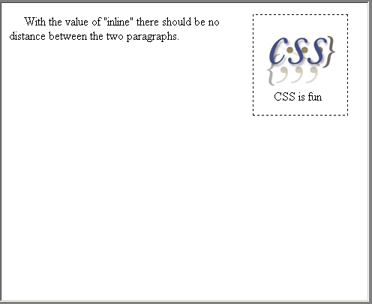

Slide 67
CSS Pseudo-classes
The syntax of pseudo-classes:
    selector:pseudo-class {property: value}
CSS classes can also be used with pseudo-classes:
    selector.class:pseudo-class {property: value}
a:link {color: #FF0000}
/* unvisited link */
a:visited {color: #00FF00}
/* visited link */
a:hover {color: #FF00FF}
/* mouse over link */
a:active {color: #0000FF}
/* selected link */
a.red:visited {color: #FF0000}
<a class="red" href="css_syntax.asp">
CSSSyntax</a>

