Slide 1

HTML
Hyper Text Markup Language

Slide 2

What is an HTML File?
HTML stands for Hyper Text Markup Language
An HTML file is a text file containing small markup tags
The markup tags tell the Web browser how to display the page
An HTML file must have an htm or html file extension
An HTML file can be created using a simple text editor

Slide 3
What is the World Wide Web?
The World Wide Web (WWW) is most often called the Web.
The Web is a network of computers all over the world.
All the computers in the Web can communicate with each other.
All the computers use a communication standard called HTTP.

Slide 4
How does the WWW work?
Web information is stored in documents called Web pages.
Web pages are files stored on computers called Web servers.
Computers reading the Web pages are called Web clients.
Web clients view the pages with a program called a Web browser.
Popular browsers are Internet Explorer and Mozilla Firefox.

Slide 5
How does the browser fetch the pages?
A browser fetches a Web page from a server by a request.
A request is a standard HTTP request containing a page address.
A page address looks like this: http://www.someone.com/page.htm.

Slide 6
How does the browser display the pages?
All Web pages contain instructions for display
The browser displays the page by reading these instructions.
The most common display instructions are called HTML tags.
HTML tags look like this <p>This is a Paragraph</p>.

Slide 7
Who is making the Web standards?
The Web standards are not made up by Netscape or Microsoft.
The rule-making body of the Web is the W3C.
W3C stands for the World Wide Web Consortium.
W3C puts together specifications for Web standards.
The most essential Web standards are HTML, CSS and XML.
The latest HTML standard is XHTML 1.0.

Slide 8
Type in the following text:
<html>
<head> <title>Title of page</title> </head>
<body> This is my first homepage.
<b>This text is bold</b>
</body>
</html>

Slide 9
The first tag in your HTML document is <html>. This tag tells your browser that this is the start of an HTML document. The last tag in your document is </html>. This tag tells your browser that this is the end of the HTML document.
The text between the <head> tag and the </head> tag is header information. Header information is not displayed in the browser window.
The text between the <title> tags is the title of your document. The title is displayed in your browser's caption.
The text between the <body> tags is the text that will be displayed in your browser.
The text between the <b> and </b> tags will be displayed in a bold font.

Slide 10
HTM or HTML Extension?
When you save an HTML file, you can use either the .htm or the .html extension.
We have used .htm in our examples.
It might be a bad habit inherited from the past when some of the commonly used software only allowed three letter extensions.
With newer software we think it will be perfectly safe to use .html.

Slide 11
HTML documents are text files made up of HTML elements.
HTML elements are defined using HTML tags.
HTML Tags
  HTML tags are used to mark-up HTML elements
  HTML tags are surrounded by the two characters < and >
  The surrounding characters are called angle brackets
  HTML tags normally come in pairs like <b> and </b>
  The first tag in a pair is the start tag, the second tag is the end tag
  The text between the start and end tags is the element content
  HTML tags are not case sensitive, <b> means the same as <B>

Slide 12
Tag Attributes
Tags can have attributes. Attributes can provide additional information about the HTML elements on your page.
This tag defines the body element of your HTML page:
  <body>. With an added bgcolor attribute, you can tell the browser that the background color of your page should be red, like this: <body bgcolor="red">.
This tag defines an HTML table: <table>.
  With an added border attribute, you can tell the browser that the table should have no borders: <table border="0">
Attributes always come in name/value pairs like this: name="value".
Attributes are always added to the start tag of an HTML element.

Slide 13
Quote Styles, "red" or 'red'?
Attribute values should always be enclosed in quotes.
Double style quotes are the most common, but single style quotes are also allowed.
In some rare situations, like when the attribute value itself contains quotes, it is necessary to use single quotes:
  name='John "ShotGun" Nelson'

Slide 14
Basic HTML Tags
Tag | Description
<html> | Defines an HTML document
<body> | Defines the document's body
<h1> to <h6> | Defines header 1 to header 6
<p> | Defines a paragraph
<br> | Inserts a single line break
<hr> | Defines a horizontal rule
<!--> | Defines a comment
The most important tags in HTML are tags that define headings, paragraphs and line breaks.

Slide 15
Headings
Headings are defined with the <h1> to <h6> tags. <h1> defines the largest heading. <h6> defines the smallest heading.
  <h1>This is a heading</h1>
  <h2>This is a heading</h2>
  <h3>This is a heading</h3>
  <h4>This is a heading</h4>
  <h5>This is a heading</h5>
  <h6>This is a heading</h6>
HTML automatically adds an extra blank line before and after a heading.

Slide 16
Paragraphs
Paragraphs are defined with the <p> tag.
  <p>This is a paragraph</p>
  <p>This is another paragraph</p>
HTML automatically adds an extra blank line before and after a paragraph.

Slide 17
Line Breaks
The <br> tag is used when you want to end a line, but don't want to start a new paragraph.
The <br> tag forces a line break wherever you place it.
<p>This <br> is a para<br>graph with line breaks</p>
The <br> tag is an empty tag. It has no closing tag.

Slide 18
Comments in HTML
The comment tag is used to insert a comment in the HTML source code.
A comment will be ignored by the browser. You can use comments to explain your code, which can help you when you edit the source code at a later date.
  <!-- This is a comment -->
Note that you need an exclamation point after the opening bracket, but not before the closing bracket.

Slide 19
HTML defines a lot of elements for formatting output, like bold or italic text.
Tag | Description
<b> | Defines bold text
<big> | Defines big text
<em> | Defines emphasized text
<i> | Defines italic text
<small> | Defines small text
<strong> | Defines strong text
<sub> | Defines subscripted text
<sup> | Defines superscripted text
<ins> | Defines inserted text
<del> | Defines deleted text
<s> | Deprecated. Use <del> instead
<strike> | Deprecated. Use <del> instead
<u> | Deprecated. Use styles instead

Slide 20
Text Formatting
<html>
<body>
<b>This text is bold</b>
<br>
<strong>
This text is strong
</strong>
<br>
<big>This text is big</big>
<br>
<em>
This text is emphasized
</em>
<br>

Slide 21
<i>
This text is italic
</i>
<br>
<small>This text is small</small>
<br>
This text contains
<sub>subscript</sub>
<br>
This text contains
<sup>superscript</sup>
</body>
</html>

Slide 22
Output
This text is bold
This text is strong
This text is big
This text is emphasized
This text is italic
This text is small
This text contains subscript
This text contains superscript

Slide 23
Pre Tag
<html><body>
<pre>
This is
preformatted text.
It preserves both spaces
and line breaks.
</pre>
<p>The pre tag is good for displaying computer code:</p>
<pre>
for i = 1 to 10
print i
next i
</pre>
</body></html>

Slide 24
Output
This is
preformatted text.
It preserves both spaces
and line breaks.
The pre tag is good for displaying computer code:
for i = 1 to 10
print i
next i

Slide 25
"Computer Output" Tags
Tag | Description
<code> | Defines computer code text
<kbd> | Defines keyboard text
<samp> | Defines sample computer code
<tt> | Defines teletype text
<var> | Defines a variable
<pre> | Defines preformatted text
<listing> | Deprecated. Use <pre> instead
<plaintext> | Deprecated. Use <pre> instead
<xmp> | Deprecated. Use <pre> instead

Slide 26
Computer Output Tags
<html><body>
<code>Computer code</code>
<br>
<kbd>Keyboard input</kbd>
<br>
<tt>Teletype text</tt>
<br>
<samp>Sample text</samp>
<br>
<var>Computer variable</var>
<br>
<p>
<b>Note:</b> These tags are often used to display computer/programming code.
</p>
</body></html>

Slide 27
Output
Computer code
Keyboard input
Teletype text
Sample text
Computer variable
Note: These tags are often used to display computer/programming code.

Slide 28
Address Tag
<html>
<body>
<address>
Donald Duck<br>
BOX 555<br>
Disneyland<br>
USA
</address>
</body>
</html>
Output
Donald Duck
BOX 555
Disneyland
USA

Slide 29
Citations, Quotations, and Definition Tags
Tag | Description
<abbr> | Defines an abbreviation
<acronym> | Defines an acronym
<address> | Defines an address element
<bdo> | Defines the text direction
<blockquote> | Defines a long quotation
<q> | Defines a short quotation
<cite> | Defines a citation
<dfn> | Defines a definition term

Slide 30
Abbreviations and acronyms
<html>
<body>
<abbr title="United Nations">UN</abbr>
<br>
<acronym title="World Wide Web">WWW</acronym>
<p>The title attribute is used to show the spelled-out version when holding the mouse pointer over the acronym or abbreviation.</p>
<p>This only works for the acronym element in IE 5.</p>
<p>This works for both the abbr and acronym element in Netscape 6.2.</p>
</body>
</html>

Slide 31
Output
UN
WWW
The title attribute is used to show the spelled-out version when holding the mouse pointer over the acronym or abbreviation.
This only works for the acronym element in IE 5.
This works for both the abbr and acronym element in Netscape 6.2.

Slide 32
Text direction
<html>
<body>
<p>
If your browser supports bi-directional override (bdo), the next line will be written from the right to the left (rtl):
</p>
<bdo dir="rtl">
Here is some Hebrew text
</bdo>
</body>
</html>

Slide 33
If your browser supports bi-directional override (bdo), the next line will be written from the right to the left (rtl):
txet werbeH emos si ereH

Slide 34
Quotations
<html>
<body>
Here comes a long quotation:
<blockquote>
This is a long quotation. This is a long quotation. This is a long quotation. This is a long quotation. This is a long quotation.
</blockquote>
Here comes a short quotation:
<q>This is a short quotation</q>
<p>With the block quote element, the browser inserts line breaks and margins, but the q element does not render as anything special.
</p>
</body>
</html>

Slide 35
Output
Here comes a long quotation:
This is a long quotation. This is a long quotation. This is a long quotation. This is a long quotation. This is a long quotation.
Here comes a short quotation: This is a short quotation
With the block quote element, the browser inserts line breaks and margins, but the q element does not render as anything special.

Slide 36
Deleted and inserted text
<html>
<body>
<p>
a dozen is
<del>twenty</del>
<ins>twelve</ins>
pieces
</p>
<p>
Most browsers will overstrike deleted text and underline inserted text.
</p>
<p>
Some older browsers will display deleted or inserted text as plain text.
</p>
</body>
</html>

Slide 37
Output
a dozen is twenty twelve pieces
Most browsers will overstrike deleted text and underline inserted text.
Some older browsers will display deleted or inserted text as plain text.

Slide 38
Character Entities
A character entity has three parts:
  an ampersand (&)
  an entity name or a #
  and an entity number, and finally a semicolon (;)
To display a less than sign in an HTML document we must write: &lt; or &#60;

Slide 39
The Most Common Character Entities:
Result | Description | Entity Name | Entity Number
 | non-breaking space | &nbsp; | &#160;
< | less than | &lt; | &#60;
> | greater than | &gt; | &#62;
& | ampersand | &amp; | &#38;
" | quotation mark | &quot; | &#34;
' | apostrophe | &apos; (does not work in IE) | &#39;

Slide 40
Some Other Commonly Used Character Entities:
Result | Description | Entity Name | Entity Number
¢ | cent | &cent; | &#162;
£ | pound | &pound; | &#163;
¥ | yen | &yen; | &#165;
§ | section | &sect; | &#167;
© | copyright | &copy; | &#169;
® | registered trademark | &reg; | &#174;
× | multiplication | &times; | &#215;
÷ | division | &divide; | &#247;

Slide 41
The Anchor Tag and the Href Attribute
An anchor can point to any resource on the Web: an HTML page, an image, a sound file, a movie, etc.
The syntax of creating an anchor:
  <a href="url">Text to be displayed</a>
  <a href="http://www.bangalore.com/">
  Visit Silicon Valley of India!
  </a>

Slide 42
The Target Attribute
With the target attribute, you can define where the linked document will be opened.
  <a href="http://www.bangalore.com/" target="_blank">
  Visit Silicon Valley of India!
  </a>
  This is a mail link:
<a href="mailto:someone@microsoft.com?subject=Hello%20again">
  Send Mail</a>
  </p>

Slide 43
The Anchor Tag and the Name Attribute
The name attribute is used to create a named anchor. When using named anchors we can create links that can jump directly into a specific section on a page, instead of letting the user scroll around to find what he/she is looking for.
  <a name="label">Text to be displayed</a>
  <a name="tips">Useful Tips Section</a>
  <a href="http://www.yahoo.com/html_links.asp#tips">
  Jump to the Useful Tips Section
  </a>
  <a href="#tips">Jump to the Useful Tips Section</a>

Slide 44
Frame Tags
  <frameset> Defines a set of frames
  <frame> Defines a sub window (a frame)
  <noframes> Defines a noframe section for browsers that do not handle frames
  <iframe> Defines an inline sub window (frame)

Slide 45
Frames
With frames, you can display more than one HTML document in the same browser window.
Each HTML document is called a frame, and each frame is independent of the others.
The disadvantages of using frames are:
  The web developer must keep track of more HTML documents
  It is difficult to print the entire page

Slide 46
The Frameset Tag
The <frameset> tag defines how to divide the window into frames
Each frameset defines a set of rows or columns
The values of the rows/columns indicate the amount of screen area each row/column will occupy

Slide 47
The Frame Tag
The <frame> tag defines what HTML document to put into each frame
  <frameset cols="25%,75%">
  <frame src="frame_a.htm">
  <frame src="frame_b.htm">
  </frameset>
  If a frame has visible borders, the user can resize it by dragging the border. To prevent a user from doing this, you can add noresize="noresize" to the <frame> tag.
  Add the <noframes> tag for browsers that do not support frames.

Slide 48
Frame
<html>
<frameset rows="50%,50%">
<frame src="frame_a.htm">
<frameset cols="25%,75%">
<frame src="frame_b.htm">
<frame src="frame_c.htm">
</frameset>
</frameset>
</html>

Slide 49
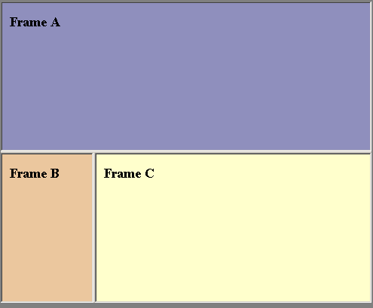
Web Browser Output

Slide 50
iframe
<html>
<body>
<iframe src="default.asp"></iframe>
<p>Some older browsers don't support iframes.</p>
<p>If they don't, the iframe will not be visible.</p>
</body>
</html>

Slide 51
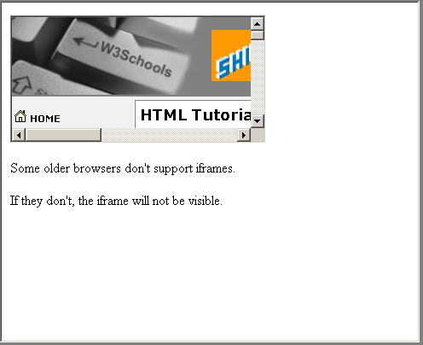
Web Browser Ouptut

Slide 52
Tables
Tables are defined with the <table> tag.
A table is divided into rows (with the <tr> tag), and each row is divided into data cells (with the <td> tag).
The letters td stands for "table data," which is the content of a data cell.
Headings in a table are defined with the <th> tag.
A data cell can contain text, images, lists, paragraphs, forms, horizontal rules, tables, etc.

Slide 53
<table border="1">
<tr>
<td>row 1, cell 1</td>
<td>row 1, cell 2</td>
</tr>
<tr>
<td>row 2, cell 1</td>
<td>row 2, cell 2</td>
</tr>
</table>
row 1, cell 1 | row 1, cell 2
row 2, cell 1 | row 2, cell 2

Slide 54
Table Cell padding
<html>
<body>
<h4>Without cellpadding:</h4>
<table border="1">
<tr>
<td>First</td>
<td>Row</td>
</tr>
<tr>
<td>Second</td>
<td>Row</td>
</tr>
</table>

Slide 55
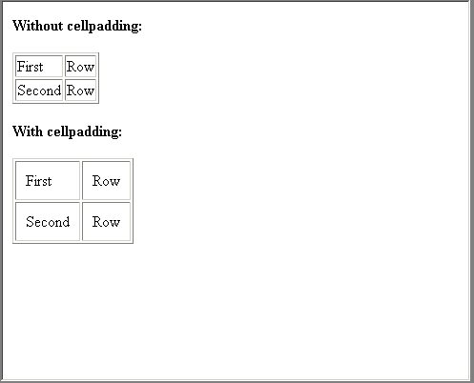
<h4>With cellpadding:</h4>
<table border="1" cellpadding="10">
<tr>
<td>First</td>
<td>Row</td>
</tr>
<tr>
<td>Second</td>
<td>Row</td>
</tr>
</table>
</body>
</html>

Slide 56
Table cells that span more than one row/column
rowspan
colspan
Align=“left” “right” “center”

Slide 57
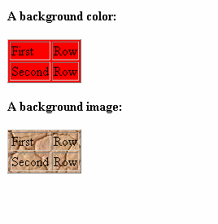
<html>
<body>
<h4>A background color:</h4>
<table border="1" bgcolor="red">
<tr> <td>First</td> <td>Row</td> </tr>
<tr> <td>Second</td> <td>Row</td> </tr>
</table>
<h4>A background image:</h4>
<table border="1" background="bgdesert.jpg">
<tr><td>First</td><td>Row</td></tr>
<tr><td>Second</td><td>Row</td></tr>
</table>
</body></html>

Slide 58
The Frame Attribute
Table can be set different Frame attributes with the following values.
border
box
void
above
below
hsides
vsides
lhs
rhs

Slide 59
Column Group
colgroup
col

Slide 60
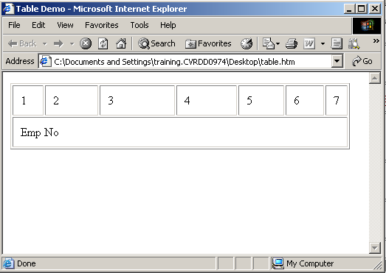
<html>
<head><title>Table Demo</title></head>
<body>
<table border=1 cellpadding=10>
<colgroup span="3">
<col width="20"></col><col width="50"></col>
<col width="80"></col><col width="60"></col>
<col width="40"></col><col width="30"></col>
</colgroup>
<tfoot>
<tr>
<td colspan=8 valign="middle">Emp No</td>
</tr>
</tfoot>
<thead>
<tr><td>1</td><td>2</td><td>3</td>
<td>4</td><td>5</td><td>6</td><td>7</td></tr>
</thead></table></body></html>

Slide 61
Table Tags
Tag | Description
<table> | Defines a table
<th> | Defines a table header
<tr> | Defines a table row
<td> | Defines a table cell
<caption> | Defines a table caption
<colgroup> | Defines groups of table columns
<col> | Defines the attribute values for one or more columns in a table
<thead> | Defines a table head
<tbody> | Defines a table body
<tfoot> | Defines a table footer

Slide 62
List Tags
Tag | Description
<ol> | Defines an ordered list
<ul> | Defines an unordered list
<li> | Defines a list item
<dl> | Defines a definition list
<dt> | Defines a definition term
<dd> | Defines a definition description
<dir> | Deprecated. Use <ul> instead
<menu> | Deprecated. Use <ul> instead

Slide 63
Unordered Lists
An unordered list is a list of items.
The list items are marked with bullets (typically small black circles).
An unordered list starts with the <ul> tag.
Each list item starts with the <li> tag.
  <ul>
  <li>Coffee</li>
  <li>Milk</li>
  </ul>
Here is how it looks in a browser:
Coffee
Milk

Slide 64
Ordered Lists
An ordered list is also a list of items.
The list items are marked with numbers.
An ordered list starts with the <ol> tag.
Each list item starts with the <li> tag.
<ol>
<li>Coffee</li>
<li>Milk</li>
</ol>
Here is how it looks in a browser:
Coffee
Milk

Slide 65
Definition Lists
A definition list is not a list of items.
This is a list of terms and explanation of the terms.
A definition list starts with the <dl> tag. Each definition-list term starts with the <dt> tag. Each definition-list definition starts with the <dd> tag.
<dl> <dt>Coffee</dt> <dd>Black hot drink</dd> <dt>Milk</dt>
<dd>White cold drink</dd> </dl>
  Here is how it looks in a browser:
  Coffee
    Black hot drink
  Milk
    White cold drink

Slide 66
Form Tags
Tag | Description
<form> | Defines a form for user input
<input> | Defines an input field
<textarea> | Defines a text-area (a multi-line text input control)
<label> | Defines a label to a control
<fieldset> | Defines a fieldset
<legend> | Defines a caption for a fieldset
<select> | Defines a selectable list (a drop-down box)
<optgroup> | Defines an option group
<option> | Defines an option in the drop-down box
<button> | Defines a push button
<isindex> | Deprecated. Use <input> instead

Slide 67
Forms
A form is an area that can contain form elements.
Form elements are elements that allow the user to enter information (like text fields, textarea fields, drop-down menus, radio buttons, checkboxes, etc.) in a form.
A form is defined with the <form> tag.
<form> <input> <input> </form>

Slide 68

Input
The most used form tag is the <input> tag. The type of input is specified with the type attribute. The most commonly used input types are explained below.
Text Fields
  Text fields are used when you want the user to type letters, numbers, etc. in a form.
  <form> First name:
  <input type="text" name="firstname">
  <br> Last name:
  <input type="text" name="lastname">
  </form>
First name:
Last name:

Slide 69

Radio Buttons
Radio Buttons are used when you want the user to select one of a limited number of choices.
    <form>
    <input type="radio" name="sex" value="male"> Male <br>
    <input type="radio" name="sex" value="female"> Female
    </form>
How it looks in a browser:
Male
Female

Slide 70

Checkboxes
Checkboxes are used when you want the user to select one or more options of a limited number of choices.
    <form>
    <input type="checkbox" name="bike">
    I have a bike <br>
    <input type="checkbox" name="car">
    I have a car
    </form>
How it looks in a browser:
I have a bike
I have a car

Slide 71


The Form's Action Attribute and the Submit Button
When the user clicks on the "Submit" button, the content of the form is sent to another file.
The form's action attribute defines the name of the file to send the content to.
The file defined in the action attribute usually does something with the received input.
  <form name="input" action="html_form_action.asp" method="get">
  Username:
  <input type="text" name="user"> <input type="submit" value="Submit">
  </form>
How it looks in a browser:
Username:

Slide 72
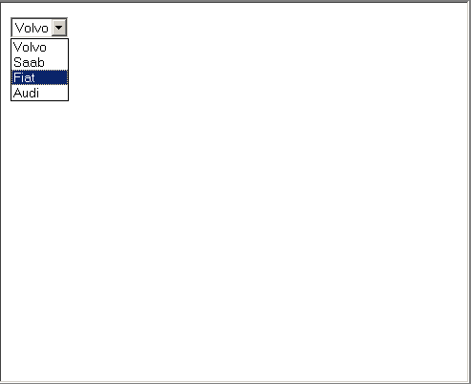
Select
<html>
<body>
<form>
<select name="cars">
<option value="volvo">Volvo
<option value="saab">Saab
<option value="fiat">Fiat
<option value="audi">Audi
</select>
</form>
</body>
</html>

Slide 73
Fieldset
<html>
<body>
<fieldset>
<legend>
Health information:
</legend>
<form>
Height <input type="text" size="3">
Weight <input type="text" size="3">
</form>
</fieldset>
<p>
If there is no border around the input form, your browser is too old.
</p>
</body>
</html>

Slide 74
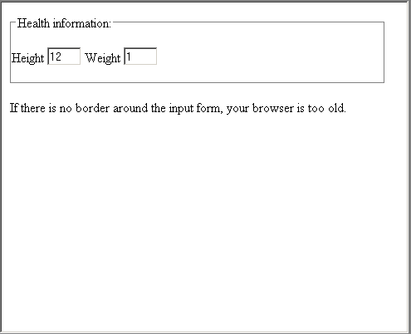

Slide 75
Email : mailto
<html>
<body>
<form action="MAILTO:someone@w3schools.com" method="post" enctype="text/plain">
<h3>This form sends an e-mail to W3Schools.</h3>
Name:<br>
<input type="text" name="name"
value="yourname" size="20">
<br>Mail:<br>
<input type="text" name="mail"
value="yourmail" size="20">
<br>Comment:<br>
<input type="text" name="comment"
value="yourcomment" size="40">
<br><br>
<input type="submit" value="Send">
<input type="reset" value="Reset">
</form>
</body>
</html>

Slide 76
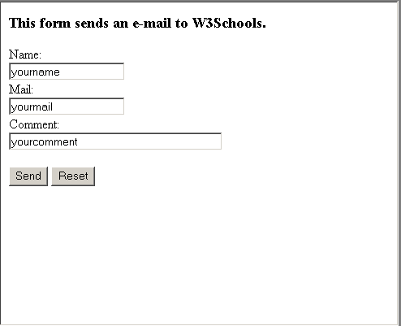

Slide 77
With HTML you can display images in a document.
Image Tags
Tag | Description
<img> | Defines an image
<map> | Defines an image map
<area> | Defines an area inside an image map

Slide 78
The Image Tag and the Src Attribute
In HTML, images are defined with the <img> tag.
The <img> tag is empty, which means that it contains attributes only and it has no closing tag.
To display an image on a page, you need to use the src attribute. Src stands for "source". The value of the src attribute is the URL of the image you want to display on your page.
<img src="url">

Slide 79
The Alt Attribute
The alt attribute is used to define an "alternate text" for an image. The value of the alt attribute is an author-defined text:
<img src="boat.gif" alt="Big Boat">
The "alt" attribute tells the reader what he or she is missing on a page if the browser can't load images.

Slide 80
Image Tag
  <html>
  <body>
  <p>
  An image from another folder:
  <img src="/images/netscape.gif"
  width="33" height="32">
  </p>
  <p>
  An image from W3Schools:
  <img src="http://www.w3schools.com/images/ie.gif" width="73" height="68">
  </p>
  </body>
  </html>

Slide 81


Slide 82
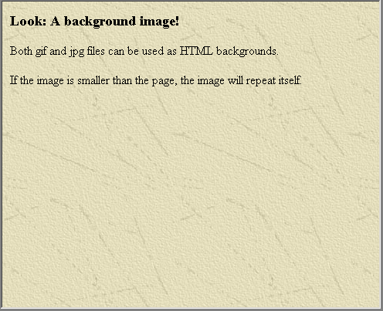
Background Image
      <html>
      <body background="background.jpg">
      <h3>Look: A background image!</h3>
      <p>Both gif and jpg files can be used as HTML backgrounds.</p>
      <p>If the image is smaller than the page, the image will repeat itself.</p>
      </body>
      </html>

Slide 83
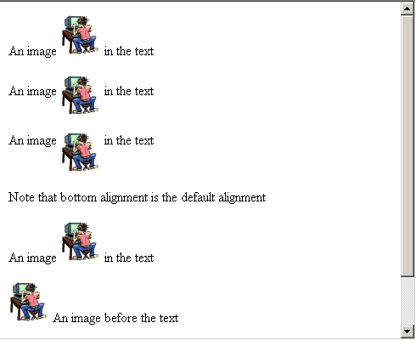
Aligning Images
  <html>
  <body>
  <p>
  An image
  <img src="hackanm.gif"
  align="bottom" width="48" height="48">
  in the text
  </p>
  <p>
  An image
  <img src ="hackanm.gif"
  align="middle" width="48" height="48">
  in the text
  </p>
  <p>
  An image
  <img src ="hackanm.gif"
  align="top" width="48" height="48">
  in the text
  </p>
  <p>Note that bottom alignment is the default alignment</p>
  </body>
  </html>
Properties : bottom, top, middle, left, right

Slide 84
Image map
<html>
<body>
<p>
Click on one of the planets to watch it closer:
</p>
<img src="planets.gif" width="145" height="126" usemap="#planetmap">
<map id="planetmap" name="planetmap">
<area shape="rect" coords="0,0,82,126" alt="Sun“ href="sun.htm">
<area shape="circle" coords="90,58,3" alt="Mercury“ href="mercur.htm">
<area shape="circle" coords="124,58,8" alt="Venus“ href="venus.htm">
</map>
<p>
<b>Note:</b> We use both an <b>id</b> and a <b>name</b> attribute in the map tag
because some versions of Netscape don't understand the id attribute.</p>
</body>
</html>

Slide 85
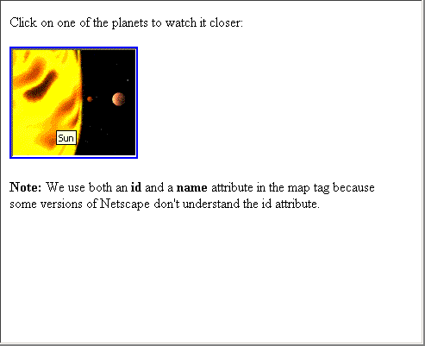

Slide 86
The HTML <font> Tag
Font Attributes
Attribute | Example | Purpose
size="number" | size="2" | Defines the font size
size="+number" | size="+1" | Increases the font size
size="-number" | size="-1" | Decreases the font size
face="face-name" | face="Times" | Defines the font-name
color="color-value" | color="#eeff00" | Defines the font color
color="color-name" | color="red" | Defines the font color
The World Wide Web Consortium (W3C) has removed the <font> tag from its recommendations. In future versions of HTML, style sheets (CSS) will be used to define the layout and display properties of HTML elements.

Slide 87
<html>
<body>
<font face=“verdana” size=80% color=“green">
This is a paragraph with some text in it. This is a paragraph with some text in it. This is a paragraph with some text in it. This is a paragraph with some text in it.
</font>
</body>
</html>

Slide 88
HTML 3.2 Was Very Wrong !
The original HTML was never intended to contain tags for formatting a document. HTML tags were intended to define the content of the document like:
  <p>This is a paragraph</p>
  <ul>This is an unordered list</ul>.
When tags like <font> and color attributes were added to the HTML 3.2 specification, it started a developers' nightmare. Development of large web sites where fonts and color information had to be added to every single Web page, became a long, expensive and unduly painful process.

Slide 89
About HTML 4.0 ?
With HTML 4.0 all formatting can be moved out of the HTML document and into a separate style sheet.
Because HTML 4.0 separates the presentation of the document from its structure, we have got what we always needed: Total control of presentation layout without messing up the document content.

Slide 90
Prepare Yourself for XHTML
XHTML is the next generation of HTML. You should start preparing for it now. The most important thing you can do is to start writing valid HTML 4.01. Also start writing your tags in lower case. Always close your tag elements. Never end a paragraph without </p>.

