Slide 1
Query Processing & Optimization
John Ortiz

Slide 2
Terms
DBMS has algorithms to implement relational algebra expressions
SQL is a different kind of high level language; specify what is wanted, not how it is obtained
Optimization – not necessarily “optimal”, but reasonably efficient
Techniques:
  Heuristic rules
  Cost estimation

Slide 3
Query Evaluation Process
Internal representation
Query
Scanner
Parser
Execution
Strategies
DBMS
Answer
Data
Optimizer
Runtime Database Processor
Code Generator
Execution
plan

Slide 4
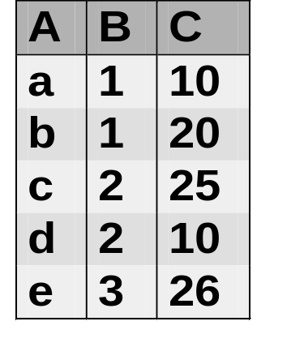
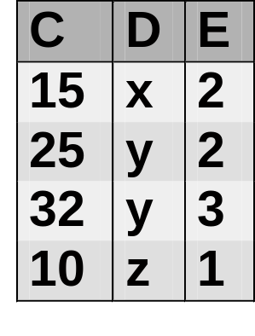
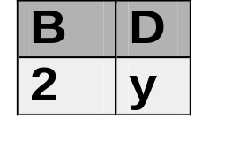
An Example
Query:
  Select B,D
  From R,S
  Where R.A = “c” and S.E = 2 and R.C=S.C
R
S
Answer

Slide 5
An Example (cont.)
Plan 1
  Cross product of R & S
  Select tuples using WHERE conditions
  Project on B & D
Algebra expression
π_{B,D}
σ_{R.A=‘c’∧ S.E=2 ∧R.C=S.C}
π_{B,D}(σ_{R.A=‘c’∧ S.E=2 ∧R.C=S.C} (R ×S))
×
R
S

Slide 6
An Example (cont.)
Plan 2
  Select R tuples with R.A=“c”
  Select S tuples with S.E=2
  Natural join
  Project B & D
Algebra expression
π_{B,D}
π_{B,D}(σ _{R.A=“c”} (R) σ_{S.E=2} (S))
σ_{R.A=‘c’}
σ_{S.E=2}
R
S

Slide 7
Query Evaluation
How to evaluate individual relational operation?
  Selection: find a subset of rows in a table
  Join: connecting tuples from two tables
  Other operations: union, projection, …
How to estimate cost of individual operation?
How does available buffer affect the cost?
How to evaluate a relational algebraic expression?

Slide 8
Cost of Operations
Cost = I/O cost + CPU cost
  I/O cost: # pages (reads & writes) or # operations (multiple pages)
  CPU cost: # comparisons or # tuples processed
  I/O cost dominates (for large databases)
Cost depends on
  Types of query conditions
  Availability of fast access paths
DBMSs keep statistics for cost estimation

Slide 9
Notations
Used to describe the cost of operations.
Relations: R, S
n_{R}: # tuples in R, n_{S}: # tuples in S
b_{R}: # pages in R
dist(R.A) : # distinct values in R.A
min(R.A) : smallest value in R.A
max(R.A) : largest value in R.A
HI: # index pages accessed (B+ tree height?)

Slide 10
Simple Selection
Simple selection: σ_{A op a}(R)
A is a single attribute, a is a constant, op is one of =, ≠, <, ≤, >, ≥.
  Do not further discuss ≠ because it requires a sequential scan of table.
How many tuples will be selected?
  Selectivity Factor (SF_{A op a}(R)) : Fraction of tuples of R satisfying “A op a”
  0 ≤ SF_{A op a}(R) ≤ 1
# tuples selected: NS = n_{R} × SFA op a(R)

Slide 11
Options of Simple Selection
Sequential (linear) Scan
  General condition: cost = b_{R}
  Equality on key: average cost = b_{R} / 2
Binary Search
  Records are stored in sorted order
  Equality on key: cost = ⎡log₂(b_{R})⎤
  Equality on non-key (duplicates allowed)
  cost = ⎡log₂(b_{R})⎤ + ⎡NS/bf_{R}⎤ - 1
    = sorted search time + selected – first one

Slide 12
Selection Using Indexes
Use index
  Search index to find pointers (or RecID)
  Follow pointers to retrieve records
  Cost = cost of searching index +
  cost of retrieving data
Equality on primary index: Cost = HI + 1
Equality on clustering index:
  Cost = HI + ⎡NS/bf_{R}⎤
Equality on secondary index: Cost = HI + NS
Range conditions are more complex

Slide 13
Example: Cost of Selection
Relation: R(A, B, C)
n_{R} = 10000 tuples
bf_{R} = 20 tuples/page
dist(A) = 50, dist(B) = 500
B+ tree clustering index on A with order 25 (p=25)
B+ tree secondary index on B w/ order 25
Query:
  select * from R where A = a1 and B = b1
Relational Algebra: σ_{A=a1 ∧ B=b1} (R)

Slide 14
Example: Cost of Selection (cont.)
Option 1: Sequential Scan
  Have to go thru the entire relation
  Cost = b_{R} = ⎡10000/20⎤ = 500
Option 2: Binary Search using A = a
  It is sorted on A (why?)
  NS = 10000/50 = 200
    assuming equal distribution
  Cost = ⎡log₂(b_{R})⎤ + ⎡NS/bf_{R}⎤ - 1
  = ⎡log₂(500)⎤ + ⎡200/20⎤ - 1 = 18

Slide 15
Example: Cost of Selection (cont.)
Option 3: Use index on R.A:
  Average order of B+ tree = (P + .5P)/2 = 19
  Leaf nodes have 18 entries, internal nodes have 19 pointers
  # leaf nodes = ⎡50/18⎤ = 3
  # nodes next level = 1
  HI = 2
  Cost = HI + ⎡NS/bf_{R}⎤ = 2 + ⎡200/20⎤ = 12

Slide 16
Example: Cost of Selection (cont.)
Option 4: Use index on R.B
  Average order = 19
  NS = 10000/500 = 20
  Use Option I (allow duplicate keys)
  # nodes 1st level = ⎡10000/18⎤ = 556 (leaf)
  # nodes 2nd level = ⎡556/19⎤ = 29 (internal)
  # nodes 3rd level = ⎡29/19⎤ = 2 (internal)
  # nodes 4th level = 1
  HI = 4
  Cost = HI + NS = 24

Slide 17
Summary: Selection
Many different implementations.
Sequential scan works always
Binary search needs a sorted file
Index is effective for highly selective condition
Primary or clustering indexes often give good performance
For general selection, working on RecID lists before retrieving data records gives better performance.

Slide 18
Join
Consider only equijoin R _{R.A = S.B} S.
Options:
  Cross product followed by selection
  R _{R.A = S.B} S and S _{S.B} _{= R.A} R
  Nested loop join
  Block-based nested loop join
  Indexed nested loop join
  Merge join
  Hash join

Slide 19
Cost of Join
Cost = # I/O reading R & S +
  # I/O writing result
Additional notation:
  M: # buffer pages available to join operation
  LB: # leaf blocks in B+ tree index
Limitation of cost estimation
  Ignoring CPU costs
  Ignoring timing
  Ignoring double buffering requirements

Slide 20
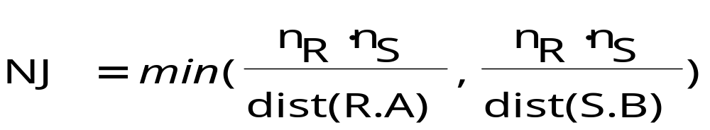
Estimate Size of Join Result
How many tuples in join result?
  Cross product (special case of join)
    NJ = n_{R} × n_{S}
  R.A is a foreign key referencing S.B
    NJ = n_{R} (assume no null value)
  S.B is a foreign key referencing R.A
    NJ = n_{S} (assume no null value)
  Both R.A & S.B are non-key

Slide 21
Estimate Size of Join Result (cont.)
How wide is a tuple in join result?
  Natural join: W = W(R) + W(S) – W(S∩R)
  Theta join: W = W(R) + W(S)
What is blocking factor of join result?
  bf_{Join} = ⎣block size / W⎦
How many blocks does join result have?
  b_{Join} = ⎡NJ / bf_{Join}⎤

Slide 22
Block-based Nested Loop Join
for each block PR of R
for each block PS of S
for each tuple r in PR
for each tuple s in PS
if r[A] == s[B] then
add (r, s) to join result

Slide 23
Cost of Nested Loop Join
R
M_{R}
S
Cost of Writing
Buffer
M=M_{R}+M_{S}+1
M_{S}
Result
# I/O pages: Cost = b_{R} + (b_{R}/M_{R}) × b_{S} + b_{Join}
# I/O ops = b_{R}/M_{R}+(b_{R}/M_{R})×(b_{S}/M_{S}) + b_{Join}

Slide 24
Cost of Nested Loop Join (cont.)
Assume b_{R} = 100000 pg, b_{S} = 1000 pg
For simplicity, ignore cost of writing result
R as outer relation
  Cost = 100000 + 100000*1000 = 100100000
What if S as outer relation?
  Cost = 1000 + 1000*100000 = 100001000
  Smaller relation should be the outer relation
Rocking scan (back & forth) inner relation
  Cost = 1000 + 1000*(100000-1) + 1
  = 100000001
  Does not matter which is outer relation

Slide 25
Query Optimization
SQL Query
Answer
parser
Plan execution
Parse tree
Pi
preprocessor
Choose plan
Logic plan
{(P1,C1), (P2, C2), … }
Alg. trans.
Est. cost
Better LP
{P1, P2, … Pn}
Est. result size
Phy. plan gen.
LP + size

Slide 26
Example: SQL query
fk
Students(SID, Name, GPA, Age, Advisor)
  Professors(PID, Name, Dept)
select Name
  from Students
  where Advisor in (
  select PID
  from Professors
  where Dept = “Computer Science”);

Slide 27
Example: Parse Tree
<Query>
<SFW>
select <SelList> from <FromList> where <Condition>
<Attribute> <RelName> <Tuple> in <Query>
Name Students <Attribute> ( <Query> )
Advisor <SFW>
select <SelList> from <FromList> where <Condition>
<Attribute> <RelName> <Attribute> = <Pattern>
PID Professors Dept “Computer Science”

Slide 28
Example: Generating Rel. Algebra
Use a two-argument selection to handle subquery
π_{Name}
σ
Students <condition>
<tuple> in π_{PID}
<attribute> σ_{Dept=“Computer Science”}
Advisor Professors

Slide 29
Example: A Logical Plan
π_{Name}
Replace IN with cross product followed by selection
σ_{Advisor=PID}
×
Students
π_{PID}
σ_{Dept=“Computer Science”}
Professors

Slide 30
Example: Improve Logical Plan
π_{Name}
Transfer cross product followed by selection into a join
_{Advisor=PID}
Students
π_{PID}
σ_{Dept=“Computer Science”}
Professors

Slide 31
Example: Estimate Result Size
π_{Name}
Need to estimate size here
_{Advisor=PID}
Students
π_{PID}
σ_{Dept=“Computer Science”}
Professors

Slide 32
Example: A Physical plan
Parameters:
Join order, buffer size
Project attributes, …
Hash join
SEQ scan
index scan
Parameters:
Select Condition,...
Students Professors
Also specify pipelining, one or two pass algorithm, which index to use, …

Slide 33
Summary: Query Optimization
Important task of DBMSs
Goal is to minimize # I/O blocks
Search space of execution plans is huge
Heuristics based on algebraic transformation lead to good logical plan, but no guarantee of optimal plan
Space of physical plans is reduced by considering left-deep plans, and search methods that use estimated cost to prune plans
Need better statistics, estimation methods, …

