Slide 1

GoldLens
Four contracts, one honest line
HACK IN HILLS, POWERED BY TINYFISH · PS 03
Honest intelligence for MCX gold futures
Four gold contracts on one scale, alerts only when a trade pays after real costs, and a lie detector for trading tips.
973
178
61
trading days of real MCX data
contracts tracked and rolled
automated tests passing
₹ per 10 g of 999 gold · Oct 2025 to Oct 2026
Team TechFast · Revant Raj
Notes:
Hack in Hills, powered by TinyFish. We're Team TechFast, and this is GoldLens: honest intelligence for MCX gold futures.
In one line: we put all four MCX gold contracts on one scale, we only raise an alert when a trade would still pay after real Indian trading costs, and we built a lie detector for trading tips.
Everything you'll see runs on 973 trading days of real MCX settlement data, 178 contracts, with 61 automated tests.

Slide 2



Same gold, four prices, and false confidence
THE PROBLEM
GOLDM
GOLDTEN
Prices can't be compared
100 g lot · per 10 g · 995
10 g lot · per 10 g · 999
Different lots, quote units, purity and expiry
₹146,425 05 NOV 26
₹146,819 30 OCT 26
Backtests overstate profit
Look-ahead and missing costs fake an edge
GOLDGUINEA
GOLDPETAL
8 g lot · per 8 g · 916
1 g lot · per 1 g · 999
Tips promise the impossible
₹118,009 30 OCT 26
₹14,755 30 OCT 26
"40% a year, guaranteed" floods Telegram
Same metal, prices 10× apart. Which one is actually cheap?
93%
WHY IT MATTERS
of individual F&O traders lost money, FY22–FY24 (SEBI study, 2024)
Notes:
MCX sells the same gold four ways. GOLDM, GOLDTEN, GOLDGUINEA and GOLDPETAL have different lot sizes, quote units, purity and expiry dates. GOLDPETAL quotes about fourteen thousand rupees and GOLDM about one lakh forty-six thousand, for the same metal. Nobody can tell at a glance which one is cheap.
Two things make it worse. Most backtests quietly cheat with look-ahead and no costs, and Telegram is full of tips promising forty percent a year, guaranteed.
Why it matters: SEBI's 2024 study found 93 percent of individual F&O traders lost money over three years. Retail traders need honest tools, not more hype.

Slide 3



GoldLens puts every contract on one honest scale
OUR SOLUTION
WHAT MAKES IT DIFFERENT
One scale
All four contracts in ₹ / 10 g of 999
Cost-aware alerts
Fires only if it pays after real costs
Honest by design
Every backtest flaw removed, step by step
Tip lie detector
Busts "guaranteed" tips in seconds
px10 = price · 10/g · 999/purity
Notes:
GoldLens converts every contract to rupees per ten grams of 999 gold: price times ten over its quote grams, times 999 over its purity. On this chart the four lines that looked unrelated collapse onto one.
What makes it different: one scale for all four contracts; alerts that fire only when a trade would pay after real Indian costs; a backtest that's honest by design; and a lie detector for trading tips.

Slide 4





From raw MCX files to one honest decision
HOW THE PROTOTYPE WORKS
1 Ingest
2 Normalise
3 Model
4 Gate
5 Deliver
Daily MCX files, validated
₹ per 10 g of 999 gold
Carry curve + past-only z-scores
Unusual, liquid, pays after costs
Web, AI analyst, Telegram
LIVE EXAMPLE · TODAY'S BEST CANDIDATE, GOLDM / GOLDPETAL (16 OCT 2026)
Unusual gap?
Liquid legs?
Pays after costs?
No alert today
Quiet by design: one gate failed, so no trade.
z = −1.88, needs ±2
37k and 162k lots traded
Edge ₹9,885 vs cost ₹1,985
Notes:
Here's the prototype's workflow. We pull MCX's public Bhavcopy every day and validate it. We normalise every contract, fit the futures curve for carry and premium, and score each pair's gap with z-scores built only from past data.
The gate needs three yeses: an unusual gap, liquid legs, and an expected reversion worth at least one and a half times the round-trip cost. Today's best candidate, GOLDM against GOLDPETAL, is liquid and would pay, but at z minus 1.88 it isn't unusual enough. So GoldLens stays quiet. Most days the honest answer is "do nothing".

Slide 5
One Python core powers web, AI and Telegram
ARCHITECTURE AND TECHNOLOGY
DATA
INGEST
ANALYTICS CORE
DELIVERY
MCX Bhavcopy
Public daily settlements since 2023
Fetch & validate
Browser-grade fetch
Date & holiday checks
Parquet cache, resumable
Normalise
Website
FastAPI · htmx · Plotly
Curve & carry
Signals + cost gate
Telegram bot
Morning brief + alerts
Upstox API
Live quotes, ready for the finale
Walk-forward backtest
Tip Checker
Landing page
GSAP animations
AI analyst
Claude → Grok → OpenRouter
61 tests
incl. no-look-ahead proof
Notes:
The architecture is one Python core. Data comes from MCX's public Bhavcopy, with the Upstox live feed already coded for the finale. The ingest layer fetches each day, checks dates and holidays and caches everything as parquet, so the app runs offline.
The analytics core has five modules: normalisation, the carry curve, signals with the cost gate, the walk-forward backtester and the Tip Checker. The AI analyst reads only the core's fact sheet and falls back from Claude to Grok to free OpenRouter models.
The same core feeds the FastAPI website, the Telegram bot and the landing page. 61 automated tests run against it, including one that proves there's no look-ahead.

Slide 6



Most backtests lie. Ours removes each lie
PROOF ON REAL DATA
PAPER PROFIT
₹25.75 lakh
Stitched prices, look-ahead, no costs
HONEST RESULT
−₹3,493
181 trades · ₹2.57 lakh in real costs
Hidden gold bet: 186 g → 13 g of gold exposure
Real edge found: GOLDTEN/GUINEA +₹1.39 lakh, 74% wins
Notes:
This is our proof, on real data. Most backtests lie, so ours removes each lie one step at a time, on the same six pairs and 973 days.
The typical backtest shows twenty-five point seven five lakh rupees of profit. Mark P&L on the real contracts with rolls and carry and it falls to two and a half lakh. Add brokerage, exchange fees, CTT, stamp duty, GST and slippage, and it becomes a loss of three thousand four hundred rupees over 181 trades.
The naive version was also secretly a 186-gram bet on gold; the honest version carries 13 grams. And the honest test still finds where a real edge exists: GOLDTEN against GOLDGUINEA made 1.39 lakh with a 74 percent win rate.

Slide 7
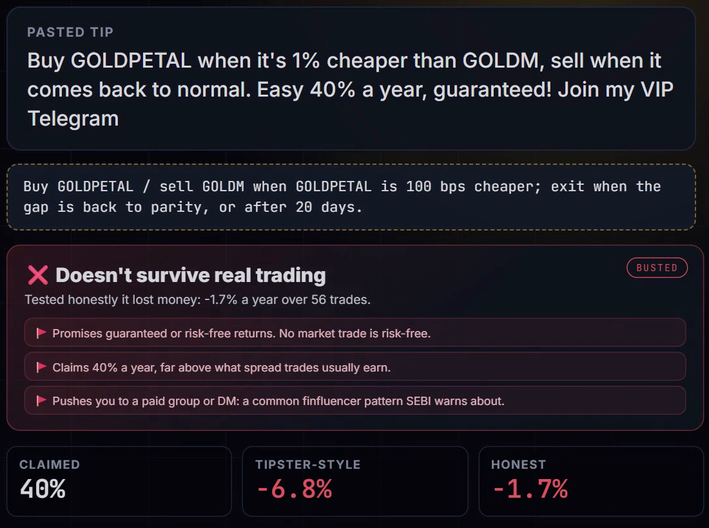
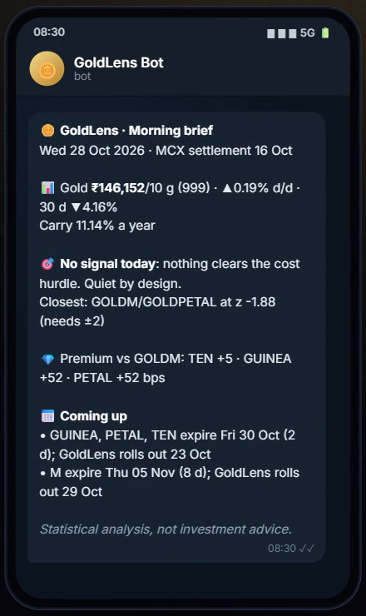

Working today, end to end, on real MCX data
FEATURES AND PROGRESS
PROGRESS
8 / 9 shipped
Data pipeline
973 days
One-scale normalisation
4 contracts
Scanner + cost gate
6 pairs
Honest backtest
7-step ladder
Tip Checker
incl. Hinglish
AI analyst
3 providers
Telegram brief
daily
Tip Checker "40% guaranteed" → honest −1.7%
Morning brief English · हिंदी
Website
10 pages
GoldLens. Honest intelligence for gold traders.
Upstox live quotes
coded, for finale
Notes:
Everything here is working today, end to end, on real MCX data.
The Tip Checker turns any tip, even in Hinglish, into a precise rule and replays it through the same honest test. This real tip promised forty percent a year, guaranteed; tested honestly it lost 1.7 percent a year, and GoldLens flags the guaranteed-returns and paid-group patterns SEBI warns about.
Every morning, one Telegram message brings the gold price, carry, signals, premiums and expiries, in English or Hindi.
Eight of nine pieces are shipped: the data pipeline, normalisation, scanner, honest backtest, Tip Checker, AI analyst, Telegram brief and the website. Live Upstox quotes are coded and ready for the grand finale.
GoldLens: honest intelligence for gold traders. Thank you.

