Slide 1
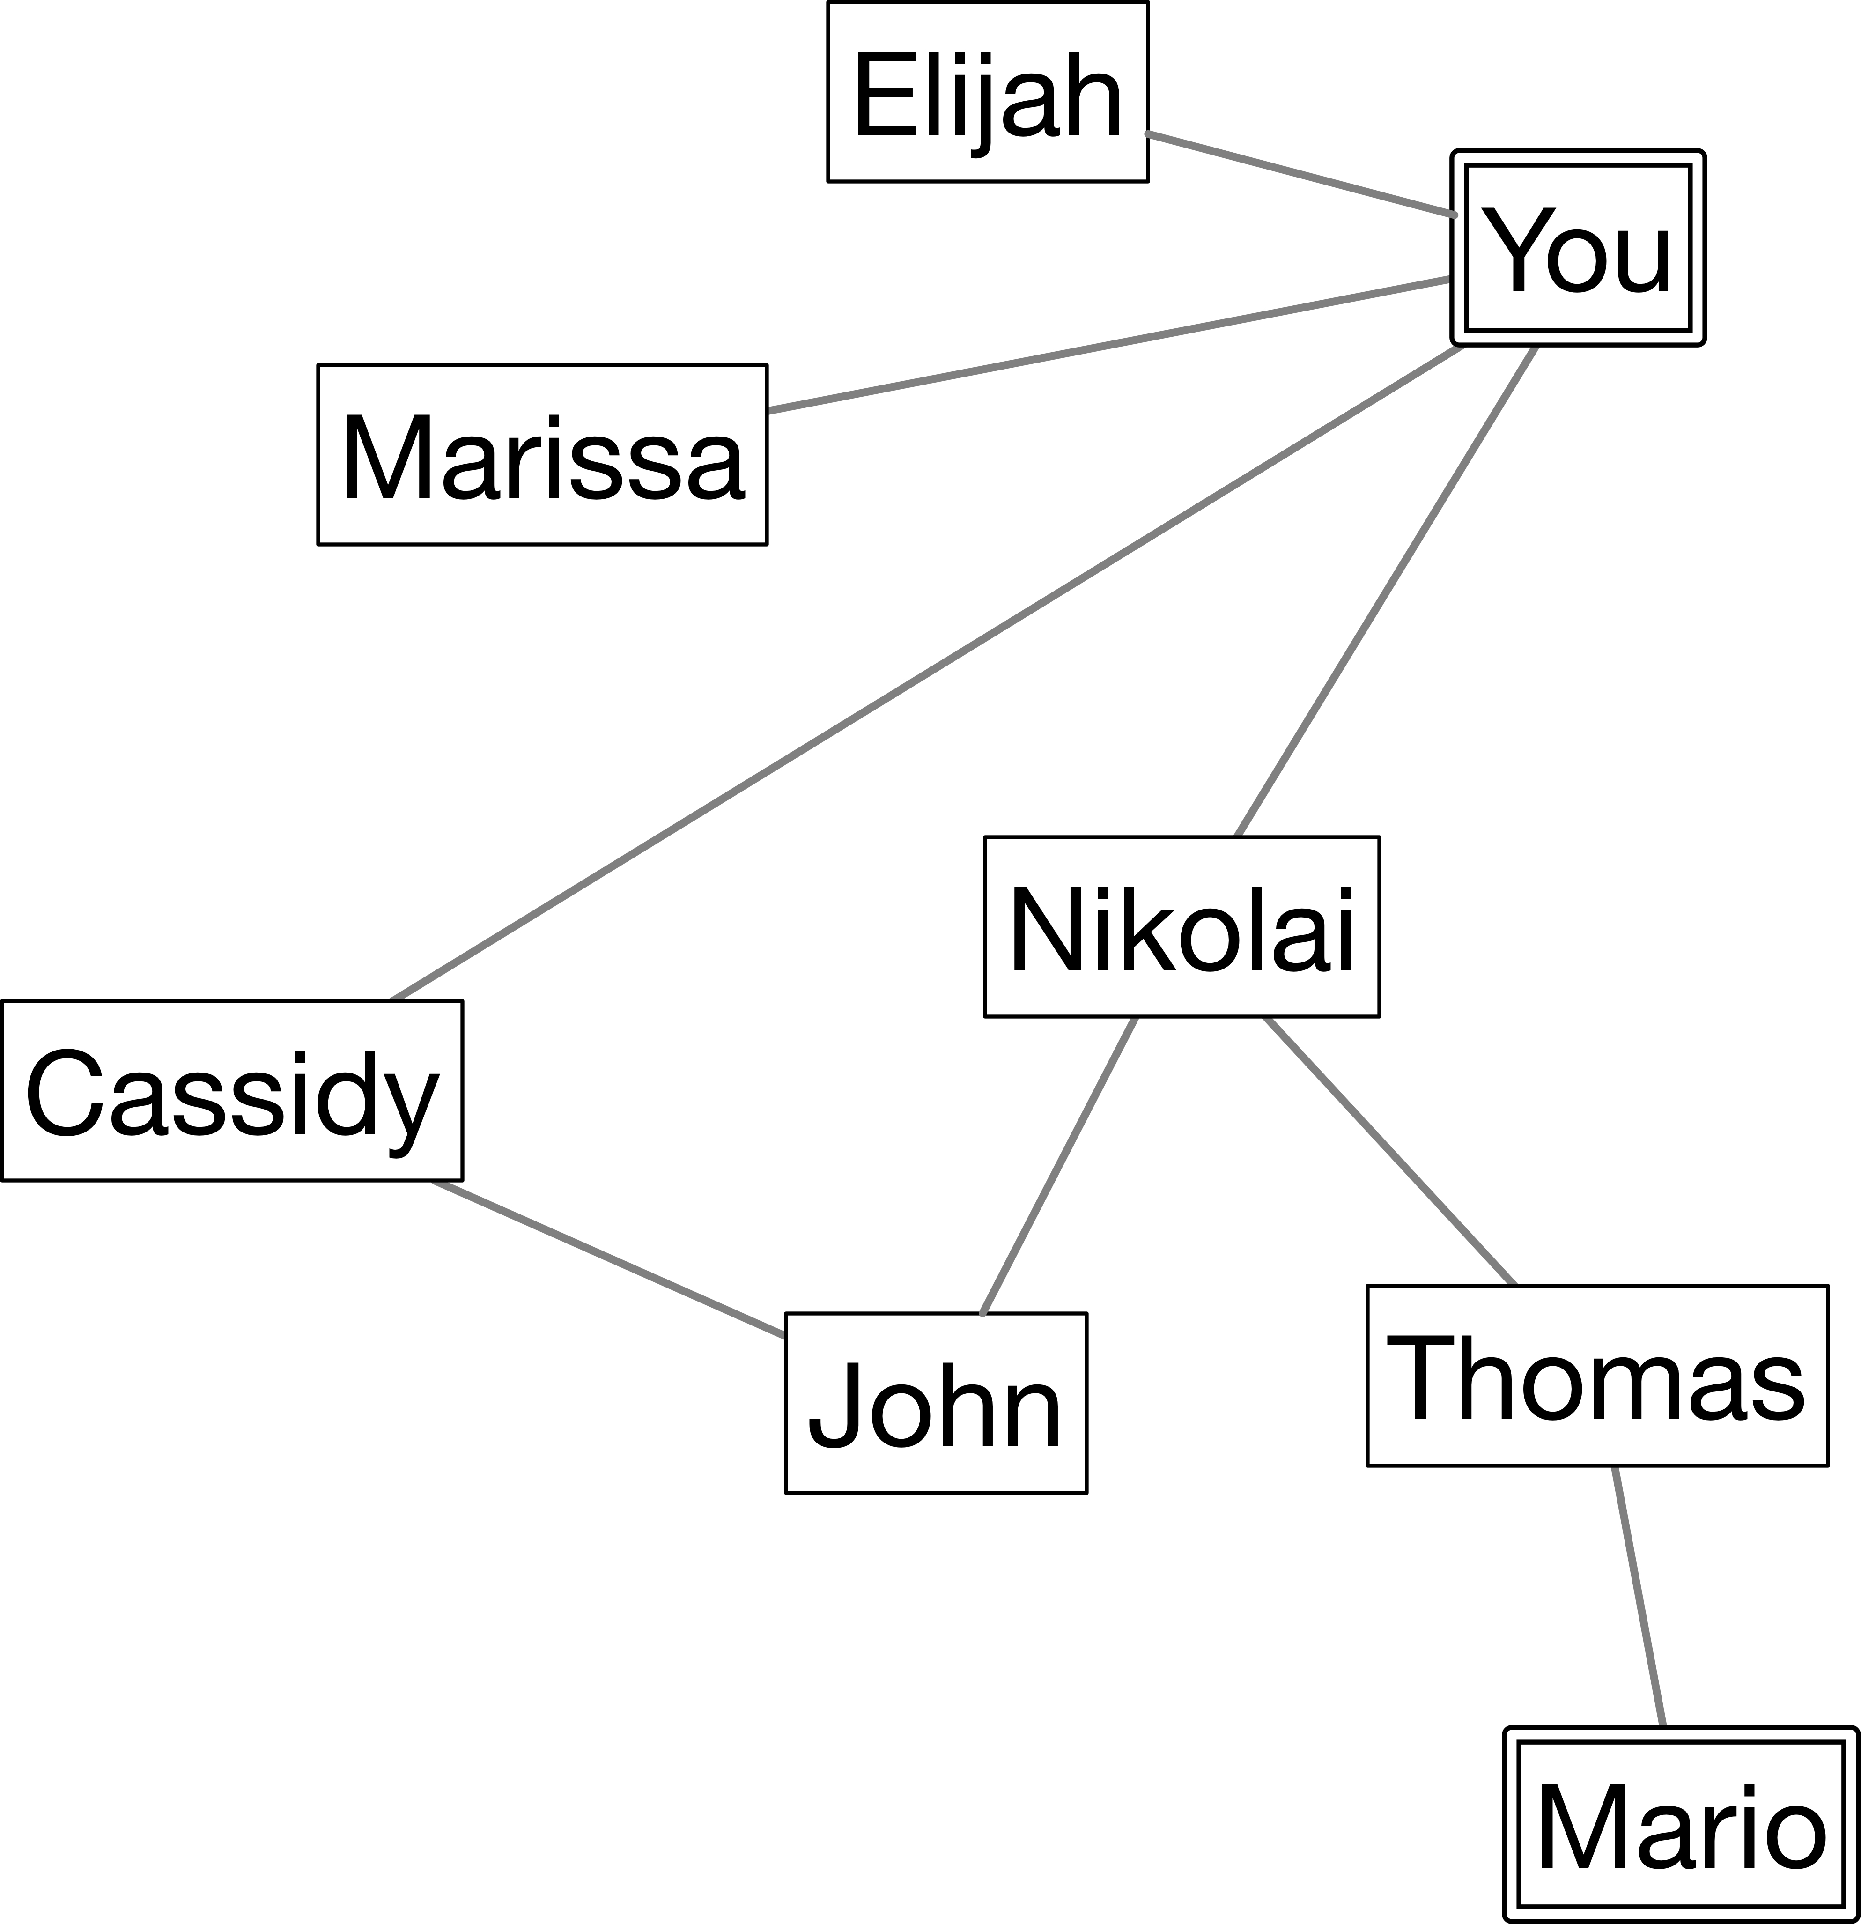
1st degree
(neighbors of “You”)
2nd degree
3rd degree

