Slide 1
CitedTCR
Thomas Cyriac – RA1711003010143
Ammar Bin Adil – RA1711003010259
Guide: Mr S.Iniyan
BlockChain & Solidity

Slide 2
Abstract
According to Mike Goldin’s white paper, the output of a token curated registry is a list. The main objective this cryptosystem wishes to accomplish is to curate and manage a high quality list.
A TCR works by allowing candidates to submit applications for some fee (stake) and the token holders are allowed to vote on whether the candidate should be accepted or not. Depending on the way the vote goes the participants will receive reward tokens.

Slide 3
Abstract
A CitedTCR is simply an expansion of the token curated registry concept.
In a normal TCR the curators are assigned randomly. This could lead to a negative impact on the quality of the curated list and eventually lower the value of the tokens.
A CitedTCR uses a citation graph in addition to a Personalized Page Rank algorithm to assign the most relevant curators to challenge the application.

Slide 4
Literature Survey
In this paper we attempt to leverage a citation graph for curator assignment and use a peer-prediction mechanism to compute the number of reward tokens paid to the curators. We have incorporated a lot of papers and past study related to Token-curated Registry. The papers we used can be found in the references slide.
The system we build will be focused around curating a list of high-quality research papers from different domains. To ensure that token holders from different domains don’t influence each other. Tokens are domain specific and cannot be exchanged.

Slide 5
Literature Survey
Tokens will also have an expiry date. This gives an incentive to token curators to be up to date with their knowledge. Each curator will have a PPR (Personalized Page Rank). They will be given preference to vote based on their PPR.
The PPR algorithm is an extension of the PageRank algorithm proposed by Gori and Pucci. It computes a score of importance for each node from the viewpoint of the entire network structure.
Peer-prediction mechanism is an application of the proper scoring rule and game theory. It is used for reward computation and assumes an environment in which each user reports probabilistic but correlated signals based on the assigned tasks.

Slide 6
Introduction
The working algorithm can be showed through this example:
Suppose there is a token-curated registry centered around the best restaurants in Chennai. If there is a restaurant that wishes to be a part of that list (candidate) then they must pay an initial deposit and enter the challenge period.
During the challenge period, token holders or people with stake in the system will analyze the restaurant and vote on whether it should be added to the list or not. If the votes reach a certain threshold the candidate will be rejected and the initial deposit will be divided up between the token holders that voted against the restaurant. Keep in mind challenges also require the token holder to put in an initial deposit. This will be divvied up with the opposition token holders in case the candidate is accepted.

Slide 7
Problem Statement
Humans have a penchant for list-making and we use lists in our everyday lives. Eg: shopping lists, list of good colleges etc.
These lists are often curated by an individual or a committee. But how does one ensure that the curated list is of high-quality? How does one maintain that list so it does not get outdated?
As long as there are parties that would desire to be curated into a given list and parties that desire a high-quality list to refer to, a market can exist in which the incentives of self-interested token holders are aligned towards curating a list of high quality content. TCRs have intrinsic economic incentives for token holders to curate the list’s contents judiciously.

Slide 8
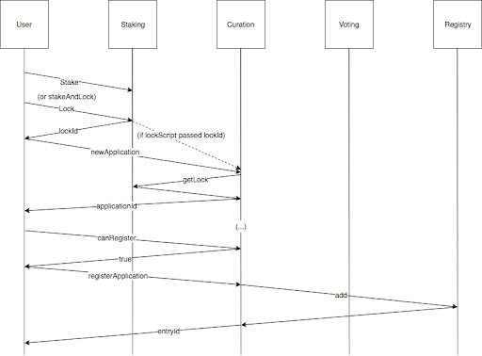
Application Flow Diagram

Slide 9
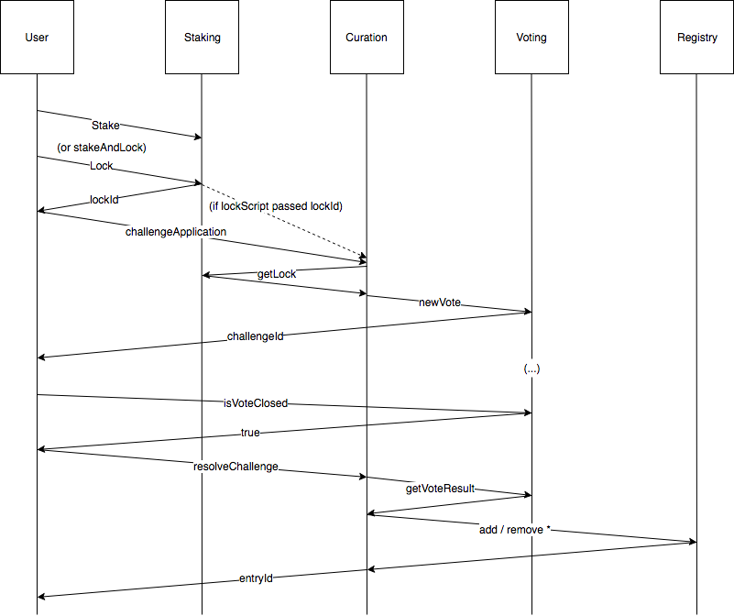
Challenge Flow Diagram

Slide 10
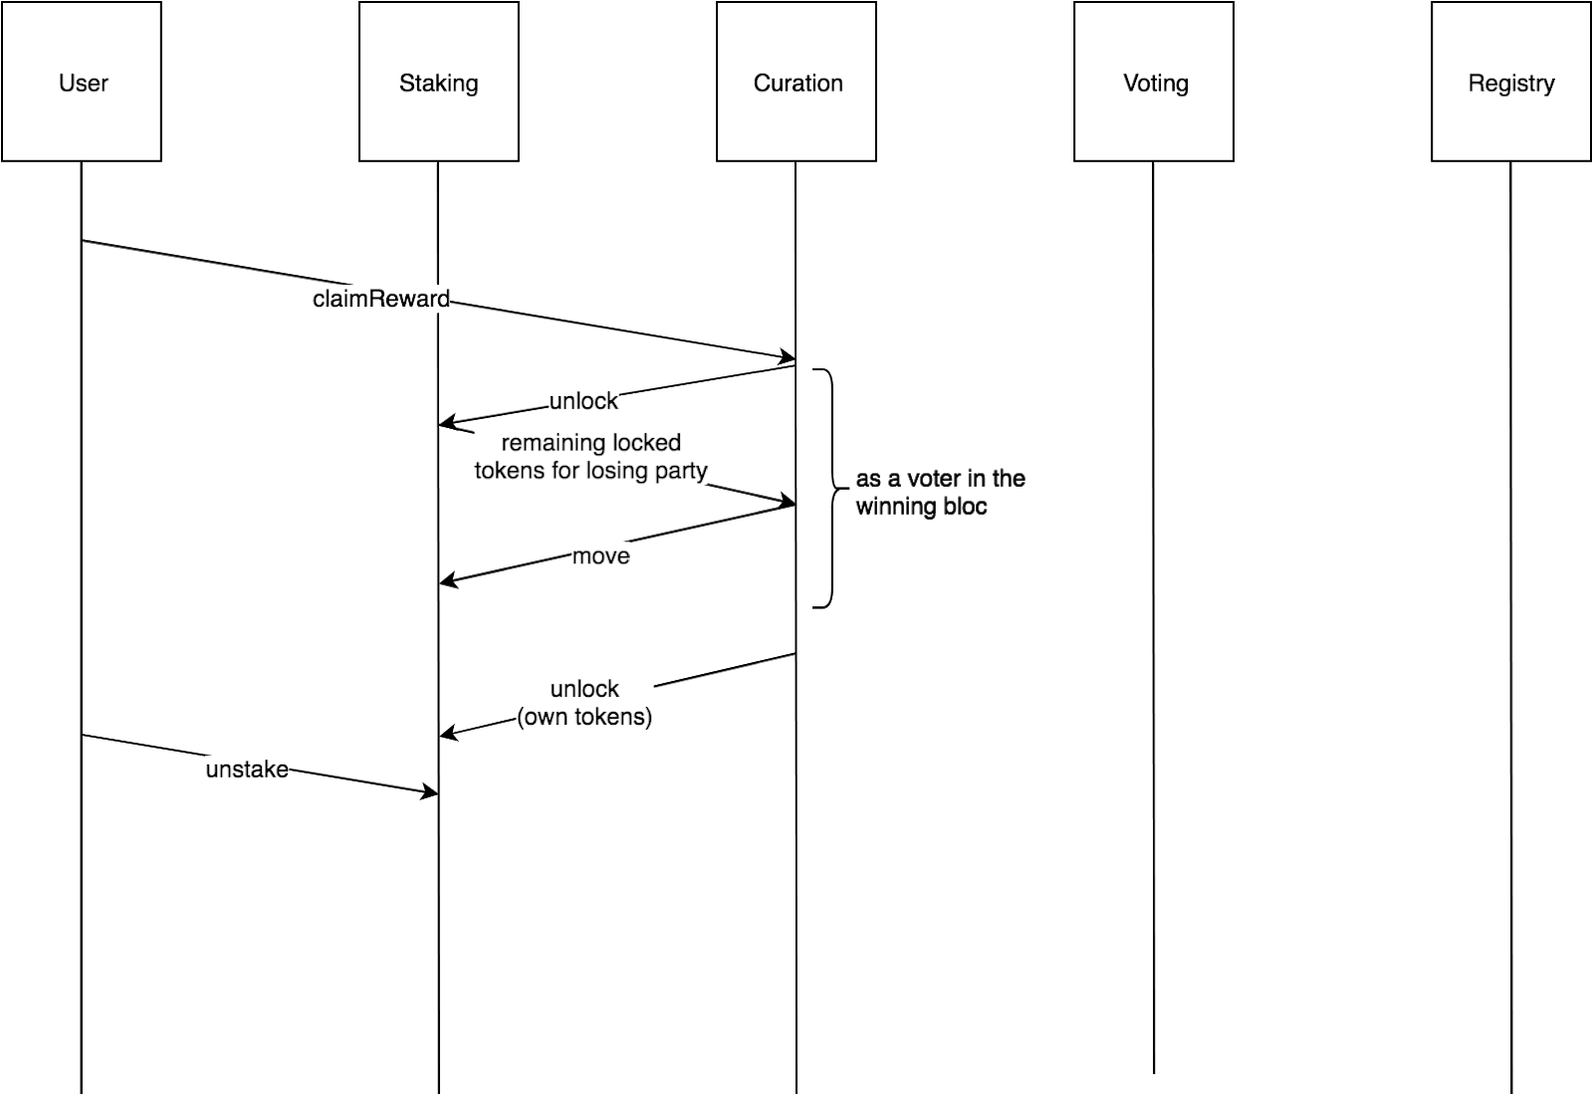
Reward Flow Diagram

Slide 11
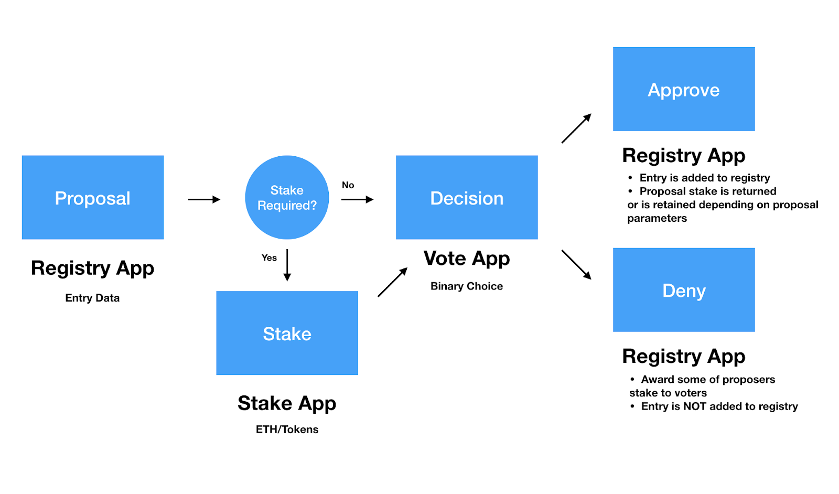
Architecture Diagram

Slide 12
Algorithms and Methodologies
We’ll be using the following parameters to implement the registry:
MIN_DEPOSIT : This is the number of tokens a candidate must lock as a deposit for their application, and for the duration of their listing thereafter.
APPLY_STAGE_LEN: The duration, in blocks or epoch time, during which an application can be challenged. If this period passes with no challenge being issued, the candidate becomes a listee.

Slide 13
Parameters (contd.)
COMMIT_PERIOD_LEN: The duration, in blocks or epoch time, during which token holders can commit votes for a particular challenge.
REVEAL_PERIOD_LEN : The duration, in blocks or epoch time, during which token holders can reveal committed votes for a particular challenge.

Slide 14
Parameters (contd.)
DISPENSION_PCT : The percentage of forfeited deposit in a challenge which is awarded to the winning party as a special dispensation compensating for their capital risk.
VOTE_QUORUM : The percentage of tokens out of the total tokens revealed in favor of admitting/keeping a challenged candidate necessary for that candidate to get/keep listee status. The VOTE_QUORUM does not count non-voting tokens, and unrevealed tokens are considered non-voting.

Slide 15
New Parameters and Methodologies
DOMAIN_TK : Domain specific tokens given to candidates with respect to the field they apply in.
DECAY_LEN: The duration given to each token before it expires.
PPR : A rank given to each curator/token-holder based on how many domain specific tokens they hold. An individual can hold multiple PPR’s depending on the number of domains they participate in.

Slide 16
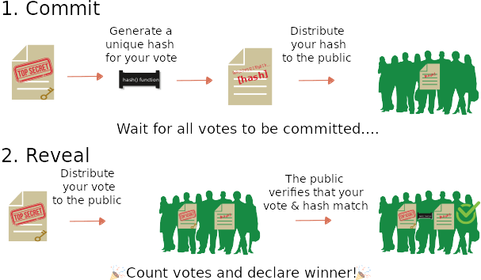
Voting

Slide 17
Algorithms
Algorithm 1: State transition in CitedTCR
1: Gt (Vt Et ) ← list in period t
2: GÛt ({x} ∪Vx , Ex ) ← proposal by x
3: {m,n} ← exogenous variables
4: Rt ← stock of reports until period t ▷ Specific to DG13
5: RÛ t ← Curation(n,Vt \ Vx , {∅},Gt) ▷ See Algorithm 2
6: Compute rewards Θ with Rt and RÛ t ▷ Use DG13
7: return Θ
8: Rt+1 ← Rt ∪ RÛ
t ▷ Specific to DG13
9: return Rt+1 ▷ Specific to DG13
10: if m ≥ |{r ∈ RÛ|r = 1}| then
11: Gt+1 ← Gt
12: else
13: Gt+1 ← Gt ∪ Gx
14: end if
15: return Gt+1

Slide 18
Algorithms
Algorithm 2 Report collection and curator assignment in CitedTCR
1: function Curation(n,C, R,G)
2: C← n curators selected from C in G ▷ Use PPR
3: R← reports collected from C within a given period of time
4: R ← R ∪ R
5: if |R| = n then
6: return R
7: else
8: n ← n − |R|
9: C ← C \ C
10: Curation(n,C, R,G)
11: end if
12: end function

Slide 19
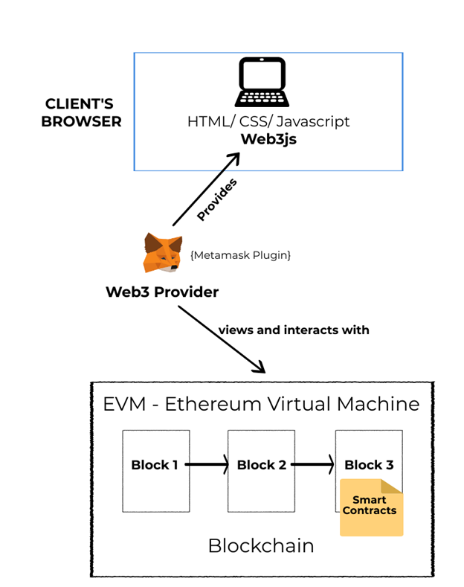
Testing Demo

Slide 20
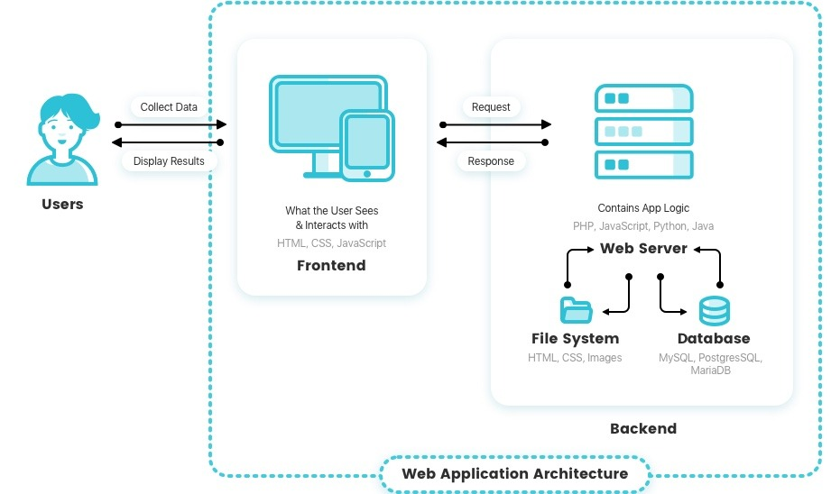
Normal web application

Slide 21
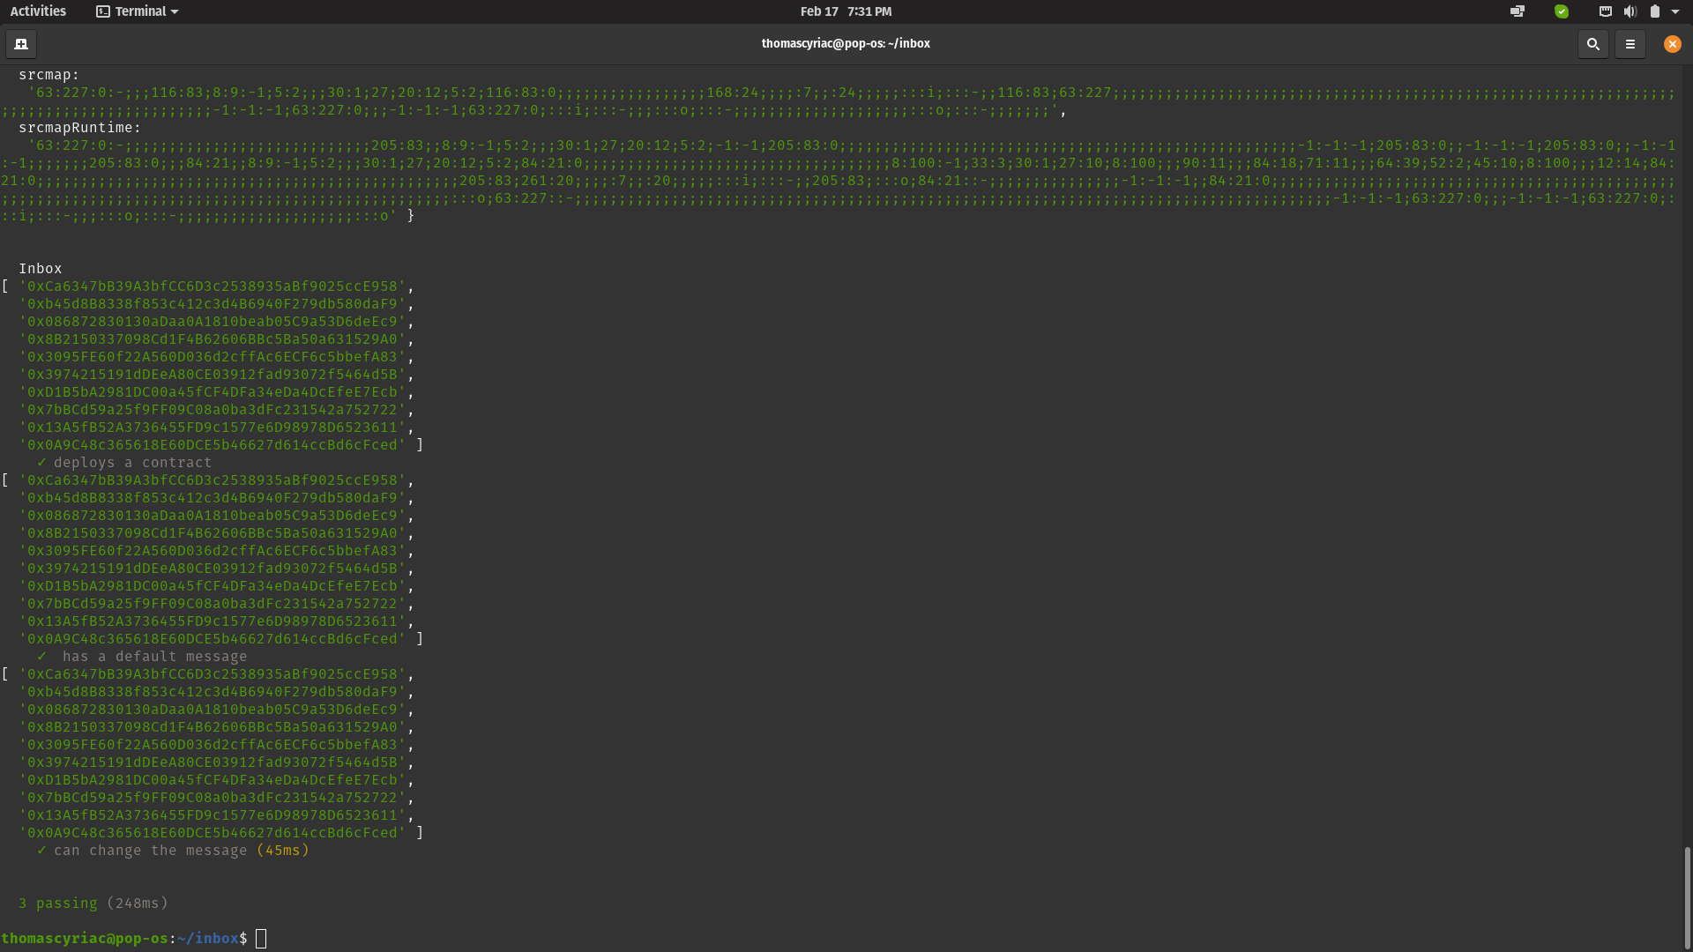
Test Demo

Slide 22
Boilerplate Requirements
Mocha
Ganache
Nodejs
Solc compiler
Remix/IDE

Slide 23
References
Token-Curated Registries 1.0 by Mike Goldin, 2017.
Token-Curated Registry with Citation Graph by Kensuke Ito, Hideyuki Tanaka, 2019.
Token Curated Registries - A Game Theoretic Approach by Aditya Asgaonkar, Bhaskar Krishnamachari 2018.
Token Curated Registry Design Patterns by Matt Loyker 2018.
Strictly proper scoring rules, prediction, and estimation Tilmann Gneiting and Adrian E Raftery. 2007
Token-Curated Registry (TCR) in a scholarly Journal: Blockchain meets invisible colleges by Artyom Kosmarski and Nikolay Gordiychuk 2018
Messari.io. 2018. Token Curated Registries | Messari - Crypto News, Pricing, and Research. Messari (2018).
ItemRank: A Random-Walk Based Scoring Algorithm for Recommender Engines by Marco Gori and Augusto Pucci 2006.

