Slide 1

Chunking Strategies in RAG

Slide 2
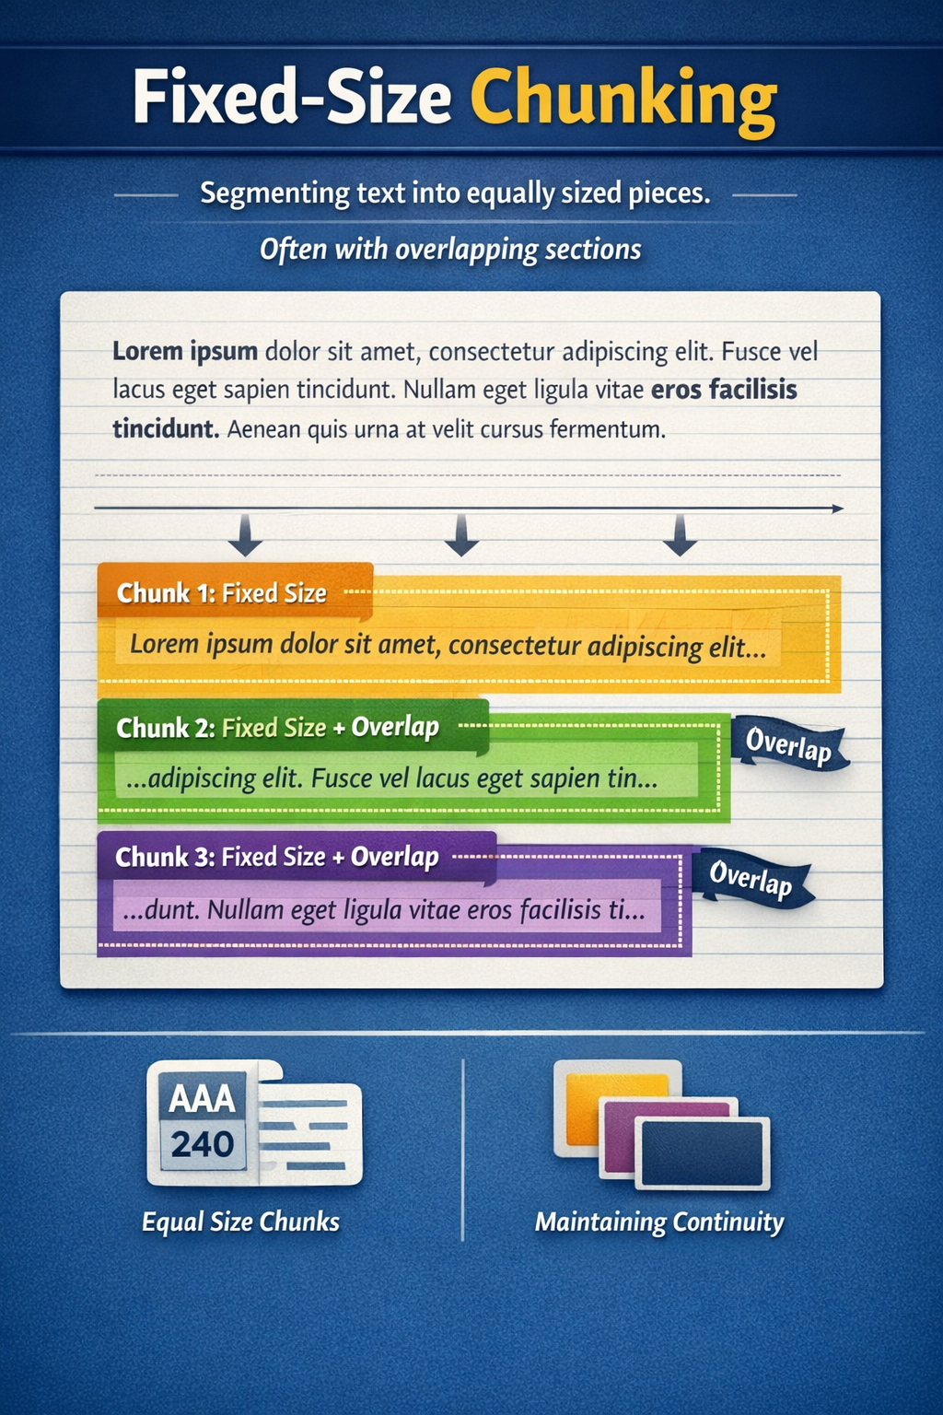
Fixed Size Chunking with Overlap
Fixed-Size Chunking with Overlap
Text is split into equal-sized chunks (by tokens / characters)
Each chunk overlaps with the previous one
Overlap preserves context continuity across chunks
Why Overlap Is Needed
Prevents loss of meaning at chunk boundaries
Ensures important sentences aren’t split across chunks
Improves retrieval quality in RAG pipelines
How It Works (Conceptually)
Chunk size: fixed (e.g. 500 tokens)
Overlap: shared portion (e.g. 50–100 tokens)
Each chunk contains:
New content
Some context from the previous chunk

Slide 3
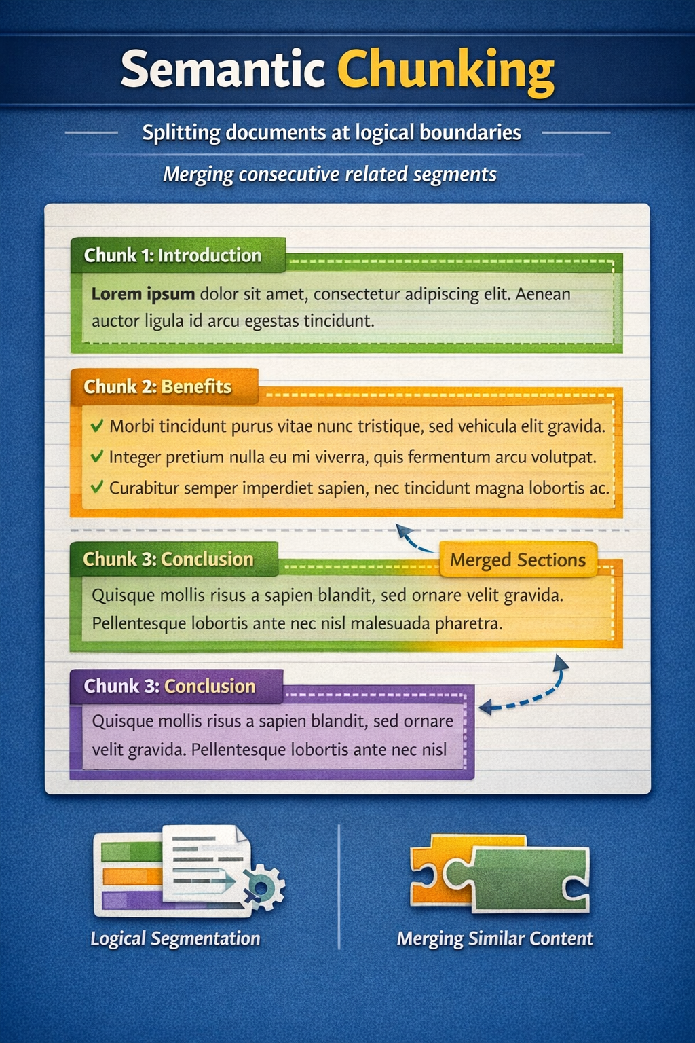
Semantic Chunking
Semantic Chunking
Text is split based on meaning and logical boundaries
Chunks align with:
Sections
Headings
Topics
Preserves semantic coherence within each chunk
How It Works
Detects natural breakpoints in the document
Groups related sentences or paragraphs
May merge smaller related sections into one chunk
Chunk sizes are variable, not fixed
Why Semantic Chunking Helps
Keeps complete ideas together
Improves retrieval relevance in RAG
Reduces context fragmentation compared to fixed-size chunking

Slide 4
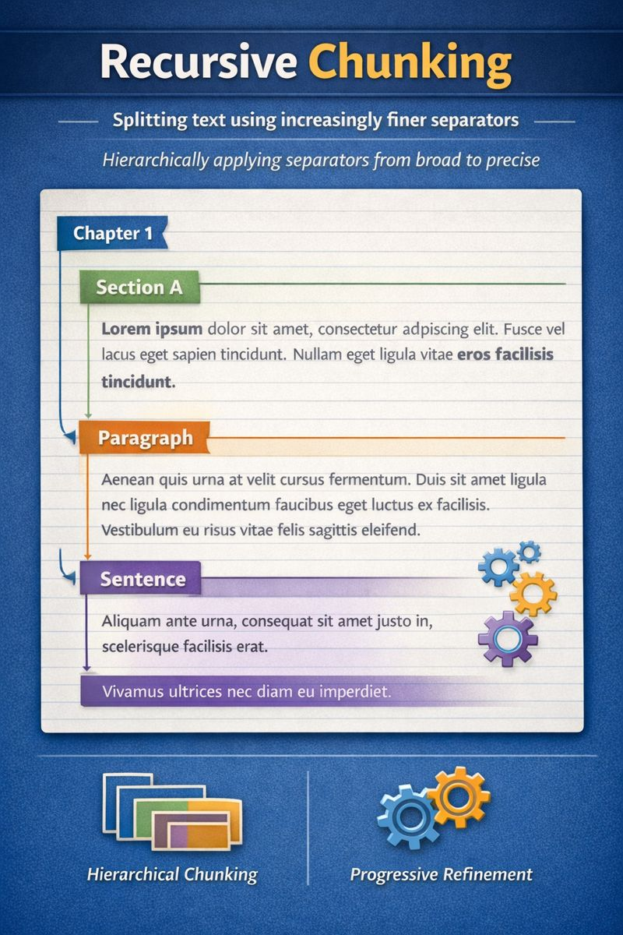
Recursive Chunking
Recursive Chunking
Text is split using hierarchical separators
Starts with coarse boundaries, then refines progressively
Preserves structure while keeping chunks within size limits
How It Works
Split by:
Sections / chapters
Paragraphs
Sentences
If a chunk is still too large:
Apply the next, finer separator
Stops when chunk size constraints are met
Why Recursive Chunking Helps
Maintains logical structure
Avoids arbitrary text splits
Produces balanced, meaningful chunks

Slide 5
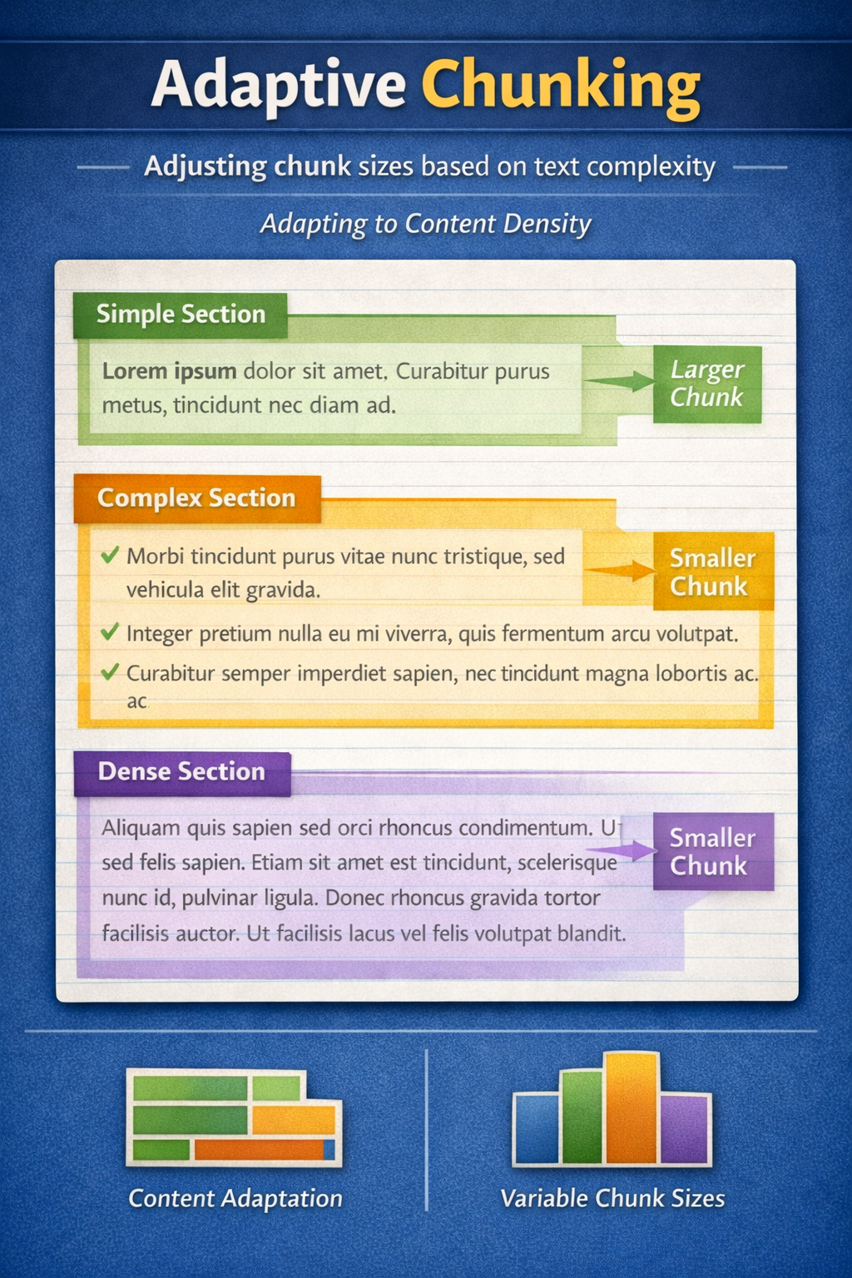
Adaptive Chunking
Adaptive Chunking
Chunk size dynamically adjusts based on content
Simple sections → larger chunks
Dense or complex sections → smaller chunks
Optimizes both context quality and cost
How It Works
Analyzes text for:
Density
Complexity
Structural signals
Determines chunk boundaries at runtime
Produces variable-sized chunks
Why Adaptive Chunking Helps
Avoids over-chunking simple content
Preserves detail in complex sections
Improves retrieval precision in RAG
Reduces unnecessary embeddings

Slide 6
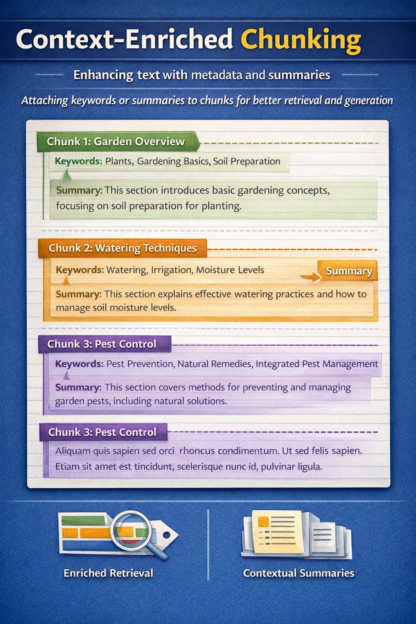
Context-Enriched Chunking
Context-Enriched Chunking
Chunks are augmented with additional context
Context can include:
Summaries
Keywords
Metadata
Improves retrieval accuracy and answer quality
How It Works
First, chunk the document (fixed / semantic / recursive)
Then, for each chunk:
Generate a short summary
Extract key terms or tags
Store both chunk text + enriched context
Why Context Enrichment Helps
Gives the retriever more signals than raw text
Improves semantic matching for user queries
Helps LLMs answer with better grounding
Reduces ambiguity for short or dense chunks

Slide 7
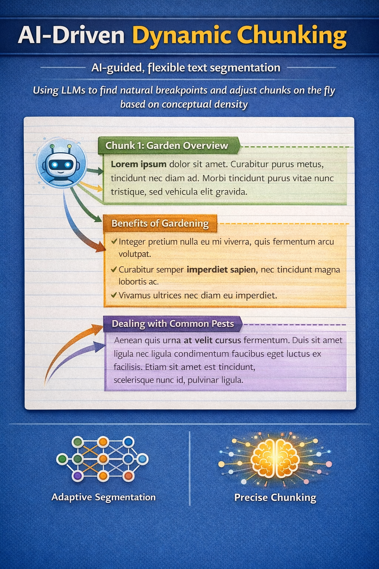
AI-Driven Dynamic Chunking
AI-Driven Dynamic Chunking
Chunking decisions are made by an LLM
Uses semantic understanding to find natural breakpoints
Chunk sizes adjust dynamically at runtime
How It Works
LLM analyzes:
Topic shifts
Conceptual density
Context importance
Decides:
Where to split
How large each chunk should be
Produces highly context-aware chunks
Why AI-Driven Chunking Helps
Preserves complete ideas
Avoids rigid rules and heuristics
Improves retrieval for:
Complex questions
Multi-topic documents
Best alignment with LLM reasoning

