Slide 1
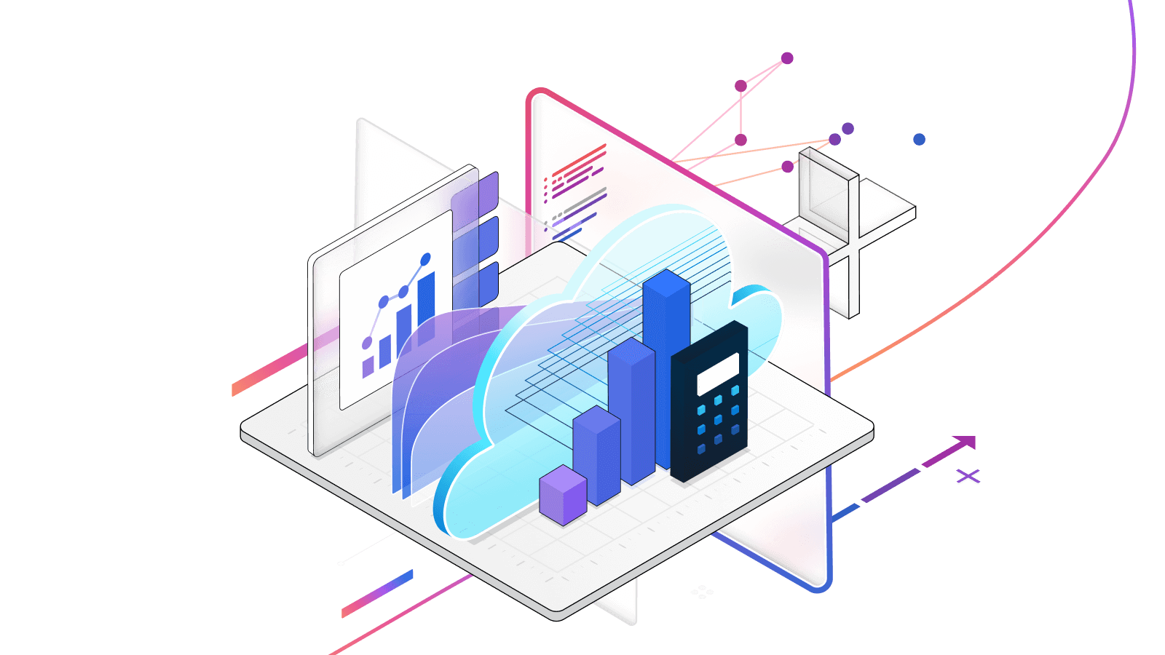
Fine-Tuning LLMs

Slide 2
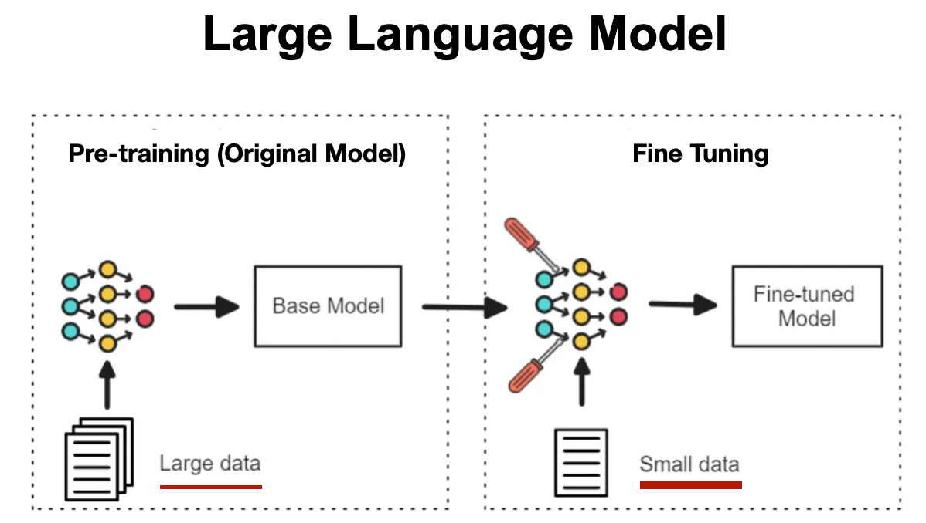
What is Fine-Tuning?
What is Fine-Tuning?
Process of adapting a pre-trained Large Language Model using additional data
Updates model weights to change behavior or specialize the model
Uses a smaller, task-specific dataset compared to original training

Slide 3
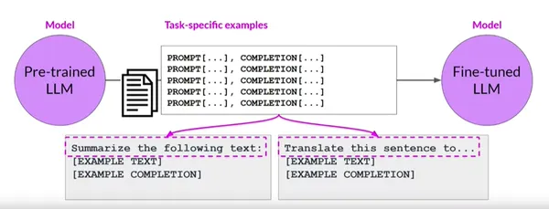
Training Cycle for Fine-Tuning
Training Cycle for Fine-Tuning
Fine-tuning adapts a pre-trained LLM using task-specific examples
Training data is formatted as prompt → completion pairs
Model weights are updated during training

Slide 4
Fine-Tuning Use Cases
Customer support response templates
Legal or policy text classification
Email drafting in a specific brand voice
Data extraction into fixed formats
Controlled summarization or translation

Slide 5
Do’s and Don'ts
What Fine-Tuning Is Best For
Enforcing consistent tone or style
Learning structured output formats
Improving performance on narrow, repetitive tasks
Encoding domain rules that rarely change
What Fine-Tuning Is NOT Good For
Frequently changing knowledge
Large or dynamic document collections
Real-time data updates
Enterprise knowledge Q&A
Use RAG

Slide 6
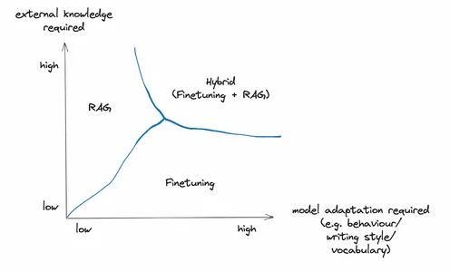
Fine-Tuning and RAG
Hybrid Approach (Fine-Tuning + RAG)
Used when both are high
Fine-tune for behavior & format
Use RAG for dynamic, factual knowledge
Common in:
Enterprise copilots
Regulated industry assistants
Multi-document reasoning systems

Slide 7
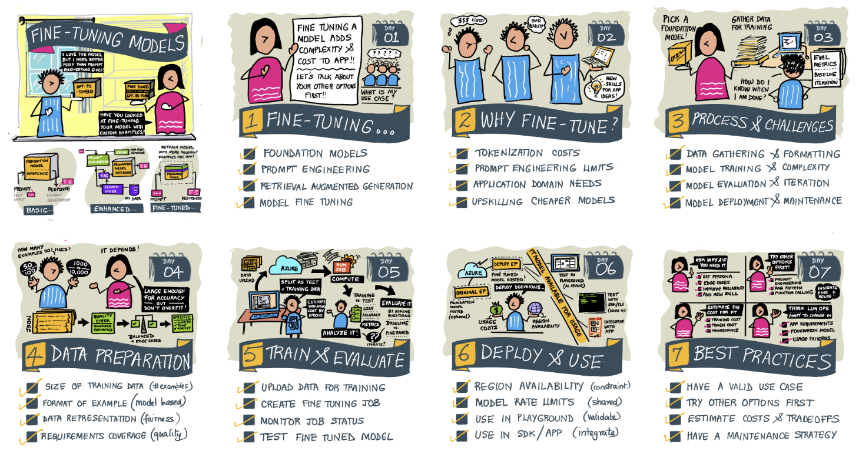
Fine-Tuning Key Takeaways

