Slide 1
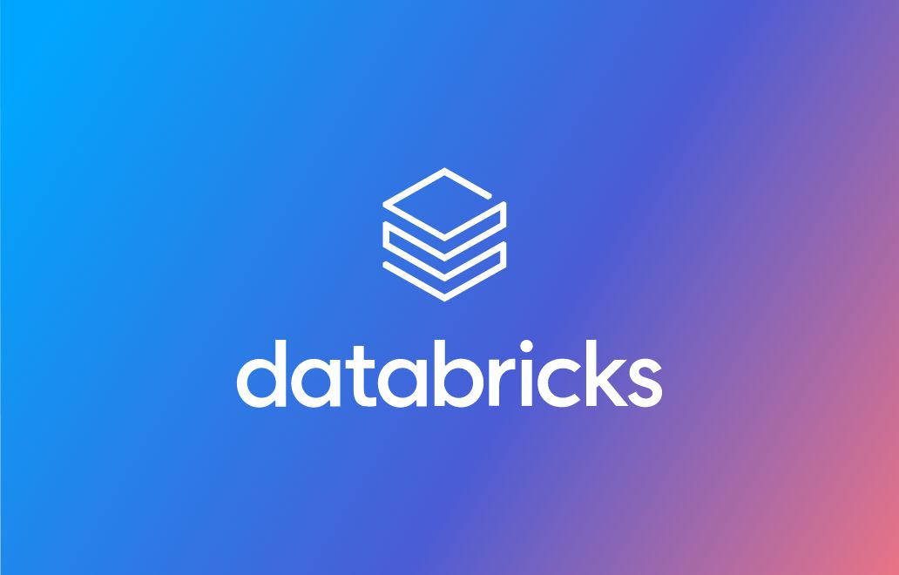
GenAI and LLMs

Slide 2
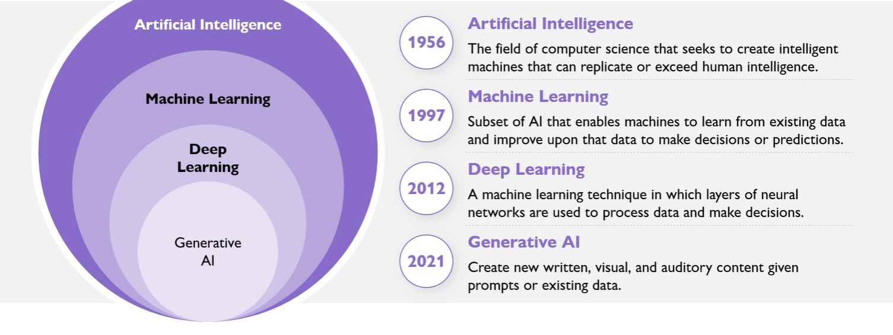
Just a Quick Look at Generative AI

Slide 3
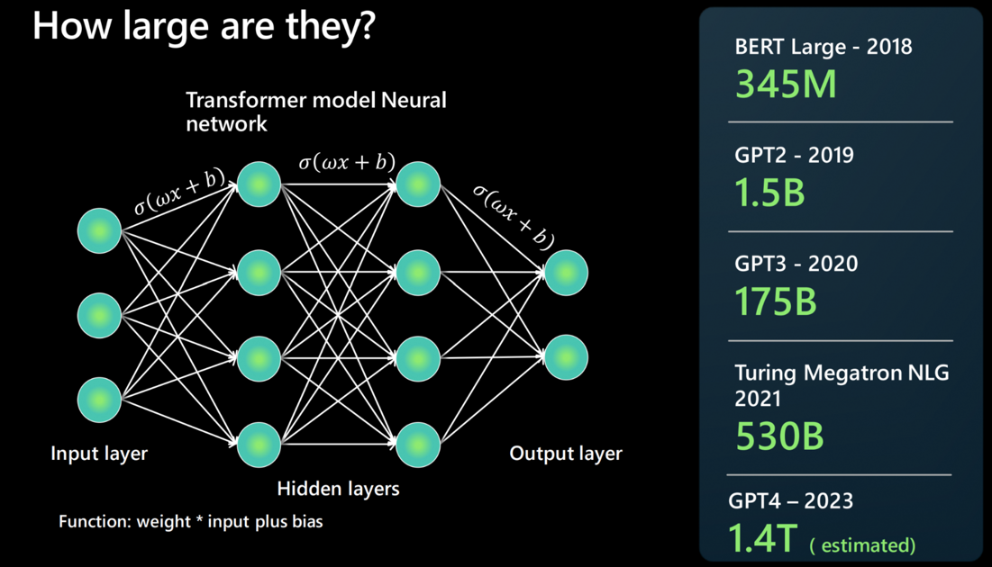
LLMs – Large Language Models
An LLM is built by using a neural network architecture. It takes an input, has several hidden layers that break down different aspects of language, and produces at the output layer.
A foundation model refers to a specific instance or version of an LLM. For example, GPT-3, GPT-4, or Codex.

