Slide 1

Prompt Engineering

Slide 2

What is prompt engineering?
it's about crafting precise and well-thought-out prompts that maximize the AI's potential to deliver accurate and meaningful results. For example:
A poorly designed prompt: "Tell me about history." (This is too vague.)
A well-engineered prompt: "Explain the causes and effects of World War II in a clear and concise manner." (This narrows down the focus.)
Prompt engineering is an essential skill for using AI effectively, especially
 | Language Generation | Code Generation | Image Generation
Prompt: | Write a haiku about marmalade | Write a Python function to add two numbers | Paint a pink fox in a field in the style of Monet
Output: | Orange sunrise, sweet Spread on toast with morning tea A marmalade treat | def add_two_numbers(a, b): return a + b
Notes:
This is New Skillset requirement In the Organization

Slide 3
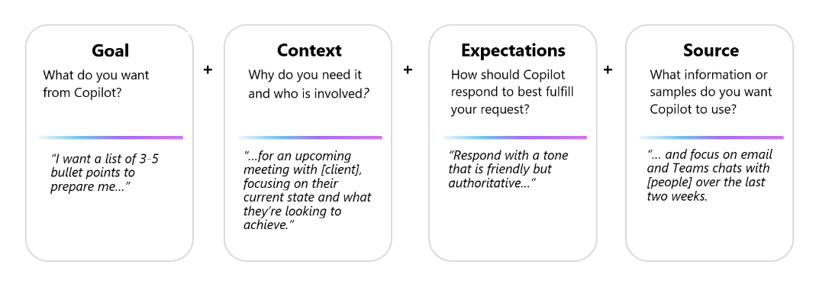
Examine how to build an effective prompt
Prompts can include four parts—the goal, context, expectations, and source, as described in the following image:

Slide 4
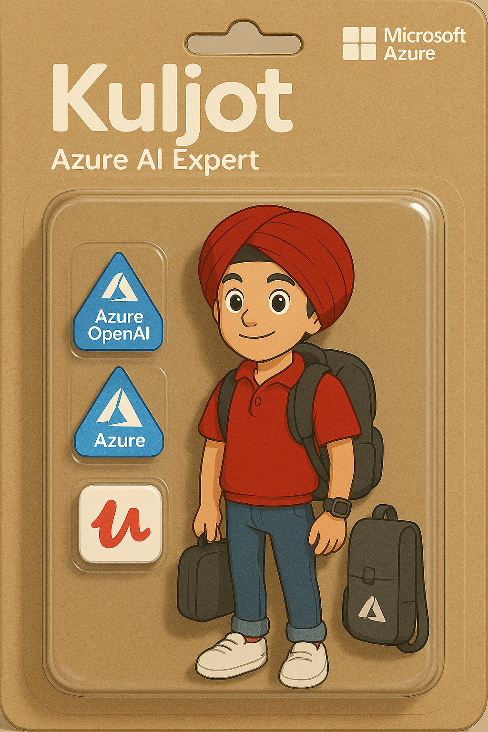
Prompt - "Make a picture of a 3D action figure toy, named "YOUR-NAME-HERE" Make it look like it's being displayed in a transparent plastic package, blister packaging model. The figure is as in the photo, [GENDER/HIS/HER/THEIR] style is very [DEFINE EVERYTHING ABOUT HAIR/FACE/ETC]. On the top of the packaging there is a large writing: "[NAME-AGAIN]" in white text then below it "[TITLE]” Dressed in [CLOTHING/ACCESSORIES]. Also add some supporting items for the job next to the figure, like [ALL-THE-THINGS]. The packaging design is minimalist, cardboard colour, cute toy style sold in stores. The style is cartoonish, cute but still neat, also put [BRAND] logo in the top right corner

