Slide 1
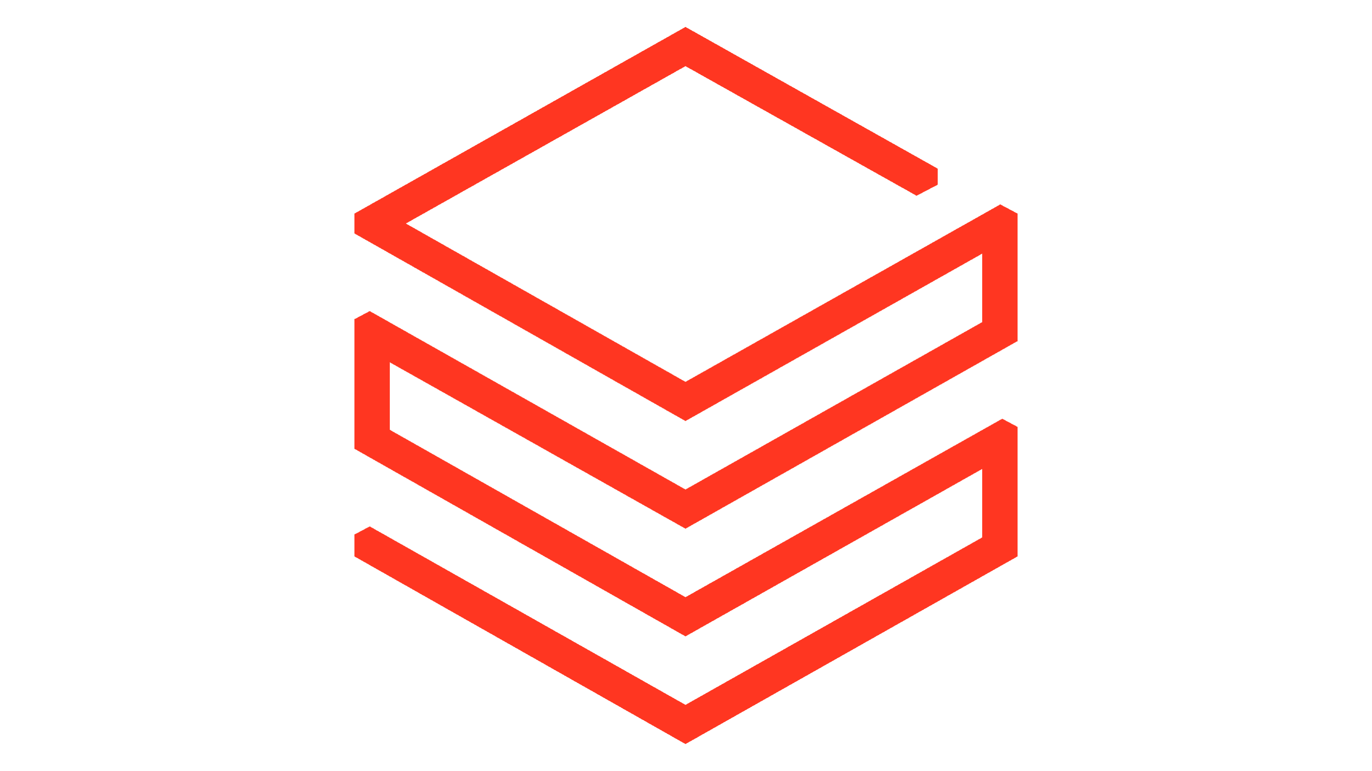
Introduction to Databricks

Slide 2
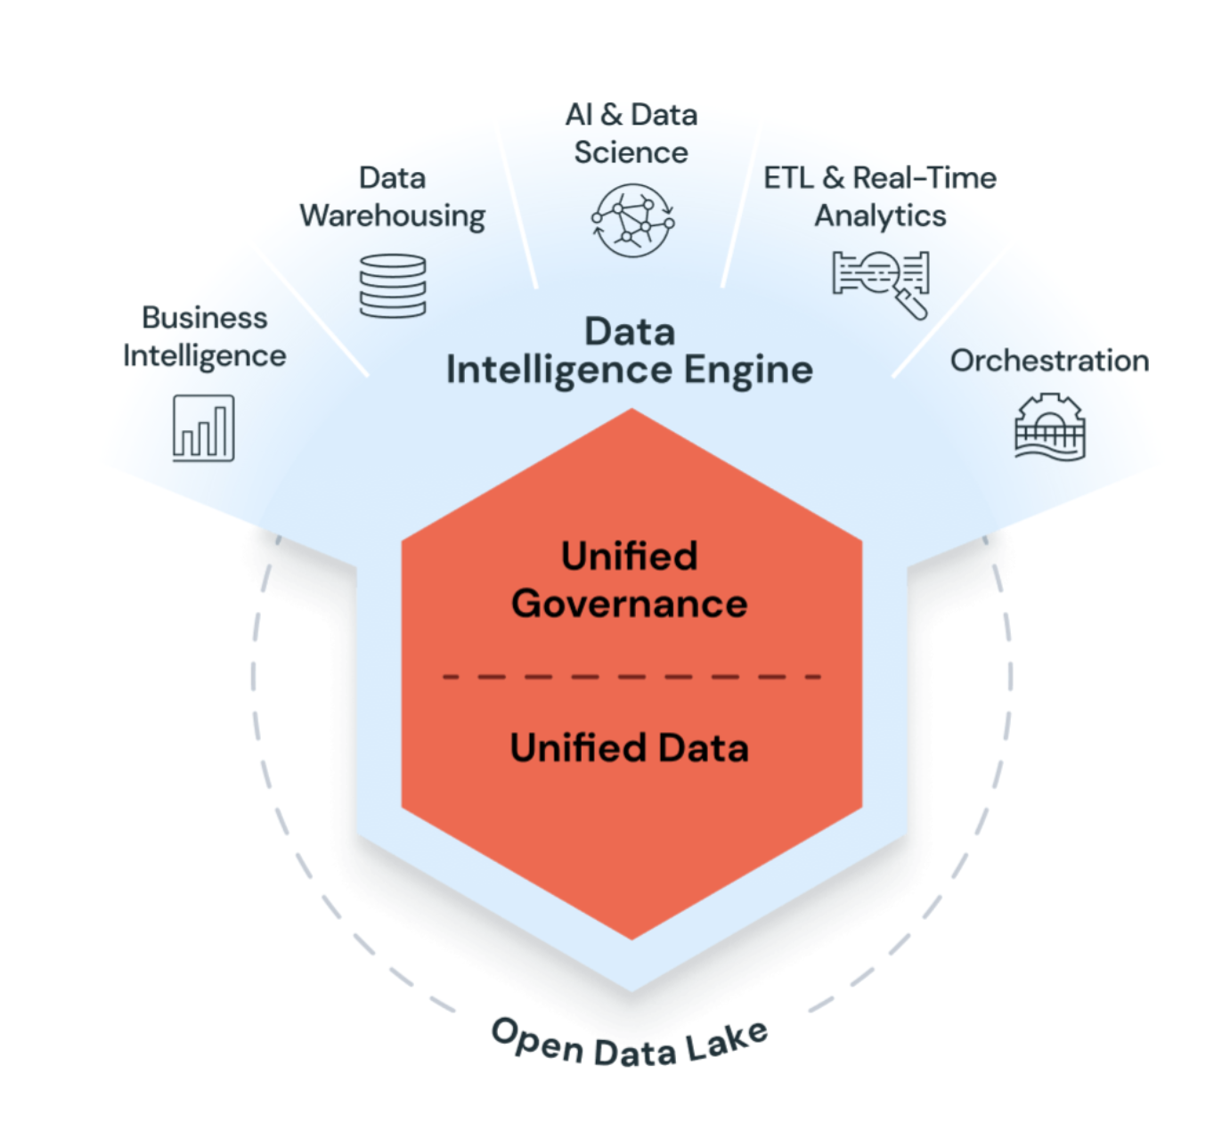
What is Databricks ?
Databricks is a unified, open analytics platform for building, deploying, sharing, and maintaining enterprise-grade data, analytics, and AI solutions at scale.
The Databricks Data Intelligence Platform integrates with cloud storage and security in your cloud account, and manages and deploys cloud infrastructure for you.
Databricks is committed to the open source community and manages updates of open source integrations with the Databricks Runtime releases.

Slide 3
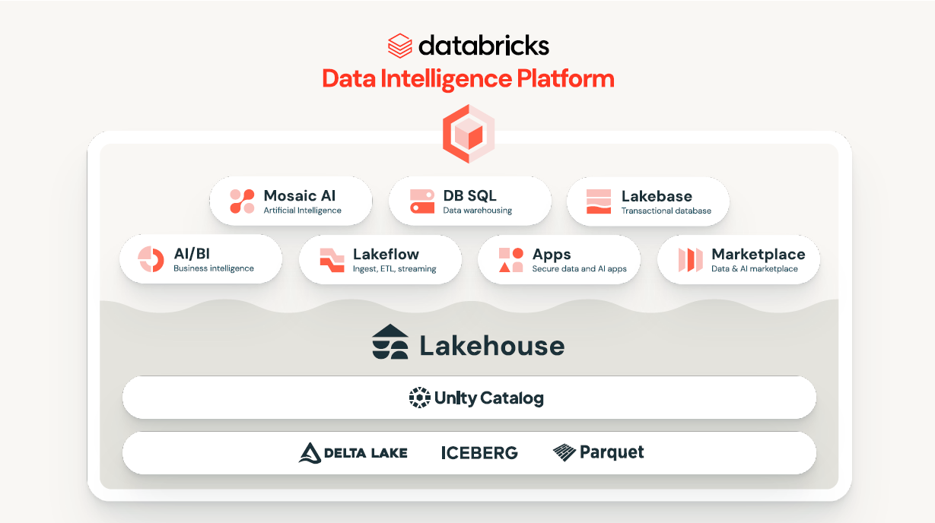
The Databricks Data Intelligence Platform
AI/BI Layer
Data Governance Layer
Data Storage and Data Processing Layer

Slide 4
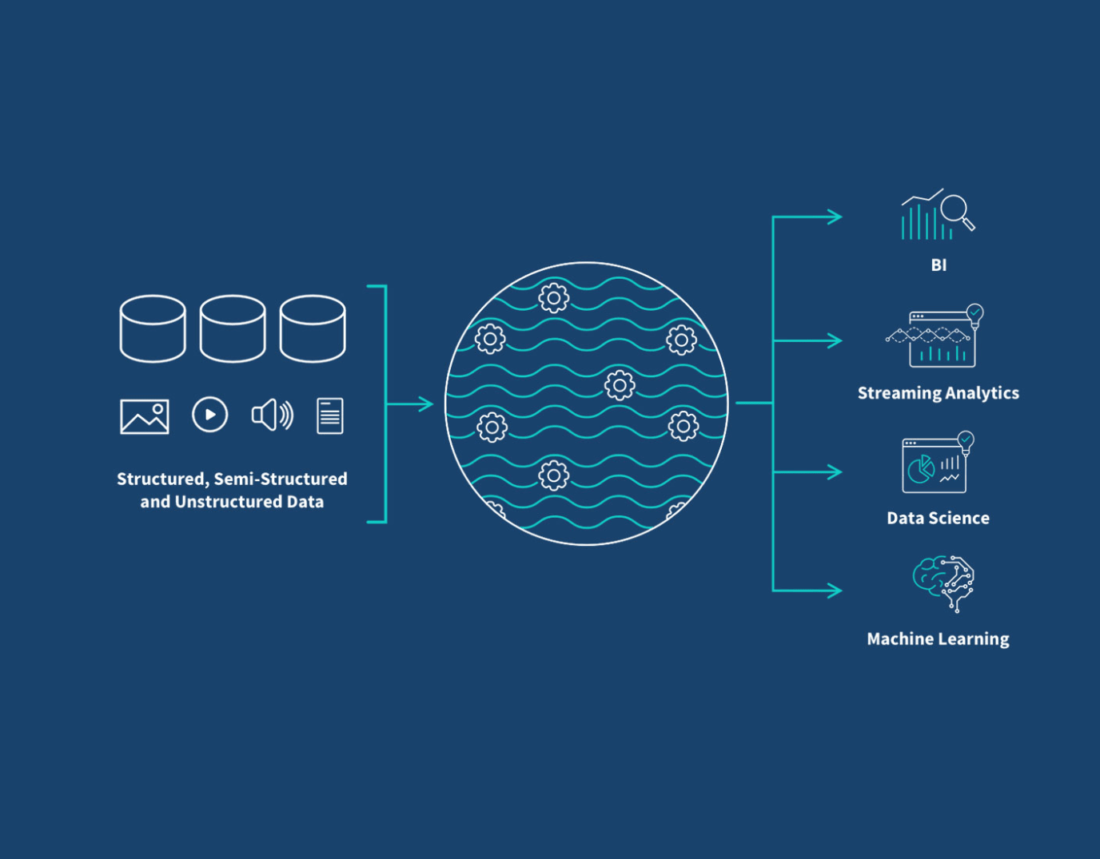
Concept of a Data Lake
Concept of a Data Lake
A Data Lake is a centralized storage system for all types of data
Stores data in its raw, native format
Designed to scale cheaply and infinitely using cloud object storage
Designed to store vast amounts of structured, semi-structured and unstructured data.
Schema-on-Read Principle
Data is stored without enforcing a schema upfront
Schema is applied at query or processing time
Enables faster ingestion and flexibility for evolving data sources

Slide 5
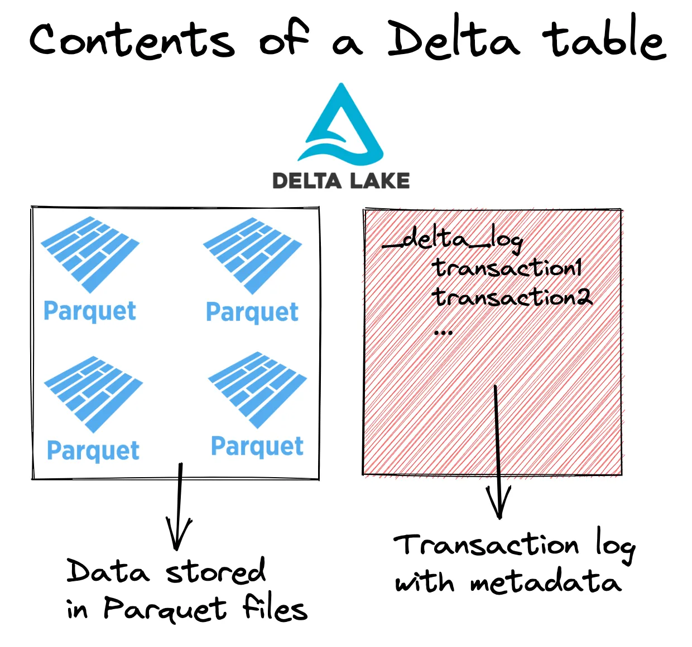
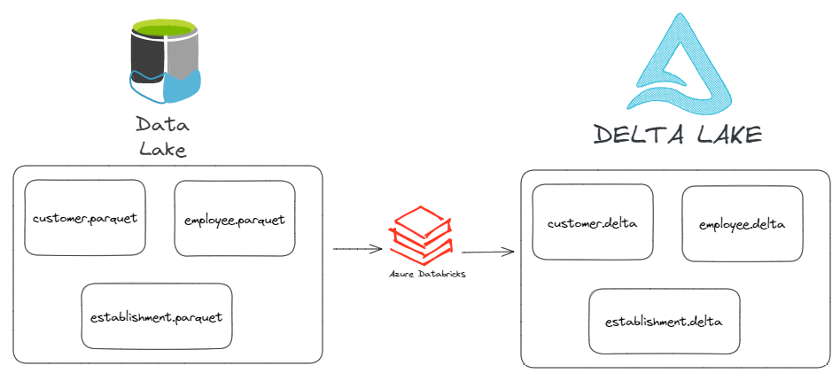
Delta Lake and Parquet => Storage Layer
Delta Lake and Parquet – Storage Layer
Delta Lake is built on top of Parquet files
Actual data is stored as immutable Parquet files in cloud storage (ADLS / S3 / GCS)
A Delta table is not a single file, but a folder structure
Data Lake and Delta Lake
Databricks provides the delta lake engine.
Delta Lake brings ACID and transactional capabilities to Data Lake Storage
Delta Lake makes data stored in data lake more accountable
Data Lake + Delta Lake => Data Lakehouse

Slide 6
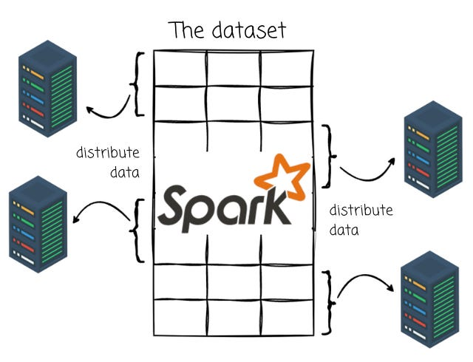
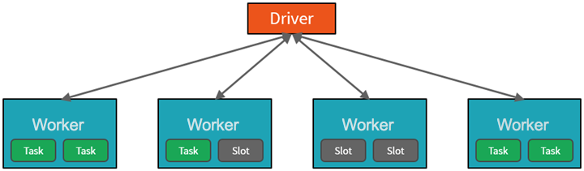
Spark – The Data Processing Engine
Spark – The Data Processing Engine
Apache Spark is a distributed data processing engine
Designed to process large datasets in parallel
Works with data stored in data lakes and Delta Lake
How Spark Processes Data
Input data is divided into partitions
Each partition is processed in parallel across multiple machines
Enables horizontal scalability

Slide 7
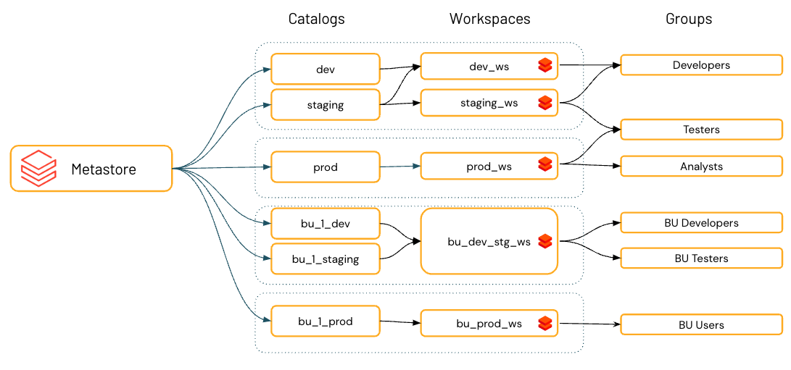
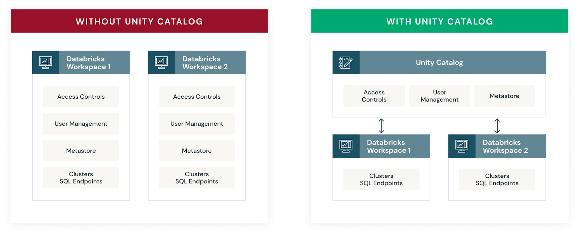
Unity Catalog – Data Governance Layer
Unity Catalog – Data Governance Layer
Unity Catalog is Databricks’ centralized governance layer
Provides fine-grained access control across all data and AI assets
Works across multiple workspaces from a single metastore
Unity Catalog is not compute
Unity Catalog is not storage
Unity Catalog = governance + access control
One metastore → multiple workspaces → consistent security

Slide 8
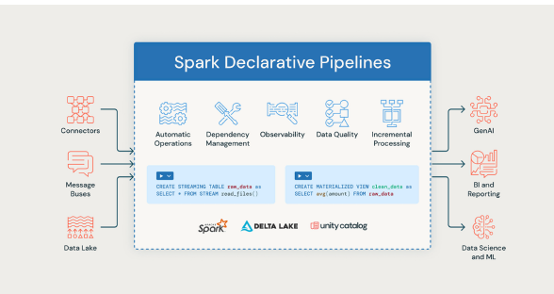
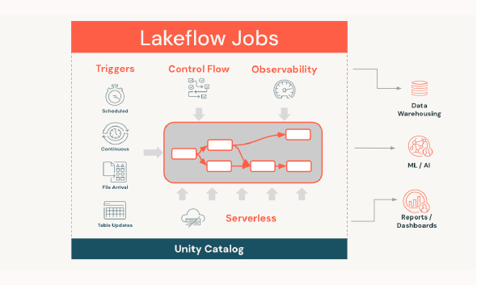
Data Engineering with Databricks
Spark Declarative Pipelines (Delta Live Tables)
Declarative approach to building pipelines
You define what the data should look like, not how to run it
Databricks handles:
Automatic operations
Dependency management
Data quality checks
Observability & monitoring
Incremental processing
Lakeflow Jobs
Orchestration layer for pipelines
Handles:
Triggers (scheduled, continuous, event-based)
Control flow and dependencies
Observability and retries
Serverless execution
Governed by Unity Catalog

Slide 9
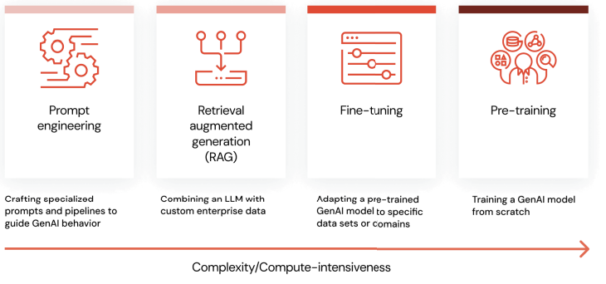
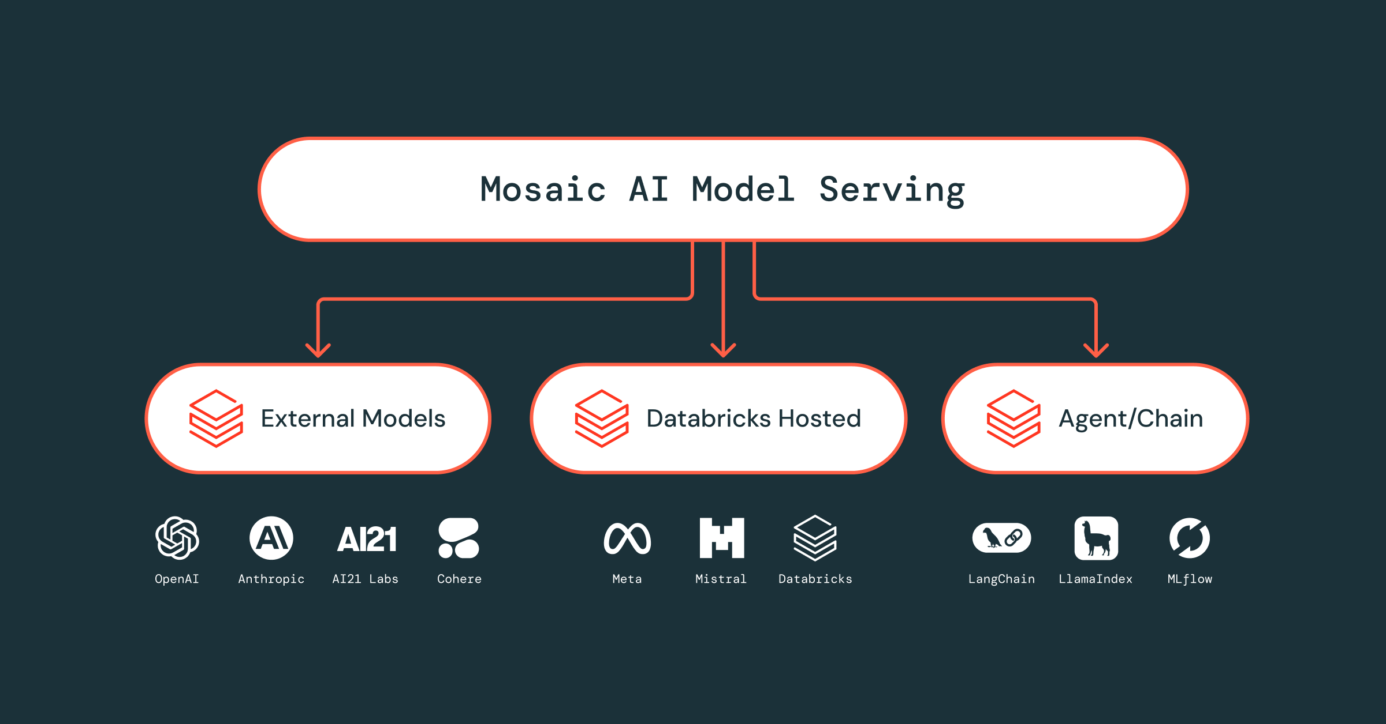
GenAI Engineering with Databricks
Databricks supports multiple GenAI development approaches
Approaches increase in complexity and compute cost from left to right
Most enterprise use cases start simple and evolve over time
Mosaic AI Model Serving
Unified serving layer for GenAI workloads
Supports:
External models (OpenAI, Anthropic, AI21, etc.)
Databricks-hosted models
Agents and chains
Production-ready:
Scaling
Monitoring
Governance

Slide 10
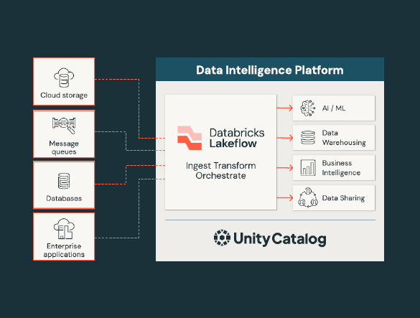
Conclusion – Databricks Data Intelligence Platform
Databricks is a unified Data Intelligence Platform
Brings together:
Data Engineering
Analytics & BI
Machine Learning
GenAI workloads
Built on the Lakehouse architecture

