Slide 1

Apache Spark

Slide 2
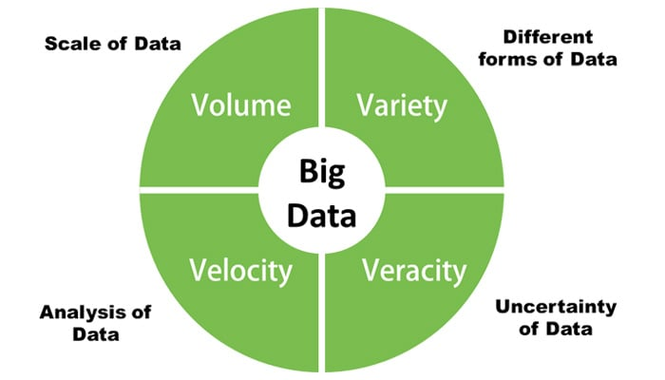
The “Big Data” Problem

Slide 3
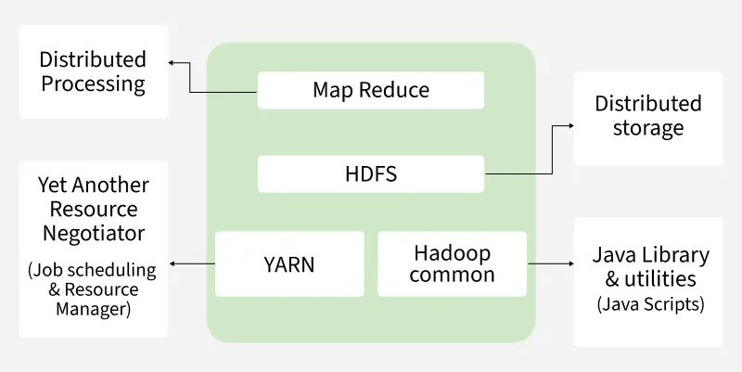
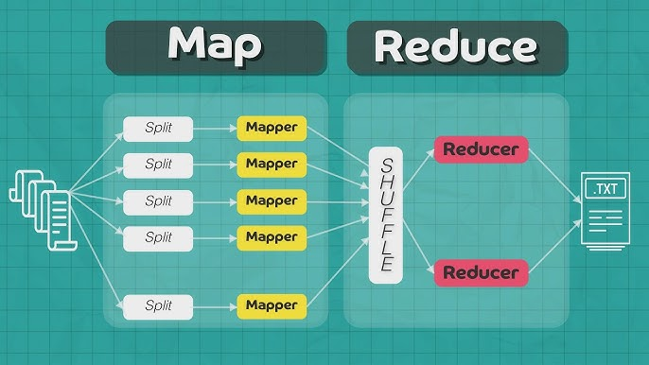
“Hadoop” and “Map-Reduce”
Hadoop and MapReduce (Historical Context)
Hadoop is an open-source framework for distributed storage and processing
Designed to process large-scale data across commodity hardware
Popular before modern cloud-native systems like Spark and Databricks

Slide 4
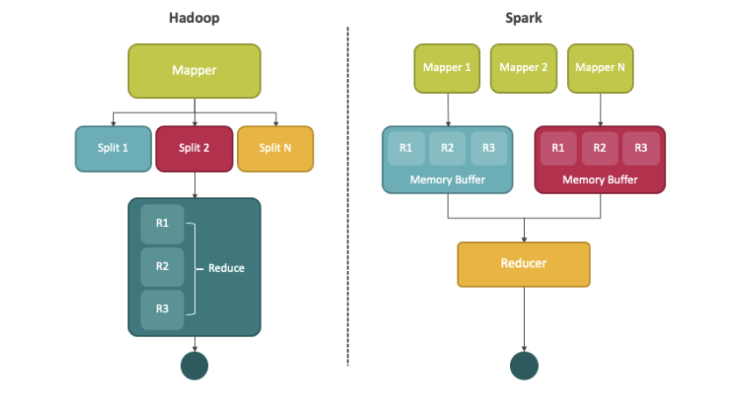
The Hadoop to Spark Evolution
Hadoop (MapReduce Model)
Processing follows a strict two-stage model:
Map → Reduce
Each stage:
Reads data from disk
Writes intermediate results back to disk
High latency due to repeated I/O
Limited to batch workloads
Complex programming model
Spark (In-Memory Engine)
Uses Resilient Distributed Datasets (RDDs) and DataFrames
Intermediate data stored in memory buffers
Multiple transformations chained together
Far fewer disk reads/writes
Supports:
Batch
Streaming
SQL
Machine Learning

Slide 5
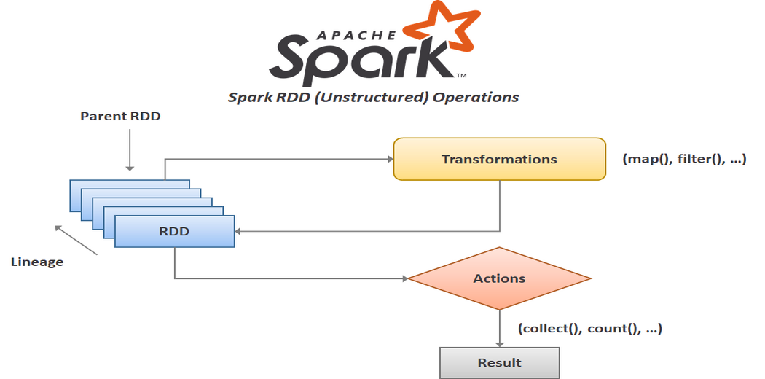
RDDs – Resilient Distributed Dataframes
RDDs – Resilient Distributed Datasets
RDD is Spark’s core low-level data abstraction
Represents an immutable, distributed collection of data
Data is partitioned across cluster nodes
Designed for fault-tolerant parallel processing
Why “Resilient”?
RDDs track lineage information
If a partition is lost:
Spark recomputes it from parent RDDs
No need for data replication in memory
Enables efficient fault recovery

