Slide 1

RAG on Databricks

Slide 2
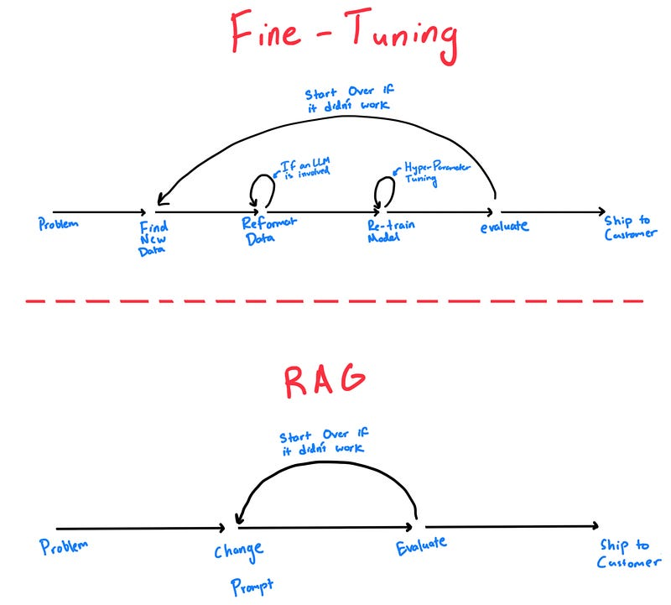
The Problem with LLMs
The Problem with LLMs (Enterprise Context)
LLMs are trained on static data
They do not know your private or latest enterprise data
Retraining or fine-tuning is slow, expensive, and brittle
High risk of hallucinations without grounding
Why Fine-Tuning Falls Short
Requires new data collection & labeling
Multiple iteration cycles: Collect → Reformat → Retrain → Tune → Evaluate
Hard to keep models up-to-date
Not ideal for frequently changing knowledge
Operationally heavy for enterprise systems

Slide 3
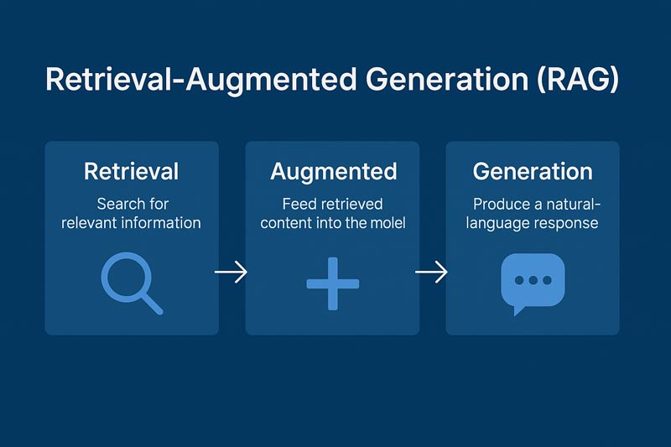
RAG – Retrieval Augmented Generation
RAG – Retrieval-Augmented Generation
Architecture that grounds LLM responses in external knowledge
Combines search + prompt augmentation + generation
Solves hallucination, freshness, and private-data limitations of LLMs
Why RAG is Critical in Enterprise AI
Keeps responses up-to-date
Works with private and proprietary data
Improves accuracy and trust
Faster and cheaper than fine-tuning

Slide 4
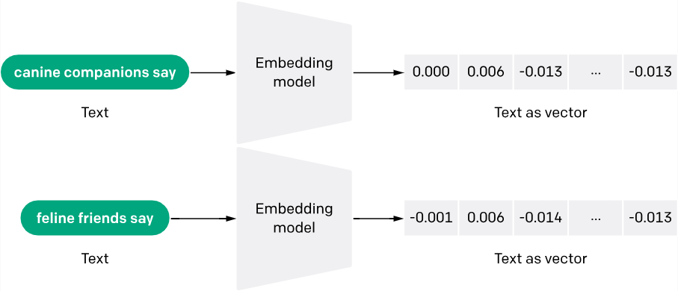
Vector embeddings are a way of representing words, sentences, images, or other data as numerical vectors in a high-dimensional space.
These vectors capture the semantic or contextual information in the data, allowing similar items to be closer together in that space
These vector embeddings are generated by text-embedding models that are offered by Azure OpenAI

Slide 5
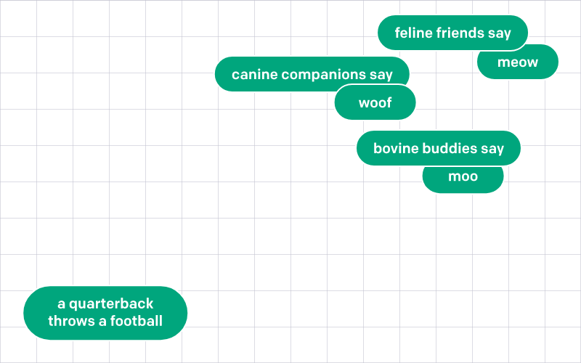

Slide 6


Slide 7
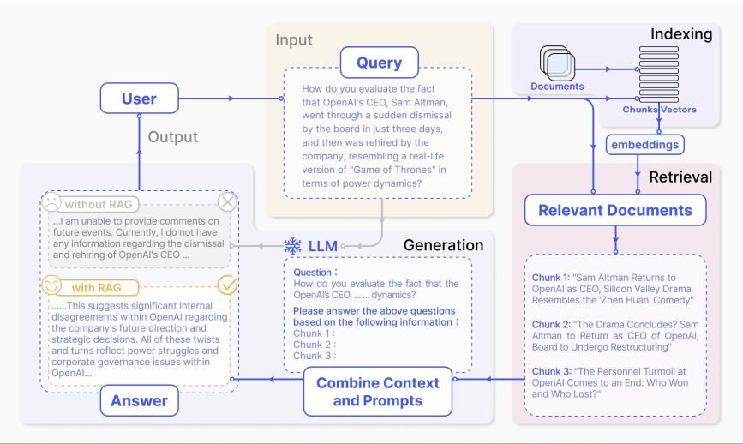
Visualize RAG

Slide 8
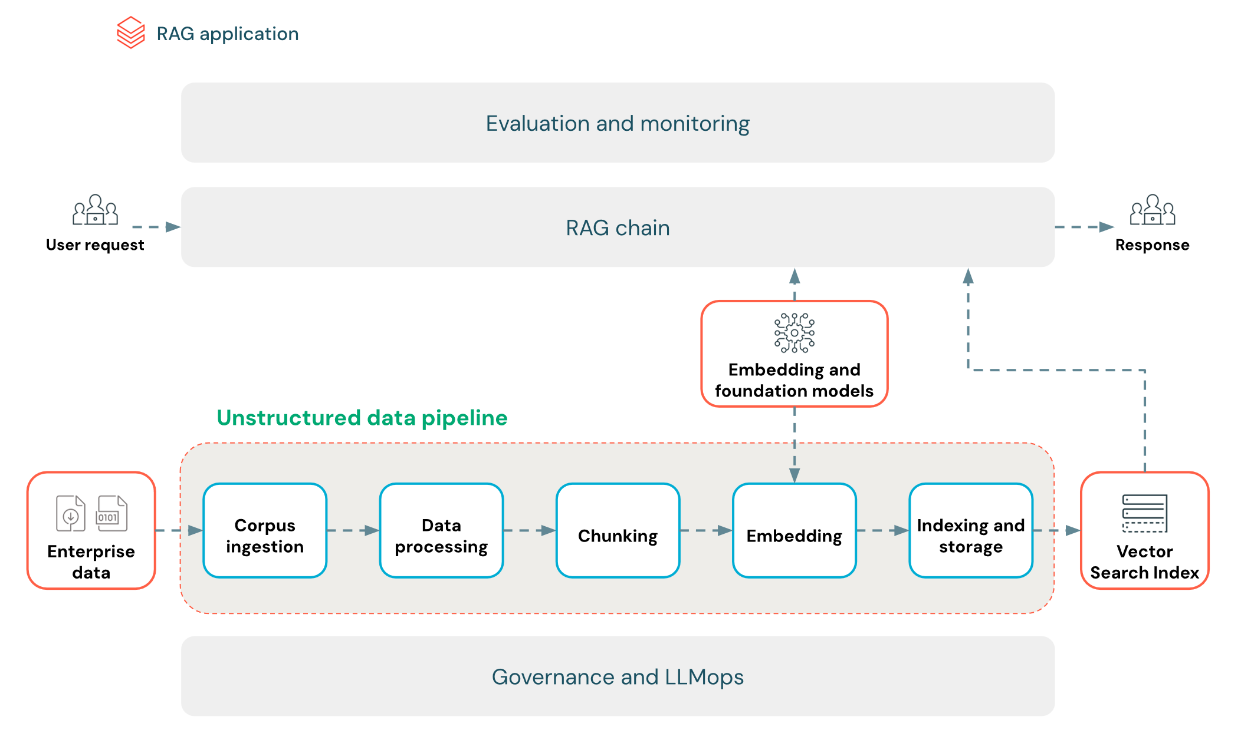

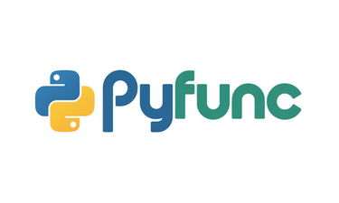
RAG Implementation on Databricks

