Slide 1
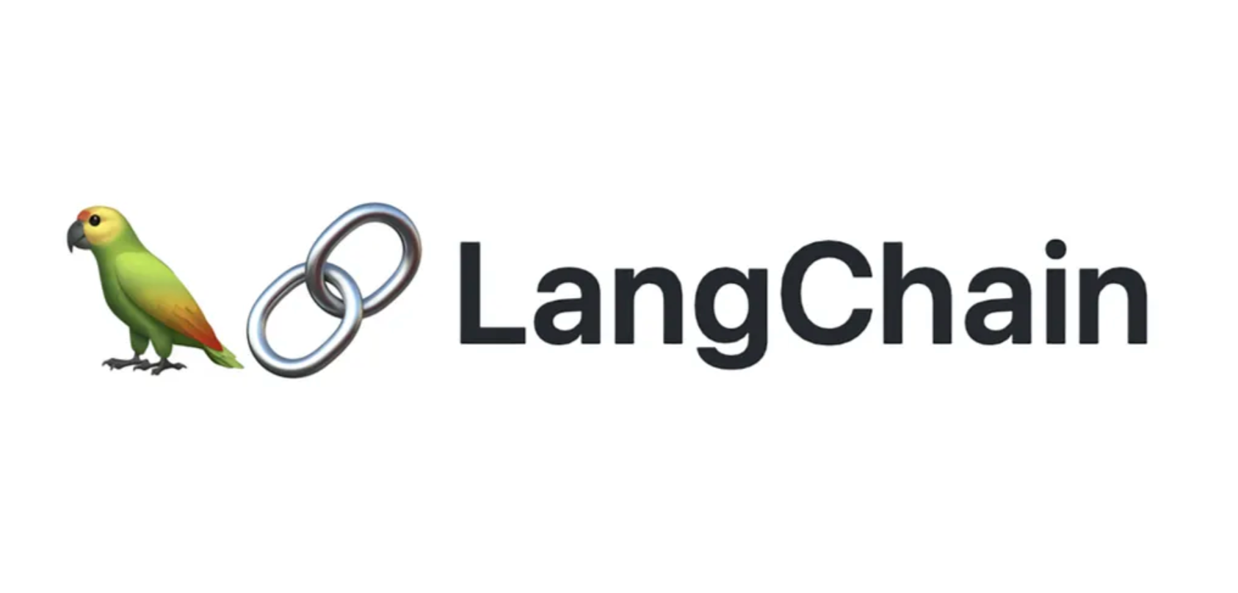
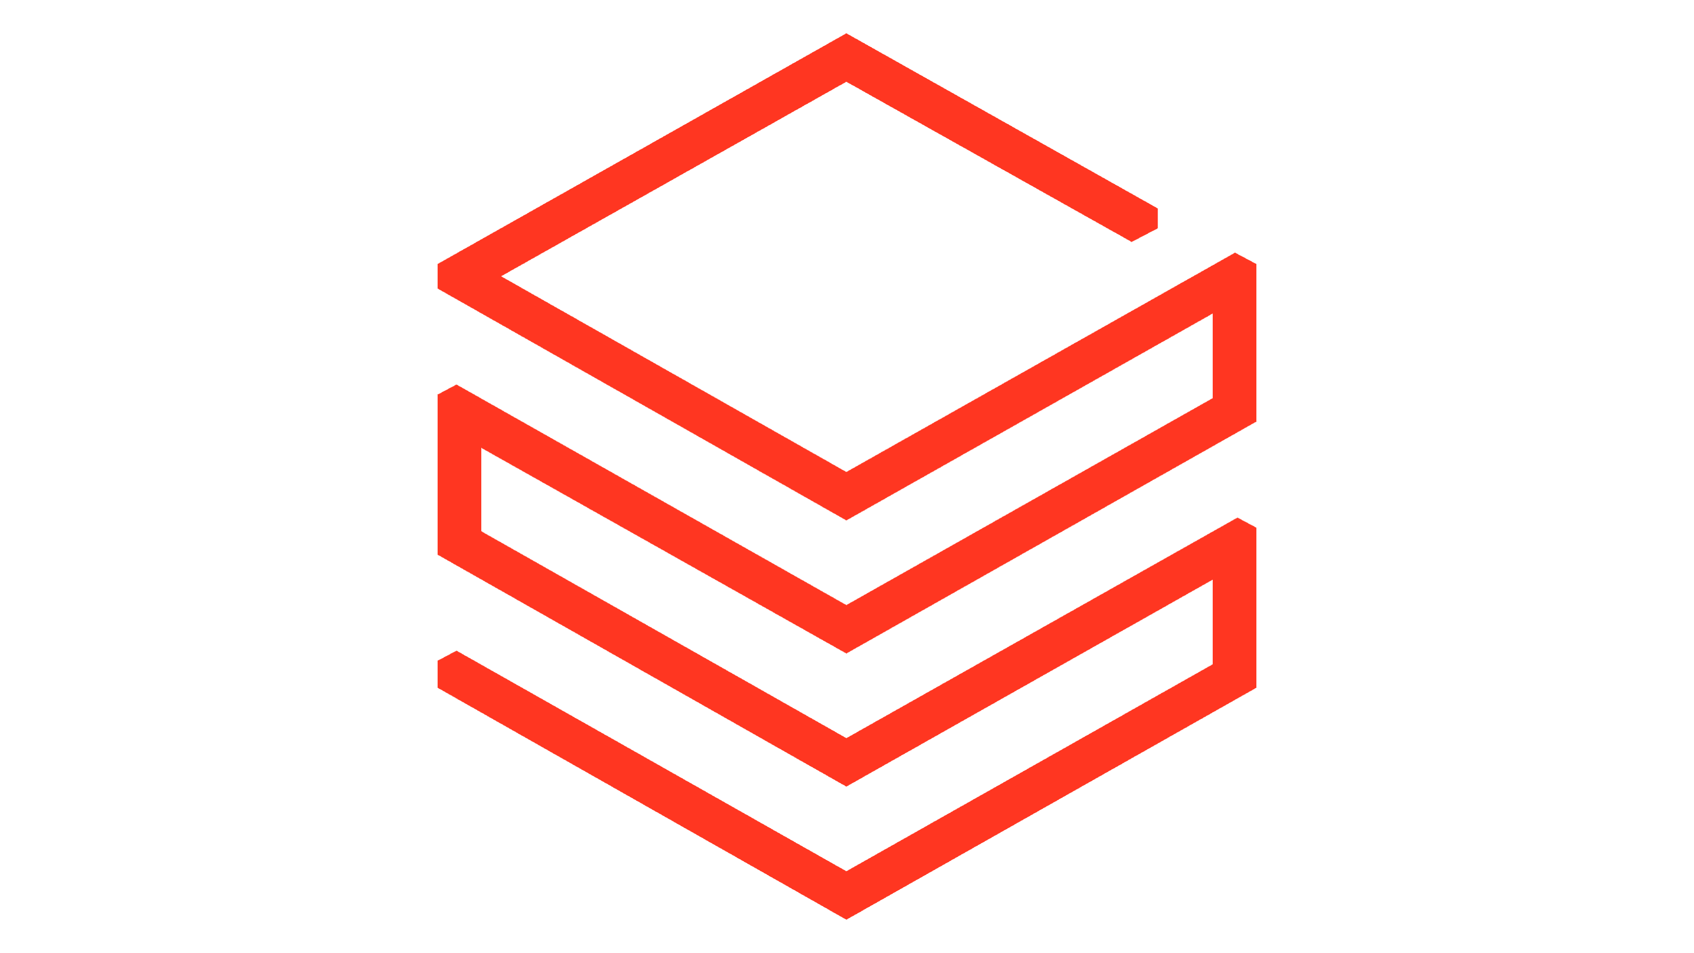
LangChain and Databricks

Slide 2
De-mystifying AI App Development
At a basic level
📄
prompt
Model
💬
response
data
Providing prompt to a model
Acting on the response
📈
run code
At scale
input
output
📈
Holding many different conversations with models & agents
Extracting information into useful results
📈
🤵
🤵
📈
📈
📈
🤵
🤵
🤵

Slide 3
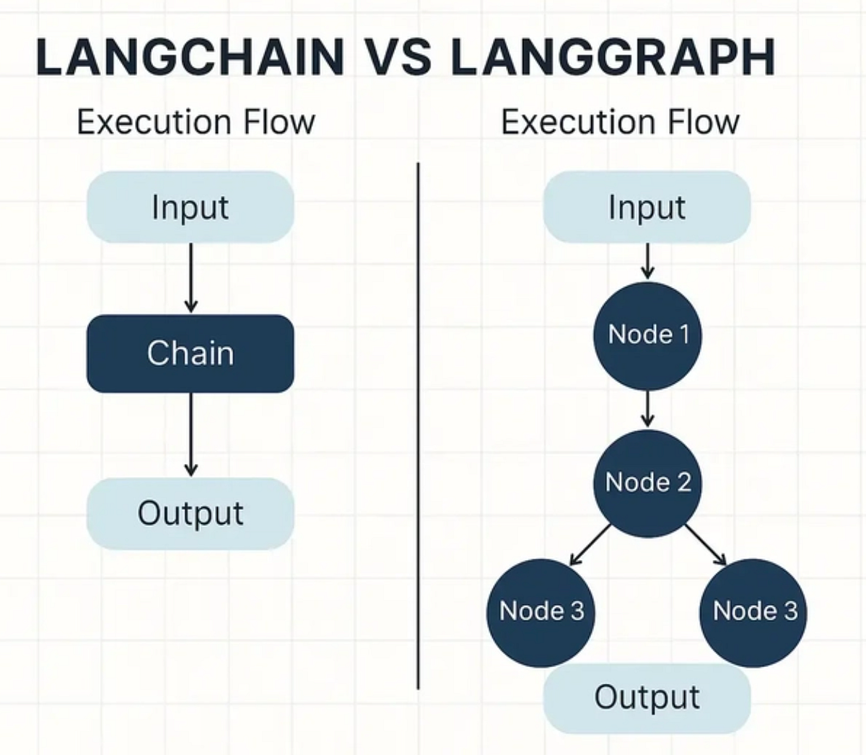
The Problem in Today’s GenAI Developer Ecosystem
The Problem in Today’s GenAI Developer Ecosystem
Fragmented tools for LLMs, RAG, agents, and data
No standard interface for inputs, outputs, or serving
Prototype ≠ production (hard to deploy, monitor, version)
Weak governance over data, models, and prompts
Poor integration with enterprise data platforms
GenAI is easy to demo, but hard to scale, govern, and productionize.

Slide 4
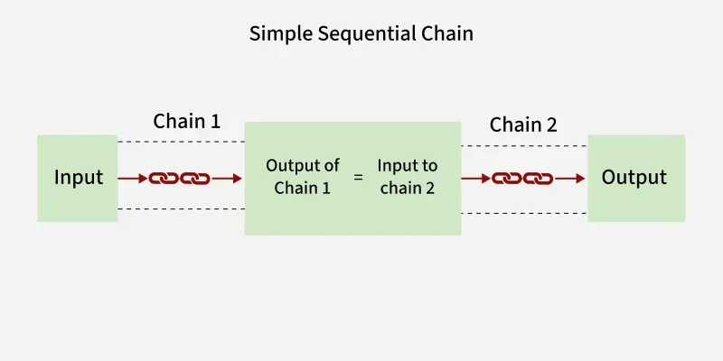
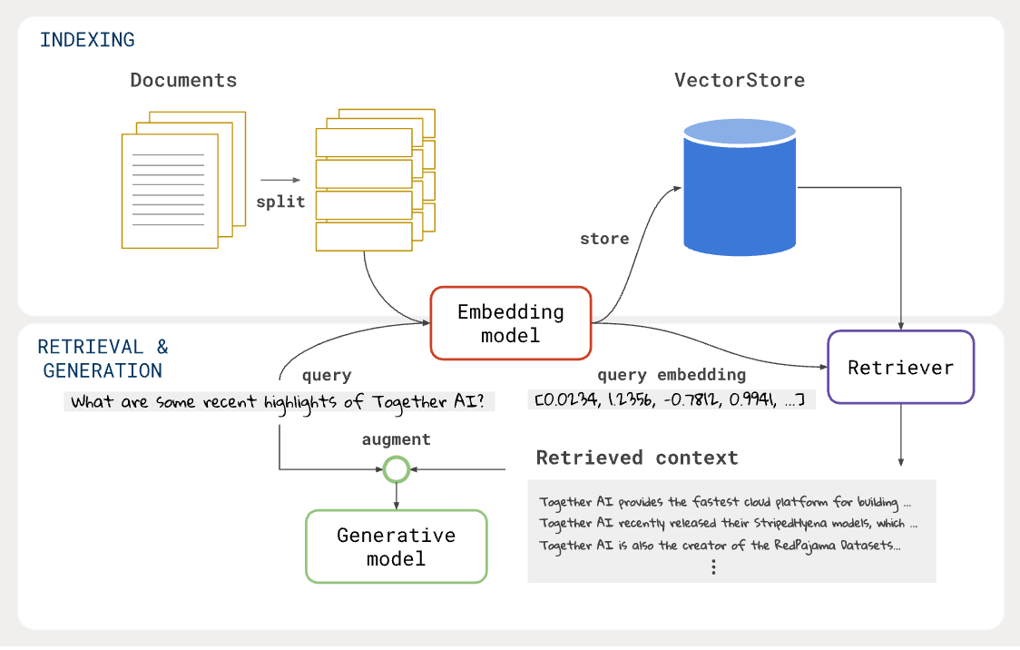
Introducing LangChain…………….
LangChain is a software framework designed to help create applications that utilize large language models (LLMs).
LangChain's strength lies in its wide array of integrations and capabilities. It includes API wrappers, web scraping subsystems, code analysis tools, document summarization tools, and more.
It also supports large language models from OpenAI, Anthropic, HuggingFace, etc. out of the box along with various data sources and types.

Slide 5
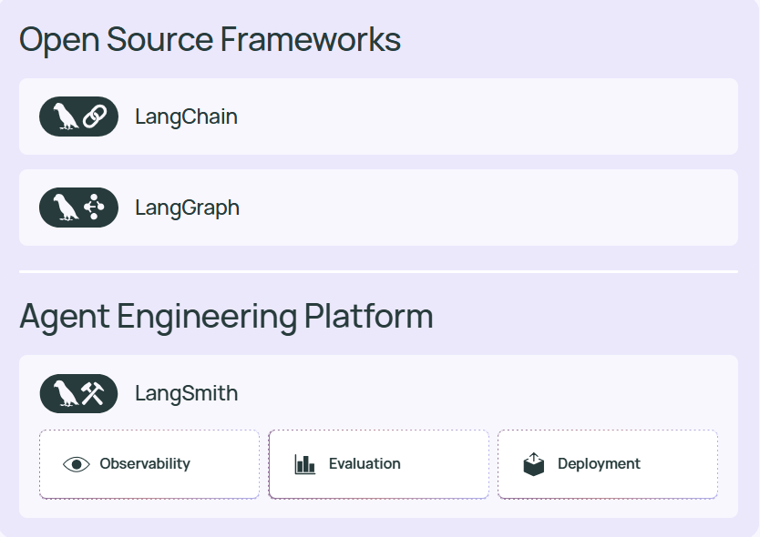
The LangChain Agent Engineering Stack

Slide 6
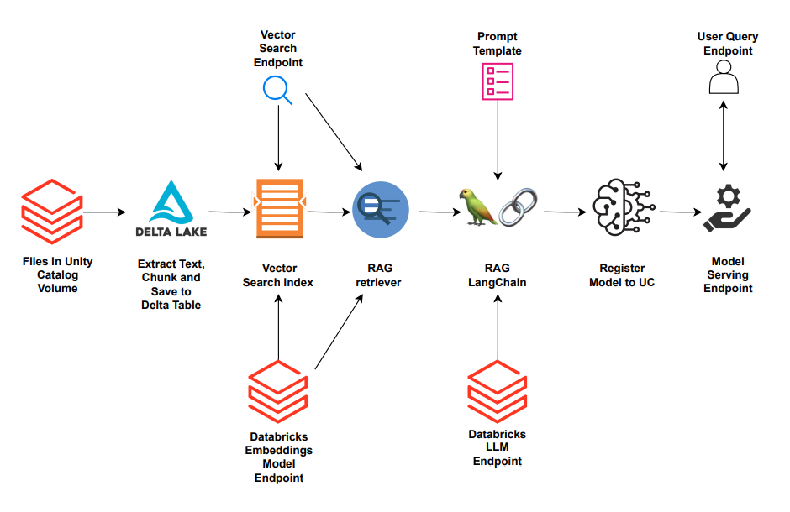
LangChain + Databricks = Life Made Easy ☺

