Slide 1
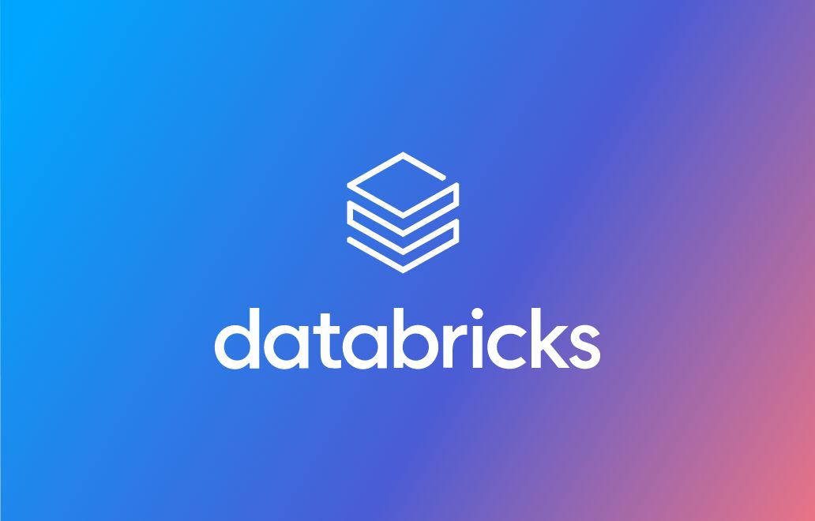
Medallion Architecture and Spark Declarative Pipelines (SDP)

Slide 2
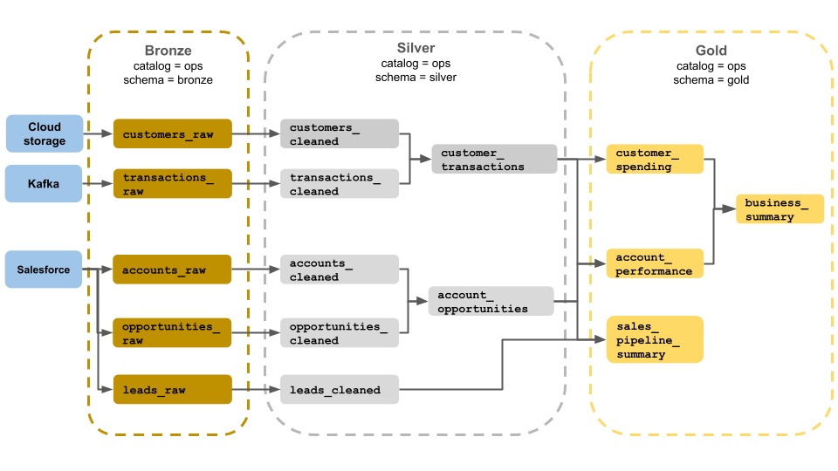
The Medallion architecture
This example of a medallion architecture shows bronze, silver, and gold layers for use by a business operations team. Each layer is stored in a different schema of the ops catalog.
Bronze Layer: This is the raw data layer where data is ingested in its original format. It is typically unprocessed and may contain duplicates, missing values, and other inconsistencies.
Silver Layer: This is the cleaned and enriched data layer. Data in this layer has been processed to remove duplicates, handle missing values, and apply basic transformations1. It is more structured and ready for further analysis.
Gold Layer: This is the curated and aggregated data layer. Data in this layer is highly processed, aggregated, and optimized for business intelligence and analytics1. It is ready for consumption by end-users and applications
Notes:
The Medallion architecture is a data design pattern used to logically organize data in a lakehouse, with the goal of incrementally and progressively improving the structure and quality of data as it flows through each layer of the architecture. It consists of three layers: Bronze, Silver, and Gold.
Layers of the Medallion Architecture:
Bronze Layer: This is the raw data layer where data is ingested in its original format. It is typically unprocessed and may contain duplicates, missing values, and other inconsistencies1.
Silver Layer: This is the cleaned and enriched data layer. Data in this layer has been processed to remove duplicates, handle missing values, and apply basic transformations1. It is more structured and ready for further analysis.
Gold Layer: This is the curated and aggregated data layer. Data in this layer is highly processed, aggregated, and optimized for business intelligence and analytics1. It is ready for consumption by end-users and applications

Slide 3
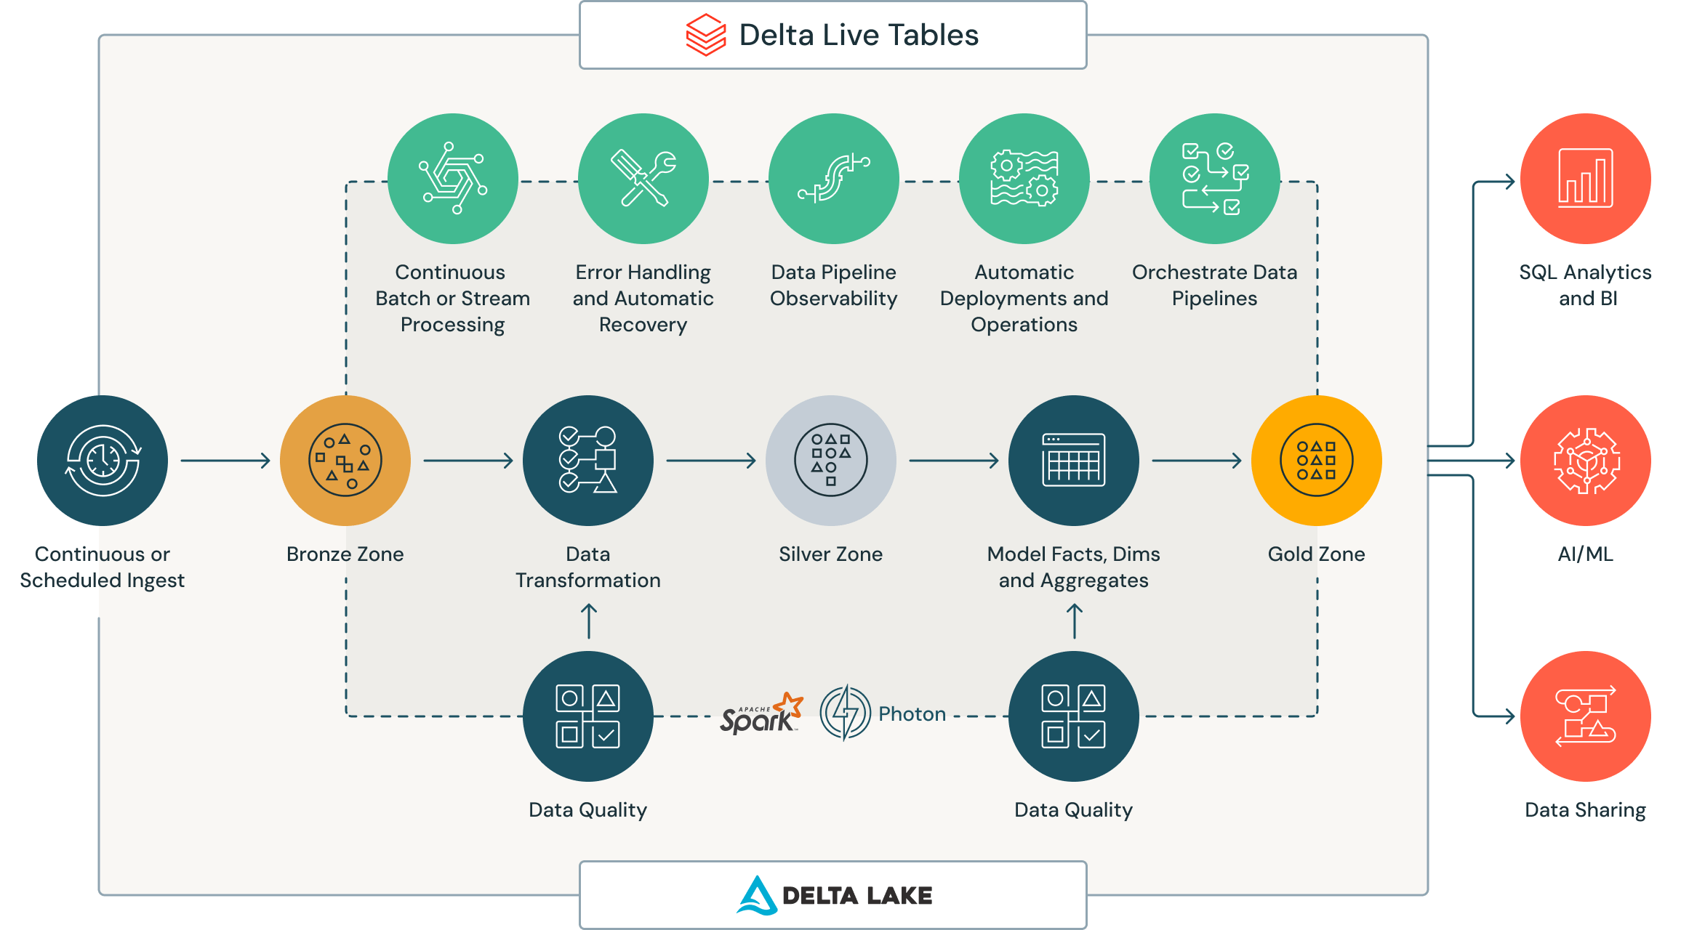
Orchestration with Spark Declarative Pipelines
Delta Live Tables is a declarative framework for building reliable, maintainable, and testable data processing pipelines. You define the transformations to perform on your data and Delta Live Tables manages task orchestration, cluster management, monitoring, data quality, and error handling.

