Slide 1
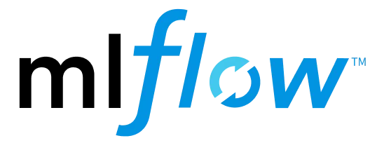
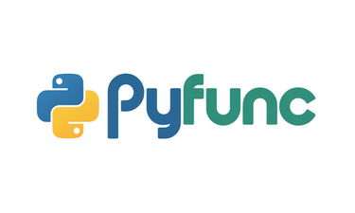
Mlflow and PyFunc in Databricks
(Building custom AI models and engines)

Slide 2
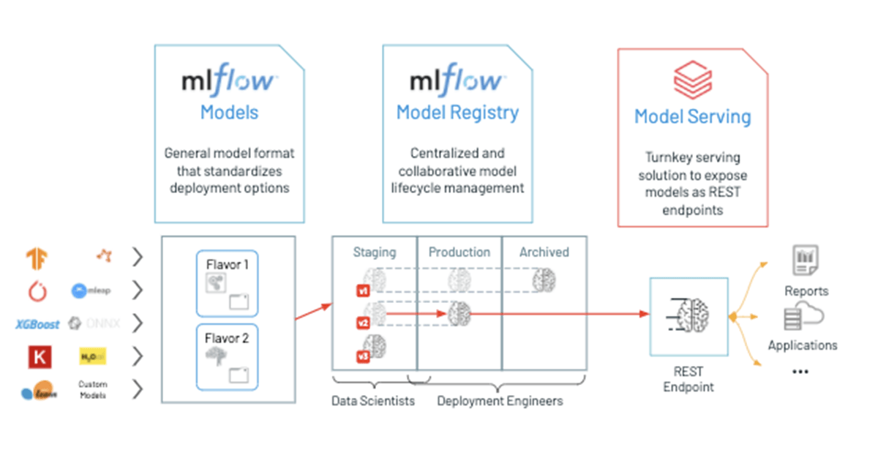
What is MLflow?
MLflow is an open source platform for developing models and generative AI applications. It has the following primary components:
Tracking: Allows you to track experiments to record and compare parameters and results.
Models: Allow you to manage and deploy models from various ML libraries to various model serving and inference platforms.
Model Registry: Allows you to manage the model deployment process from staging to production, with model versioning and annotation capabilities.
AI agent evaluation and tracing: Allows you to develop high-quality AI agents by helping you compare, evaluate, and troubleshoot agents.

Slide 3
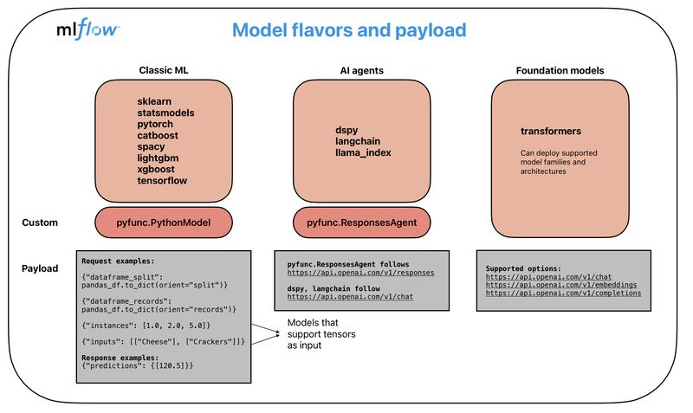
Mlflow Flavors
MLflow Flavors – Big Picture
MLflow Flavors define how different types of models are packaged, logged, and served
Each flavor standardizes:
How a model is saved
How inputs are passed
How outputs are returned
Enables consistent model deployment across tools and teams
Prebuilt mlflow flavors are all fine and good, but what if I want to go the completely custom route and build my own flavor?

Slide 4
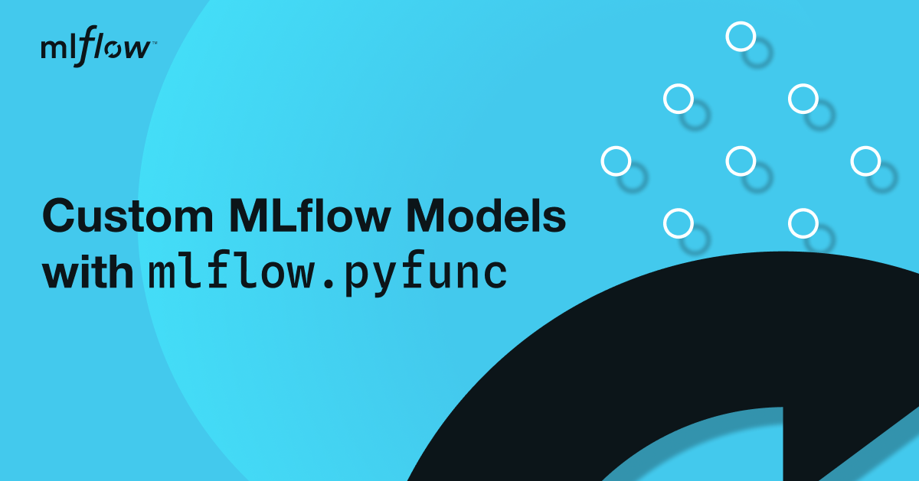
PyFunc – Solution to Building Custom Flavors with MLflow
The Problem (Recap from Previous Slide)
MLflow supports many built-in flavors
Each flavor has:
Different input formats
Different output structures
Different serving APIs
Hard to:
Standardize inference
Mix ML + LLMs + agents
Build one production API
What Is PyFunc?
PyFunc is MLflow’s generic, universal model interface
Allows you to define:
Custom input handling
Custom inference logic
Custom output format
Works for any model type

Slide 5
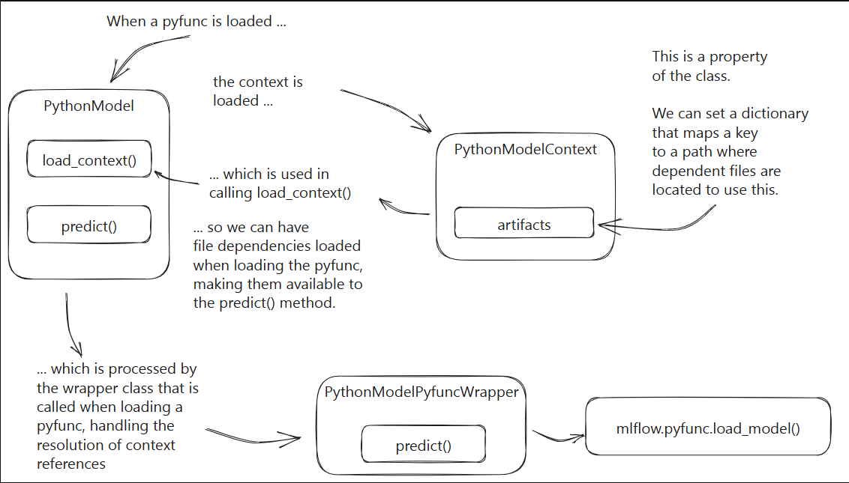
Understanding PyFunc in MLflow

