Slide 1
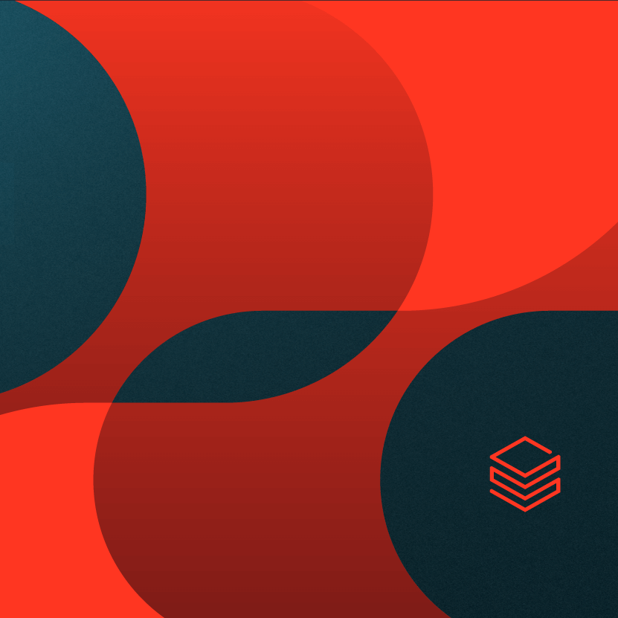
Mosaic AI Agent Framework

Slide 2
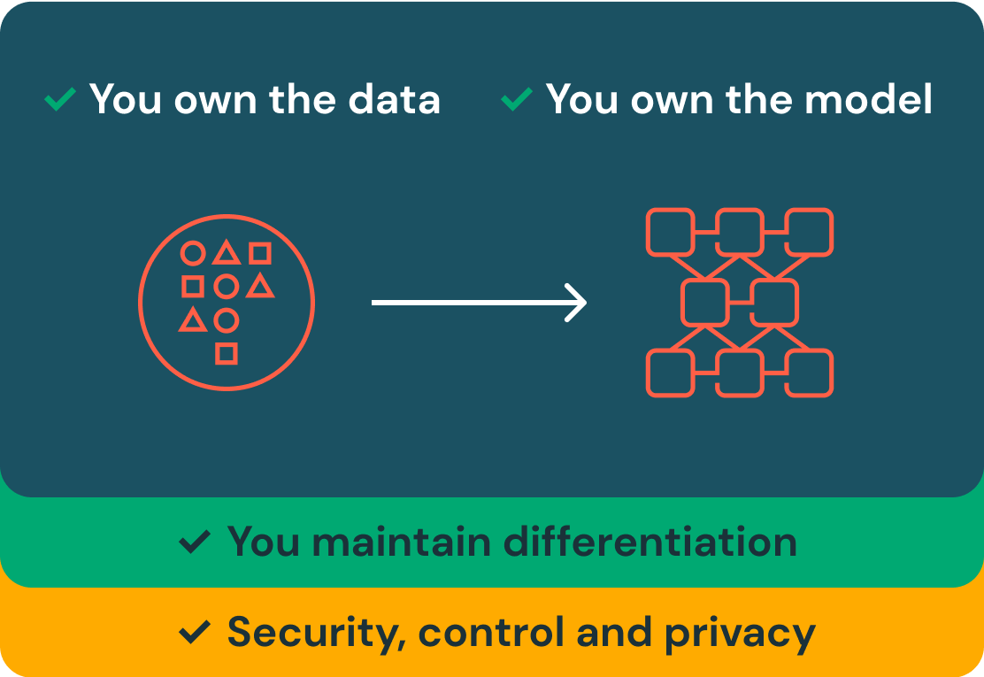
Mosaic AI in Azure Databricks
Mosaic AI is part of the Databricks Data Intelligence Platform, which unifies data, model training and production environments in a single solution.
Model Serving is a unified service for deploying, governing and querying AI models. This unified approach makes it easy to experiment with and productionize models. This includes:
Custom ML models like PyFunc, scikit-learn and LangChain
Foundation models (FMs) on Databricks like Llama 3, MPT, Mistral and BGE
Foundation models hosted elsewhere like ChatGPT, Claude 3, Cohere and Stable Diffusion
Mosaic AI enables organizations to securely and cost-effectively build production-quality compound AI systems integrated with their enterprise data.

Slide 3
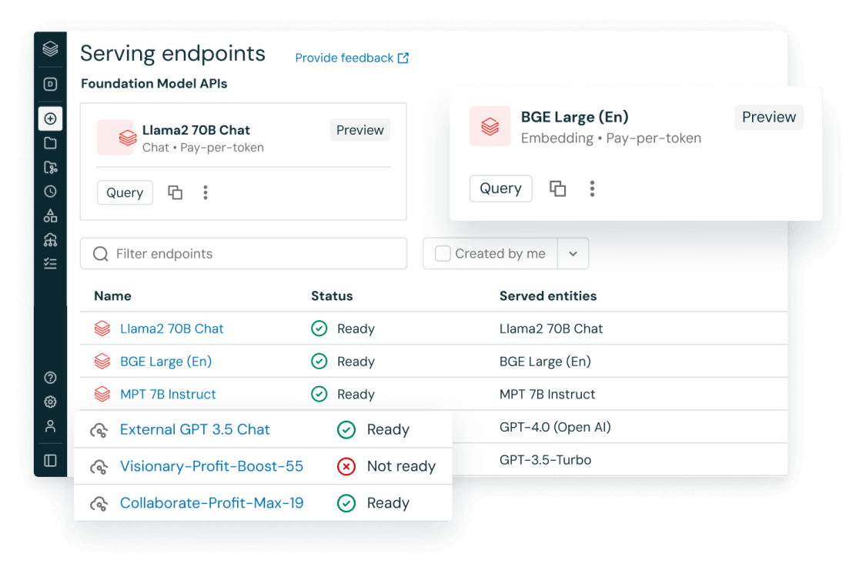
Simplified deployment for all AI models and agents

Slide 4
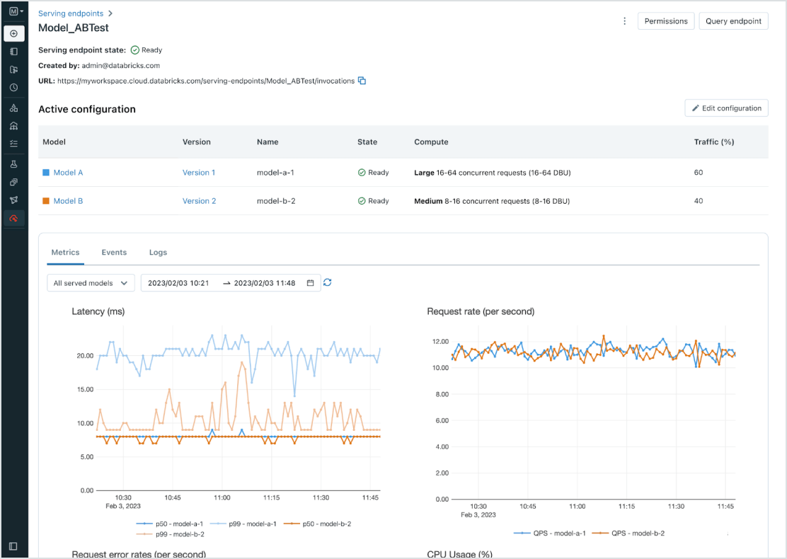
Simplified deployment for all AI models and agents

Slide 5
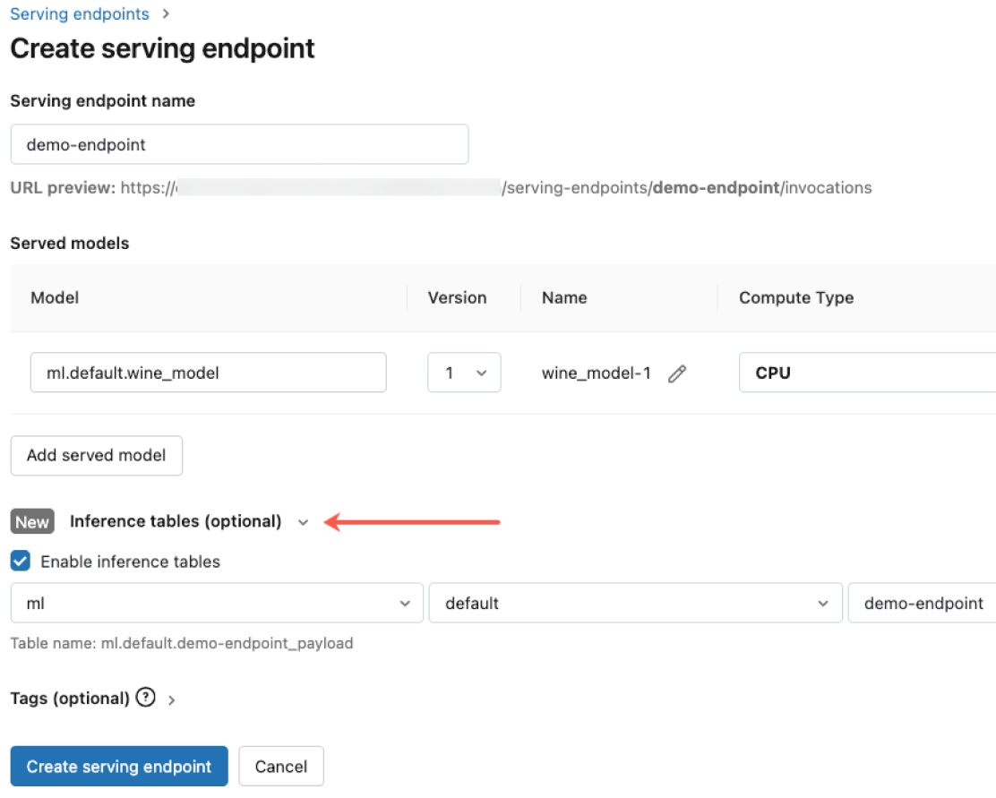
Governance built-in

Slide 6
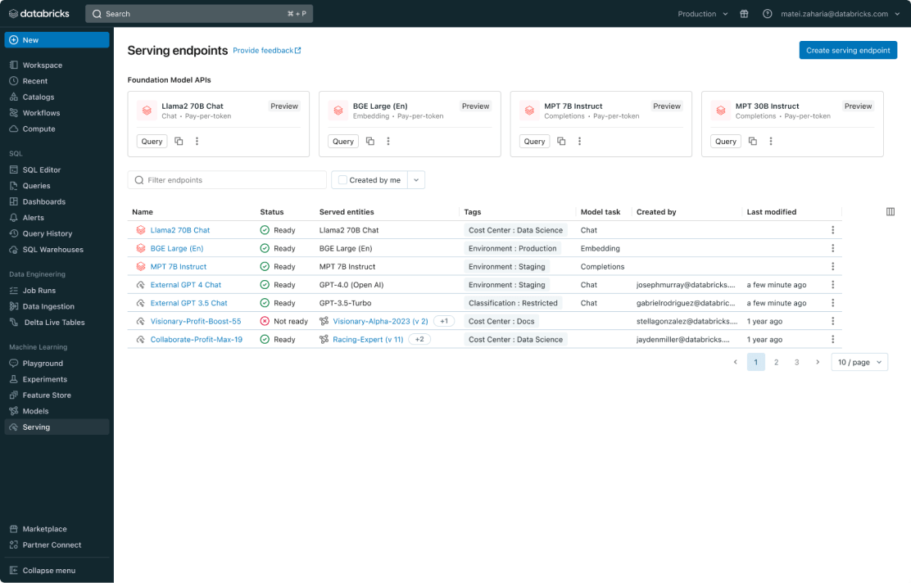
Unified Management for all Models

Slide 7
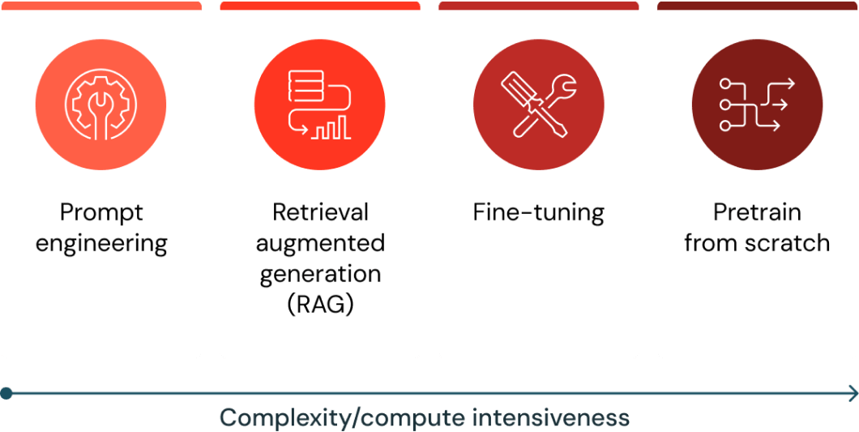
Mosaic AI Agent Framework for GenAI
Mosaic AI Agent Framework comprises a set of tools on Databricks designed to help developers build, deploy, and evaluate production-quality agents like Retrieval Augmented Generation (RAG) applications.
You can deploy Foundational Large Language Models in Azure Databricks. Base models, like DBRX Instruct, Meta-Llama-3.1-70B-Instruct, GTE-Large, and Mistral-7B are available for immediate use with pay-per-token pricing, and workloads that require performance guarantees, like fine-tuned model variants, can be deployed with provisioned throughput.

Slide 8
Mosaic AI Agent Framework Python SDK
%pip install -U -qqqq mlflow databricks-openai databricks-agents
dbutils.library.restartPython()
from databricks import agents
deployment_info = agents.deploy(
model_name=registered_model_name,
model_version=logged_agent_info.registered_model_version,
scale_to_zero=True,
deploy_feedback_model=False
)

