Slide 1
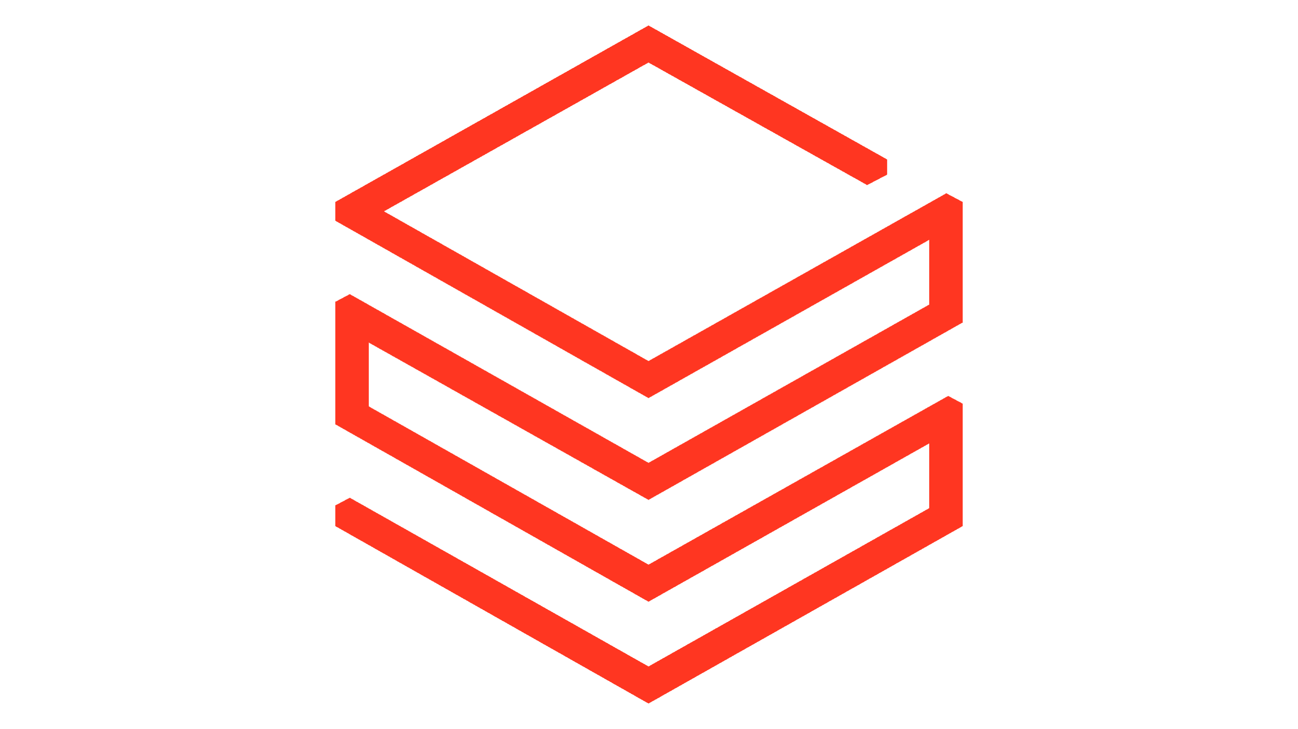
The Entire Data Estate

Slide 2
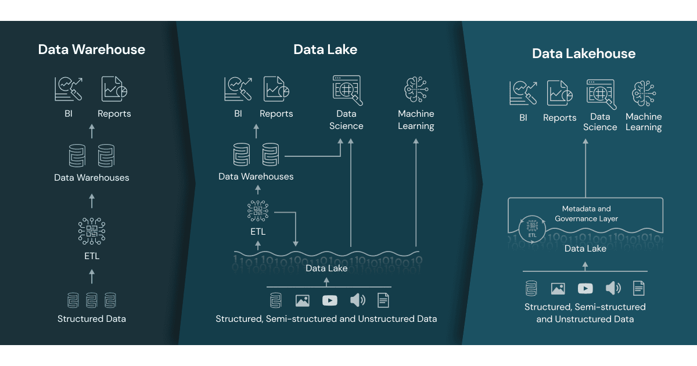

Data Lakehouse
A data lakehouse provides scalable storage and processing capabilities for modern organizations that want to avoid isolated systems for processing different workloads, like machine learning (ML) and business intelligence (BI).
A data lakehouse is a modern data management architecture that combines the best features of data lakes and data warehouses. It provides the scalability and flexibility of data lakes with the data management and transactional capabilities of data warehouse
A data lakehouse can help establish a single source of truth, eliminate redundant costs, and ensure data freshness.
When you combine the data storage layer of Data Lake and transactional capabilities of Delta Lake, you get a Data Lakehouse
Delta Lake Integration
Notes:
Storage Foundation: ADLS serves as the underlying storage layer for a data lakehouse. It provides the scalable and cost-effective storage needed to hold large volumes of data.
Delta Lake Integration: On top of ADLS, Delta Lake is often used to add data management capabilities. Delta Lake provides ACID transactions, schema enforcement, and other data management features that enhance the reliability and performance of the data lakehouse.
Unified Data Access: The data lakehouse architecture allows users to access and analyze data stored in ADLS using a single platform, simplifying data workflows and reducing the need for multiple systems
Delta Lake can be considered a bridge between traditional data lakes and data warehouses. By adding data warehouse-like management capabilities to data lakes (like ACID transactions and schema enforcement), Delta Lake transforms a simple data lake into a more robust, reliable, and performance-optimized data platform, which is sometimes referred to as a data lakehouse
Delta lake = data warehouse
Not quite. Although Delta Lake provides some data warehouse-like features, it is not a data warehouse itself. Here's a breakdown:
Delta lake = data warehouse
Not quite. Although Delta Lake provides some data warehouse-like features, it is not a data warehouse itself. Here's a breakdown:
Delta Lake
Purpose: Delta Lake is an open-source storage layer that adds reliability and performance optimizations to data lakes.
Features: It provides ACID transactions, scalable metadata handling, and unified batch and streaming data processing.
Integration: It integrates with big data tools like Apache Spark to enhance the capabilities of a data lake.
Data Warehouse
Purpose: A data warehouse is a system designed for querying and analyzing large volumes of structured data, typically from various sources.
Features: It includes optimized storage, complex querying capabilities, and data transformation functionalities, usually structured in a star or snowflake schema.
Usage: Data warehouses are used for Business Intelligence (BI) and reporting.

Slide 3
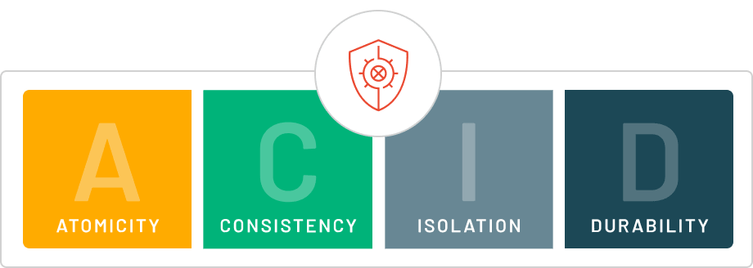
Data becomes your single source of truth
Azure Databricks uses cloud object storage to store all data files and transaction logs. Cloud object storage has high availability and durability.
The transaction log controls commit atomicity. During a transaction, data files are written to the file directory backing the table. When the transaction completes, a new entry is committed to the transaction log that includes the paths to all files written during the transaction.
Azure Databricks uses write serializable isolation by default for all table writes and updates. Snapshot isolation is used for all table reads.
Delta Lake uses optimistic concurrency control to provide transactional guarantees between writes.
Notes:
By adding data warehouse-like management capabilities to data lakes (like ACID transactions and schema enforcement), Delta Lake transforms a simple data lake into a more robust, reliable, and performance-optimized data platform, which is sometimes referred to as a data lakehouse.

