Slide 1

Vector Indices in Databricks
(Types and Properties)

Slide 2
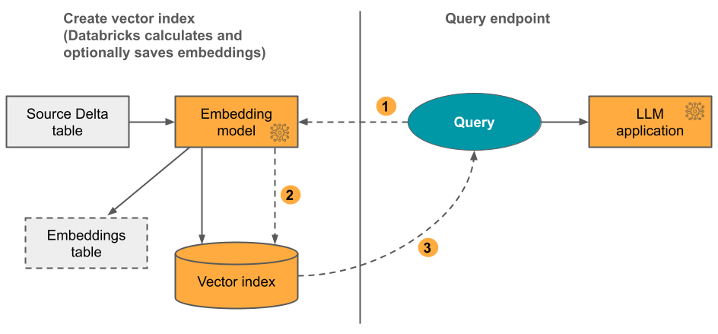
Delta Sync Index with Embeddings Computed by Databricks
You provide a source Delta table that contains data in text format. Databricks calculates the embeddings, using a model that you specify, and optionally saves the embeddings to a table in Unity Catalog.
As the Delta table is updated, the index stays synced with the Delta table.

Slide 3
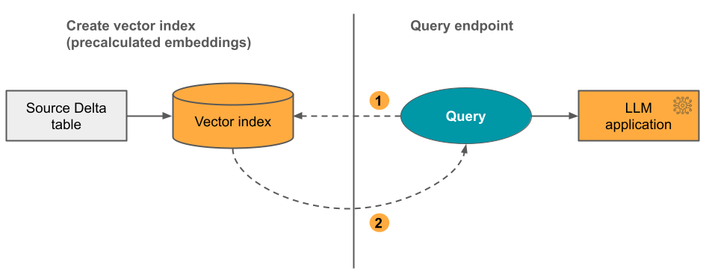
Delta Sync Index with Self-Managed Embeddings
With this option, you provide a source Delta table that contains pre-calculated embeddings. As the Delta table is updated, the index stays synced with the Delta table.

Slide 4
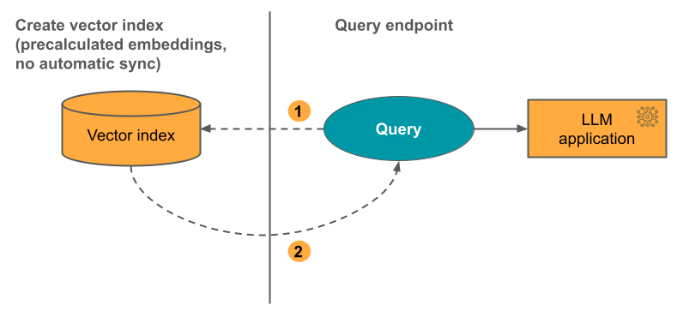
Direct Vector Access Index
With this option, you must manually update the index using the REST API when the embeddings table changes.

Slide 5
