Slide 1





A-DRM: Architecture-aware Distributed Resource Management of Virtualized Clusters
Hui Wang†*, Canturk Isci‡, Lavanya Subramanian*,
Jongmoo Choi#*, Depei Qian†, Onur Mutlu*
†Beihang University, ‡IBM T. J. Watson Research Center,
*Carnegie Mellon University, #Dankook University

Slide 2
Executive Summary
Virtualized Clusters dynamically schedule a set of Virtual Machines (VM) across many physical hosts (called DRM, Distributed Resource Management)
Observation: State-of-the-art DRM techniques do not take into account microarchitecture-level resource (cache and memory bandwidth) interference between VMs
Problem: This lack of visibility into microarchitecture-level resources significantly impacts the entire virtualized cluster’s performance
Our Goal: Maximize virtualized cluster performance by making DRM microarchitecture aware
Mechanism: Architecture-aware Distributed Resource Management (A-DRM):
1) Dynamically monitors the microarchitecture-level shared resource usage
2) Balances the microarchitecture-level interference across the cluster (while accounting for other resources as well)
Key Results: 9.67% higher performance and 17% higher memory bandwidth utilization than conventional DRM

Slide 3
Virtualized Cluster
VM
VM
VM
VM
App
App
App
App
How to dynamically schedule VMs onto hosts?
Distributed Resource Management (DRM) policies
Host
Host
Core0
Core1
Core0
Core1
LLC
LLC
DRAM
DRAM

Slide 4
Conventional DRM Policies
Based on operating-system-level metrics
e.g., CPU utilization, memory capacity demand
VM
VM
App
App
App
App
Memory Capacity
Host
Host
VM
Core0
Core1
Core0
Core1
CPU
App
LLC
LLC
DRAM
DRAM

Slide 5
Microarchitecture-level Interference
Host
Core0
Core1
VMs within a host compete for:
Shared cache capacity
Shared memory bandwidth
VM
VM
App
App
LLC
DRAM
Can operating-system-level metrics capture the microarchitecture-level resource interference?

Slide 6

Microarchitecture Unawareness
VM | Operating-system-level metrics
 | CPU Utilization | Memory Capacity
 | 92% | 369 MB
 | 93% | 348 MB
Microarchitecture-level metrics
LLC Hit Ratio | Memory Bandwidth
2% | 2267 MB/s
98% | 1 MB/s
App
Host
Host
Memory Capacity
Core0
Core1
Core0
Core1
VM
VM
VM
VM
VM
CPU
App
App
App
App
App
STREAM
LLC
LLC
App
gromacs
DRAM
DRAM

Slide 7
Impact on Performance
Host
Host
Memory Capacity
Core0
Core1
Core0
Core1
VM
VM
VM
VM
VM
CPU
App
App
SWAP
App
App
App
STREAM
LLC
LLC
App
gromacs
DRAM
DRAM

Slide 8
Impact on Performance
We need microarchitecture-level interference awareness in DRM!
49%
Host
Host
Memory Capacity
Core0
Core1
Core0
Core1
VM
VM
VM
VM
VM
CPU
App
App
App
App
App
STREAM
LLC
LLC
App
gromacs
DRAM
DRAM

Slide 9
Outline
Motivation
A-DRM
Methodology
Evaluation
Conclusion

Slide 10
A-DRM: Architecture-aware DRM
Goal: Take into account microarchitecture-level shared resource interference
Shared cache capacity
Shared memory bandwidth
Key Idea:
Monitor and detect microarchitecture-level shared resource interference
Balance microarchitecture-level resource usage across cluster

Slide 11
Conventional DRM
Hosts
Controller
DRM: Global Resource Manager
OS+Hypervisor
Profiling Engine
VM
VM
App
•••
App
Distributed Resource Management (Policy)
CPU/Memory Capacity
Profiler
Migration Engine

Slide 12
A-DRM: Architecture-aware DRM
Hosts
Controller
A-DRM: Global Architecture –aware Resource Manager
OS+Hypervisor
Profiling Engine
VM
VM
App
•••
App
Architecture-aware
Interference Detector
Architecture-aware
Distributed Resource Management (Policy)
CPU/Memory Capacity
Architectural Resource
Architectural Resources
Profiler
Migration Engine

Slide 13
Architectural Resource Profiler
Leverages the Hardware Performance Monitoring Units (PMUs):
Last level cache (LLC)
Memory bandwidth (MBW)
Reports to Controller periodically

Slide 14
A-DRM: Architecture-aware DRM
Hosts
Controller
A-DRM: Global Architecture –aware Resource Manager
OS+Hypervisor
Profiling Engine
VM
VM
App
•••
App
Architecture-aware
Interference Detector
Architecture-aware
Distributed Resource Management (Policy)
CPU/Memory
Architectural Resource
Architectural Resources
Profiler
Migration Engine

Slide 15
Architecture-aware Interference Detector
Goal: Detect shared cache capacity and memory bandwidth interference
Memory bandwidth utilization (MBW_{util}) captures both:
Shared cache capacity interference
Shared memory bandwidth interference
Host
Core0
Core1
VM
VM
Key observation: If MBW_{util} is too high, the host is experiencing interference
App
App
LLC
DRAM

Slide 16
A-DRM: Architecture-aware DRM
Hosts
Controller
A-DRM: Global Architecture –aware Resource Manager
OS+Hypervisor
Profiling Engine
VM
VM
App
•••
App
Architecture-aware
Interference Detector
Architecture-aware
Distributed Resource Management (Policy)
CPU/Memory
Architectural Resource
Architectural Resources
Profiler
Migration Engine

Slide 17
A-DRM Policy
Two-phase algorithm
Phase One:
Goal: Mitigate microarchitecture-level resource interference
Key Idea: Suggest migrations to balance memory bandwidth utilization across cluster using a new cost-benefit analysis
Phase Two:
Goal: Finalize migration decisions by also taking into account OS-level metrics (similar to conventional DRM)

Slide 18
A-DRM Policy: Phase One
Goal: Mitigate microarchitecture-level shared resource interference
Employ a new cost-benefit analysis to filter out migrations that cannot provide enough benefit
Only migrate the least number of VMs required to bring the MBW_{util} below a threshold (MBW_{Threshold})
Source
Destination
Core0
Core1
Core0
Core1
VM
VM
VM
VM
App
App
App
App
High MBW
LLC
LLC
App
Low MBW
DRAM
DRAM

Slide 19
A-DRM Policy: Phase Two
Goals:
Finalize migration decisions by also taking into account OS-level metrics
Avoid new microarchitecture-level resource hotspots
Source
Destination
Core0
Core1
Core0
Core1
VM
VM
VM
VM
App
App
App
App
High MBW
LLC
LLC
App
Low MBW
DRAM
DRAM

Slide 20
A-DRM Policy
Two-phase algorithm
Phase One:
Goal: Mitigate microarchitecture-level resource interference
Key Idea: Suggest migrations to balance memory bandwidth utilization across cluster using a new cost-benefit analysis
Phase Two:
Goal: Finalize migration decisions by also taking into account OS-level metrics (similar to conventional DRM)

Slide 21
The Goal of Cost-Benefit Analysis
For every VM at a contended host, we need to determine:
If we should migrate it
Where we should migrate it
For each VM at a contended source, we consider migrating it to every uncontended destination
We develop a new linear model to estimate the performance degradation/improvement in terms of time

Slide 22
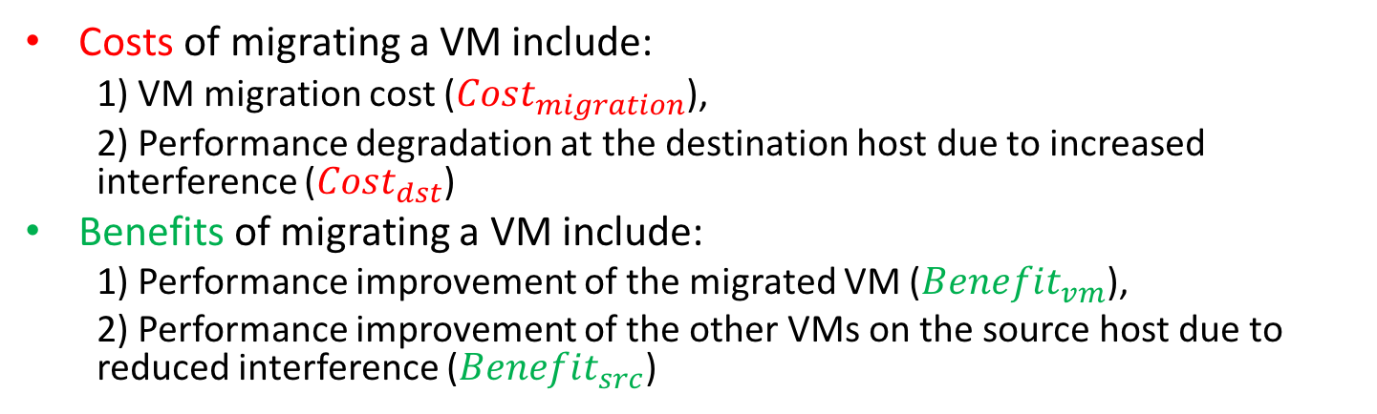
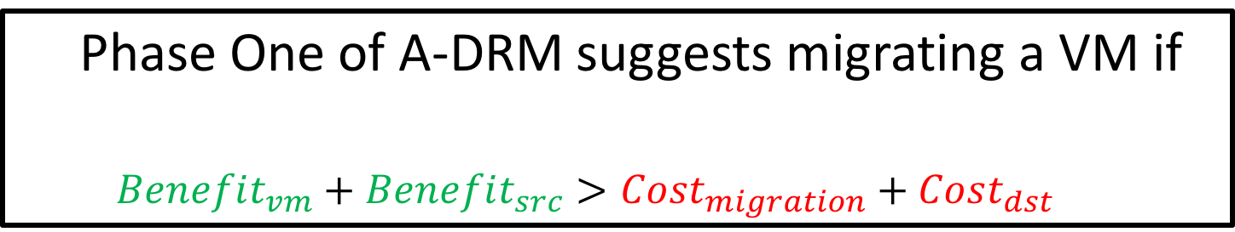
Cost-Benefit Analysis
Costs of migrating a VM include:
1) VM migration cost ($Cost_{migration}$),
2) Performance degradation at the destination host due to increased interference ($Cost_{dst}$)
Benefits of migrating a VM include:
1) Performance improvement of the migrated VM ($Benefit_{vm}$),
2) Performance improvement of the other VMs on the source host due to reduced interference ($Benefit_{src}$)
src
dst
Core0
Core1
VM
Core0
Core1
VM
VM
VM
VM
Phase One of A-DRM suggests migrating a VM if
$$Benefit_{vm}+Benefit_{src}>Cost_{migration}+Cost_{dst}$$
App
App
App
App
App
LLC
LLC
DRAM
DRAM

Slide 23
Cost-Benefit Analysis
Costs of migrating a VM include:
1) VM migration cost ($Cost_{migration}$),
2) Performance degradation at the destination host due to increased interference ($Cost_{dst}$)
Benefits of migrating a VM include:
1) Performance improvement of the migrated VM ($Benefit_{vm}$),
2) Performance improvement of the other VMs on the source host due to reduced interference ($Benefit_{src}$)
Phase One of A-DRM suggests migrating a VM if
$$Benefit_{vm}+Benefit_{src}>Cost_{migration}+Cost_{dst}$$

Slide 24

$Cost_{migration}$: VM migration
VM migration approach used in A-DRM:
‘Pre-copy-based’ live migration + timeout support
High cost since all of the VM’s pages need to be iteratively:
scanned, tracked
transferred
The migration time can be estimated similar to conventional DRM policies

Slide 25
Cost-Benefit Analysis
Costs of migrating a VM include:
1) VM migration cost ($Cost_{migration}$),
2) Performance degradation at the destination host due to increased interference ($Cost_{dst}$)
Benefits of migrating a VM include:
1) Performance improvement of the migrated VM ($Benefit_{vm}$),
2) Performance improvement of the other VMs on the source host due to reduced interference ($Benefit_{src}$)
Phase One of A-DRM suggests migrating a VM if
$$Benefit_{vm}+Benefit_{src}>Cost_{migration}+Cost_{dst}$$

Slide 26

$Cost_{dst}$: Performance Degradation at dst
The migrated vm competes for:
Shared cache capacity
Shared memory bandwidth
Performance at dst degrades due to:
Increase in memory bandwidth consumption
Increase in the memory stall time experienced by VMs
dst
Core0
Core1
VM
vm
VM
App
App
App
LLC
DRAM

Slide 27
Cost-Benefit Analysis
Costs of migrating a VM include:
1) VM migration cost ($Cost_{migration}$),
2) Performance degradation at the destination host due to increased interference ($Cost_{dst}$)
Benefits of migrating a VM include:
1) Performance improvement of the migrated VM ($Benefit_{vm}$),
2) Performance improvement of the other VMs on the source host due to reduced interference ($Benefit_{src}$)
Phase One of A-DRM suggests migrating a VM if
$$Benefit_{vm}+Benefit_{src}>Cost_{migration}+Cost_{dst}$$

Slide 28

$Benefit_{vm}$: Performance improvement of vm
The performance of migrated vm improves due to:
Lower contention for memory bandwidth
Lower memory stall time
src
dst
Core0
Core1
Core0
Core1
VM
vm
VM
VM
App
App
App
App
LLC
LLC
DRAM
DRAM

Slide 29
Cost-Benefit Analysis
Costs of migrating a VM include:
1) VM migration cost ($Cost_{migration}$),
2) Performance degradation at the destination host due to increased interference ($Cost_{dst}$)
Benefits of migrating a VM include:
1) Performance improvement of the migrated VM ($Benefit_{vm}$),
2) Performance improvement of the other VMs on the source host due to reduced interference ($Benefit_{src}$)
Phase One of A-DRM suggests migrating a VM if
$$Benefit_{vm}+Benefit_{src}>Cost_{migration}+Cost_{dst}$$

Slide 30

$Benefit_{src}$: Performance improvement at src
src
The performance at src improves due to:
Reduced memory bandwidth consumption
Reduced stall time experienced by VMs
Core0
Core1
VM
VM
App
App
LLC
DRAM

Slide 31
A-DRM Policy
Two-phase algorithm
Phase One:
Goal: Mitigate microarchitecture-level resource interference
Key Idea: Suggest migrations to balance memory bandwidth utilization across cluster using a new cost-benefit analysis
Phase Two:
Goal: Finalize migration decisions by also taking into account OS-level metrics (similar to conventional DRM)

Slide 32
Outline
Motivation
A-DRM
Methodology
Evaluation
Conclusion

Slide 33
Evaluation Infrastructure
2/4 dual-socket Hosts
Two 4-core Xeon L5630 Processors (Westmere-EP) with hyperthreading disabled
L1/L2/shared LLC: 32KB/256KB/12MB
One 8GB DDR3-1066 DIMM per socket
VM Images placed in shared storage (NAS)
OS and Hypervisor:
Fedora 20 with Linux Kernel version 3.13.5-202
QEMU: 1.6.2
Libvirt: 1.1.3.5
Host
Socket 1
Socket 2
Core
Core
Core
Core
Core
Core
Core
Core
QPI
LLC
LLC
DRAM
DRAM

Slide 34
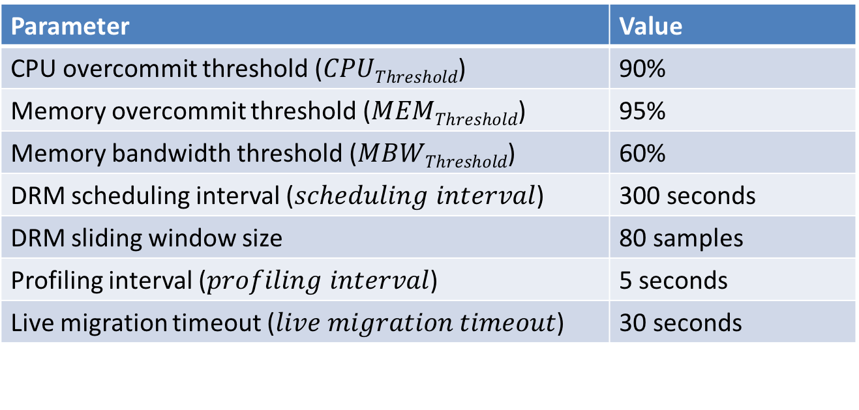
DRM Parameters
Baseline: Conventional DRM [Isci et al., NOMS’ 10]
Parameter | Value
CPU overcommit threshold ($CPUThreshold$) | 90%
Memory overcommit threshold ($MEMThreshold$) | 95%
Memory bandwidth threshold ($MBWThreshold$) | 60%
DRM scheduling interval ($scheduling interval$) | 300 seconds
DRM sliding window size | 80 samples
Profiling interval ($profiling interval$) | 5 seconds
Live migration timeout ($live migration timeout$) | 30 seconds

Slide 35
Workloads
55 Workloads chosen from:
PARSEC (10)
SPEC CPU 2006 (28)
NAS Parallel Benchmark (14)
STREAM (1)
Microbenchmark (2)
Classified based on memory intensity:
memory-intensive (memory bandwidth larger than 1GB/s)
memory-non-intensive

Slide 36
Outline
Motivation
A-DRM
Methodology
Evaluation
1. Case Study
2. Heterogeneous Workloads
3. Per-Host vs. Per-Socket Interference Detection
Conclusion

Slide 37
1. Case Study
14 VMs on two 8-core hosts
Initially:
Host A: 7 memory-intensive VMs (STREAM)
Host B: 7 memory-non-intensive VMs (gromacs)
MBW Demand
Host State
Memory Bandwidth Enough
H
Memory Bandwidth Starved
L
Host A
Host B

Slide 38
Host A
Host B
CPU
Util [%]
Mem Capacity
Util [%]
MBW
Util [%]
Host A
Host B

Slide 39
Host A
Host B
CPU
Util [%]
Mem Capacity
Util [%]
MBW
Util [%]
Host A
Host B

Slide 40
Host A
Host B
CPU
Util [%]
Mem Capacity
Util [%]
MBW
Util [%]
Host A
Host B

Slide 41
Host A
Host B
CPU
Util [%]
Mem Capacity
Util [%]
MBW
Util [%]
By migrating VMs using online measurement of microarchitecture-level resource usage, A-DRM:
Mitigates resource interference
Achieves better memory bandwidth utilization
Host A
Host B

Slide 42
Outline
Motivation
A-DRM
Methodology
Evaluation
1. Case Study
2. Heterogeneous Workloads
3. Per-Host vs. Per-Socket Interference Detection
Conclusion

Slide 43
2. Heterogeneous workloads
28 VMs on four 8-core hosts
Unbalanced placement according to intensity
Workloads (denoted as iXnY-Z):
X VMs running memory-intensive benchmarks
Y VMs running memory-non-intensive benchmarks
Z indicates the two different workloads under the same intensity

Slide 44
Performance Benefits of A-DRM
9.7%
Compared to traditional DRM scheme:
Performance improves by up to 26.6%, with an average of 9.7%
The higher the imbalance between hosts, the greater the performance improvement

Slide 45
Number of Migrations
6
The higher the imbalance between hosts, the greater the number of migrations

Slide 46
Cluster-wide Resource Utilization
Average memory bandwidth utilization improves by 17%
Comparable CPU and memory capacity utilization

Slide 47
Outline
Motivation
A-DRM
Methodology
Evaluation
1. Case Study
2. Heterogeneous Workloads
3. Per-Host vs. Per-Socket Interference Detection
Conclusion

Slide 48
Per-Host vs. Per-Socket Interference Detection
Host A
Host B
Socket 1
Socket 2
Socket 1
Socket 2
Core
Core
Core
Core
Core
Core
Core
Core
VM
VM
VM
VM
VM
VM
VM
VM
App
App
App
App
App
App
App
App
QPI
QPI
LLC
LLC
LLC
LLC
DRAM
DRAM
DRAM
DRAM
Per-Host
Per-Socket

Slide 49
Performance Benefits of Per-Host vs. Per-Socket
Per-Socket Detection achieves better IPC improvement than Per-Host Detection

Slide 50
Outline
Motivation
A-DRM
Methodology
Evaluation
Conclusion

Slide 51
Conclusion
Virtualized Clusters dynamically schedule a set of Virtual Machines (VM) across many physical hosts (called DRM, Distributed Resource Management)
Observation: State-of-the-art DRM techniques do not take into account microarchitecture-level resource (cache and memory bandwidth) interference between VMs
Problem: This lack of visibility into microarchitecture-level resources significantly impacts the entire virtualized cluster’s performance
Our Goal: Maximize virtualized cluster performance by making DRM microarchitecture aware
Mechanism: Architecture-aware Distributed Resource Management (A-DRM):
1) Dynamically monitors the microarchitecture-level shared resource usage
2) Balances the microarchitecture-level interference across the cluster (while accounting for other resources as well)
Key Results: 9.67% higher performance and 17% higher memory bandwidth utilization than conventional DRM

Slide 52
A-DRM: Architecture-aware Distributed Resource Management of Virtualized Clusters
Hui Wang†*, Canturk Isci‡, Lavanya Subramanian*,
Jongmoo Choi#*, Depei Qian†, Onur Mutlu*
†Beihang University, ‡IBM T. J. Watson Research Center,
*Carnegie Mellon University, #Dankook University

Slide 53
Backup Slides
Hui Wang†*, Canturk Isci‡, Lavanya Subramanian*,
Jongmoo Choi#*, Depei Qian†, Onur Mutlu*
†Beihang University, ‡IBM T. J. Watson Research Center,
*Carnegie Mellon University, #Dankook University

Slide 54
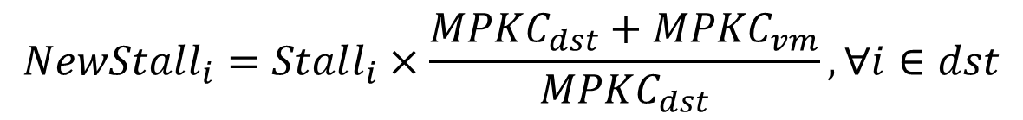
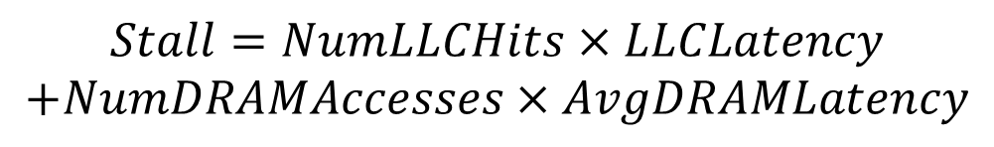
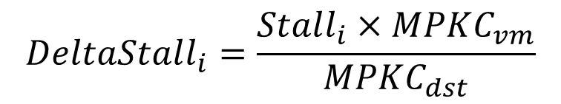
Performance Modeling
A linear model:
the stall cycles is proportional to the Miss Per Kilo Cycles (MPKC)
$$Stall=NumLLCHits×LLCLatency$$
$$+NumDRAMAccesses×AvgDRAMLatency$$
$$NewStall_{i}=Stall_{i}×\frac{MPKC_{dst}+MPKC_{vm}}{MPKC_{dst}}, ∀i∈dst$$
$$DeltaStall_{i}=\frac{Stall_{i}×MPKC_{vm}}{MPKC_{dst}}$$

Slide 55
Execution Time vs. IPC

Slide 56
Parameter Sensitivity

Slide 57
Heterogeneous Workloads
Weighted Speedup and Maximum Slowdown

