Slide 1
Gem5 Guide
Wang Hui
Sino-German Joint Software Institution
hui.wang@jsi.buaa.edu.cn

Slide 2
Gem5 Guide Outline
What is Gem5?
Build & Run Gem5 Simulator
Gem5 Basics
Run your code under SE mode
Run SPLASH2 Benchmark under SE mode
Run your code under FS mode
Run SPLASH2 Benchmark under FS mode
Inside the Gem5
Modify to satisfy your needs
Summary

Slide 3
Gem5 Guide Outline
What is Gem5?
Build & Run Gem5 Simulator
Gem5 Basics
Run your code under SE mode
Run SPLASH2 Benchmark under SE mode
Run your code under FS mode
Run SPLASH2 Benchmark under FS mode
Inside the Gem5
Modify to satisfy your needs
Summary

Slide 4
What is Gem5
The combination of M5 and GEMS into a new simulator
Google scholar statistics
M5 (IEEE Micro, CAECW): 440 citations
GEMS (CAN): 588 citations
Best aspects of both glued together
M5: CPU models, ISAs, I/O devices, infrastructure
GEMS (essentially Ruby): cache coherence protocols, interconnect models

Slide 5
Main Goals
Flexibility
Multiple CPU models across the speed vs. accuracy spectrum
Two execution modes: System-call Emulation & Full-system
Two memory system models: Classic & Ruby
Once you learn it, you can apply to a wide-range of investigations
Availability
For both academic and corporate researchers
No dependence on proprietary code
BSD license
Collaboration
Combined effort of many with different specialties
Active community leveraging collaborative technologies

Slide 6
Key Features
Pervasive object-oriented design
Provides modularity, flexibility
Significantly leverages inheritance e.g. SimObject
Python integration
Powerful front-end interface
Provides initialization, configuration, & simulation control
Domain-Specific Languages
ISA DSL: defines ISA semantics
Cache Coherence DSL (a.k.a.SLICC): defines coherence logic
Standard interfaces: Ports and MessageBuffers

Slide 7
Capabilities
Execution modes: System-call Emulation (SE) & Full-System (FS)
ISAs: Alpha, ARM, MIPS, Power, SPARC, X86
CPU models: AtomicSimple, TimingSimple, InOrder, and O3
Cache coherence protocols: broadcast-based, directories, etc.
Interconnection networks: Simple & Garnet (Princeton, MIT)
Devices: NICs, IDE controller, etc.
Multiple systems: communicate over TCP/IP

Slide 8
To us
Python and C++ with an event queue and a bunch of APIs

Slide 9
Gem5 Guide Outline
What is Gem5?
Build & Run Gem5 Simulator
Gem5 Basics
Run your code under SE mode
Run SPLASH2 Benchmark under SE mode
Run your code under FS mode
Run SPLASH2 Benchmark under FS mode
Inside the Gem5
Modify to satisfy your needs
Summary

Slide 10
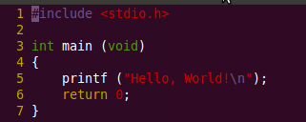
Start with a simple example
suppose we want to run a hello world program
and suppose we have installed a number of packages and tools that gem5 depend on
g++, python, scons, swig, zlib, m4, [mercurial]
Ubuntu Server: sudo apt-get install mercurial scons swig python-dev g++ build-essential texinfo …
first we need to download the GEM5 Simulator source code
Mercurial: hg clone http://repo.gem5.org/gem5 [-stable]
then we need to compile GEM5 Simulator

Slide 11
Dependence
Tools
GCC/G++ 3.4.6+
Most frequently tested with 4.2-4.5
Python 2.4+
SCons 0.98.1+
We generally test versions 0.98.5 and 1.2.0
http://www.scons.org
SWIG 1.3.31+
http://www.swig.org
Other materials: (Full System Images, Cross Compiler, Benchmarks)
http://gem5.org/Download

Slide 12
Start with a simple example
Compile Targets: build/<config>/<binary>
config
By convention, usually <isa>[_<coherence protocol>]
ALPHA_MESI _CMP_directory
Other ISAs: ARM, MIPS, POWER, SPARC, X86
You can define your own config
binary
gem5.debug – debug build, symbols, tracing, assert
gem5.opt – optimized build, symbols, tracing, assert
gem5.fast – optimized build, no debugging, no symbols, no tracing, no assertions
gem5.prof – gem5.fast + profiling support

Slide 13
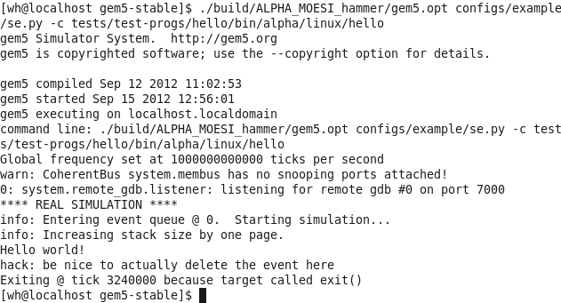
Start with a simple example
so let’s try this command to compile Gem5 Simulator:
and run the simulator:
Notes:
If errors, first check the packages GEM5 depend on are installed
scons –j 2 build/ALPHA_MOESI_hammer/gem5.opt
./build/ALPHA_MOESI_hammer/gem5.opt configs/example/se.py –c test/test-progs/hello/bin/alpha/linux/hello

Slide 14
Question on the simple example
what the output means?
what is configs/example/se.py? how it works?

Slide 15
Gem5 Guide Outline
What is Gem5?
Build & Run Gem5 Simulator
Gem5 Basics
Run your code under SE mode
Run SPLASH2 Benchmark under SE mode
Run your code under FS mode
Run SPLASH2 Benchmark under FS mode
Inside the Gem5
Modify to satisfy your needs
Summary

Slide 16
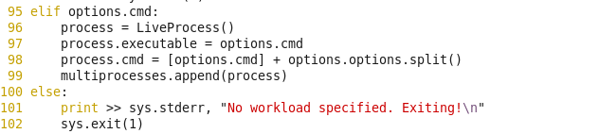
How se.py works?

Slide 17
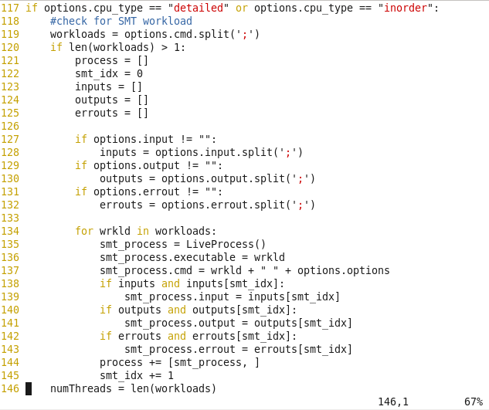
How se.py works?

Slide 18
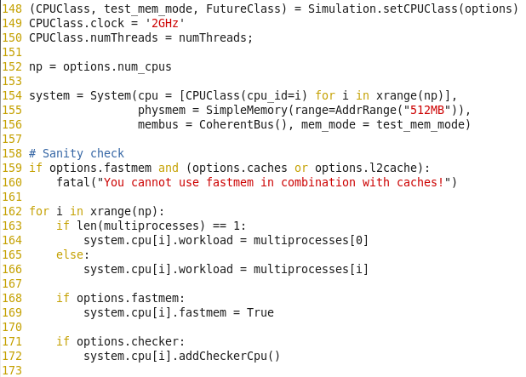
How se.py works?

Slide 19
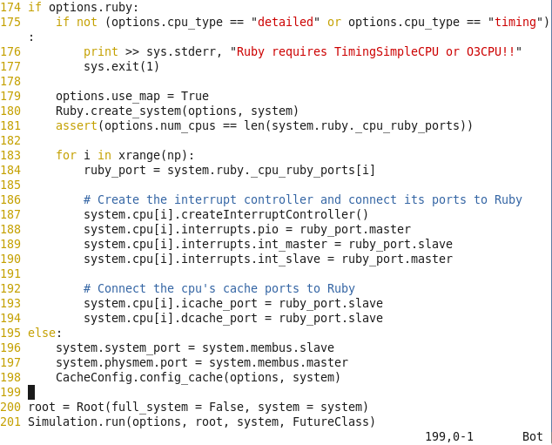
How se.py works?

Slide 20
Summary on se.py --- Modes
gem5 has two fundamental modes
Full system (FS)
For booting operating systems
Models bare hardware, including devices
Interrupts, exceptions, privileged instructions, fault handlers
Syscall emulation (SE)
For running individual applications, or set of applications on MP/SMT
Models user-visible ISA plus common system calls
System calls emulated, typ. by calling host OS
Simplified address translation model, no scheduling
Selected via compile-time option
Vast majority of code is unchanged, though

Slide 21
Summary on se.py --- Objects
Everything you care about is an object (C++/Python)
Derived from SimObject base class
Common code for creation, configuration parameters, naming, checkpointing, etc.
Uniform method-based APIs for object types
CPUs, caches, memory, etc.
Plug-compatibility across implementations
Functional vs. detailed CPU
Conventional vs. indirect-index cache
Easy replication: cores, multiple systems, . . .

Slide 22
Summary on se.py --- Events
Standard event queue timing model
Global logical time in “ticks”
No fixed relation to real time
Normally picoseconds in our examples
Objects schedule their own events
Flexibility for detail vs. performance trade-offs
E.g., a CPU typically schedules event at regular intervals
Every cycle or every n picoseconds
Won’t schedule self if stalled/idle
Now you knows how a Event Driven Simulator works --- the Simulator just fetch events from the EQ(Event Queue), all events generated by Objects and it produce new events and insert them into the EQ

Slide 23
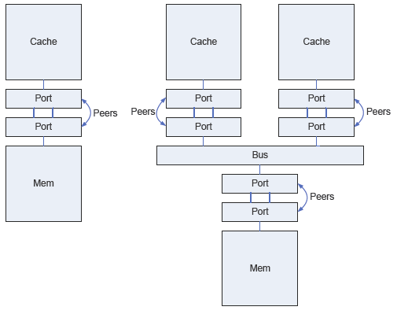
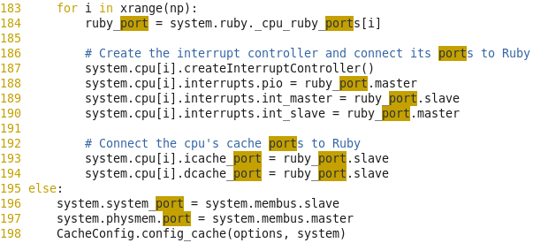
Summary on se.py --- Ports
Method for connecting MemObjects together
Each MemObject subclass has its own Port subclass(es)
Specialized to forward packets to appropriate methods of MemObject subclass
Each pair of MemObjects is connected via a pair of Ports (“peers”)
Function pairs pass packets across ports
sendTiming() on one port calls recvTiming() on peer
Result: class-specific handling with arbitrary connections and only a single virtual function call

Slide 24
Summary on se.py --- Access Mode
Three access modes: Functional, Atomic, Timing
Selected by choosing function on initial Port:
sendFunctional(), sendAtomic(), sendTiming()
Functional mode:
Just “make it happen”
Used for loading binaries, debugging, etc.
Accesses happen instantaneously updating data everywhere in the hierarchy
If devices contain queues of packets they must be scanned and updated as well
Atomic mode:
Requests complete before sendAtomic() returns
Models state changes (cache fills, coherence, etc.)
Returns approx. latency w/o contention or queuing delay
Used for fast simulation, fast forwarding, or warming caches
Timing mode:
Models all timing/queuing in the memory system
Split transaction
sendTiming() just initiates send of request to target
Target later calls sendTiming() to send response packet
Atomic and Timing accesses can not coexist in system

Slide 25
Summary on se.py --- m5out/*
config.ini/config.json
The simulated System
stats.txt
Simulation Statistics
you can generate statistic you needed by add some code, check GEM5 Tutorial for details
ruby.stats
Ruby Statistics

Slide 26
How to Debug?
Tracing
Using gdb to debug gem5
Python Debugging

Slide 27
Tracing
src/base/trace.*
printf() is a nice debugging tool
Keep good printfs for tracing
Lots of debug output is a very good thing
Example flags:
Fetch, Decode, Ethernet, Exec, TLB, DMA, Bus, Cache, Loader, O3CPUAll, etc.
Print out all flags with --debug-help option

Slide 28
Enabling Tracing
Selecting flags:
--debug-flags=Cache,Bus
--debug-flags=Exec,-ExecTicks
Selecting destination:
--trace-file=my_trace.out
--trace-file=my_trace.out.gz
Selecting start:
--trace-start=3000000
./build/ALPHA_MOESI_hammer/gem5.opt --debug-flags=MemoryAccess --trace-start=3000000 configs/example/se.py

Slide 29
Adding Debuging
Print statement put in source code
Encourage you to add ones to your models or contribute ones you find particularly useful
Macros remove them for gem5.fast or gem5.prof binaries
So you must be using gem5.debug or gem5.opt to get any output
Adding an extra tracing statement:
#include “debug/MyFlag.h”
DPRINTF(MyFlag, “normal printf %snn”, “arguments”);
Adding a new debug flags (in a SConscript):
DebugFlag(’MyFlag’)

Slide 30
Using GDB with Gem5
Several gem5 functions designed to be called from GDB:
schedBreakCycle() – also with --debug-break
setDebugFlag()/clearDebugFlag()
dumpDebugStatus()
eventqDump()
SimObject::find()
takeCheckpoint()

Slide 31
Using GDB with Gem5
wh@arch-node1:~/gem5-stable$ gdb --args ./build/ALPHA_SE/gem5.opt configs/example/se.py
GNU gdb (Ubuntu/Linaro 7.2-1ubuntu11) 7.2
...
(gdb) b main
Breakpoint 1 at 0x4087e0: file build/ALPHA_SE/sim/main.cc, line 41.
(gdb) run
Starting program: /home/wh/gem5-stable/build/ALPHA_SE/gem5.opt configs/example/se.py
[Thread debugging using libthread_db enabled]
Breakpoint 1, main (argc=2, argv=0x7fffffffe688) at build/ALPHA_SE/sim/main.cc:41
41 {
(gdb) call schedBreakCycle(1000000)
warn: need to stop all queues

Slide 32
Using GDB with Gem5
(gdb) continue
Continuing.
gem5 Simulator System. http://gem5.org
gem5 is copyrighted software; use the --copyright option for details.
gem5 compiled Aug 29 2011 22:41:08
gem5 started Aug 29 2011 22:47:08
gem5 executing on arch-node1
command line: /home/wh/gem5-stable/build/ALPHA_SE/gem5.opt configs/example/se.py
Global frequency set at 1000000000000 ticks per second
0: system.remote_gdb.listener: listening for remote gdb #0 on port 7000
**** REAL SIMULATION ****
info: Entering event queue @ 0. Starting simulation...
info: Increasing stack size by one page.
Program received signal SIGTRAP, Trace/breakpoint trap.
0x00007ffff638dfe7 in kill () from /lib/x86_64-linux-gnu/libc.so.6
(gdb) p _curTick
$1 = 1000000

Slide 33
Using GDB with Gem5
(gdb) print SimObject::find("system.cpu")
$2 = (SimObject *) 0x16aa980
(gdb) print (BaseCPU*)SimObject::find("system.cpu")
$3 = (BaseCPU *) 0x16aa980
(gdb) p $3->instCnt
$4 = 94699
(gdb) continue
Continuing.
Hello world!
hack: be nice to actually delete the event here
Exiting @ tick 3252000 because target called exit()
Program exited normally.

Slide 34
Python Debugging
It is possible to drop into the python interpreter (-i flag)
This currently happens after the script file is run
If you want to do this before objects are instantiated, remove them from script
It is possible to drop into the python debugger (--pdb flag)
Occurs just before your script is invoked
Lets you use the debugger to debug your script code
Code that enables this stuff is in src/python/m5/main.py
At the bottom of the main function
Can copy the mechanism directly into your scripts, if in the wrong place for you needs
import pdb
pdb.set_trace()

Slide 35
More
http://gem5.org/Debugging

Slide 36
how to configure your architecture
http://gem5.org/Simulation_Scripts_Explained

Slide 37
Gem5 Guide Outline
What is Gem5?
Build & Run Gem5 Simulator
Gem5 Basics
Run your code under SE mode
Run SPLASH2 Benchmark under SE mode
Run your code under FS mode
Run SPLASH2 Benchmark under FS mode
Inside the Gem5
Modify to satisfy your needs
Summary

Slide 38
Cross Compiler
The first tool your need to prepared
check the Gem5 Status Matrix, ALPHA is the best supported architecture
I had compiled a alpha cross compiler, so your can copy it to use as your wish
How to use?
append this command to ~/.bashrc
export PATH=~/bin:~/alphaev67-unknown-linux-gnu/bin:$PATH

Slide 39
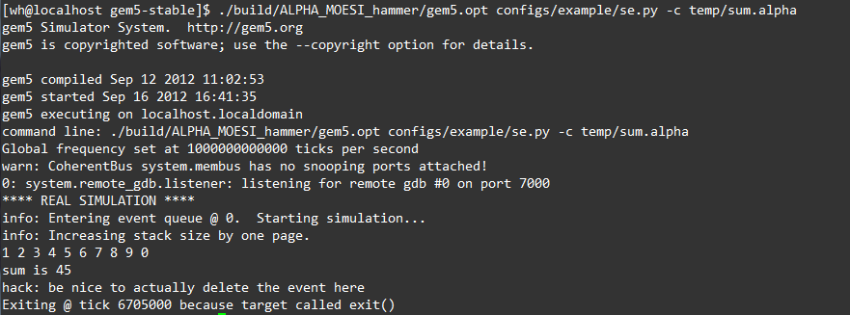
Run your code under SE mode
compile your code with –static flag, Cross-Compiler
using config/example/se.py –c to run your_own_code
results:
alphaev67-unknown-linux-gnu-gcc –o sum sum.c –static –O2
./build/ALPHA_MOESI_hammer/gem5.opt configs/example/se.py –c /PATH/TO/sum

Slide 40
Gem5 Guide Outline
What is Gem5?
Build & Run Gem5 Simulator
Gem5 Basics
Run your code under SE mode
Run SPLASH2 Benchmark under SE mode
Run your code under FS mode
Run SPLASH2 Benchmark under FS mode
Inside the Gem5
Modify to satisfy your needs
Summary

Slide 41
Run SPLASH2 under SE mode
Get SPLASH2 Benchmark from http://gem5.org/Download
Run
./build/ALPHA_MOESI_hammer/gem5.opt configs/example/se.py -c benchmarks/splash2/codes/kernels/fft/FFT

Slide 42
Gem5 Guide Outline
What is Gem5?
Build & Run Gem5 Simulator
Gem5 Basics
Run your code under SE mode
Run SPLASH2 Benchmark under SE mode
Run your code under FS mode
Run SPLASH2 Benchmark under FS mode
Inside the Gem5
Modify to satisfy your needs
Summary

Slide 43
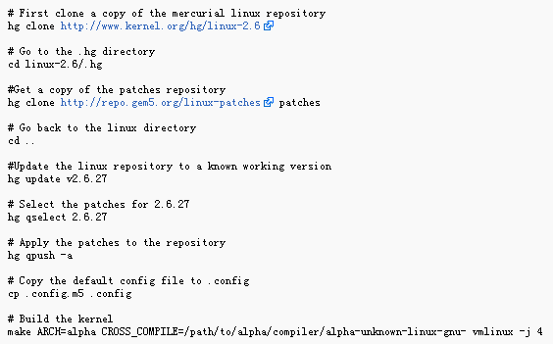
What is FS mode
load linux kernel
how to compile your kernel image?

Slide 44
Full System related files
configs/common/SysPaths.py
where is the disk image
configs/common/FSConfig.py
pal, kernel
configs/common/Benchmarks.py
disk image name
m5term
cd util/term
make
sudo make install

Slide 45
Run your code under FS mode
Preparation: put your code into the image
Run
sudo mount –o loop,offset=32256 linux-latest.img /mnt
sudo mkdir –p /mnt/benchmark/mybench
sudo cp sum /mnt/benchmark/mybench
sudo umount /mnt
scons build/ALPHA/gem5.opt
./build/ALPHA/gem5.opt configs/example/fs.py
m5term 3456
./sum

Slide 46
Gem5 Guide Outline
What is Gem5?
Build & Run Gem5 Simulator
Gem5 Basics
Run your code under SE mode
Run SPLASH2 Benchmark under SE mode
Run your code under FS mode
Run SPLASH2 Benchmark under FS mode
Inside the Gem5
Modify to satisfy your needs
Summary

Slide 47
Run SPLASH2 under FS mode
Preparation: put your code into the image
Run
sudo mount –o loop,offset=32256 linux-latest.img /mnt
sudo mkdir –p /mnt/benchmark/mybench
sudo cp FFT /mnt/benchmark/mybench
sudo umount /mnt
scons build/ALPHA/gem5.opt
./build/ALPHA/gem5.opt configs/example/fs.py
m5term 3456
./FFT -t

Slide 48
Run SPLASH2 under FS mode
more convenient way?
Run
vi configs/common/Benchmarks.py
+ ‘fft’: [SysConfig(‘fft.rcS’, ‘512MB’)],
vi configs/boot/ffs.rcS
+ #!/bin/sh
+ cd benchmarks/mybench
+ echo “Running FFT now…”
+ ./FFT –t –p1
+ /sbin/m5 exit
scons build/ALPHA/gem5.opt
./build/ALPHA/gem5.opt configs/example/fs.py –n 1 –b fft
cat m5out/system.terminal

Slide 49
Gem5 Guide Outline
What is Gem5?
Build & Run Gem5 Simulator
Gem5 Basics
Run your code under SE mode
Run SPLASH2 Benchmark under SE mode
Run your code under FS mode
Run SPLASH2 Benchmark under FS mode
Inside the Gem5
Modify to satisfy your needs
Summary

Slide 50
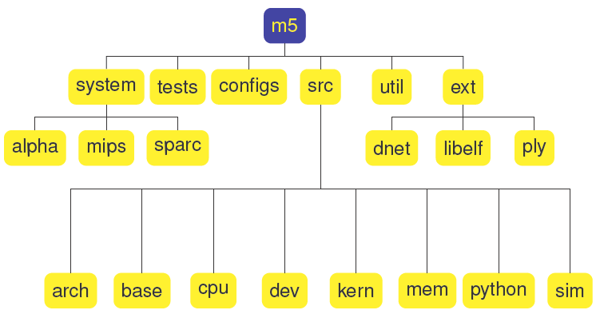
Inside Gem5
Source Code Tree Organization

Slide 51
Inside Gem5
Source Code Tree Organization
configs: sample m5 scripts
src/arch: architecture definition & ISA-specific components
src/base: general data structures/facilities
src/python: Python config code
src/cpu, src/mem, src/dev: specific models
src/sim: simulator base functionality
system: platform specific code (palcode, firmware, bios, etc.) — packaged separately
test: regression tests
util: utility programs

Slide 52
CPU Models Overview
Supported CPU Models
AtomicSimpleCPU
TimingSimpleCPU
InOrderCPU
O3CPU
CPU Model Internals
Parameters
Time Buffers
Key Interfaces

Slide 53
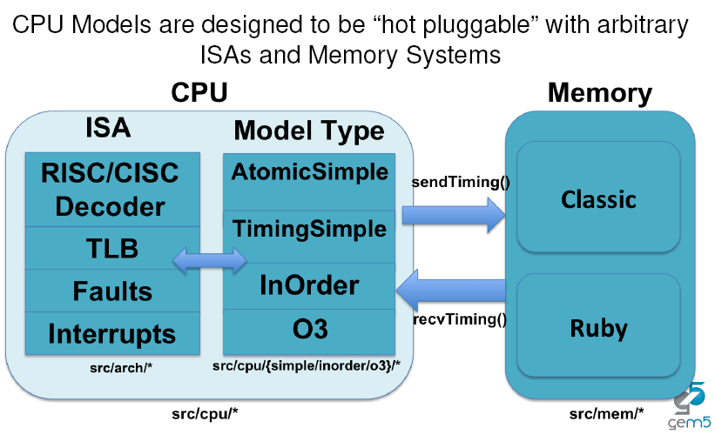
CPU Models Overview

Slide 54
Supported CPU Models
src/cpu/*.hh,cc
Simple CPUs
Models Single-Thread 1 CPI Machine
Two Types: AtomicSimpleCPU and TimingSimpleCPU
Common Uses:
Fast, Functional Simulation: 2.9 million and 1.2 million instructions per second on the “twolf” benchmark
Warming Up Caches
Studies that do not require detailed CPU modeling
Detailed CPUs
Parameterizable Pipeline Models w/SMT support
Two Types: InOrderCPU and O3CPU
“Execute in Execute”, detailed modeling
Slower than SimpleCPUs: 200K instructions per second on the “twolf” benchmark
Models the timing for each pipeline stage
Forces both timing and execution of simulation to be accurate
Important for Coherence, I/O, Multiprocessor Studies, etc.

Slide 55
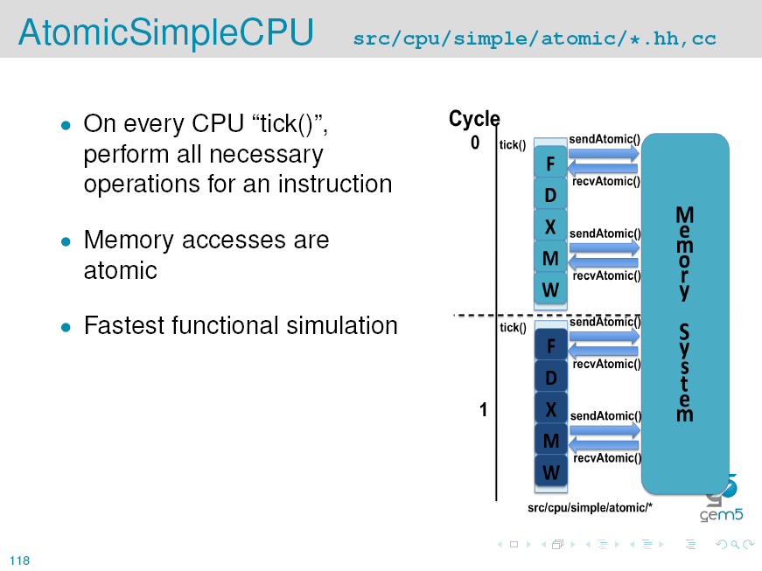
Inside Gem5---CPU Model

Slide 56
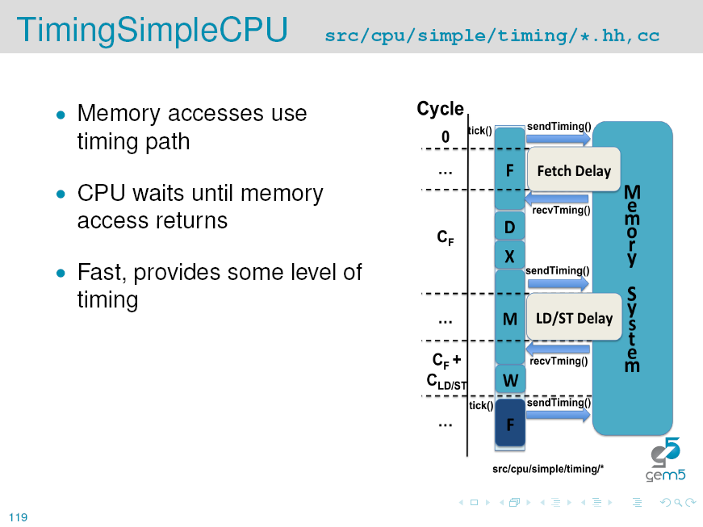
Inside Gem5---CPU Model

Slide 57
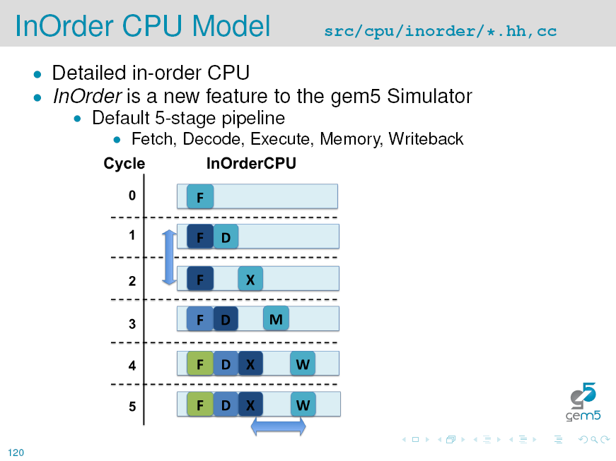
Inside Gem5---CPU Model

Slide 58
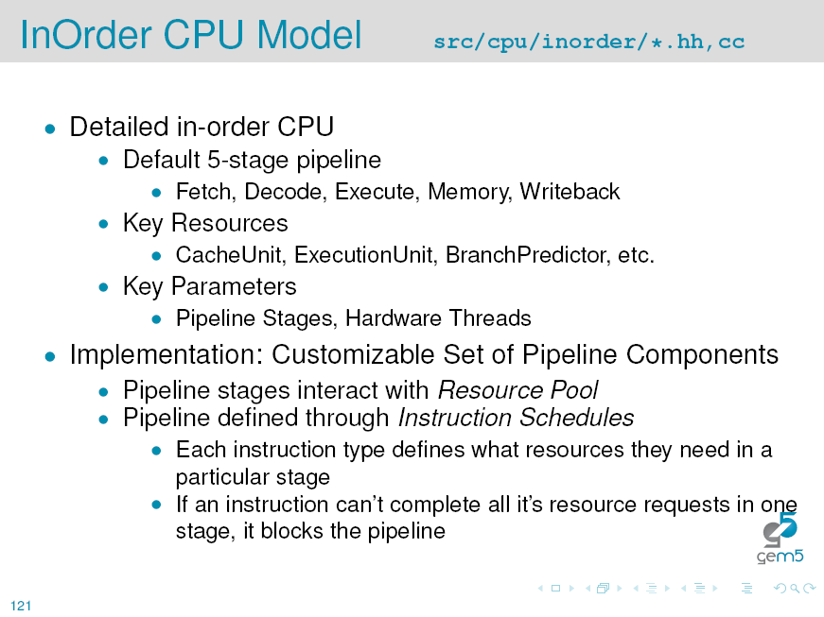
Inside Gem5---CPU Model

Slide 59
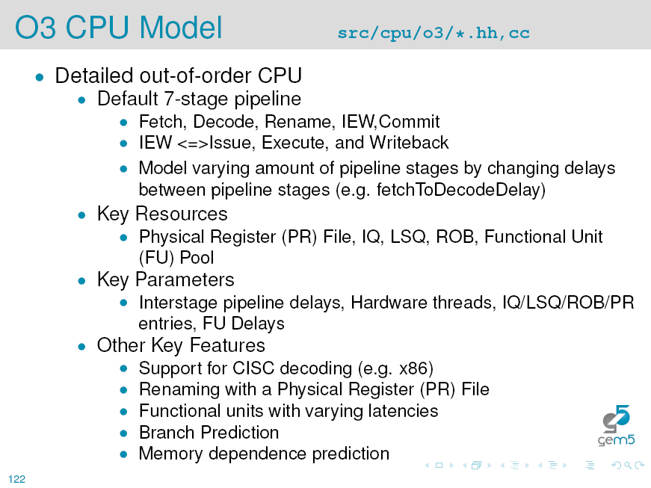
Inside Gem5---CPU Model

Slide 60
Inside Gem5---Memory Model
General Memory System
Ports
Packets
Requests
Atomic/Timing/Functional accesses
Two memory system models
Classic
Ruby
Check http://gem5.org/General_Memory_System for details

Slide 61
Ruby Memory Model
Flexible Memory System
Rich configuration - Just run it
Simulate combinations of caches, coherence, interconnect, etc...
Rapid prototyping - Just create it
Domain-Specific Language (SLICC) for coherence protocols
Modular components
Detailed statistics
e.g., Request size/type distribution, state transition frequencies, etc...
Detailed component simulation
Network (fixed/flexible pipeline and simple)
Caches (Pluggable replacement policies)
Memory (DDR2)

Slide 62
Ruby Memory Model
Can build many different memory systems
CMPs, SMPs, SCMPs
1/2/3 level caches
Pt2Pt/Torus/Mesh Topologies
MESI/MOESI coherence
Each components is individually configurable
Build heterogeneous cache architectures (new)
Adjust cache sizes, bandwidth, link latencies, etc...

Slide 63
Ruby Memory Model
8 core CMP, 2-Level, MESI protocol, 32K L1s, 8MB 8-banked L2s, crossbar interconnect
scons build/ALPHA_MOESI_hammer/gem5.opt
./build/ALPHA_MOESI_hammer/gem5.opt configs/example/ruby_fs.py -n 8 --l1i_size=32kB --l1d_size=32kB --l2_size=8MB --num-l2caches=8 --topology=Crossbar --timing
64 socket SMP, 2-Level on-chip Caches, MOESI protocol, 32K L1s, 8MB L2 per chip, mesh interconnect
scons build/ALPHA_MOESI_hammer/gem5.opt
./build/ALPHA_MOESI_hammer/m5.opt configs/example/ruby_fs.py -n 64 --l1i_size=32kB --l1d_size=32kB --l2_size=512MB --num-l2caches=64 --topology=Mesh --timing

Slide 64
Ruby Memory Model
Domain-Specific Language
Syntatically similar to C/C++
Like HDLs, constrains operations to be hardware-like (e.g., no loops)
Two generation targets
C++ for simulation
Coherence controller object
HTML for documentation
Table-driven specification (State x Event -> Actions & next state)

Slide 65
Gem5 Guide Outline
What is Gem5?
Build & Run Gem5 Simulator
Gem5 Basics
Run your code under SE mode
Run SPLASH2 Benchmark under SE mode
Run your code under FS mode
Run SPLASH2 Benchmark under FS mode
Inside the Gem5
Modify to satisfy your needs
Summary

Slide 66
Modify to meet your needs
All your need are provided
Modify Python code
Miss some device your need
Add C++ code
maybe need Modify the Linux Kernel

Slide 67
Gem5 Guide Outline
What is Gem5?
Build & Run Gem5 Simulator
Gem5 Basics
Run your code under SE mode
Run SPLASH2 Benchmark under SE mode
Run your code under FS mode
Run SPLASH2 Benchmark under FS mode
Inside the Gem5
Modify to satisfy your needs
Summary

Slide 68
Summary
The basics
Debugging
CPU model
Ruby memory system
How to use gem5
How gem5 works

Slide 69
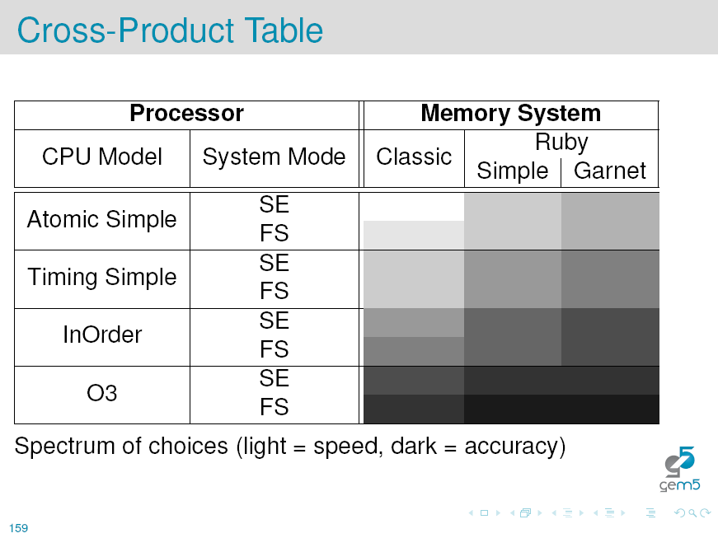
Summary

Slide 70
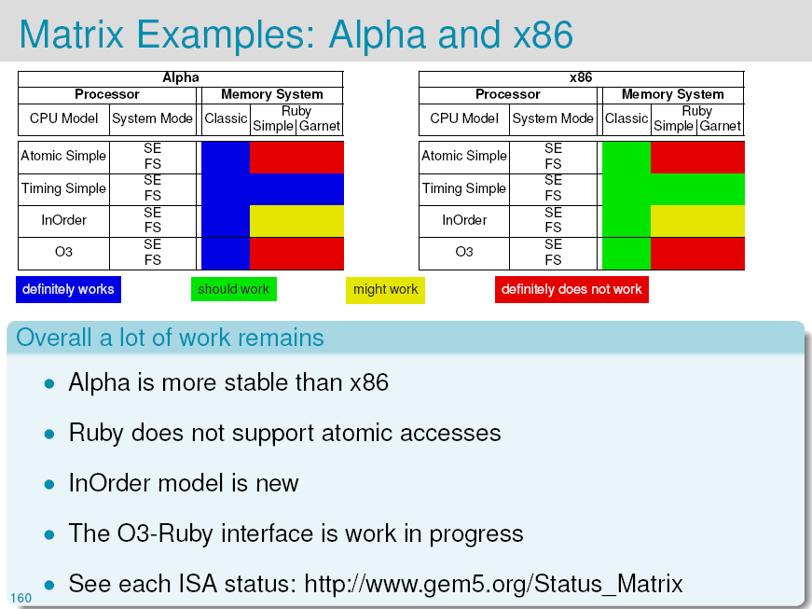
Summary

Slide 71
Further Read
http://gem5.org/Documentation
isca2011 Gem5 workshop slides
asplos2008 Gem5 tutorial slides

Slide 72
Gem5 Guide Outline
What is Gem5?
Build & Run Gem5 Simulator
Gem5 Basics
Run your code under SE mode
Run SPLASH2 Benchmark under SE mode
Run your code under FS mode
Run SPLASH2 Benchmark under FS mode
Inside the Gem5
Modify to satisfy your needs
Summary

