Slide 1

Distributed version control system
(AdVANCED)

Slide 2
Advanced Topics Overview
Comparing Differences
Branching, Merging and Conflict Resolution
Milestones
Work In Progress
Time Travels

Slide 3
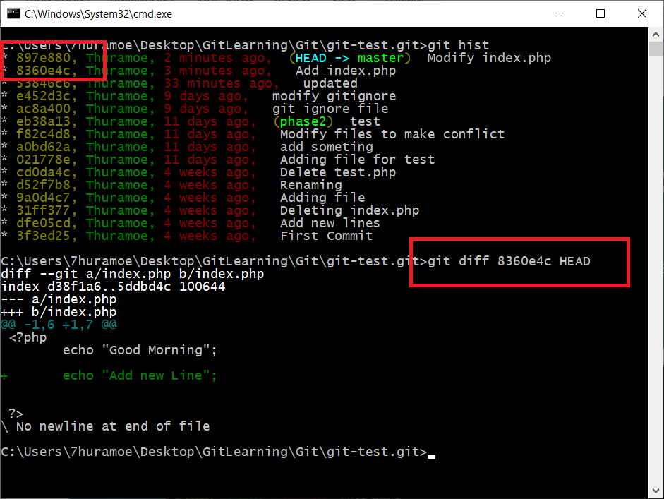
Comparing Differences
Sometimes, we need to check the differences of what we write in the previous commit and our latest source code of same file. At this time, we need to check the differences by using `git diff` command.
git diff [commit hash] [commit hash] git diff 9a0d4c7 HEAD

Slide 4
Install Helix Visual Merge Tool
When using `git diff` command, it will be difficult to see what is the differences because it can only show differences in command prompt. But, Git allow us to use other comparing tools to see the differences clearly.
So, we will use `P4Merge`. By using this tool, we can make comparing and merging very easily.
Go to https://www.perforce.com/downloads and only download Helix Visual Merge Tool. When click download, registration form will show, click skip registration. (Note: this website design is changed very often.)
And then install that application.

Slide 5
Integrate P4Merge as Diff tool
Before integrate P4Merge with Git, we will need to know the install location of P4Merge because we will need to used that location in later.(May be in C:\Program Files\Perforce)
So, let’s start integrate P4Merge as diff tool. Type following command in command prompt.
git config --global diff.tool p4merge
Then, we need to add actual path of P4Merge tools. Note: you will need to used forward slash(/), when writing path.
git config --global difftool.p4merge.path “C:/Program Files/Perforce/p4merge.exe”
By default, when we use difftool command, git will confirm you to open or not the application, that you set as difftool(P4Merge). To skip this question, we can set prompt setting as shown in below.
git config --global difftool.prompt false (yes, no ask tar ma paw ag)

Slide 6
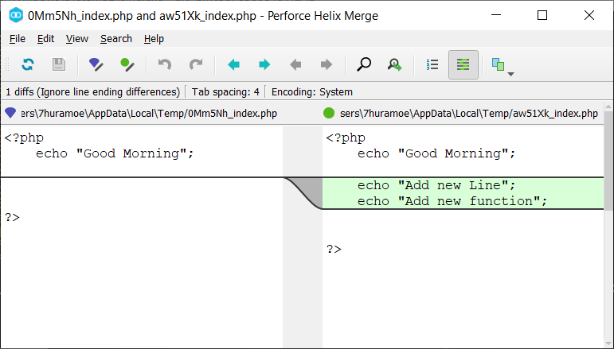
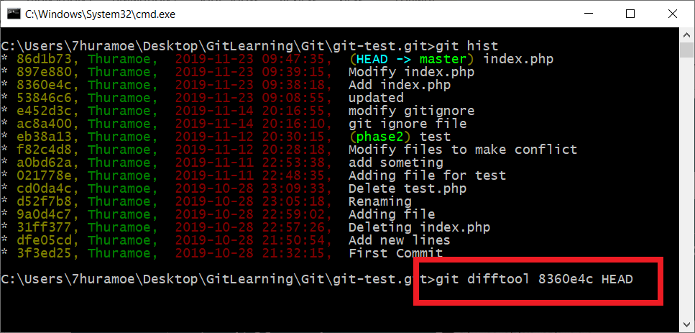
Comparing by P4Merge
Now, its time to use our comparing tool. When you type difftool command and press enter, you will see differences of your file via P4Merge tool.
git difftool 8360e4c HEAD

Slide 7
Branching
A branch is just a timeline of commits. It means, branches are the names or labels we give timeline in git. We can create or deleting branches without effecting timelines.
Feature Branch
Master Branch
New Merge Commit

Slide 8
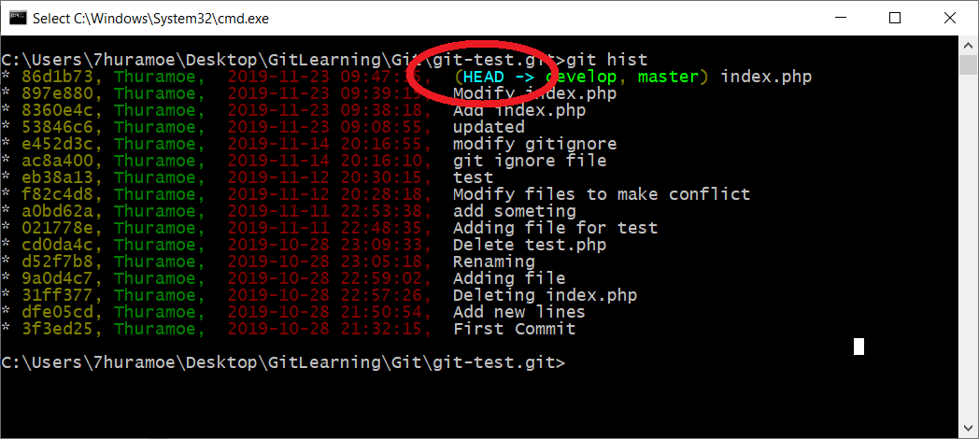
Special Marker (HEAD)
Before we move on to creating branch, we need to know git special markers or pointers called `HEAD`.
HEAD is normally the last commit of current branch. And also, it can be move.
That means, when you switch to another branches, the location of HEAD moves to the last commit location of that branch.
Even you can move HEAD pointer to another commit instead of last commit.

Slide 9
Creating Branch
A branch is a timeline of commits. Branches are a labels or names we give timelines in Git. We can create or delete branches without effecting timelines. When we start initialize a Git repository, all of works are start doing in ‘master’ branch. This is also the default branch of Git.
So, Lets start to create branch.
git branch [branch-name]
git branch features
You can use following command to see which branch now you are working with.
git branch
If you want to switch between already created branches, then use
git checkout features
You can also create branch and switch immediately by using following command.
git checkout –b updates
If you want to delete a branch. (Note: you can’t delete branch that you are currently checkout.)
git branch –d features

Slide 10
Integrate P4Merge as Merge tool
Before integrate P4Merge with Git, we will need to know the install location of P4Merge because we will need to used that location in later.(May be in C:\Program Files\Perforce)
So, let’s start integrate P4Merge as merge tool. Type following command in command prompt.
git config --global merge.tool p4merge
Then, we need to add actual path of P4Merge tools. Note: you will need to used forward slash(/), when writing path.
git config --global mergetool.p4merge.path “C:/Program Files/Perforce/p4merge.exe”
By default, when we use mergetool command, Git will confirm you to open or not the application, that you set as mergetool(P4Merge). To skip this question, we can set prompt setting as shown in below.
git config --global mergetool.prompt false

Slide 11
Simple Merge (Fast-Forward Merge)
While merging Git tries to automatically merge when possible, if there is no additional work is detected on the parent branch (master branch), Git will simply apply all commits from the other branch directly onto the parent branch.
Let’s try to test Git Merge with following scenarios.
1. Modify a file (eg. ‘index.php’) and then create a branch called ‘updates’ or anything you want and switch to that branch.
2. When you are on new branch ‘updates’, then commit ‘index.php’.
3. After that, switch back to ‘master’ branch and merge with following merge command.
git merge updates
Note: When you want to merge your branches into master branch, firstly you should be on master branch and then merge.

Slide 12
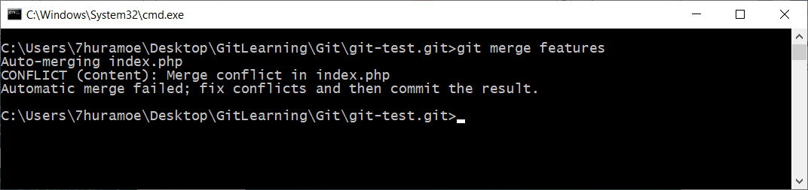
Merge with Resolving Conflict
When Git unable to automatically resolve any conflict, then you have to resolve that conflict with manual merge. Let’s try to test Git Manual Merge with following scenarios.
1. Create a branch called ‘features’ or anything you want and switch to that branch. Then modify already existing a file (eg. index.php or whatever you have) and commit.
2. Then switch to master branch and modify same file and same line of code that you already edit like in ‘features’ branch and commit.
3. Let’s try to merge these ‘features’ branch into ‘master’ branch.
git merge features
At this time, modification line number of ‘index.php’ is same in both branches. So, Git cannot auto merge and you will see the result of conflict.

Slide 13
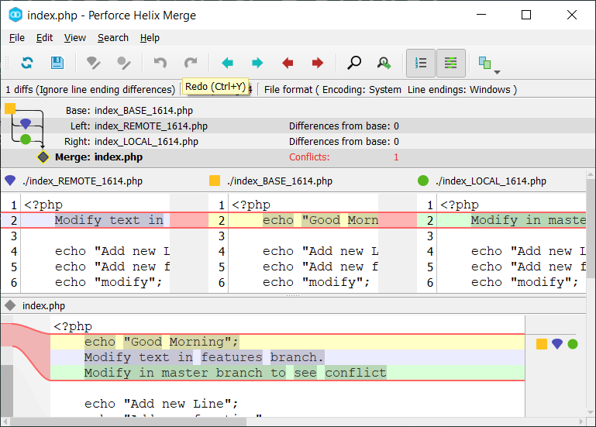
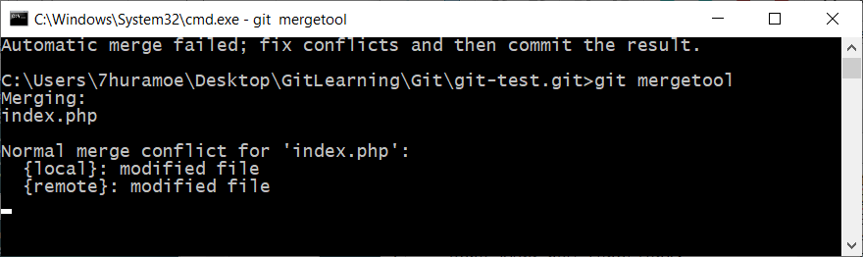
Merge with Resolving Conflict
So, we will try to merge by using our mergetool that we already created. Type ‘git mergetool’, then merge tool will open and you can resolve conflict and save file. Then close mergetool and make commit.
Note: After resolve a conflict, our merge tool(Perforce Helix Merege) will leave original file (eg. ‘index.php.orig’). You can delete that file and no need to adding into Git.

