Slide 1

Distributed version control system
(BASIC)

Slide 2
What is “version control”, and why should you care?
Version control systems are a category of software tools that help a software team manage changes to source code over time. Version control software keeps track of every modification to the code in a special kind of database.
If a mistake is made, developers can turn back the clock and compare earlier versions of the code to help fix the mistake while minimizing disruption to all team members.

Slide 3

Local Version Control Systems
Programmers long ago developed local VCSs that had a simple database that kept all the changes to files under revision control.
Cons:
Can’t collaborate with other people.

Slide 4
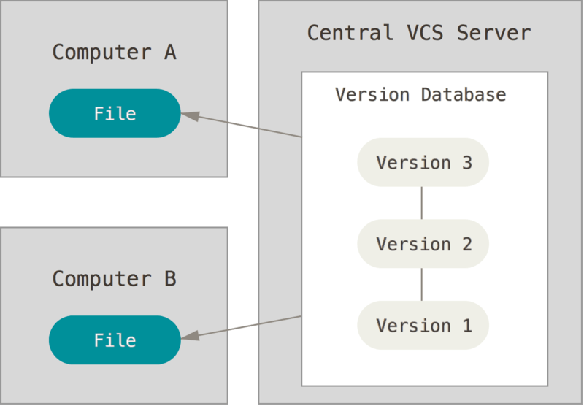
Centralized Version Control Systems
To deal with this problem, Centralized Version Control Systems (CVCSs) were developed.
These systems (such as CVS, Subversion, and Perforce) have a single server that contains all the versioned files, and a number of clients that check out files from that central place. For many years, this has been the standard for version control.
Cons:
If centralized server goes down, nobody can collaborate at all or save versioned changes to anything they’re working on.

Slide 5
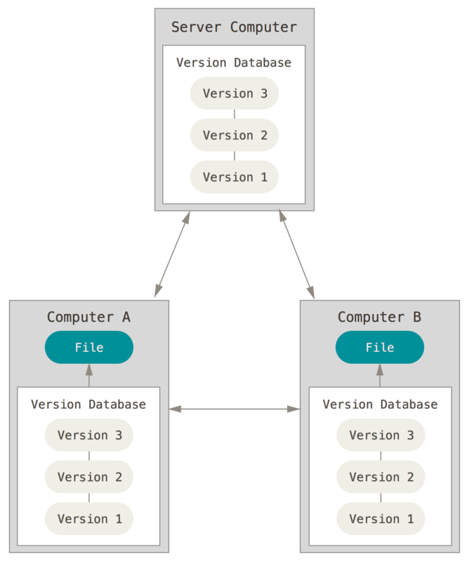
Distributed Version Control Systems
In a DVCS (such as Git, Mercurial, Bazaar or Darcs), clients don’t just check out the latest snapshot of the files; rather, they fully mirror the repository, including its full history. Thus, if any server dies, and these systems were collaborating via that server, any of the client repositories can be copied back up to the server to restore it. Every clone is really a full backup of all the data.
Cons:
Steep learning curve: Many commands with many options, some commands are non-intuitive and need a level of understanding the internals of git, commands and arguments are inconsistent to some degree.

Slide 6

Why Git?
Speed
Simple design
Strong support for non-linear development (thousands of parallel branches)
Fully distributed
Able to handle large projects like the Linux kernel efficiently (speed and data size)
One of the biggest advantages of Git is its branching capabilities. Unlike centralized version control systems, Git branches are cheap and easy to merge. This facilitates the feature branch workflow popular with many Git users. Feature branches provide an isolated environment for every change to your codebase.

Slide 7
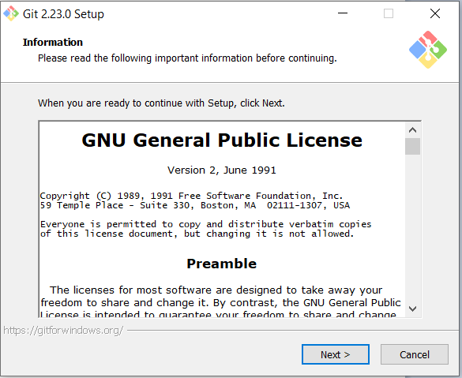
Git Installation for windows
Download link : https://gitforwindows.org/

Slide 8
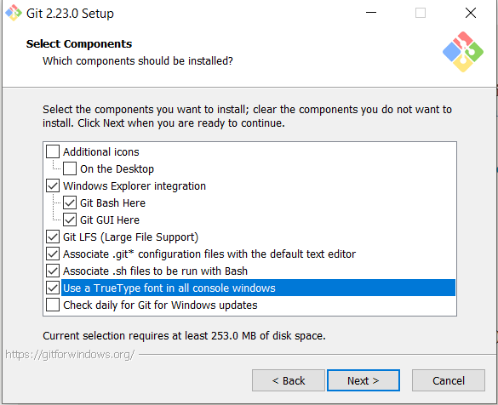
Git Installation for windows
Download link : https://gitforwindows.org/

Slide 9
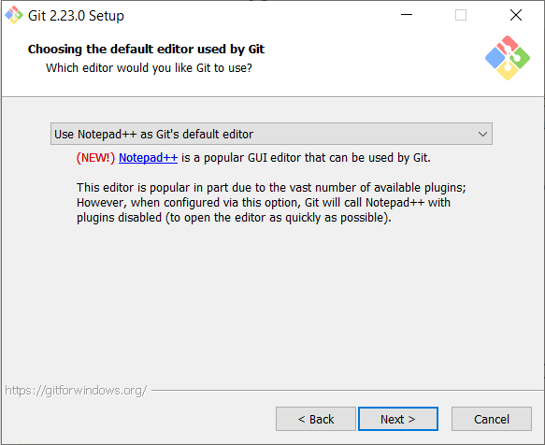
Git Installation for windows
Download link : https://gitforwindows.org/

Slide 10
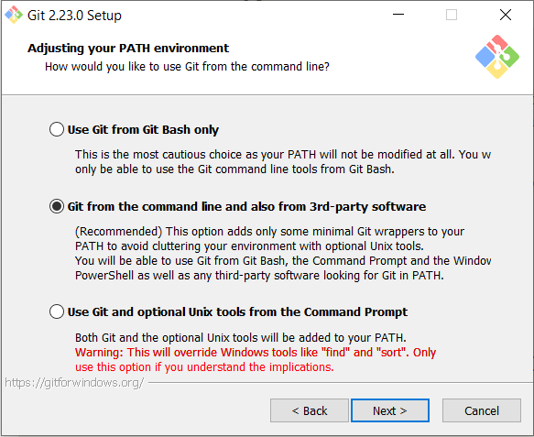
Git Installation for windows
Download link : https://gitforwindows.org/

Slide 11
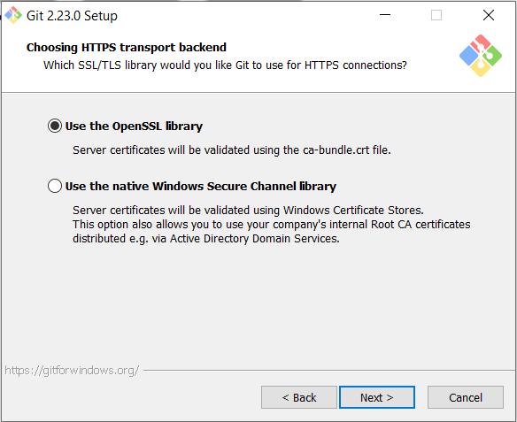
Git Installation for windows
Download link : https://gitforwindows.org/

Slide 12
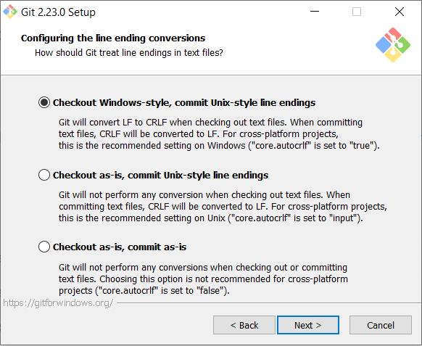
Git Installation for windows
Download link : https://gitforwindows.org/

Slide 13
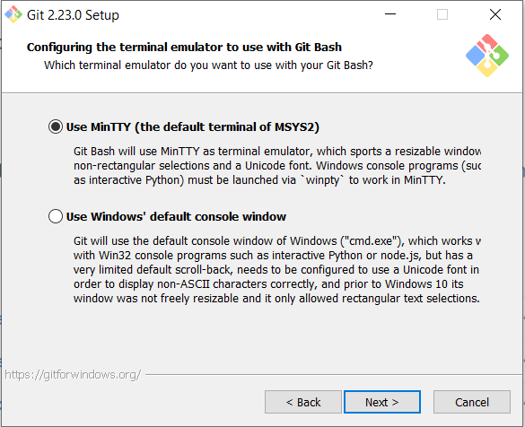
Git Installation for windows
Download link : https://gitforwindows.org/

Slide 14
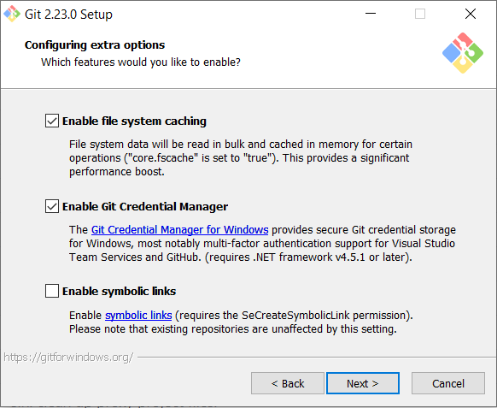
Git Installation for windows
Download link : https://gitforwindows.org/

Slide 15
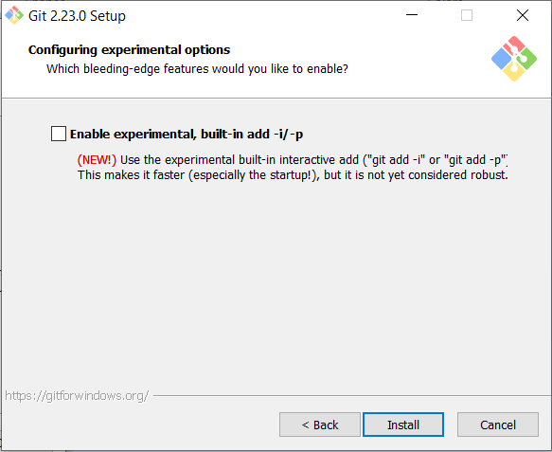
Git Installation for windows
Download link : https://gitforwindows.org/

Slide 16
Git Installation for windows
After installation complete, open cmd and type `git --version` to check git is working properly in command prompt.
If you have got this error : git is not recognized as an internal or external command, add git path to your system variable as shown in below.
Find git installation folder under `C:\Program Files` or `C:\Program Files (x86)` based on your installed git version 32 bit or 64 bit.
Copy path of cmd folder under git install folder. `C:\Program Files\Git\cmd`
R-click on `This PC` or `My Computer` and click `Properties`.
Click `Advanced system settings` and open `Environment Variables…`
Under `System variables`, select `Path` and click `Edit`.
Click `New` and paste the path that you already copied `C:\Program Files\Git\cmd`.
Press OK.
Now, you can also use git from window command prompt.

Slide 17
Git installing on Linux
If you want to install the basic Git tools on Linux via a binary installer, you can generally do so through the package management tool that comes with your distribution. If you’re on Fedora (or any closely-related RPM-based distribution, such as RHEL or CentOS), you can use dnf:
$ sudo dnf install git-all
If you’re on a Debian-based distribution, such as Ubuntu, try apt:
$ sudo apt install git-all
For more options, there are instructions for installing on several different Unix distributions on the Git website, at https://git-scm.com/download/linux.

Slide 18
Configuration
Before we start using Git, we need to configure some basic information such as user name and email address. There are two types of configuration:
Global Configuration
Local Configuration

Slide 19
Configuration (Global)
Global configuration will effect every git repository in the machine. Global configuration(.gitconfig) file is located under “C:\Users\[UserName]\”. You don’t need to open and edit this file directly. Just use the command. Following is the config command of user name and email as globally.
git config --global user.name “Thuramoe”
git config --global user.email thuramoe@gmail.com
You can see your information with following commad.
git config --global --list
You can open and edit configuration file with following commad.
git config --global --edit
If you want to delete name and email from global configuration, use following command.
git config --global --unset user.name
git config --global --unset user.email

Slide 20
Configuration (Global)
As the Operating Systems are different(Windows, Mac, Linux), these systems used different `Line Ending`. Some OS used Carriage Return (CR) as line ending. Some are Line Feed(LF) and also used (CRLF).
If you write some code in Windows OS and open that code file in Linux, Line ending will change. At this time, Git will assume that code is modified, even you don’t change the code. To prevent this problem, you can configure line ending as shown in below. So, Git will automatically convert proper line ending based on Operating System.
For Windows OS,
git config --global core.autocrlf true
git config --global core.safecrlf true
For Mac or Linux,
git config --global core.autocrlf input
git config --global core.safecrlf true

Slide 21
Configuration (Local)
If you want to set user name and email for each repository, go to specific git repository and type following command. This setting will only effect in specific git repository.
git config user.name “Thuramoe”
git config user.email “thuramoe@gmail.com”
You can see your information with following commad.
git config --list
If you want to delete name and email from global configuration, use following command.
git config --global --unset user.name
git config --global --unset user.email

Slide 22
Git States
Local Git States
Working Directory
(All files)
Staging Area
(Add file)
Repository(.git folder)
(All commit files)
Remote Repository

Slide 23
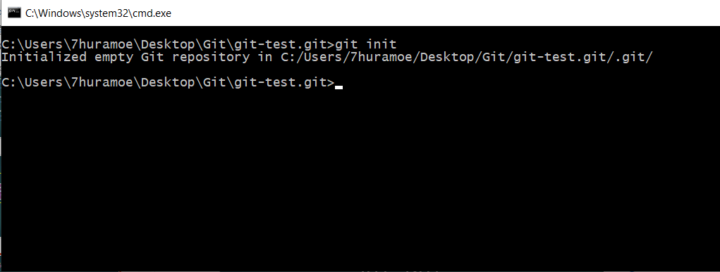
Initializing a Repository
To create a Git Repository, use `git init` command. Go to your specified folder and run `git init` from command prompt.
git init
Or you can also create folder when initializing. git init git-test.git
The above command will create an empty git repository with `.git` folder.

Slide 24
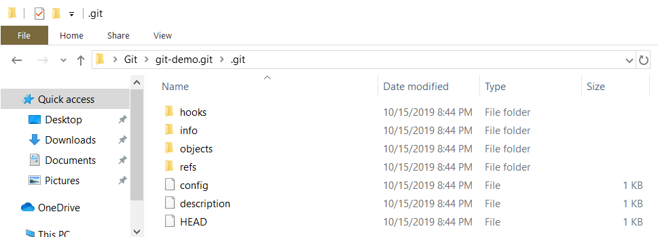
Initializing a Repository
Normally, you can’t see `.git` folder because it will be hidden. This folder will record everything about versioning. Inside this folder, you will see following:
hooks
info
objects
refs
config
Description
HEAD
When you do action in git, git will check the above config(also known as local configuration) file first and then it will check HEAD file to get the current branch to make versioning.
But, you don’t need to open and edit `.git` folder. I just want to show how it works.

Slide 25
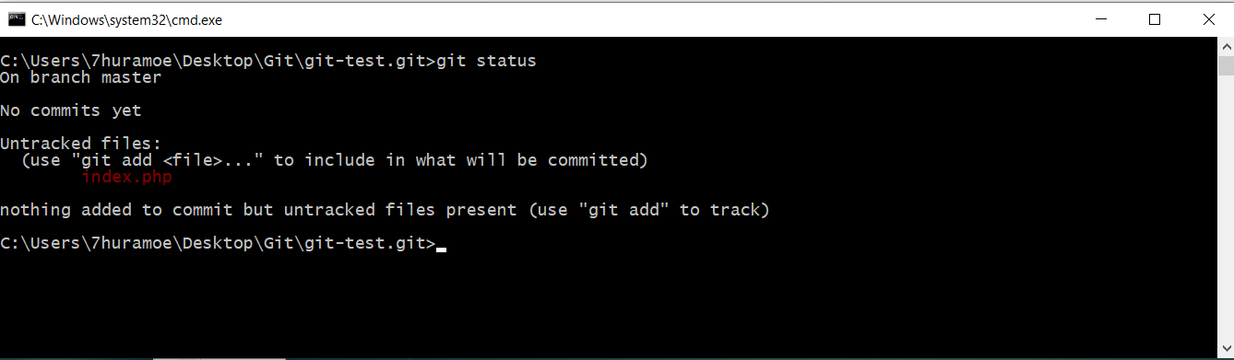
Check file status
Create some file in your repository(eg. index.php). And then check file status.
git status
`index.php` file is not yet tracked by git.

Slide 26
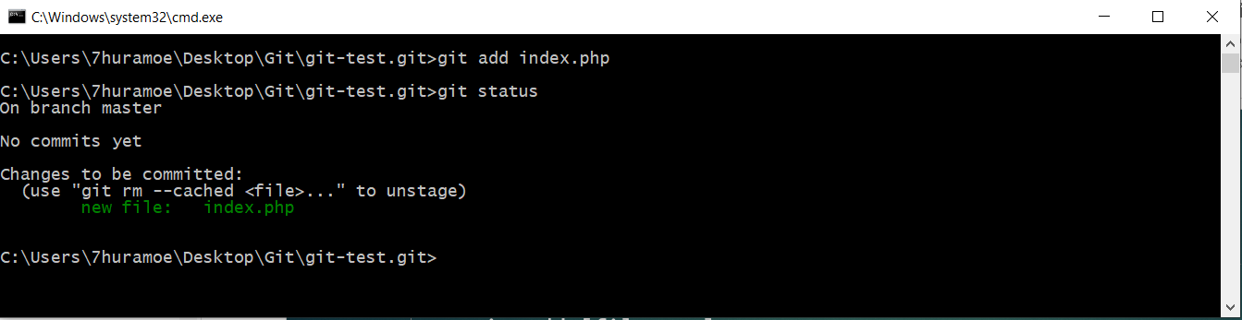
Adding files into Git
Following command to add files into git states.
git add [filename]
git add .

Slide 27
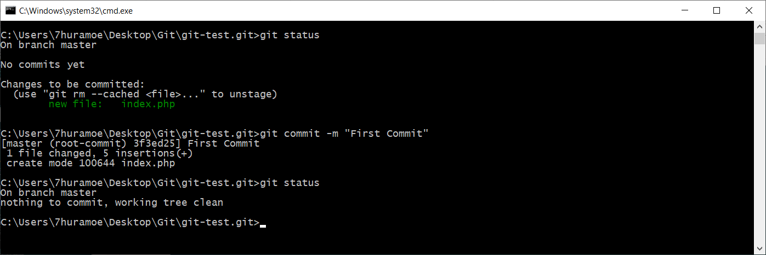
Commit files into Git
After adding files into git, we need to commit files into git.
git commit –m “First Commit”
* -m is used to add comment when making a commit.

Slide 28
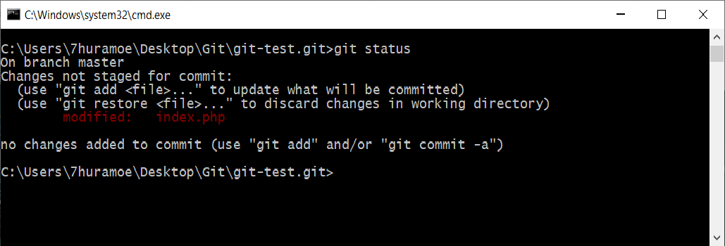
Modifying and committing
Add new lines into index.php and check status again.
As this file is already tracked by git, you don’t need to used `git add ` command again. Instead of this, you can add and commit that file in single command.
git commit –am “Add new line”

Slide 29
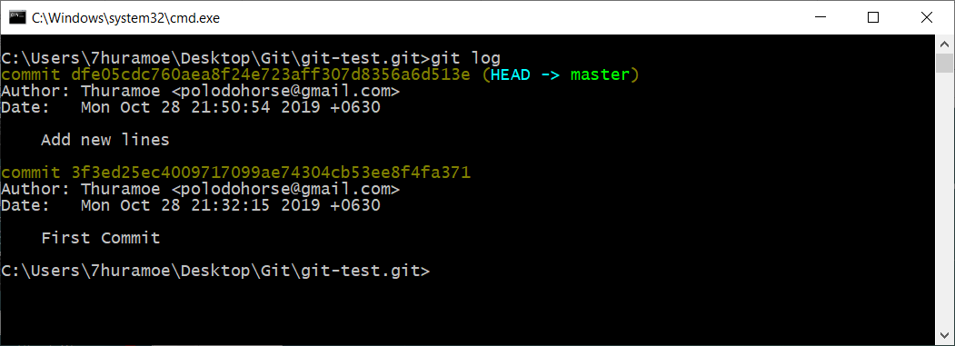
Check file versions(Log)
You can see all of your committed files and their versions by using git log command.
git log
git log --pretty=oneline
Each version has their own Commit Hash with 40 characters. If you want to go from one version to another you will used this hash number.

Slide 30
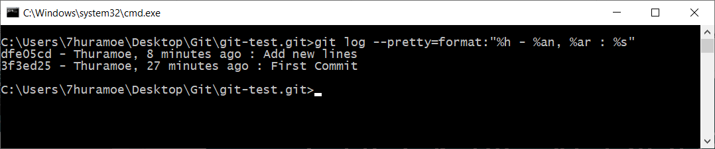
Check file versions(Log)
You can also used other format to see your log more readable.
git log --pretty=format:"%h - %an, %ar : %s“
%h means Short Commit Hash. Instead of 40 hash, it will show only first 7 characters.
%an means Author Name.
%ar means Author Date Relative and %s means Commit Comment Subject.

Slide 31
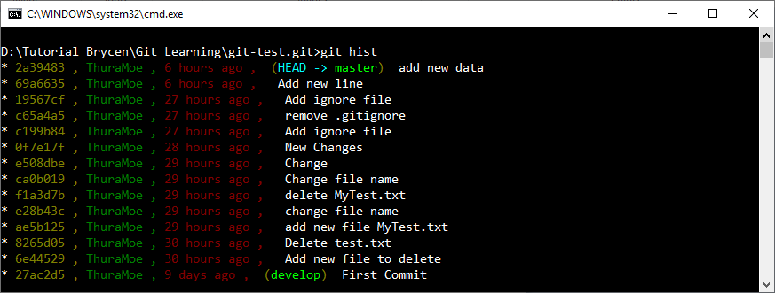
Creating Log Alias
Instead of writing whole log command every time, we can make log command as alias. You can create alias as follows:
git config --global alias.[alias_name]
So, now we create log alias called `hist`.
git config --global alias.hist "log --pretty=format:'%C(yellow)%h , %C(green)%cn , %C(red)%ar , %C(auto)%d %Creset %s' --graph --all"

Slide 32
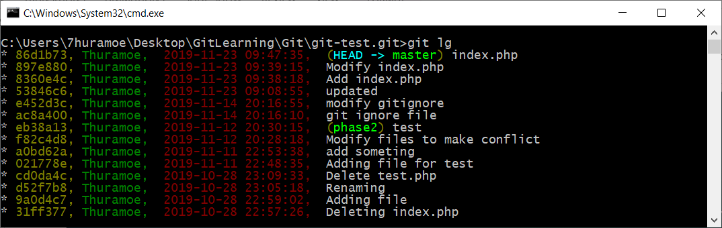
Creating Log Alias
Another way of log alias with specific times.
git config --global alias.lg "log --graph --decorate --all --date-order --date=format:'%Y-%m-%d %H:%M:%S' --pretty=format:'%C(yellow)%h, %C(green)%cn, %Creset %C(red)%ad, %Creset%C(auto)%d %s'"

Slide 33
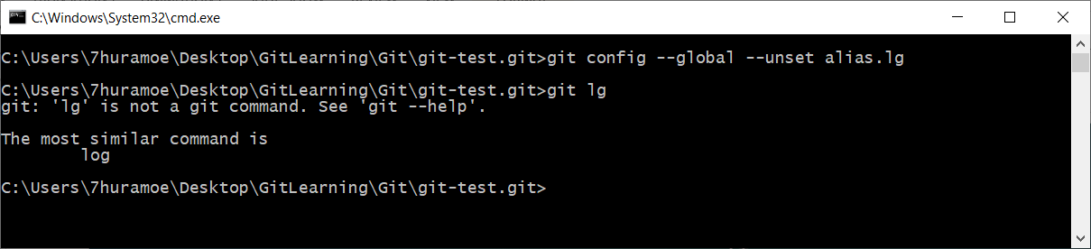
Removing Alias
If you want to remove an alias that you create, you can use following command.
git config --global --unset alias.[alias_name] git conifg --global --unset alias.hist

Slide 34
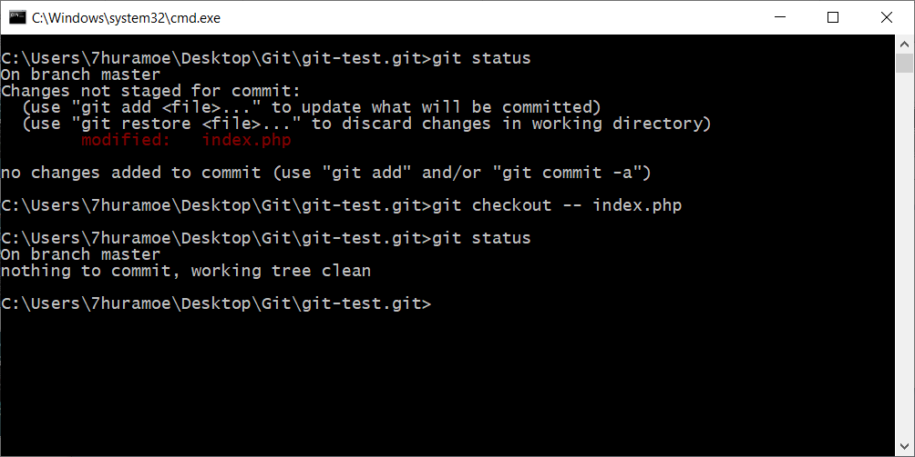
Backing out changes
If you make some modification to your file. After that, you don’t want that changes and want to remove all of your modification, you can remove all of your modification with following command.
git checkout -- index.php

Slide 35
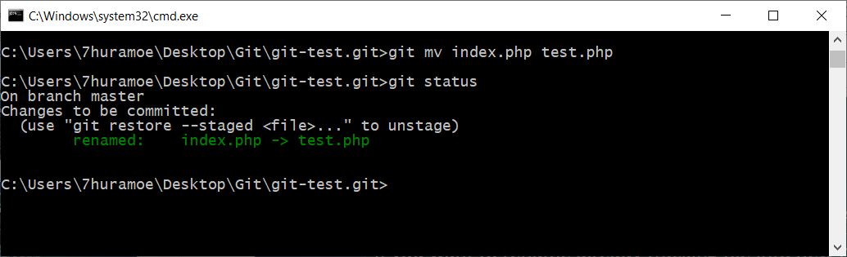
Renaming Files
If you want to rename already tracking file into new name. Use following command.
git mv index.php test.php
By using above command, git still tracking even file name is changed. And then, you need to commit again.

Slide 36
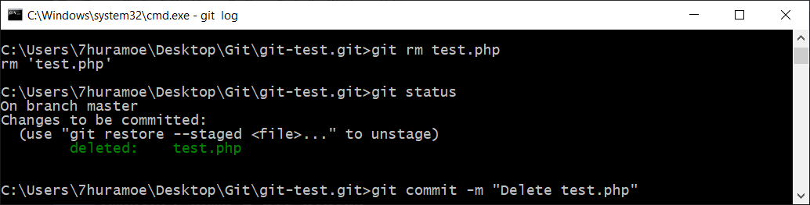
Deleting Files
If you want to delete already tracking file, use following command.
git rm test.php
After that, commit it.

Slide 37
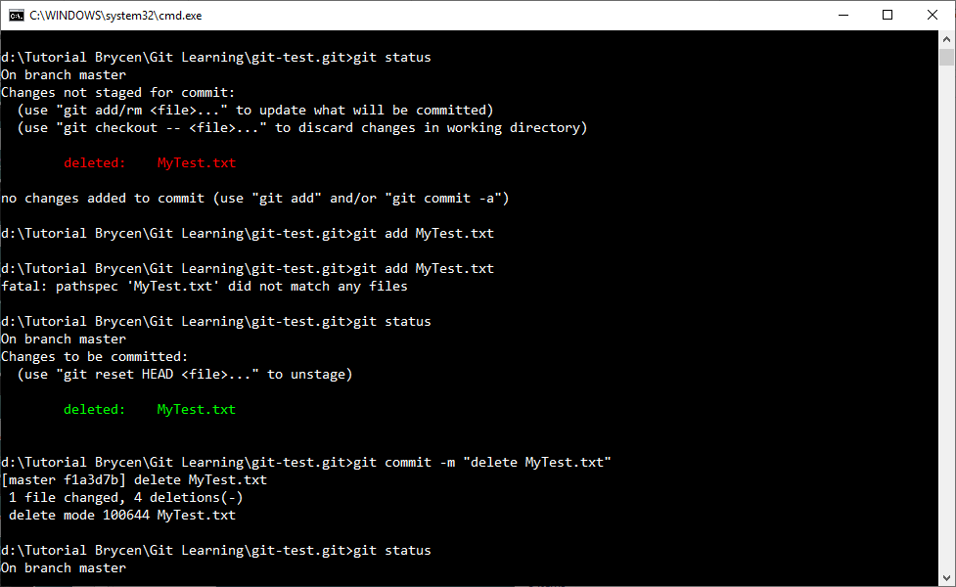
Managing Files Outside of Git
If you want to delete or rename file that already tracked by git without using git rm or git mv command, it means you delete or rename file directly in your repository(folder). Then you need to track that changes into git by using `git add` and `git commit` again.

Slide 38
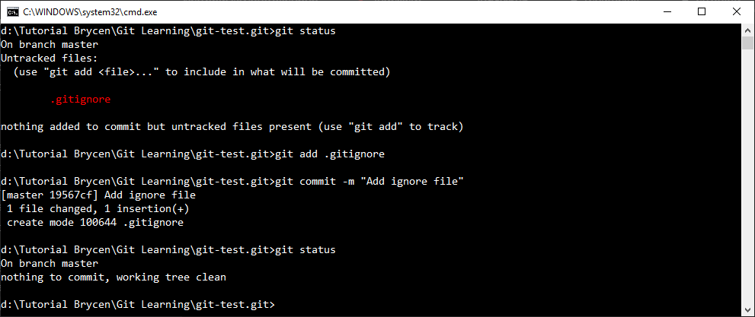
Ignoring Files From Git
If you want to untrack some files from Git such as your application log file, you will add those files into .gitignore file.
To untrack files from Git, you need to create a file called `.gitignore`. And write file name that you want to ignore into `.gitignore` file. If you want to ignore all files with `.log` extensions, you can write `*.log`.
Then you need to add and commit `.gitignore` file into git.

Slide 39
Reference
https://www.git-scm.com/book/en/v2
Rockstar-Developer-by-Ei.Maung.pdf
git-going-fast (Udemy Course)
github-ultimate course (Udemy Course)

