Slide 1
Civil Rights
Summarized AI
Progress Report & Fragmentation Analysis
Michigan State University CMSE Capstone
Liam Sandy | March 2026

Slide 2
Project Overview
Data Ingestion
LoRA Fine-Tuning
3-Tier Evaluation
Resilient API pipeline pulling case records from the Civil Rights Litigation Clearinghouse with checkpointing, retries, and raw payload archiving.
Qwen2.5-7B-Instruct fine-tuned with LoRA (r=16, alpha=32) on 9,841 case summarization examples across fragmented documents.
ROUGE lexical overlap, BERTScore semantic similarity, and LLM-as-Judge with Claude scoring on 5 expert dimensions.
12,303 training records • 9,841 train / 1,231 val / 1,231 test

Slide 3
The Fragmentation Problem
54%
of prompts fit in
Qwen's 32K context
Root Causes
No document prioritization
Dockets treated same as opinions
Naive fixed-size chunking
~25KB chunks split mid-document
Training instability
Loss spikes to 5,000+, NaN eval losses
Wasted context on boilerplate
18.5% of tokens are low-value dockets
2.5M
max tokens in a
single prompt
27K
median prompt
token count

Slide 4
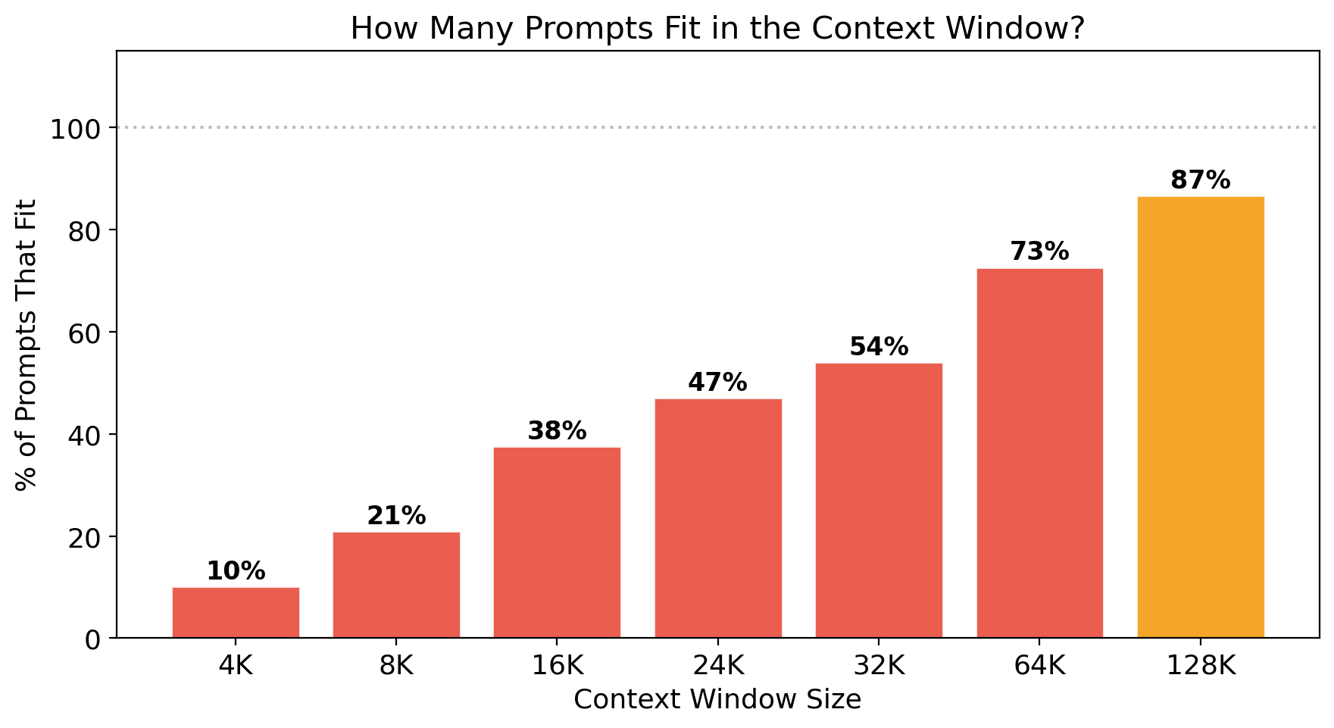
Context Window Analysis

Slide 5
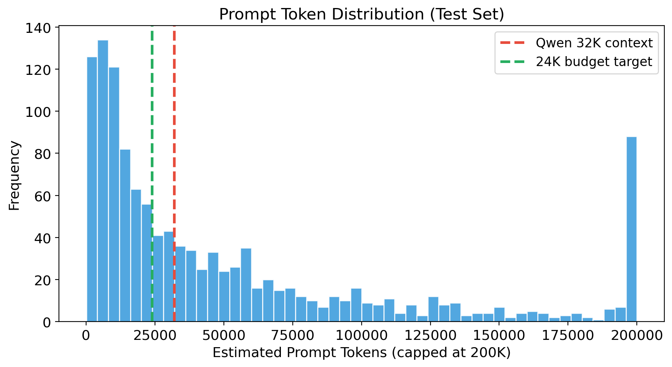
Prompt Token Distribution

Slide 6
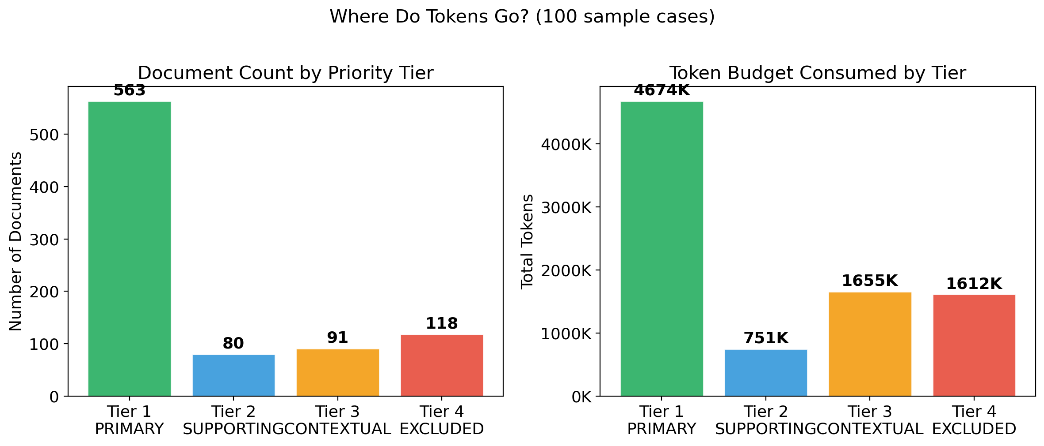
Document Type Analysis

Slide 7
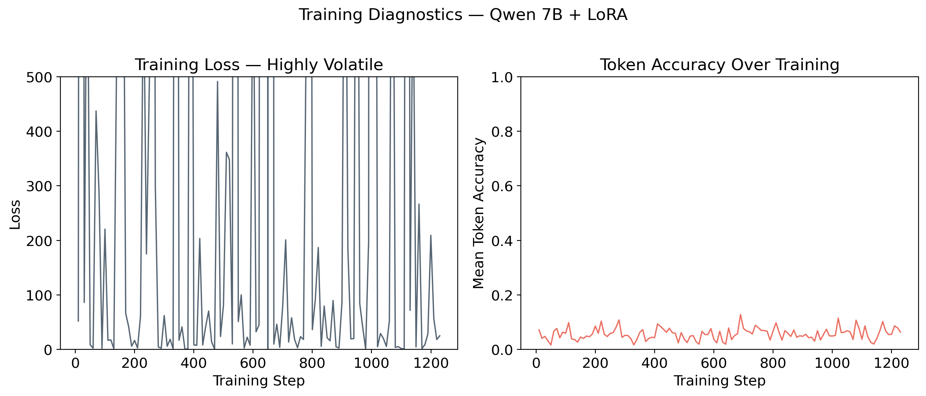
Training Diagnostics

Slide 8
Solution: Document-Aware Fragmentation
1
Document Classification
Classify each document into 4 priority tiers: Opinions > Complaints > Briefs > Dockets
2
Token Budget Allocation
Fill 24K token budget with highest-priority documents first. Truncate if needed, skip Tier 4.
3
Structured Prompts
Hierarchical format with timeline, importance labels ([PRIMARY], [SUPPORTING]), instructions at end.
4
Extract-Then-Summarize
Use local model to extract structured facts per document. Train on condensed extractions (~4K tokens).

Slide 9
Document Priority Tiers
Tier | Label | Document Types | Action
1 | PRIMARY | Opinions, Orders, Judgments, Consent Decrees, Settlement Agreements | Must include
2 | SUPPORTING | Complaints, Motions to Dismiss, Class Cert, Preliminary Injunctions | Include if space
3 | CONTEXTUAL | Reply briefs, Amici curiae, Supplemental memoranda, Objections | Selectively
4 | EXCLUDED | PACER Dockets, Correspondence, Newsletters, Press releases | Skip entirely
Tier 4 documents consume 18.5% of total tokens while adding minimal value to summaries.

Slide 10
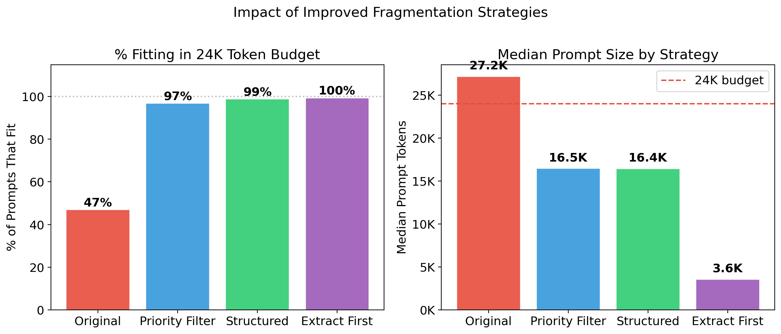
Strategy Comparison

Slide 11
Quantitative Improvement
Strategy | Median Tokens | Fit in 24K | Reduction
Original (baseline) | 27,192 | 47.0% | —
Priority Filter | 16,482 | 96.9% | 39% smaller
Structured | 16,447 | 98.9% | 40% smaller
Extract First | 3,576 | 99.5% | 87% smaller
All improved strategies achieve near-100% context fit, up from 47%.

Slide 12
Next Steps
1
Re-prepare training data
Run the structured strategy on full 9,841 training records
2
Re-train Qwen + LoRA
Fine-tune on improved prompts that fit within context window
3
Run evaluation pipeline
Generate summaries and score with ROUGE, BERTScore, and LLM-as-Judge
4
Generate comparison figures
Before/after metrics for the final report and presentation

