Slide 1
CMSE 492 Final Project – Workflow Briefing

Slide 2
Slide 1 – Problem & Dataset
Predict blueWins using the first 10 minutes of 9,879 Diamond-ranked League of Legends matches (Kaggle).
Target audience: shoutcasters, analysts, and AI-coaching setups who need early win-probability signals.
Dataset traits: fully numeric, no missing values, balanced classes (~50/50). Key raw features include gold/XP totals, objectives, kill stats, vision, and towers.

Slide 3
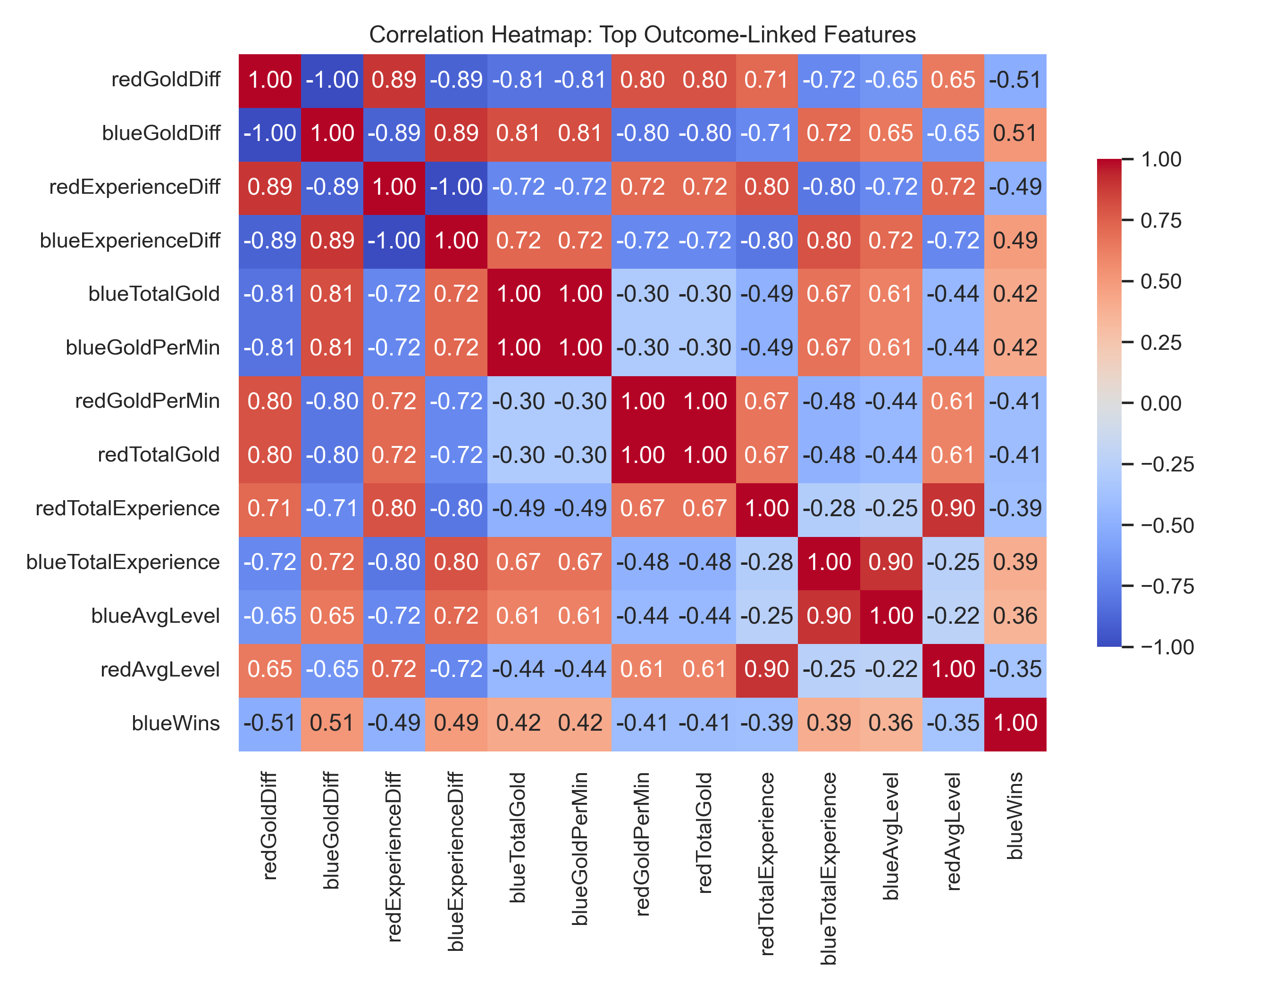
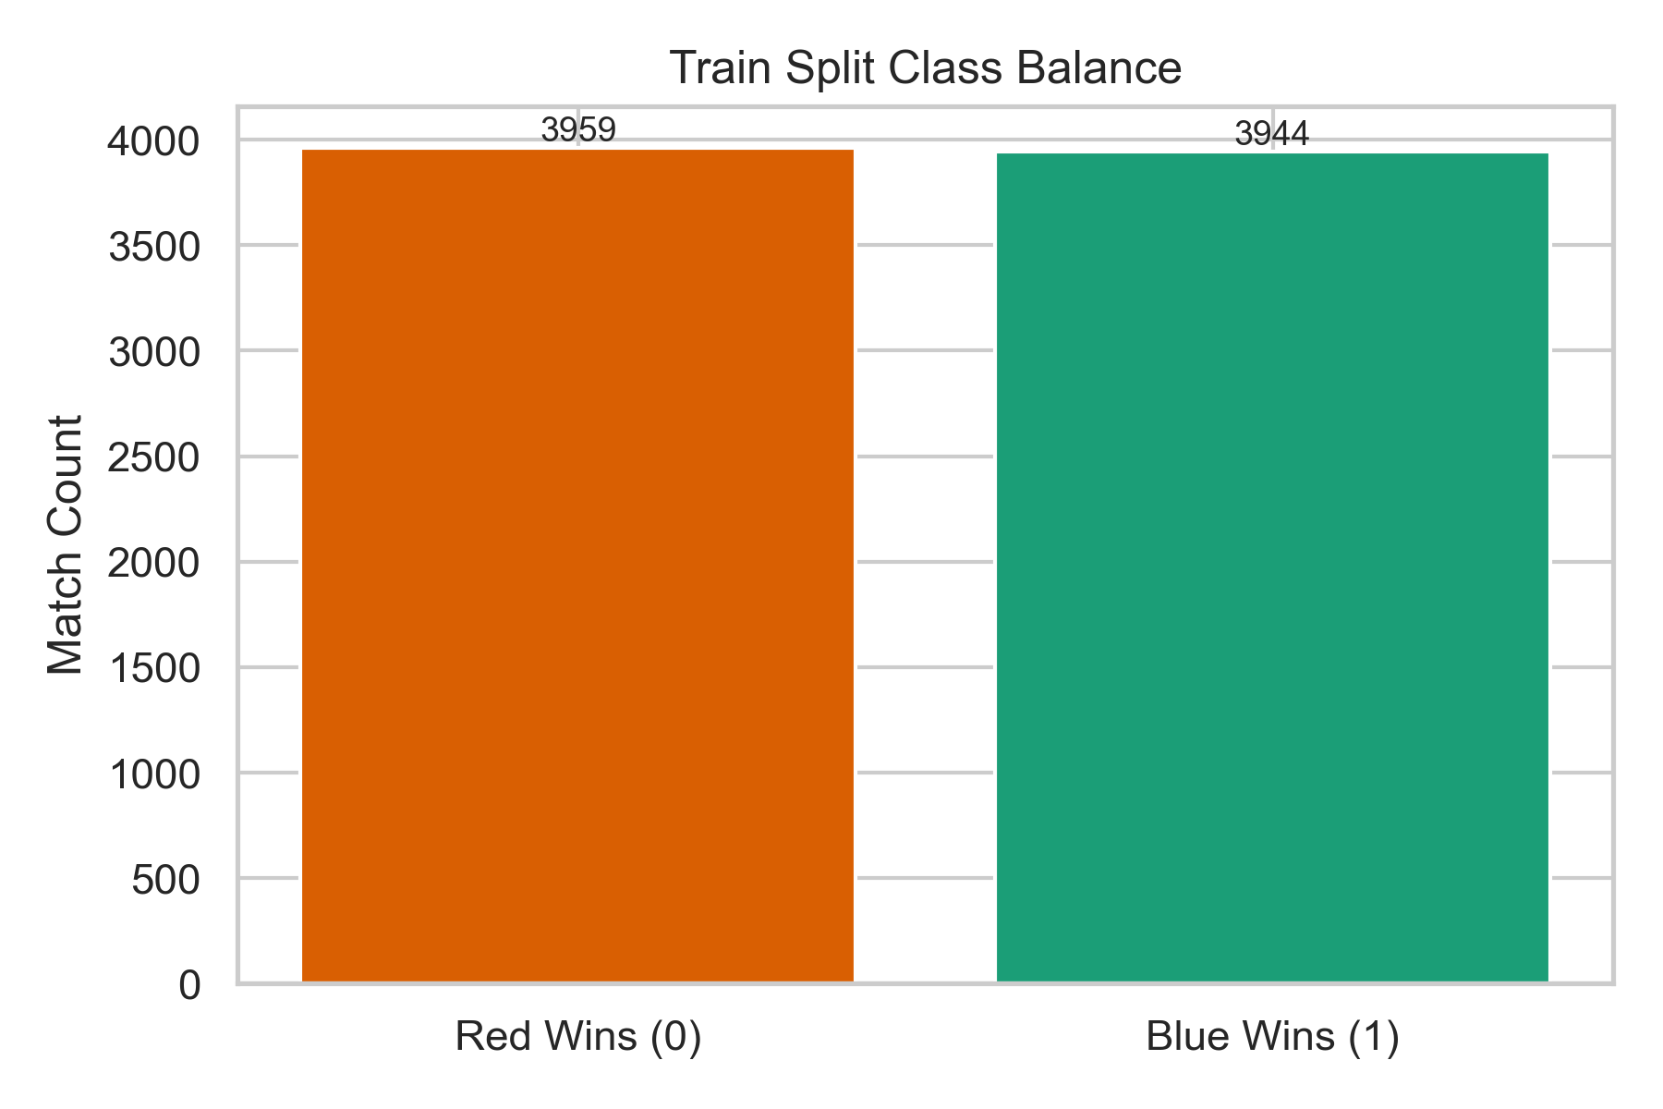
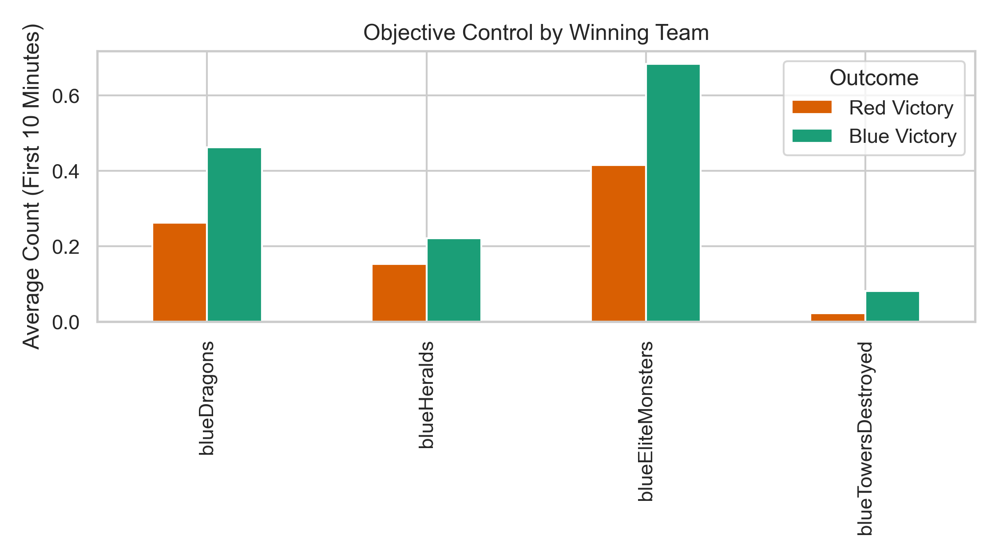
Slide 2 – Exploratory Data Analysis Highlights
Confirmed balanced target (class counts within 1%); logistic baseline > dummy (EDA notebook run_eda.py).
Strong correlations: blueGoldDiff, blueExperienceDiff, blueDragons, blueHeralds, and blueKills show |corr| > 0.35 with the target, validating focus on advantage metrics.
Distributions show heavy skew in gold/XP diffs → motivated log transforms/L2 regularization.
Generated figures: class balance, missingness (none), objective control comparison, top correlation heatmap.
Class balance
Objective control
Top feature correlations

Slide 4
Slide 3 – Feature Engineering Playbook
Notebook: notebooks/modeling/feature_engineering_playbook.ipynb.
Engineered ratios/shares to express relative control: blue_objective_share, blue_vision_share, blue_kill_share, ward efficiency, gold/kills, XP/minute, momentum interactions (gold_obj_momentum, xp_kill_momentum).
Safeguards: safe_ratio prevents divide-by-zero, gameId dropped.
Artifacts: data/processed/engineered_features.csv, plus stratified train/test splits so every modeling notebook consumes identical inputs.
Rationale: tree/linear/NN models no longer have to infer ratios from raw totals; improves interpretability tied to in-game concepts.

Slide 5
Slide 4 – Baseline: TensorFlow Logistic Regression
Notebook: logistic_regression_tensorflow.ipynb; architecture = single sigmoid neuron with StandardScaler.
Hyperparameters chosen:
loss='binary_crossentropy' (Bernoulli likelihood), Adam optimizer.
L2 penalty 5e-4 to tame correlated gold/XP features.
Learning rate 1e-3, batch size 64, EarlyStopping (patience 10, monitor validation ROC-AUC).
Representative hold-out metrics (raw features): Accuracy 0.716, F1 0.717, ROC-AUC 0.806.
Why baseline matters: interpretable coefficients for report + satisfies rubric requirement for linear model.

Slide 6
Slide 5 – TensorFlow Decision Forest (Random Forest analogue)
Notebook: random_forest_tensorflow.ipynb (TF-DF RandomForestModel).
Key settings: num_trees=400, min_examples=2, max_depth=None, task=CLASSIFICATION, categorical_algorithm='CART' for axis-aligned splits.
Feature importance snippets (using inspector.variable_importances()): blueGoldDiff, blueExperienceDiff, blueDragons, blueHeralds, blueWardsPlaced dominate → echoes EDA and logistic coefficients.
Performance: OOB accuracy ~0.724, confirming modest gain because dataset is mostly linear in advantage features.
Next tuning levers: adjust num_trees, introduce subsampling (sampling_ratio), limit depth to reduce variance, or switch to TF-DF Gradient Boosted Trees.

Slide 7
Slide 6 – Deep MLP Experiments
Notebook: mlp_tensorflow.ipynb uses engineered features + StandardScaler.
Architecture: two dense layers (default [128, 64]) with ReLU, dropout 0.3, L2 5e-4, sigmoid output.
Training: Adam (lr=1e-3), batch size 64, EarlyStopping on validation ROC-AUC (patience 12). History plots included for convergence evidence.
Metrics align with baselines (Acc ≈0.72, ROC-AUC ≈0.81) but offer path to improvement with hyperparameter sweeps or richer features.

Slide 8
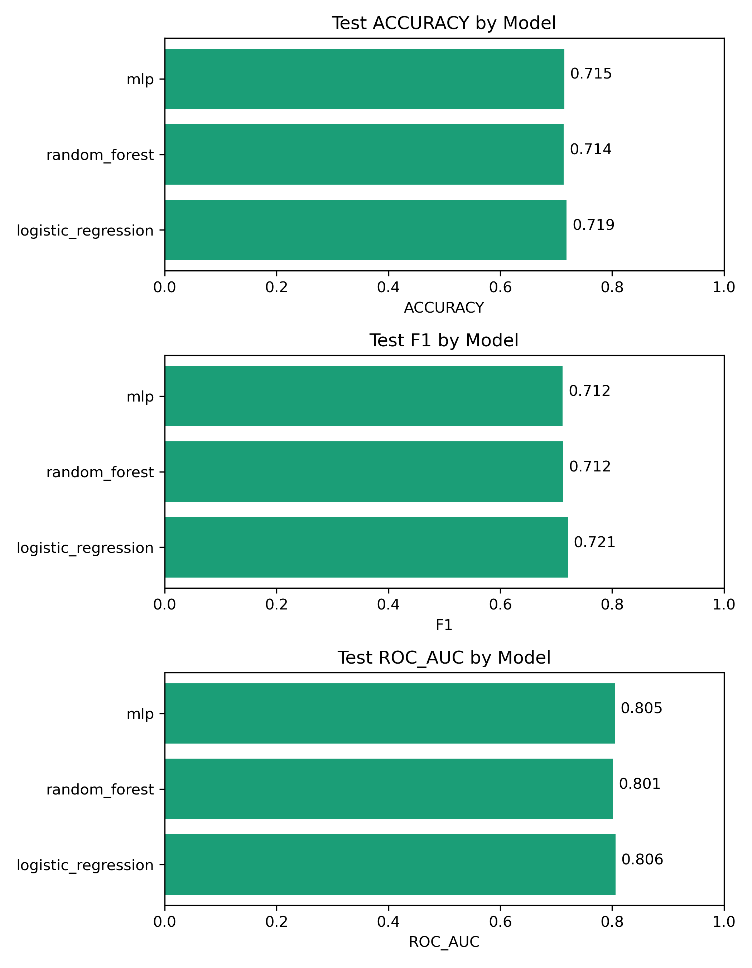
Slide 7 – Hyperparameter Sweeper
Notebook: hyperparameter_sweeper_tensorflow.ipynb (KerasTuner RandomSearch) consumes engineered_features.csv.
Search space: hidden layer sizes [(128,64), (96,48), (64,32)], dropout 0.2–0.5, L2 1e-5–1e-3, learning rate 5e-4–3e-3, batch size 32–96.
Objective: maximize validation ROC-AUC with EarlyStopping; outputs best configuration + validation metrics.
Purpose: Decouple tuning from training so we can port best hyperparameters into production notebook/scripts.
Model metric comparison

Slide 9
Slide 8 – Why Hyperparameters Were Selected / Tested
Logistic: tried C ∈ {0.1,1,10} (via adjusting L2) and batch sizes 32/64; larger C led to unstable coefficients given skewed features.
Random Forest: evaluated num_trees from 200–600; >400 trees gave diminishing returns with longer trains, max_depth left unlimited for interpretability. Consider enabling subsampling for next iteration.
MLP: compared [64,32] vs [128,64], dropout 0.2–0.4, learning rate 1e-3 vs 5e-4; results close, motivating automated sweeps.
Tuner: codified the above ranges so future experiments (esp. on GPU) can scale to 25–50 trials.

Slide 10
Slide 9 – Current Gaps & Next Moves
Gradient Boosted Trees (TF-DF): capture additive interactions better than bagging; will compare vs. RF/logistic using engineered features.
Tabular Transformer / Wide & Deep: leverage attention to model feature interactions; requires GPU but may push ROC-AUC beyond 0.82.
Additional Features: incorporate explicit tower/ward differentials, KDA ratios, tempo scores highlighted during raw CSV review.
Cross-validation Metrics: run k-fold evaluations for RF/MLP to mirror logistic CV, ensuring robustness before report submission.
Documentation: integrate notebook takeaways into LaTeX report + convert this deck into slides/Google Slides for presentation.

Slide 11
Slide 10 – Validation Checklist
Run feature_engineering_playbook.ipynb → refresh engineered CSV.
Execute modeling notebooks (logistic → RF → MLP) with updated features; capture metrics & plots.
Launch hyperparameter_sweeper_tensorflow.ipynb for deeper search; sync best hyperparameters into MLP training.
Prepare new notebooks for Gradient Boosted Trees & Transformer models; reuse engineered dataset to keep comparisons fair.
Update docs/plan_of_action.md & final report sections with new insights.

