Slide 1
BDD / Exec Specs VS 2013
Tommy Hinrichs
3/21/2015

Slide 2
The Terms (Some with my own spin)
BDD – Behavior Driven Development [0]
“BDD is a second-generation, outside-in, pull-based, multiple-stakeholder, multiple-scale, high-automation, agile methodology” – Dan North
EXEC SPECS – Executable Specifications [1]
In this case, Specifications agreed upon by the business, written in English, using their ubiquitous language, that can be executed, preferably in an automated fashion.
UBIQUITOUS LANGUAGE [2]
A language, or set of terms, used to communicate about a domain. In this case, the business’ language; as molded by the dev teams domain experts

Slide 3
The Terms (Some with my own spin)
DSL – Domain Specific Language [3]
Internal DSL: - “Internal DSLs are a particular form of API in a host general purpose language, often referred to as a fluent interface” – Martin Fowler
Bridge from business’ ubiquitous language to your systems’ behavior
PAGE OBJECT [4]
Class, exercised by automation, representing UI elements (in this case assertion free)

Slide 4
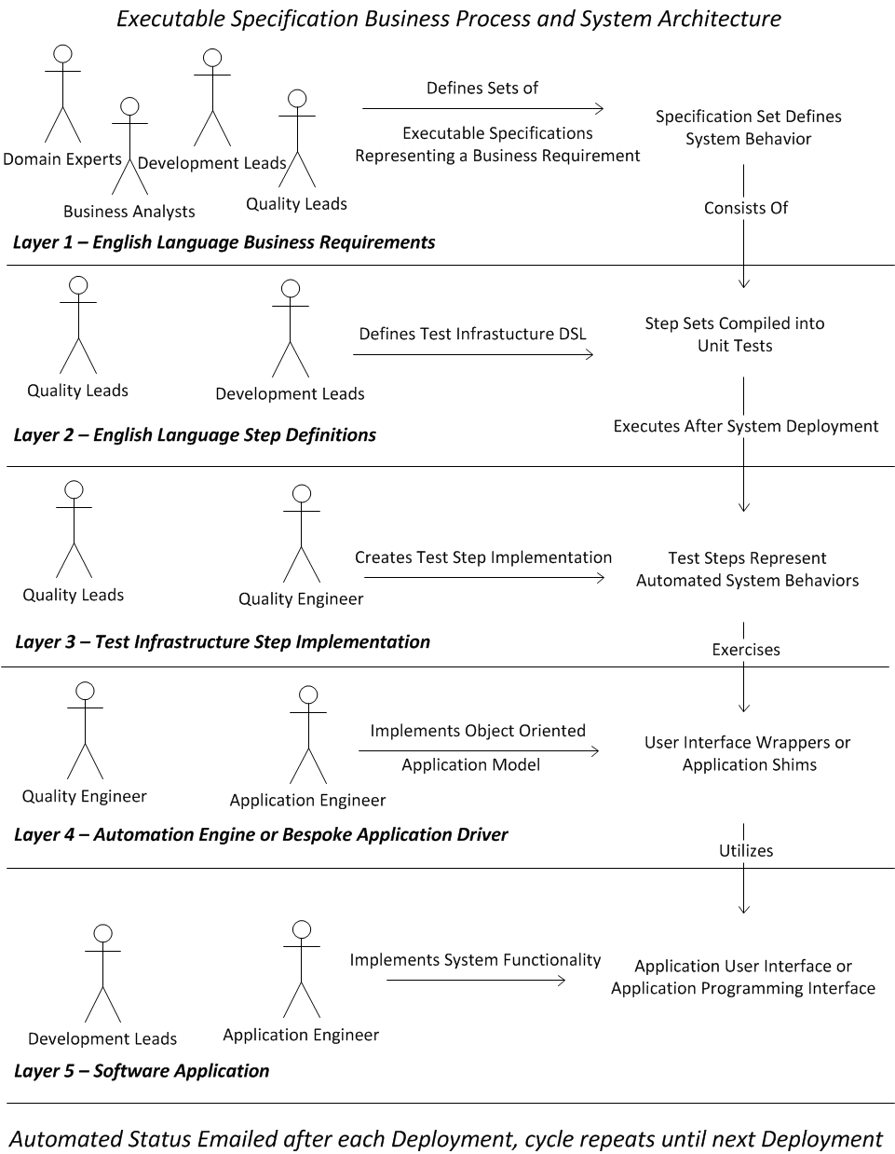
The Process
Key
Figures – Roles, Not Individuals
Right Arrows – Role’s Actions
Down arrows – Layer Relation
Layer 1 – During Feature Definition
Layer 2 to 5 – Parallel through sprint

Slide 5
The Tools
VS 2013 [5]
I’m Demoing with Visual Studio Ultimate
Link is for Visual Studio Community
SpecFlow [6]
Visual Studio add in, Nuget Package, MSBuild tasks
DOS Batch (Probably should be PS)

Slide 6
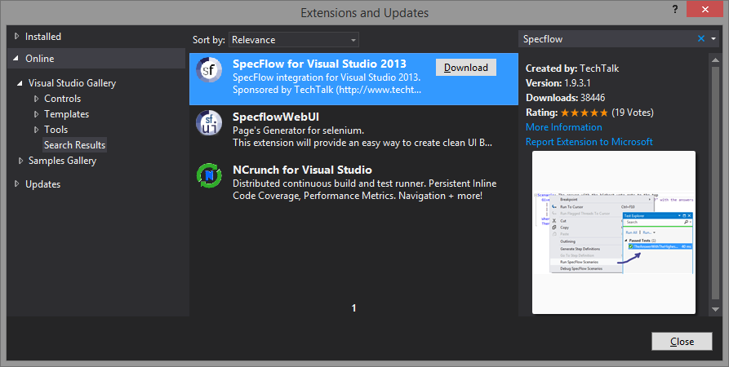
SPECFLOW Installation
VSIX

Slide 7

SPECFLOW Installation
Decide which test runner to use
NUGET PACKAGE

Slide 8
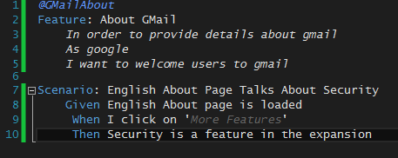
SPECFLOW Feature File SYNTAX
Utilizes Gherkin [7]
Given … When … Then [8]

Slide 9
English language specifications
@SomeLogicalFeatureGrouping (optional)
Feature: Deliverable Unit
User Story
@SomeLogicalFeatureGrouping (optional)
Scenario to be completed for the deliverable
Given: Initial state
When: Action taken / system input
Then: Observable behavior

Slide 10
Specification tips
Specs are for the entire team, including the business
Declarative, not imperative
The value of English Language specifications is that business and delivery teams are saying the same thing with the same words
Push the how down [9]
How? – Now some code, finally

Slide 11
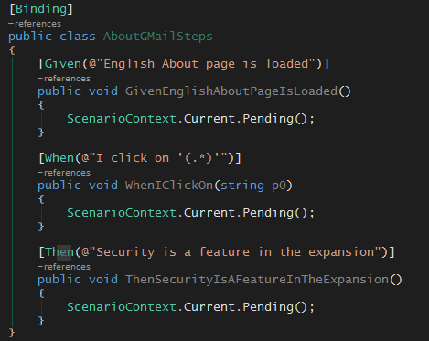
Stub generated code

Slide 12
References
[0] - http://en.wikipedia.org/wiki/Behavior-driven_development
[1] - http://specificationbyexample.com/key_ideas.html
[2] - http://martinfowler.com/bliki/UbiquitousLanguage.html
[3] - http://martinfowler.com/bliki/DomainSpecificLanguage.html
[4] - http://martinfowler.com/bliki/PageObject.html
[5] - https://www.visualstudio.com/en-us/products/visual-studio-community-vs.aspx
[6] - http://www.specflow.org/documentation/Installation/
[7] - https://github.com/cucumber/cucumber/wiki/Gherkin
[8] - https://github.com/cucumber/cucumber/wiki/Given-When-Then
[9] - http://www.marcusoft.net/2013/04/PushTheHowDown.html

Slide 13
THANK YOU Tommy Hinrichs 3/21/2015

