Slide 1
4COSCO11C.2 Web Design and Development
Introduction to JavaScript
Week 5

Slide 2
How JavaScript aligns with other Web Technologies
HTML is for content
CSS is for presentation
JavaScript is for interactivity
validate user input in an HTML form before sending the data to a server;
build forms that respond to user input without accessing a server;
change the appearance of HTML documents and write data to browser Windows;
open and close new browser windows or frames;
build small but complete client side programs.

Slide 3
Things you can do with JavaScript - Some examples:
Validate User Input
Checking the values in input fields
Checking a Password
Checking numeric values
Forms that respond to user input without accessing a server
Forms that load a URL
Forms that calculate
Write information into HTML documents using Javascript Statements
Programmed output via document.write() or [element selector].innerHTML
Adjust document colours
Change/rewrite images in a document
Open and Close Browser windows and Frames
Create new Browser windows with documents or programmed output
Build small but complete client side programs
Calculators
Games
Control Robots
Control drones (IOT)

Slide 4
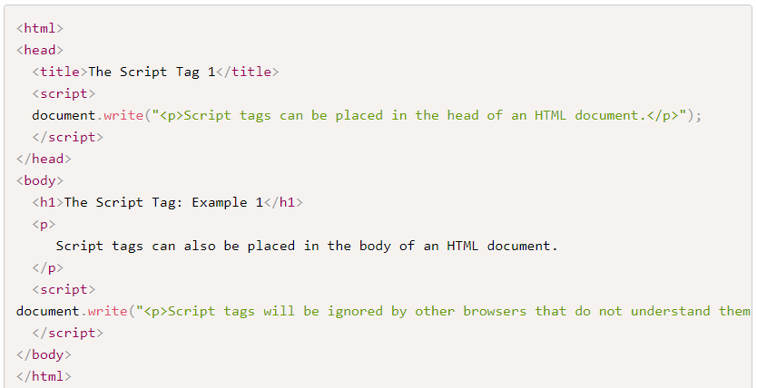
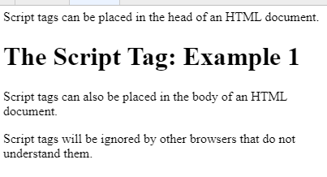
The <script> </script> tag

Slide 5
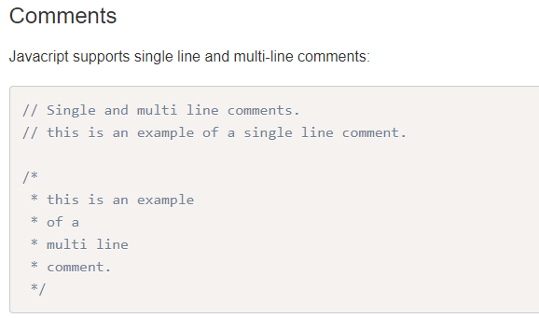
JavaScript syntax basics

Slide 6
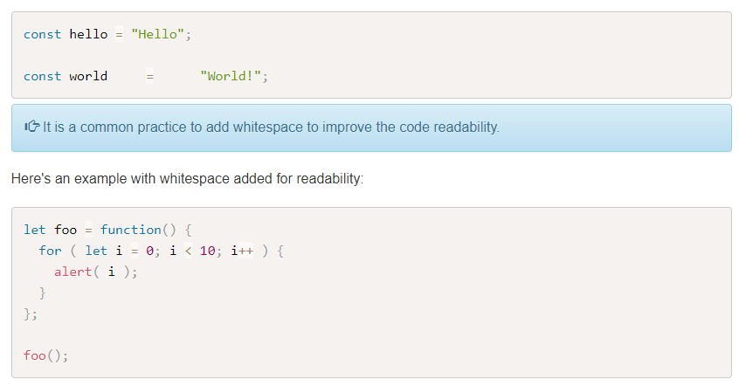
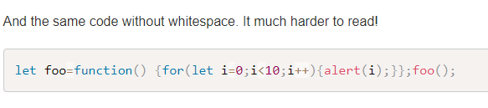
Whitespace

Slide 7
Reserved Keywords
There are a handful of reserved words that can't be used when declaring user-defined variables and functions.
Some of these reserved words are currently implemented, some are saved for future use, and others are reserved for historical reasons. A list of words and in-depth explanations for each can be found on the Mozilla Developer Network JavaScript Reference site.

Slide 8
Variables
Variables are containers for storing data. You can declare a variable in JavaScript:
Using var
Using let
Using const

Slide 9
Declaring variables with var
The var statement declares a function-scoped or globally-scoped variable, optionally initializing it to a value.
In addition, variables declared with var are processed before any code is executed. This is called hoisting.
The scope of a variable declared with var is its current execution context and closures thereof, which is either the enclosing function and functions declared within it, or, for variables declared outside any function, global. Duplicate variable declarations using var will not trigger an error, even in strict mode, and the variable will not lose its value, unless another assignment is performed.
More on var

Slide 10
Declaring variables with let
The let statement declares a block-scoped local variable, optionally initializing it to a value.
let allows you to declare variables that are limited to the scope of a block statement, or expression on which it is used, unlike the var keyword, which declares a variable globally, or locally to an entire function regardless of block scope. The other difference between var and let is that the latter is initialized to a value only when a parser evaluates it
More on let

Slide 11
Declaring variables with const
const allows you to declare and initialize a read-only variable that will hold a constant value and something that we can never change. Const variables are block-scoped, much like variables declared using the let keyword. The value of a constant can't be changed through reassignment (i.e. by using the assignment operator), and it can't be redeclared (i.e. through a variable declaration). However, if a variable declared with const is an object or array its properties or items can be updated or removed.
An initializer for a constant is required. You must specify its value in the same statement in which it's declared. (This makes sense, given that it can't be changed later.)
The const declaration creates a read-only reference to a value. It does not mean the value it holds is immutable—just that the variable identifier cannot be reassigned. For instance, in the case where the content is an object, this means the object's contents (e.g., its properties) can be altered.
This declaration creates a constant whose scope can be either global or local to the block in which it is declared.
More information on const

Slide 12
General Rule for declaring variables
In general, use const for declaring objects or arrays, and variables that will not change. Use let to declare variables that will change through reassignment.
Use var only if your code needs to run on in older browsers

Slide 13
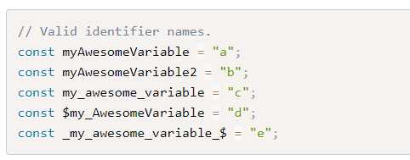
Identifiers
Identifiers are used to give variables and functions a unique name so they can subsequently be referred to by that name. The name of an identifier must follow a few rules:
Cannot be a reserved word.
Can only be composed of letters, numbers, dollar signs, and underscores.
The first character cannot be a number.
It's best practice to name identifiers in a way that will make sense to you and other developers later on.

Slide 14
Types
Types in JavaScript fall into two categories: primitives or objects. Primitive types include:
String
Number
Boolean
Null
Undefined

Slide 15
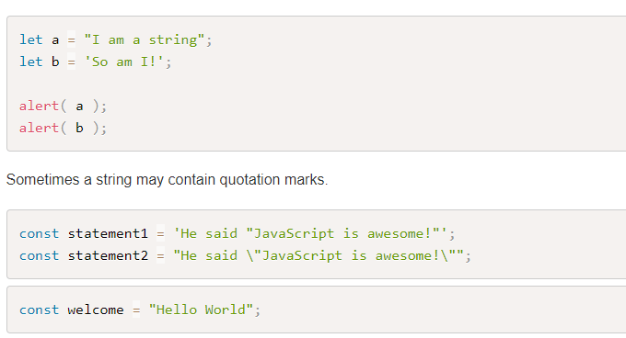
Strings
Strings are text wrapped in single or double quotation marks. It is best practice to consistently use one or the other. There may be times when the string contains quotation marks that collide with the ones used to create the string. In this case, either escape the characters using a \ backslash or use different quotes around the string.
Strings can created with double or single quotes.

Slide 16
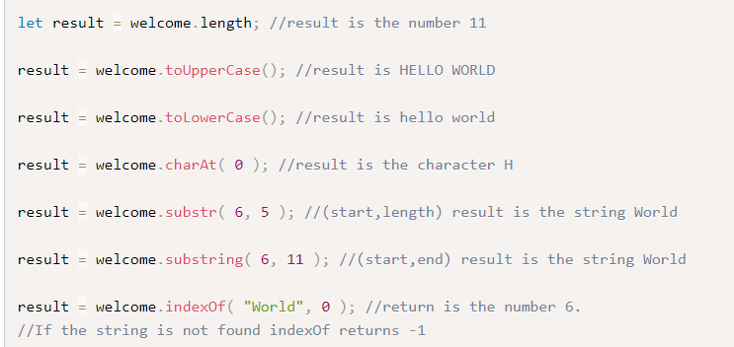
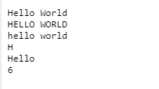
Contd

Slide 17
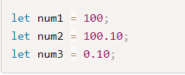

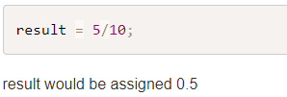
Number
Number types are any positive or negative numeric value. There is no distinction between integer and floating point values.
JavaScript is a loosely typed language. Programmers used to strongly typed languages such as C++ or Java find this difficult to get used to. For example in C/C++/Java the following statements, including the integer division,
result would equal 0. In JavaScipt there are no explicit integers or floating point numbers. "Unofficially," you will get one or the other back.

Slide 18


JavaScript Precision
Integers are considered accurate up to 15 digits.
The maximum number of decimals is 17, but floating point arithmetic is not always 100% accurate:
The solution to this problem depends on the type of problem you are dealing with. You can round the result, truncate it or work in a smaller unit. The easiest solution is to use correction factors (multiply by a suitable power of 10) so that the arithmetic happens between integers. For example, in the case of 0.2 + 0.1, the correction factor is 10, and you would performing the calculation:

Slide 19
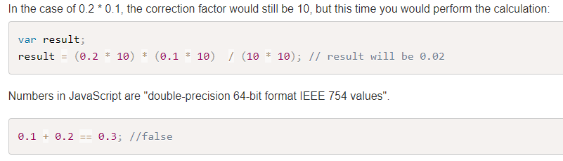
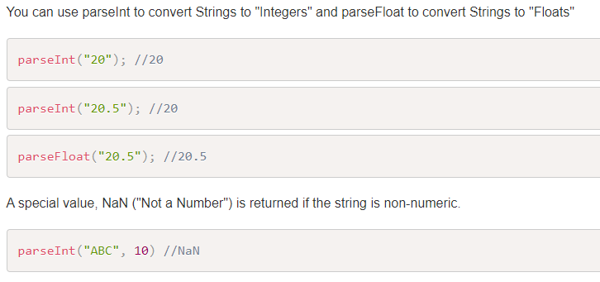
JavaScript Precision

Slide 20

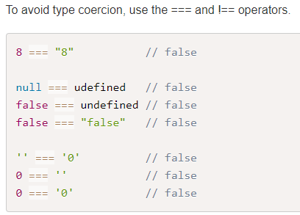
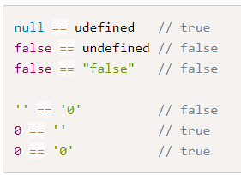
Type Coercion
JavaScript uses type coercion whenever it needs to perform an operation on two operands that need to be the same type and are not.
Relying on type coercion is not a good idea.

Slide 21

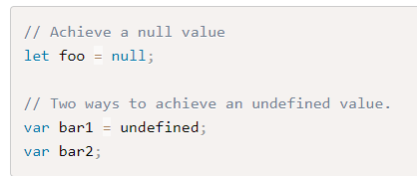
Boolean, Null and Undefined
Boolean types are either true or false.
Null and Undefined
Null and undefined are special types in JavaScript. Null types are a value that represent the absence of a value, similar to many other programming languages. Undefined types represent a state in which no value has been assigned at all. This type is created in two ways: by using the undefined keyword or by not defining a value at all.

Slide 22
Objects
Everything else is in JavaScript is considered an Object. While there are numerous built-in objects, here we will cover:
Date
Array
Function

Slide 23
Conditional Statements
In JavaScript we have the following conditional statements:
if statement - use this statement to execute some code only if a specified condition is true
if...else statement - use this statement to execute some code if the condition is true and another code if the condition is false
if...else if....else statement - use this statement to select one of many blocks of code to be executed
switch statement - use this statement to select one of many blocks of code to be executed

Slide 24
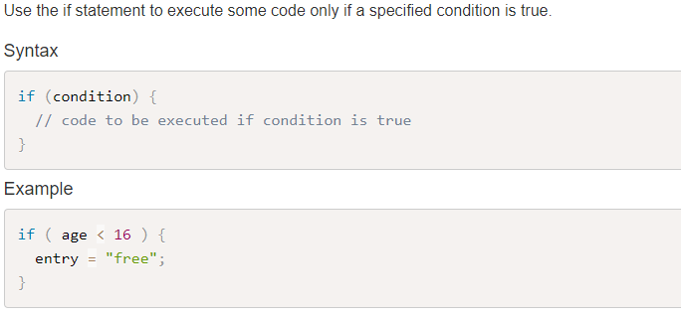
If Statement

Slide 25
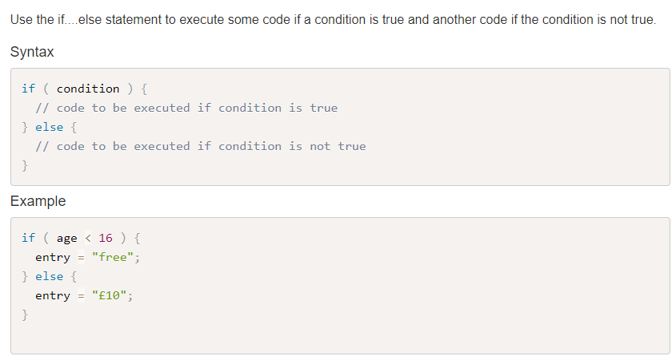
If...else Statement

Slide 26
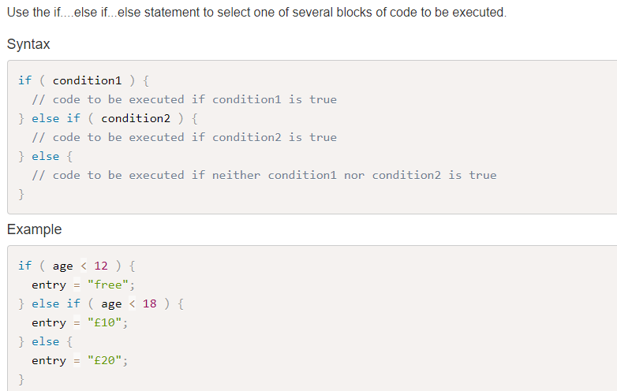
If...else if....else Statement

Slide 27
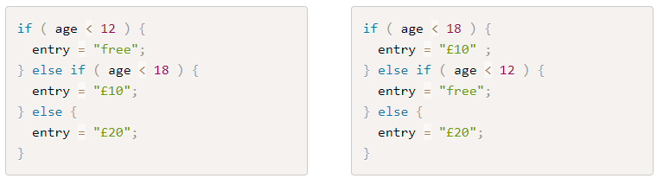
Question
Are these equivalent and why?

Slide 28
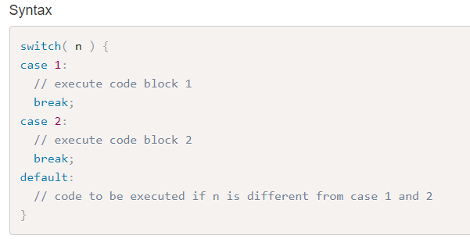
The JavaScript Switch Statement

Slide 29
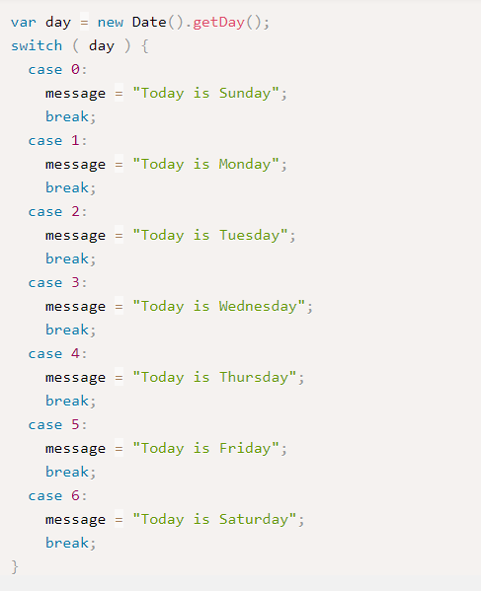
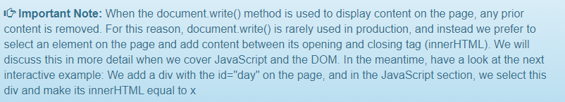
The JavaScript Switch Statement

Slide 30
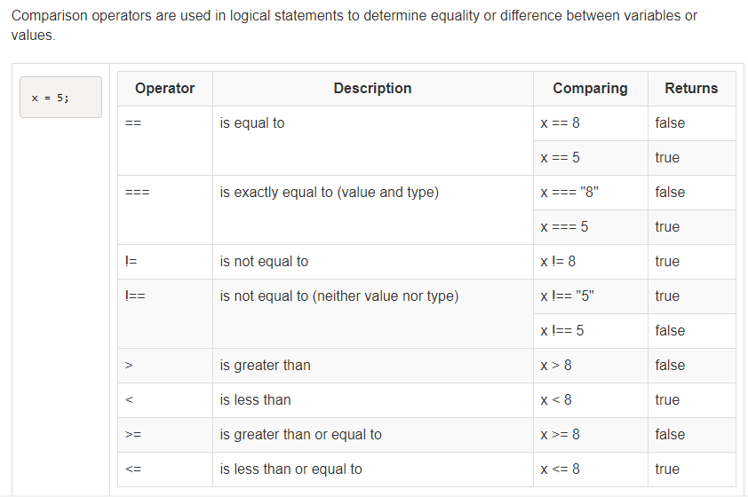
Comparison Operators

Slide 31
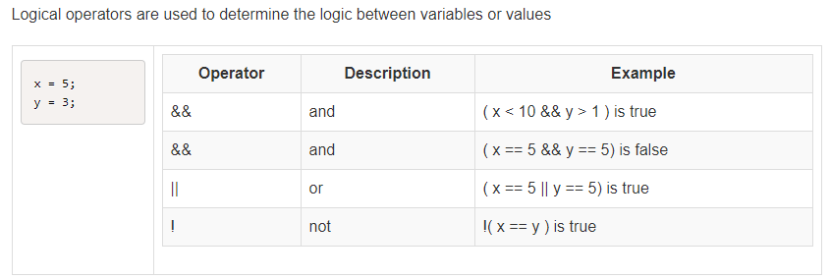
Logical Operators

Slide 32
JavaScript Loops
In JavaScript we have the following loops:
for - loops through a block of code a number of times
for/in - loops through the properties of an object
while - loops through a block of code while a specified condition is true
do/while - also loops through a block of code while a specified condition is true

Slide 33
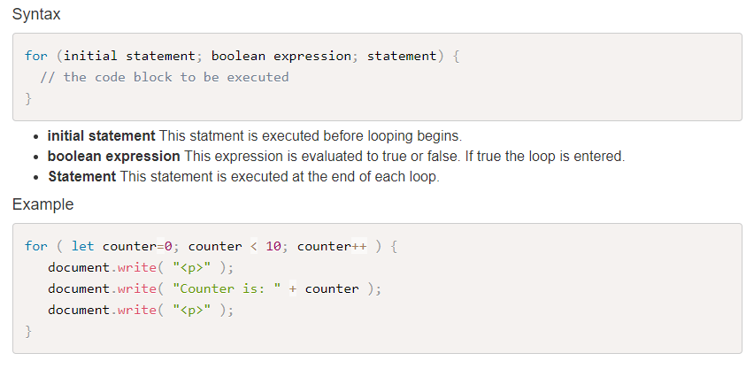
The For Loop
The for loop is often the tool you will use when you want to create a loop. This will often be used if you want to repeat the same code a number of times, each time with a different value.

Slide 34
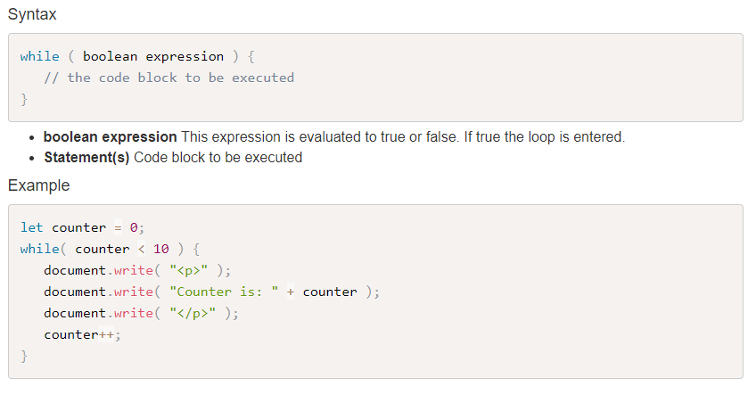
The While Loop
The while loop allows you to run a block of code while a condition is true. If the condition is not true at the start, the block of code inside the while loop will not be executed at all.

Slide 35
The Do While Loop
The do while loop allows you to run a block of code once, and to continue to run it while a condition is true.
If the condition is not true at the start, the block of code inside curly braces will be executed once, as the condition check only takes place at the end of the execution of that block of code.
This is particularly useful when asking for user input and validating it. You can ask the user to enter their input once, and to repeat as long as the value they have entered is invalid, see Example 2.

Slide 36
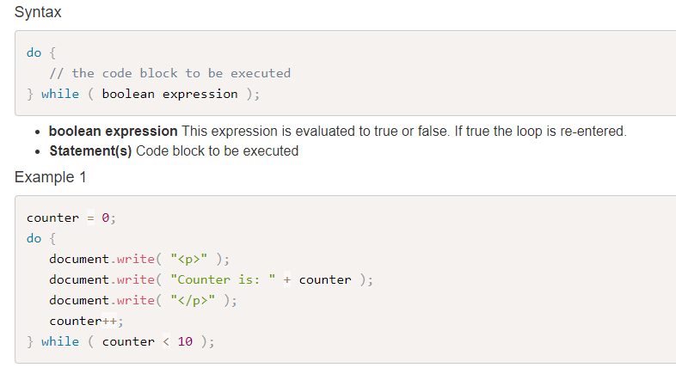
The Do While Loop

Slide 37
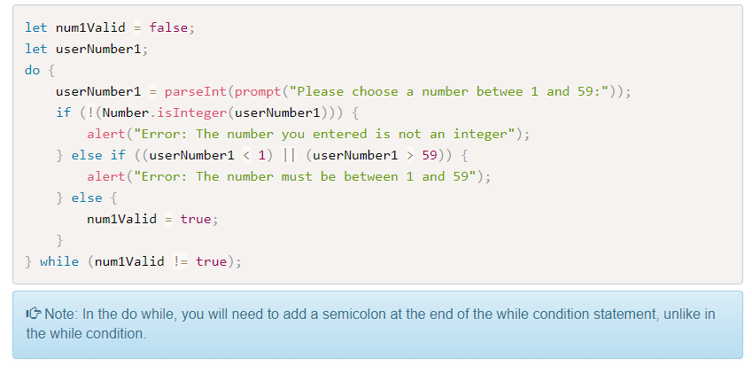
The Do While Loop

Slide 38
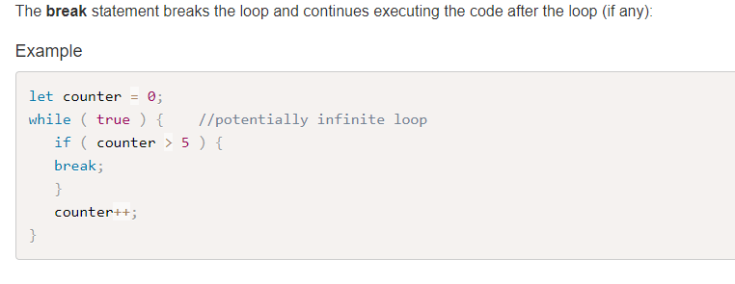
The Break Statement

Slide 39
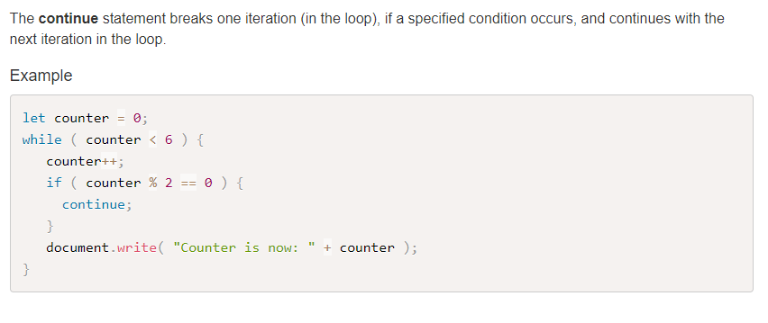
The Continue Statement

Slide 40
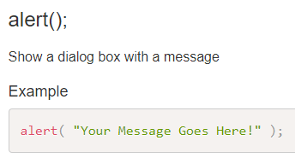
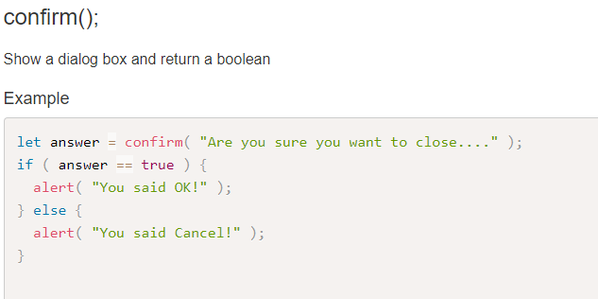
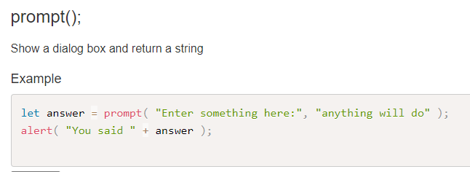
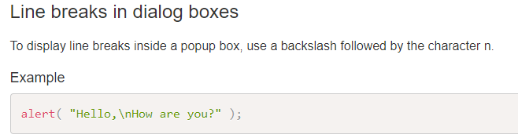
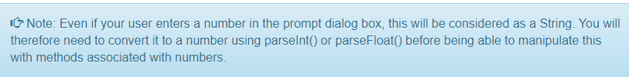
JavaScript Dialog Boxes

Slide 41
Review Questions
Question 1 - Which HTML tags are used to hold JavaScript code?
Question 2 - In which parts of the HTML document should the scripts go?
Question 3 - Would it make sense to have a string holding HTML code as a parameter for the write() method?
Question 4 - Would it make sense to have a string holding HTML code as a parameter for the alert() method?
Question 5 - What are the 3 JavaScript dialog boxes and what are their differences?

