Slide 1
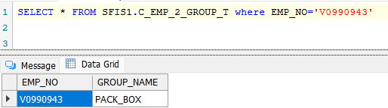
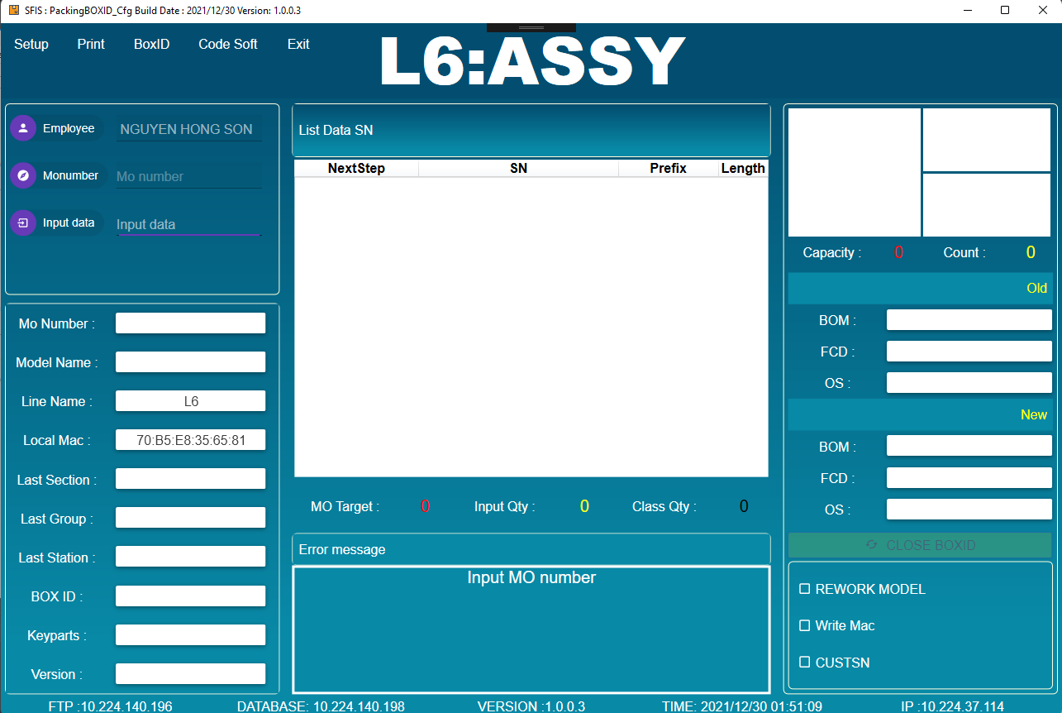
1.Open program
Use SFIS_AMS 5.0 to download and run program. Login by employee have login privilege (as below image).
Call procedure: SFIS1.API_EXECUTE

Slide 2
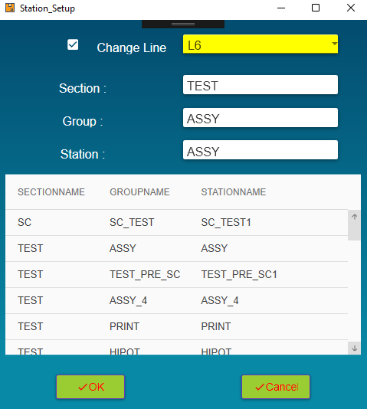
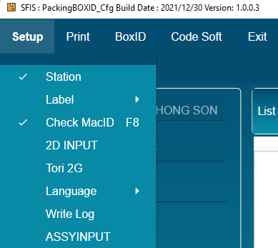
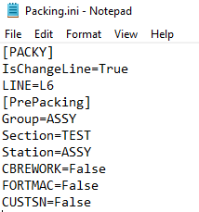
2.Setup station
The program will save the station value in File(C:\PACKING\Packing.ini)

Slide 3
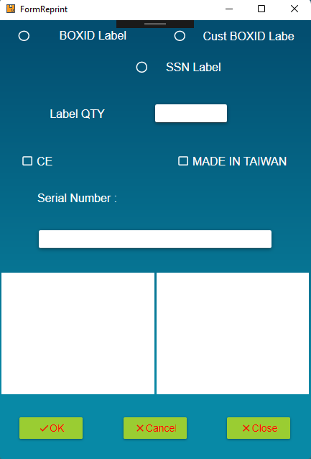
3. Reprint

Slide 4
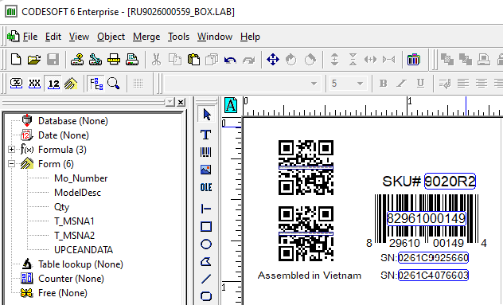
4. Label and Visible label
Using Label Checking system to manage.
Visible label using CODESOFT to display value and variables in Label.

Slide 5
2021 FG IT Weekly Meeting 資訊管理部報告
Check dup
Have data
Check table c_pallet_t
with LINE_NAME and MO
Have data
Check table R_pallet_t
With mac of pc
Scan MAC
No data
No data
Create pallet no

