Slide 1
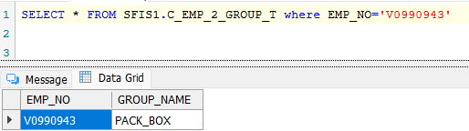
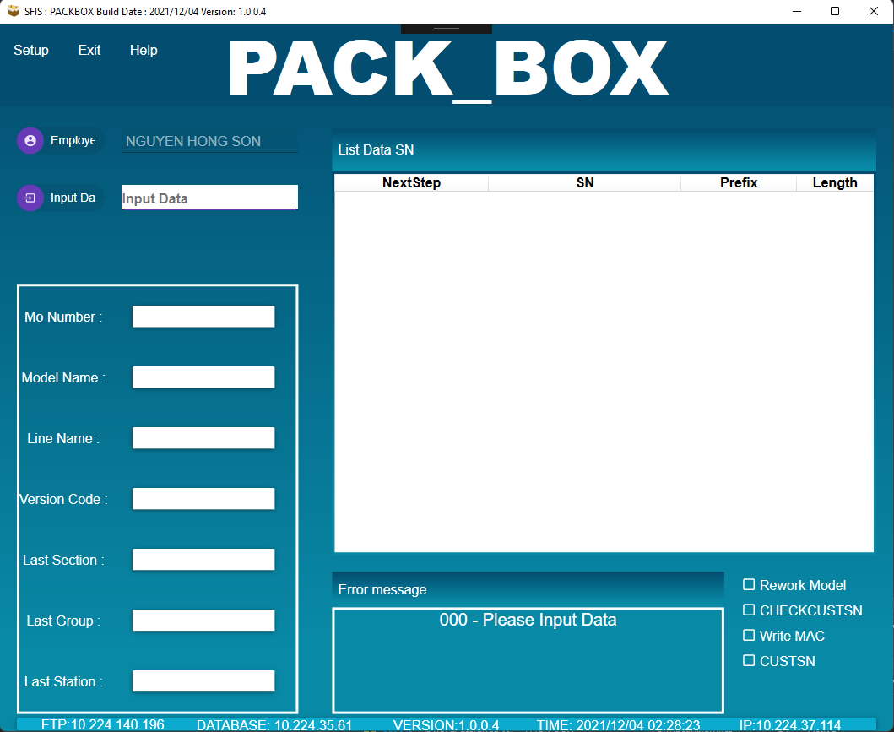
1.Open program
Use SFIS_AMS 5.0 to download and run program. Login by employee have login privilege (as below image).
Call procedure: SFIS1.API_EXECUTE

Slide 2
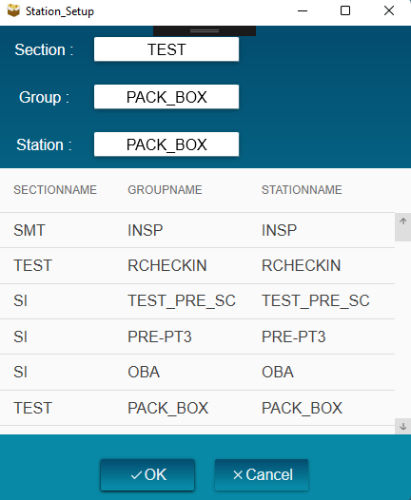
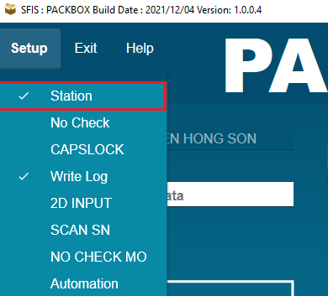
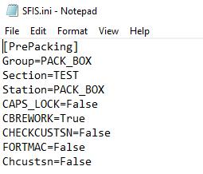
2.Setup station
Write and read station to file SFIS.ini

Slide 3
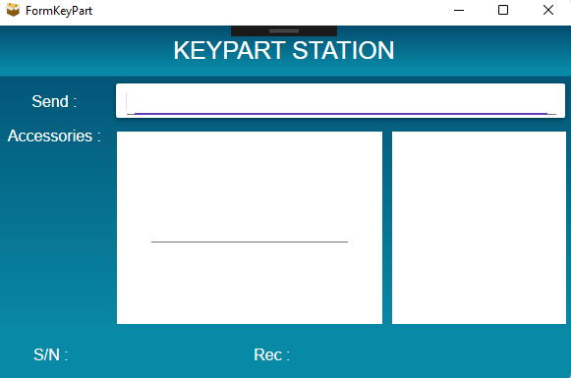
3.Scan Keypart
Call procedure: SFIS1.CHECK_SN
SFIS1.CHECK_LOTKP_FOR_ALL

