Slide 1
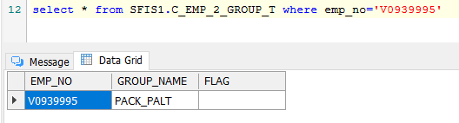
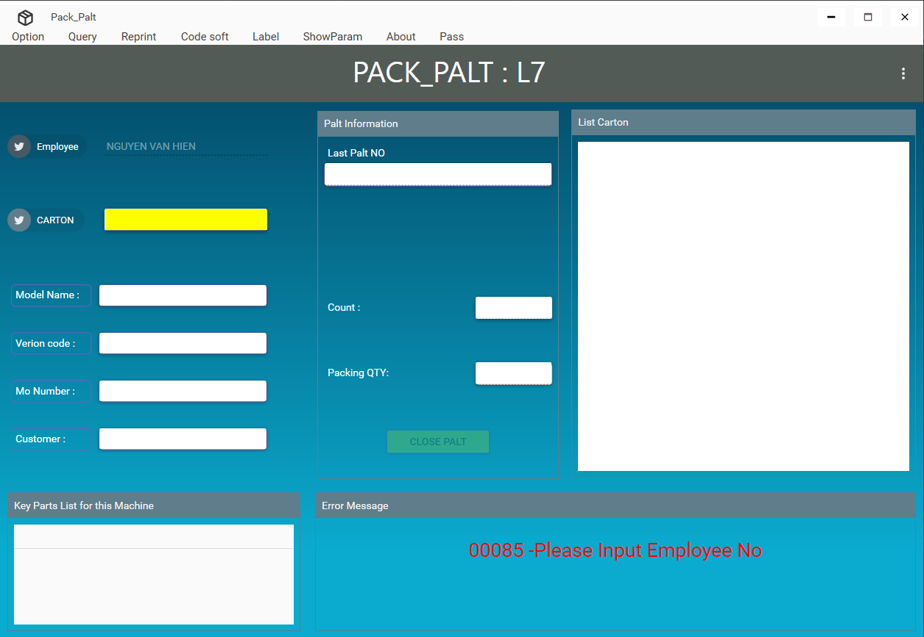
1.Open program
Use SFIS_AMS 5.0 to download and run program. Login by employee have login privilege (as below image).
Call procedure: SFIS1.PACK_PALT_API_EXECUTE.
TYPE = "CHECKEMP"

Slide 2
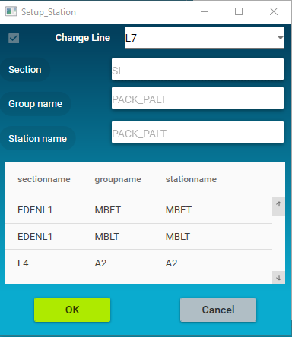
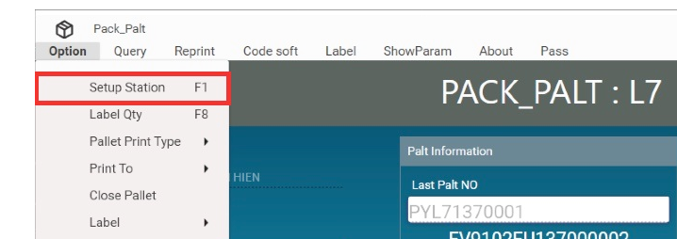
2.Setup station

Slide 3
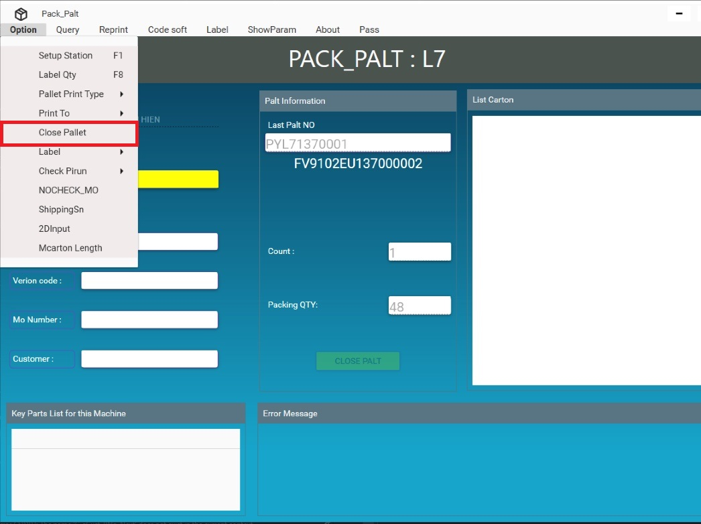
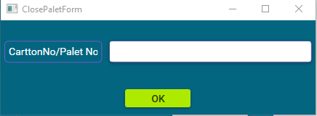
3.Close Pallet
Call procedure: SFIS1.PACK_PALT_API_EXECUTE.
TYPE = "CLOSEPALLET"
Click Close pallet in menu
=>scan carton no or pallet no
on ClosePalletForm

Slide 4
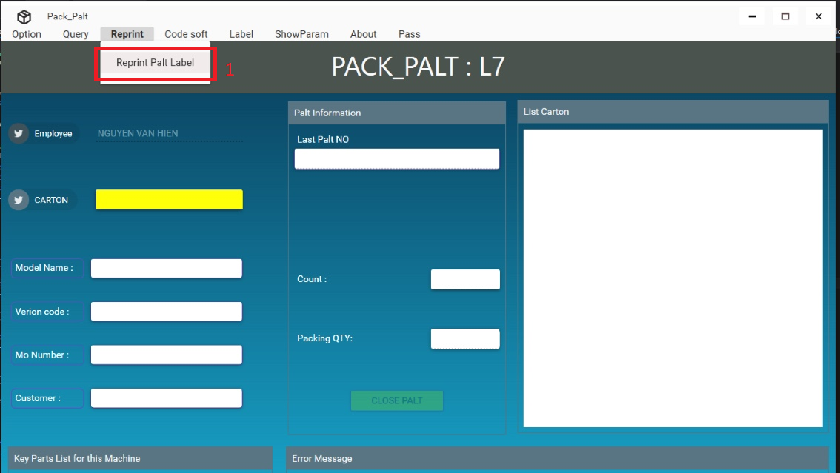
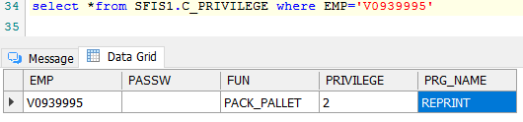
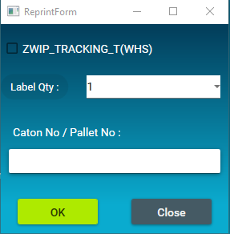
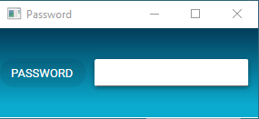
4. REPRINT LABEL
. Reprint by employee have login privilege
1- CLICK REPRINT LABEL
2- enter password
Call procedure: SFIS1.PACK_PALT_API_EXECUTE.
TYPE = "REPRINT"
3- select qty label
4. Enter carton or pallet
2
3
Call procedure: SFIS1.PACK_PALT_API_EXECUTE.
TYPE = "FINDPALLETREPRINT"

Slide 5
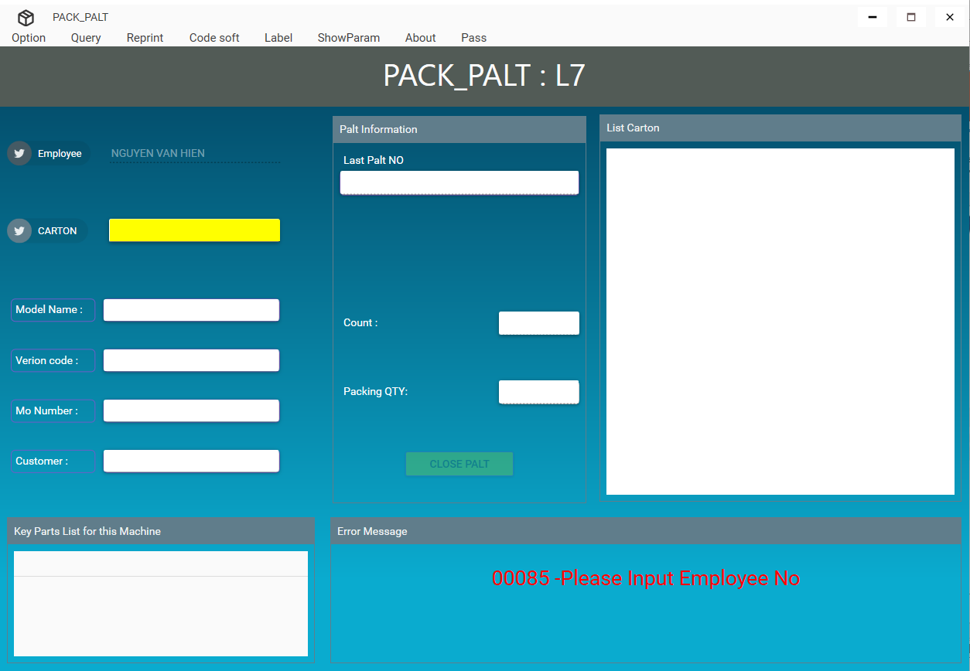
5. Scan carton and print label pallet.
Call procedure: SFIS1.PACK_PALT_API_EXECUTE.
1- Check Mo_number
TYPE = "CHECKMO"
2-Get Pallet No
TYPE = "GETPALLETNO"
3-updateR107 and r117
TYPE = "UPDATER107“ and
TYPE = " UPDATETODB“

Slide 6
5. Scan carton and print label pallet.
Call procedure: SFIS1.PACK_PALT_API_EXECUTE.
4 – Tack data for label
TYPE = "CLOSEPALT"
the data sent to the label file is
inserted into the table
SFISM4.R_FQA_CHECKLABEL_T

Slide 7
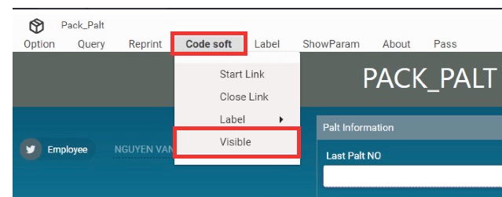
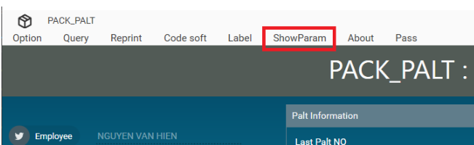
6.Visible and show param.
Choose Code soft => Click Visible
Click Show param on Menu

Slide 8
7. Project source code.
Structure: WPF MVVM (Model-View-ViewModel) and C#.
References file need add more:
Interop.LabelManager2.dll, Interop.TkxRFTAG.dll use to connect with Codesoft program.
Newtonsoft.Json.dll, Sfc.Core.dll, Sfc.Library.HttpClient.dll, Newtonsoft.Json.dll use to connect with API server.
Need add “Materialdesigninxaml” extension to design view interface.

