Slide 1
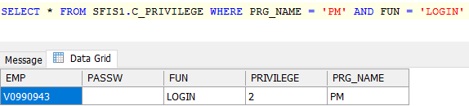
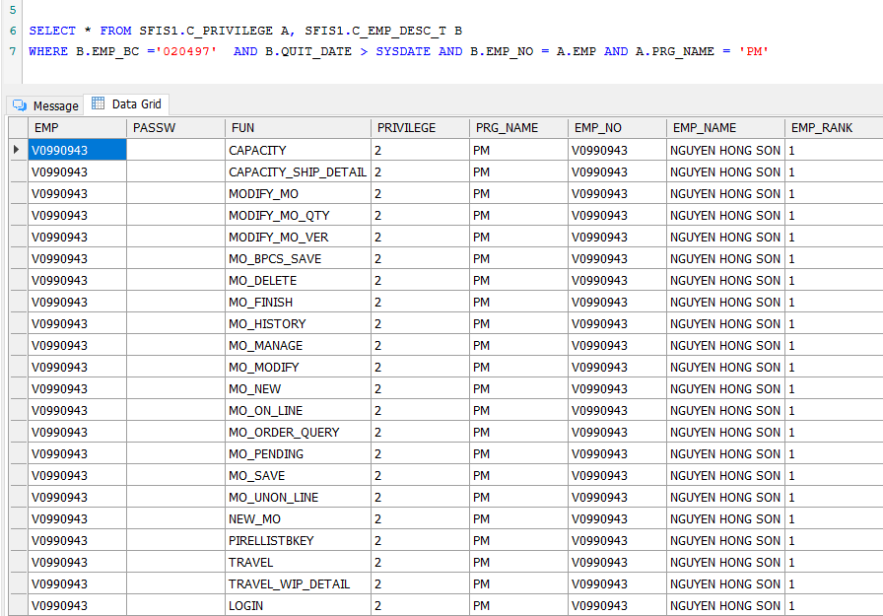
1.Open program
Use SFIS_AMS 5.0 to download and run program. Login by employee have login privilege (as below image).
Check user permissions in program.
Call procedure: SFIS1.API_EXECUTE

Slide 2
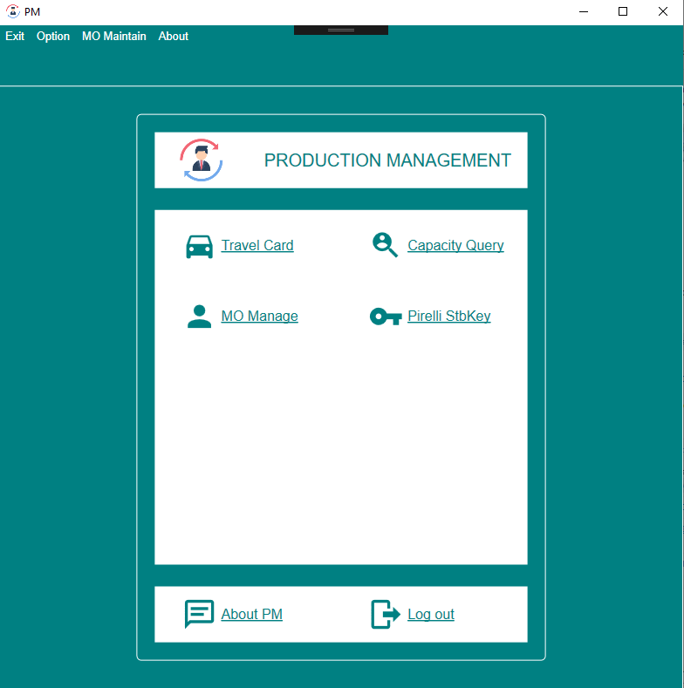
2. First interface
Select function
Select function

Slide 3
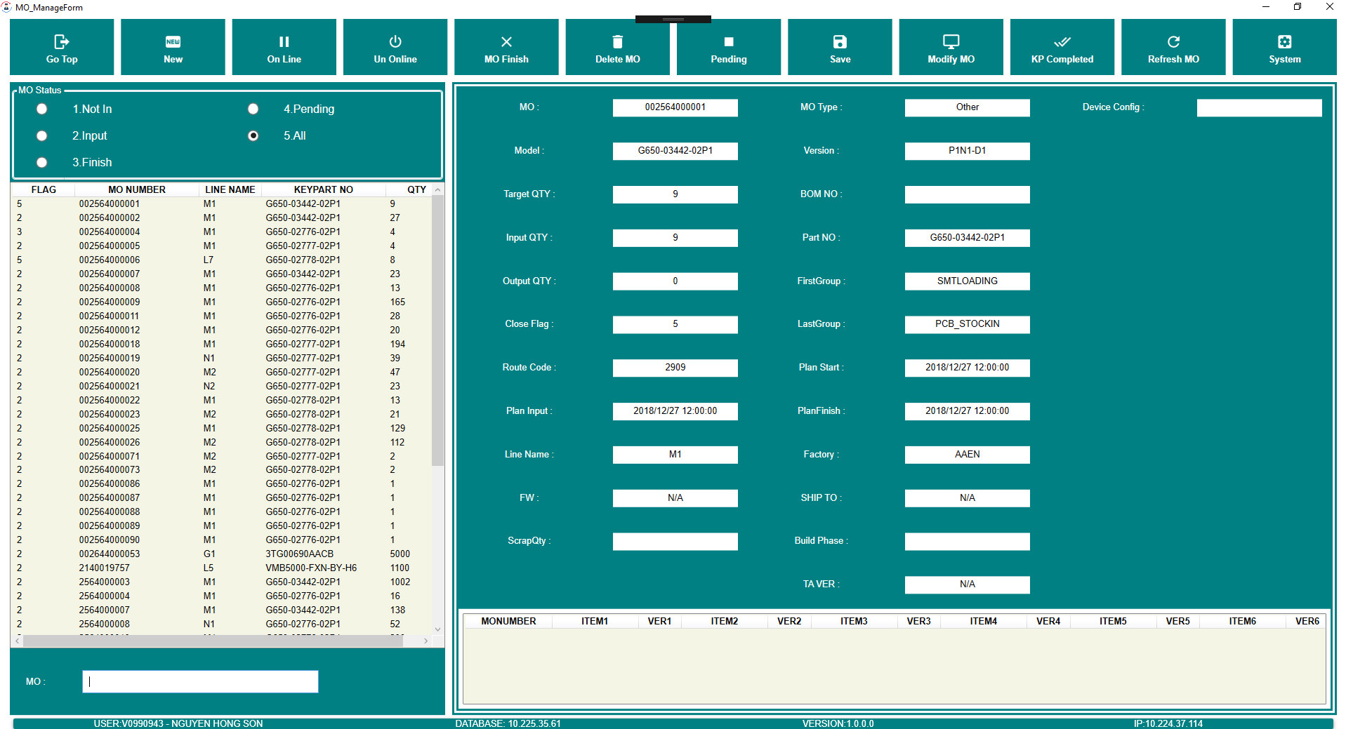
3. List function
function
function
function
function
function
function
function
function
function
function
function
function
User choose
function
Info monumber
List monumber
Search monumber
Infor user and program

Slide 4
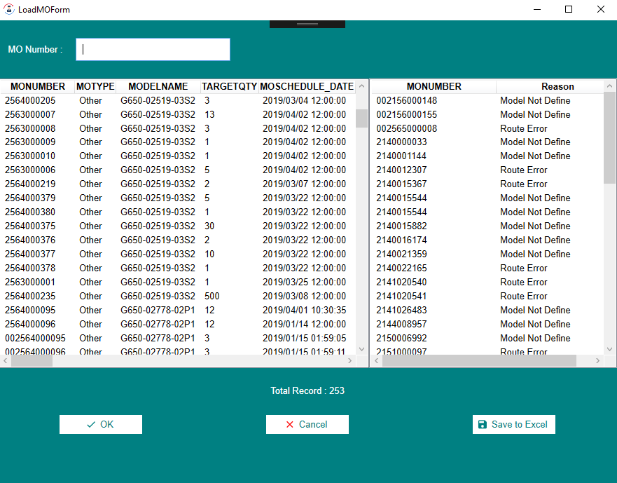
Search monumber
4. Function Load MO
Export file Excel

Slide 5
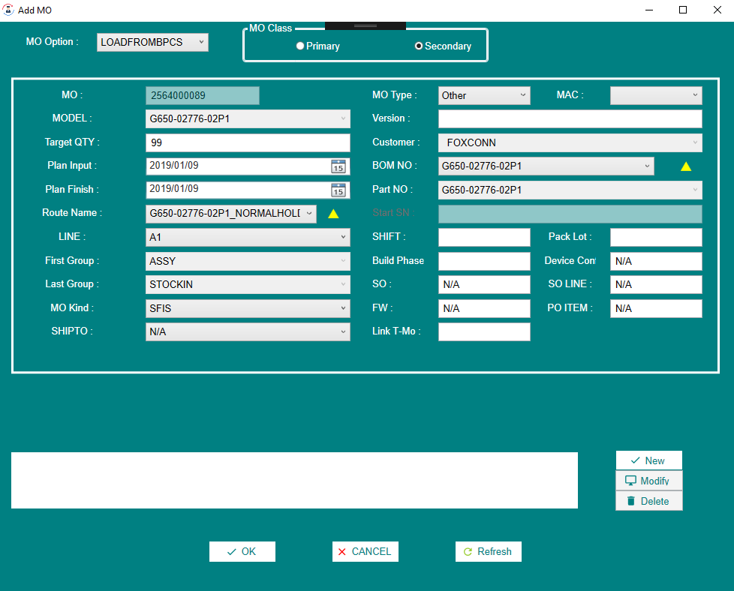
5. Function Add MO
Fill and choose in the information for the fields

Slide 6
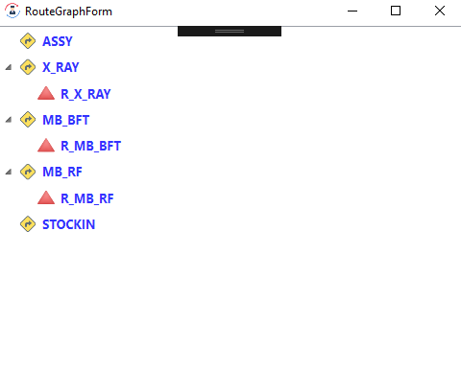
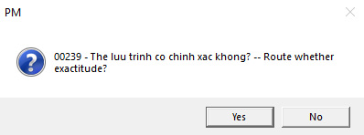
6. Function Add MO
Check Route

Slide 7
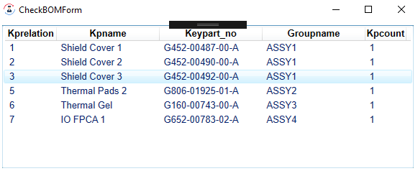
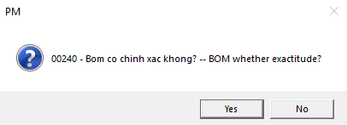
7. Function Add MO
Check BOM

Slide 8
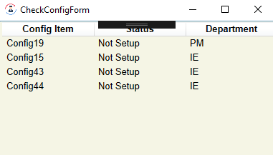
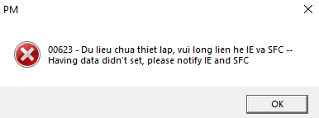
8. Function Add MO
Check Setup of Department

Slide 9
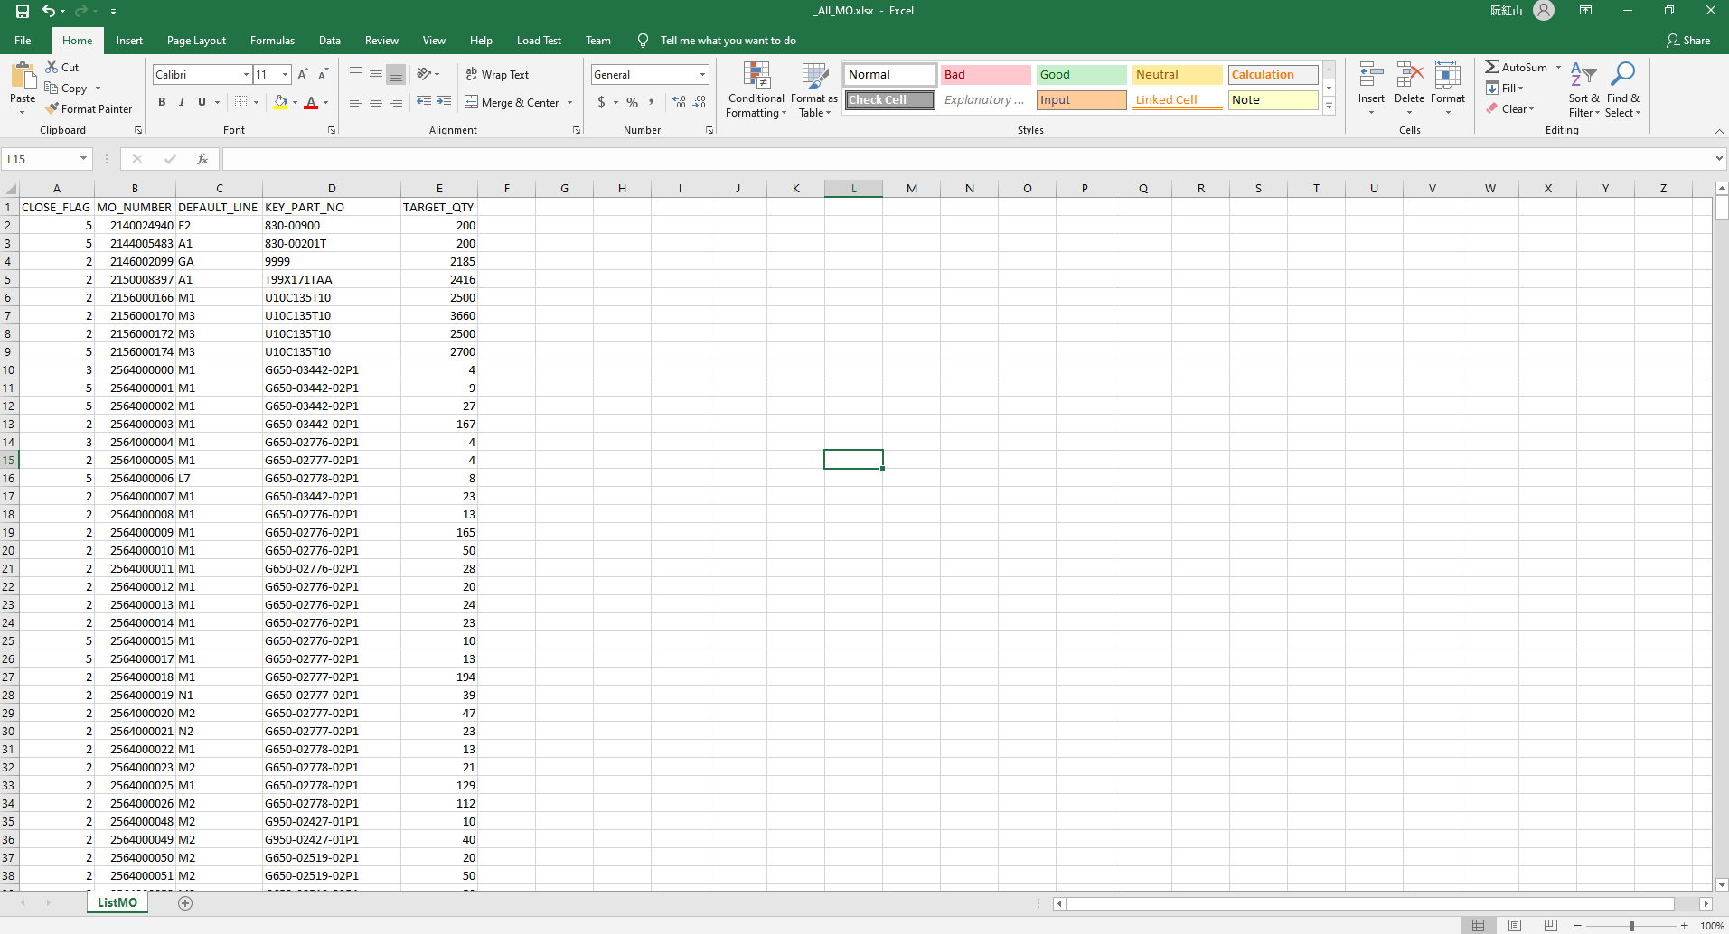

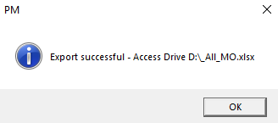
9. Function Export File Excel

