Slide 1

在此输入您要输入的标题

Slide 2




CONTEXT
about
about
about
about
Add your title
Add your title
Add your title
Add your title

Slide 3

Part 1
about

Slide 4
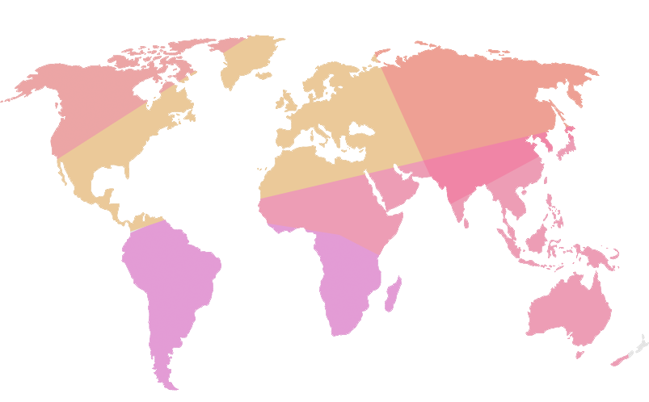
输入你的标题
Add your title
Add your title
Know a lot of sense, but still had bad in this life
Add your title
Know a lot of sense, but still had bad in this life
Add your title
Know a lot of sense, but still had bad in this life

Slide 5
输入你的标题
Add your title
Add your title
Know a lot of sense, but still had bad in this life
Add your title
Add your title
Know a lot of sense, but still had bad in this life
Know a lot of sense, but still had bad in this life

Slide 6


输入你的标题
Add your title
Add your title
Add your title
Add your title
Know a lot of sense, but still had bad in this life
Know a lot of sense, but still had bad in this life
Know a lot of sense, but still had bad in this life

Slide 7

Part 2
about

Slide 8
输入你的标题
Add your title
Add your title
Know a lot of sense, but still had bad in this life
Add your title
Add your title
Know a lot of sense, but still had bad
Add your title
Know a lot of sense, but still had bad in this life
Know a lot of sense, but still had bad
Add your title
Know a lot of sense, but still had bad in this life

Slide 9




输入你的标题
Add your title
Add your title
Know a lot of sense, but still had bad in this life
Add your title
Know a lot of sense, but still had bad in this life
Add your title
Know a lot of sense, but still had bad in this life

Slide 10


输入你的标题
Add your title
Add your title
Know a lot of sense, but still had bad in this life
Add your title
Know a lot of sense, but still had bad in this life
Add your title
Know a lot of sense, but still had bad in this life

Slide 11
输入你的标题
Know a lot of sense, but still had bad in this life
Add your title
Add
your title
Add
your title
Add
your title
Know a lot of sense, but still had bad in this life
Add
your title
Know a lot of sense, but still had bad in this life
Know a lot of sense, but still had bad in this life

Slide 12
Part 3
about

Slide 13




输入你的标题
Add your title
Add your title
Add your title
Know a lot of sense, but still had bad in this life
Know a lot of sense, but still had bad in this life
Add your title
Add your title
Know a lot of sense, but still had bad in this life
Know a lot of sense, but still had bad in this life
Add your title
Add your title
Know a lot of sense, but still had bad in this life
Know a lot of sense, but still had bad in this life

Slide 14

输入你的标题
Add your title
Add your title
Add your title
Add your title
Add your title
Know a lot of sense, but still had bad in this life
Know a lot of sense, but still had bad in this life
Know a lot of sense, but still had bad in this life
Know a lot of sense, but still had bad in this life

Slide 15
输入你的标题
Add your title
Add your title
1、Add your title
Know a lot of sense, but still had bad in this life
4
1
2、Add your title
3
2
Know a lot of sense, but still had bad in this life
3、Add your title
Know a lot of sense, but still had bad in this life
Q1
Q2
Q3
Q4
4、Add your title
Know a lot of sense, but still had bad in this life

Slide 16
输入你的标题
Add your title
7
1
4
6
3
5
8
2
1
2
3
4
5
6
7
8
Add your title
Add your title
Add your title
Know a lot of sense, but still had bad in this life
Know a lot of sense, but still had bad in this life
Know a lot of sense, but still had bad in this life

Slide 17
Part 4
about

Slide 18

输入你的标题
Add your title
Add your title
Know a lot of sense, but still had bad in this life
20%
30%
Add your title
Know a lot of sense, but still had bad in this life
project
Add your title
15%
Know a lot of sense, but still had bad in this life
Add your title
35%
Know a lot of sense, but still had bad in this life

Slide 19
输入你的标题
Add your title
Know a lot of sense, but still had bad in this life
Know a lot of sense, but still had bad in this life
Add your title
Add your title
2011
2012
2013
2014
Add your title
Add your title
Know a lot of sense, but still had bad in this life
Know a lot of sense, but still had bad in this life

Slide 20
输入你的标题
Add your title
Add your title
Add your title
1
4
Know a lot of sense, but still had bad in this life
Know a lot of sense, but still had bad in this life
Add your title
Add your title
2
5
Know a lot of sense, but still had bad in this life
Know a lot of sense, but still had bad in this life
Add your title
Add your title
3
6
Know a lot of sense, but still had bad in this life
Know a lot of sense, but still had bad in this life

Slide 21
THANKS

