Slide 1
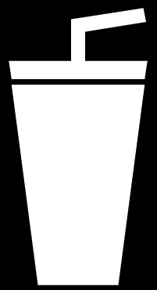

Udajuicer:
Threat Report
YOUR NAME: Thioro Fall
DATE: 5/14/2021

Slide 2
Section 1
Threat Assessment

Slide 3
Purpose of this Report:
This is a threat model report for Udajuicer. The report will describe the threats facing Udajuicer. The model will cover the following:
Threat Assessment
Scoping out Asset Inventory
Architecture Audit
Threat Model Diagram
Threats to the Organization
Identifying Threat Actors
Vulnerability Analysis
Risk Analysis
Mitigation Plan

Slide 4
1.1 Asset Inventory
Components and Functions
Web Server: process and distributes the information to the end users
Application Server: helps to access the informations requested by the end users from the database.
Database: Storage of data

Slide 5
1.1 Asset Inventory (cont )
How a request goes from client to server
When a client makes a request, it establishes a communication between the client’s browser and the web server. The client needs an internet connection to place an order at the shop. The internet will connect the client to the shop web server.
From the web server, a communication request is established with the application server.
Then from the application server, the request goes to the SQL database.

Slide 6
1.2 Architecture Audit
Flaws
No trust boundary between client-web server.
No trust boundaries between application sever-database.
No secure request ( HTTPS, SQL..).
No CDN to resolve the problem of SPOF (single point of failure) using distributed server clusters.
No load balancers to resolve the issue of balancing high traffic across clustered servers.

Slide 7
1.3 Threat Model Diagram
Using OWASP Threat Dragon, build a diagram showing the flow of data in the Juice Shop application and identify 3 possible threats to the Juice Shop. Make sure to include the following components:
Client
Web Server
Application Server
Database

Slide 8
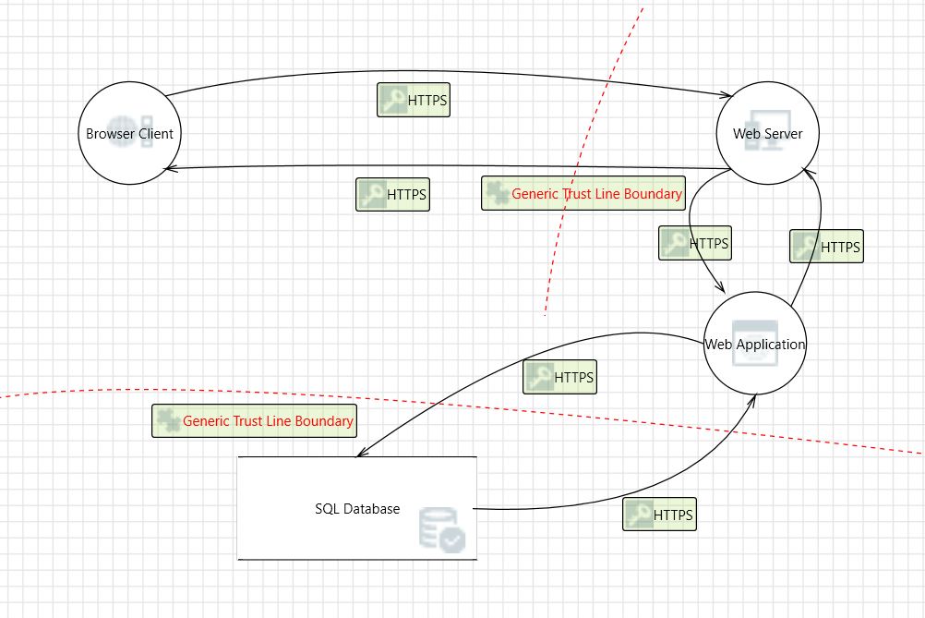
1.3 Threat Model Diagram
Threat Model Diagram

Slide 9
1.3 Threat Model Diagram (cont )
Three possible threats that would cause the server to go constantly down are:
DoS
XML external entities (XXE)
Using components with know vulnerabilities

Slide 10
1.4 Threat Analysis
What Type of Attack Caused the Crash?
DDoS (Distribution Denial of Service) attack
The system receives too much traffic to the server to buffer.
Attacker may attack the web application er server by creating as many processes and transactions possible.
What in the Logs Proves Your Theory?
No trust boundaries between client-server-database which cause Man in the-Middle
attack.
No CDN and load balancers

Slide 11
1.5 Threat Actor Analysis
Who is the Most Likely Threat Actor?
Script kiddies
What Proves Your Theory?
The server is open to anyone.
The attacker may exploite vulnerabilities of websites when placing an order.
The attacker may have limited knowledge since the system did not crash immediately.

Slide 12
Section 2
Vulnerability Analysis

Slide 13
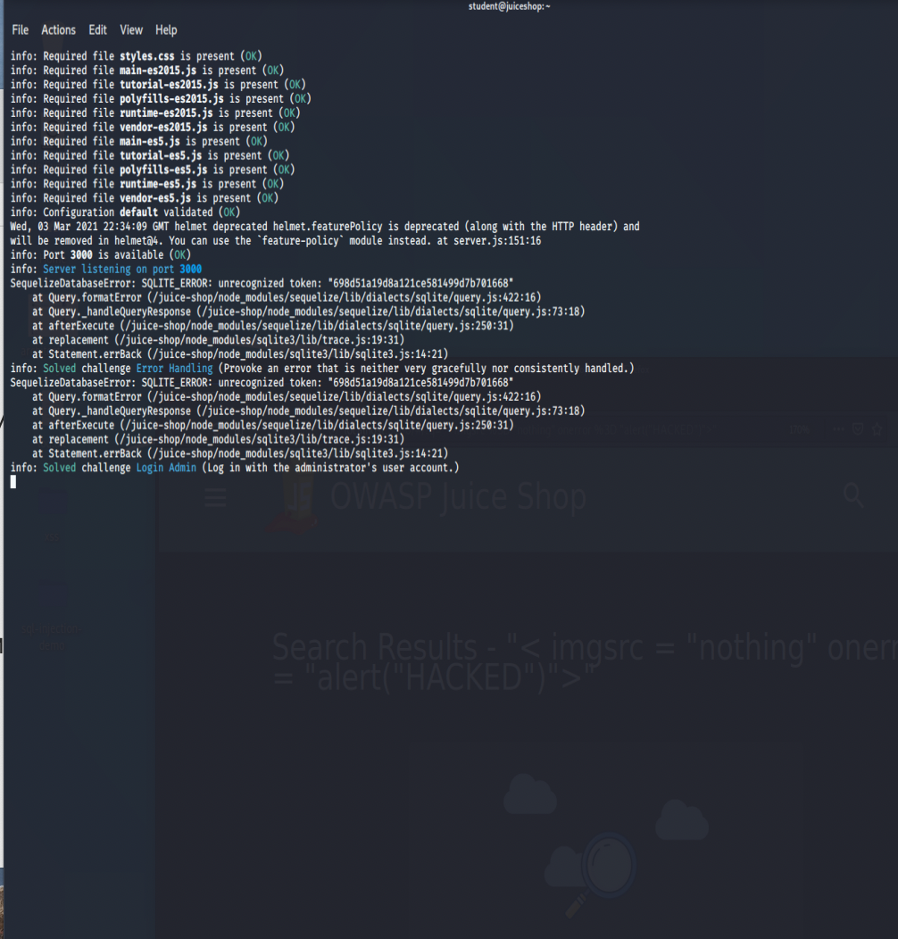
2.1 SQL Injection

Slide 14
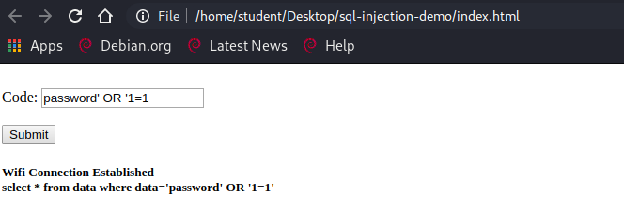
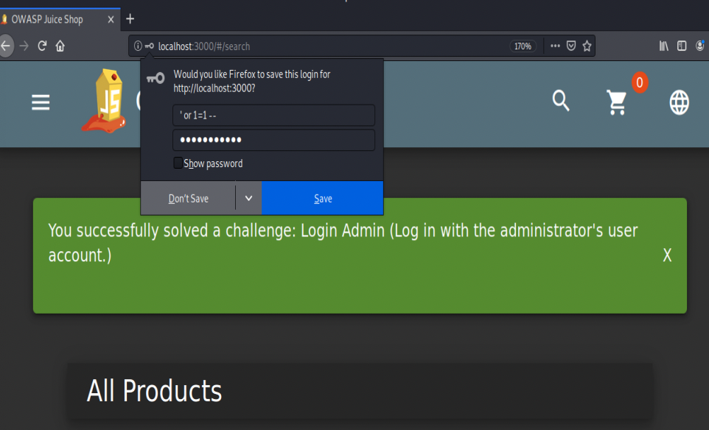
2.1 SQL Injection (cont )

Slide 15
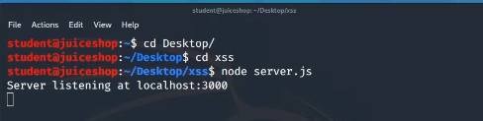
2.2 XSS

Slide 16
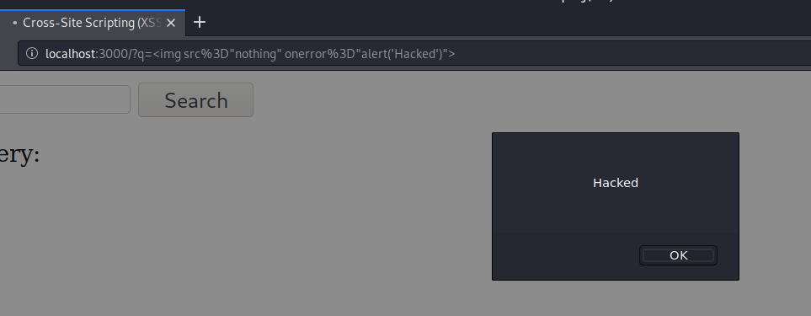
2.2 XSS (cont )

Slide 17
Section 3
Risk Analysis

Slide 18
3.1 Scoring Risks
Risk | Score (1 is most dangerous, 4 is least dangerous)
Denial of service | 1
Insecure Architecture | 2
SQL Injection | 3
XSS Vulnerability | 4

Slide 19
3.2 Risk Rationale
Why Did You Choose That Ranking?
First, DoS which is the primary concern of the business right now. The server is receiving too much traffic and the system is constantly going down.
Second, insure architecture because the company should first take care of the present DoS vulnerability situation.
Third, SQL due also to the online demand. This is another type of vulnerability that can slow down or crash the server.
Last, XSS, due to the COVID-19, the shop function with online orders where customers can place orders for delivery/pickup. This is another type of vulnerability that can slow down or crash the server as well.

Slide 20
Section 4
Mitigation Plan

Slide 21
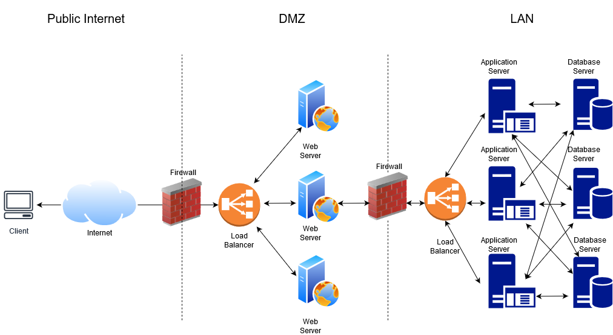
4.1 Secure Architecture
Example of secure architecture

Slide 22
4.2 Mystery Attack Mitigation
Mitigation Plan:
A secure architecture
Trust boundaries (perimeter firewall, WAF…)
Encrypt the data
Input filtering and sanitization
Load balancing
CDN

Slide 23
4.3 SQL Injection Mitigation
Mitigation Plan:
Input sanitization
Input validation
Prepared statements with parameterized queries
Escaping

Slide 24
4.4 XSS Mitigation
Mitigation Plan:
Sanitizing user input
Validating user input
Escaping

