Slide 1
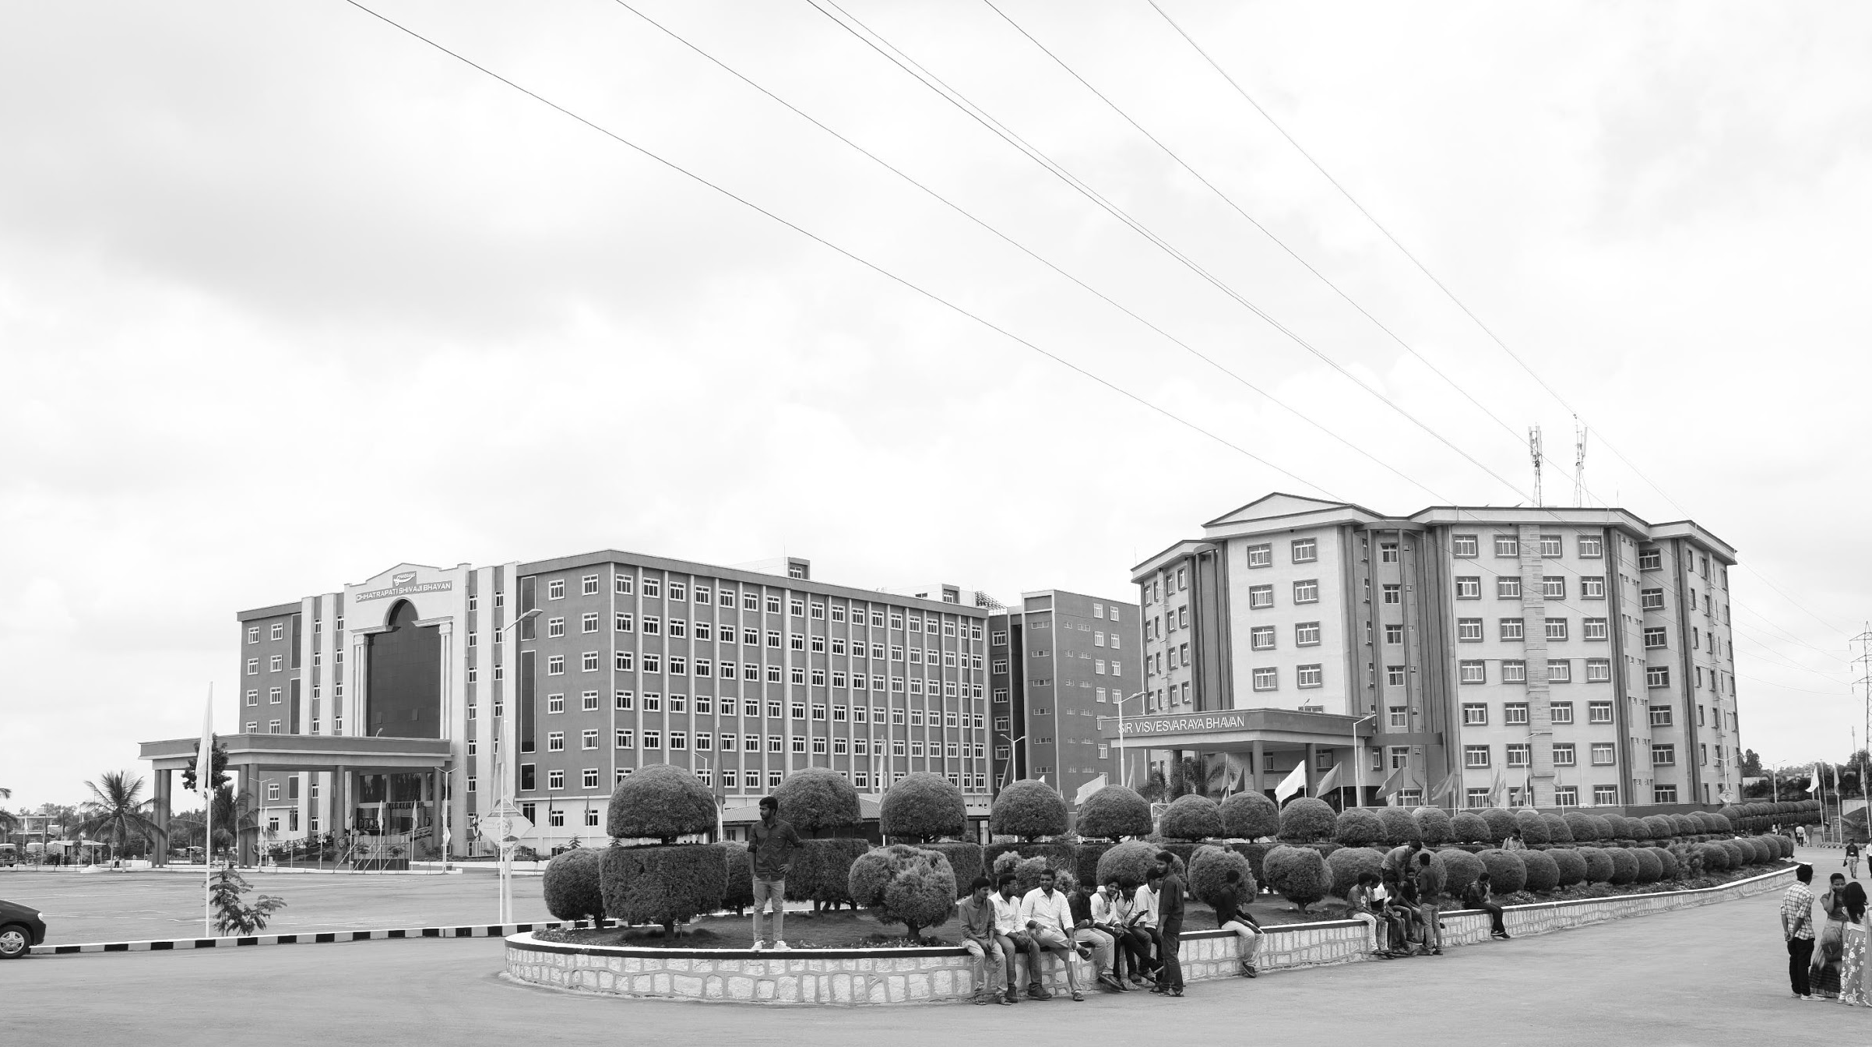

Visual Odometry
Review-I
AY 2025-26
Capstone Project – Introduction (PROJ2999)
GITAM (Deemed-to-be) University
Department of Electrical Electronics and Communication Engineering
Project Team:
Thippeswamy k s
Bharath M
M Gopichand
Project Mentor:
Prithvi Shekar Pagala
Project In-charge:
Jaya Prakash Saho
www.gitam.edu

Slide 2
Objective and Goals
Objective
To develop and validate a GPS-independent, monocular camera-based localization and path reconstruction system that accurately determines a vehicle's global position and orientation by integrating Visual Odometry (VO) with real-time semantic feature matching against digital map data (e.g., OpenStreetMap). The system aims to provide a low-cost, robust, and deployable solution for navigation in GPS-denied or degraded environments.
Goals
The primary goals of the Visual Map Mono project are to implement robust visual odometry, develop a comprehensive semantic feature extraction pipeline, establish an efficient map data management and lookup system, design and implement an accurate pattern matching and localization module, achieve reliable path reconstruction and drift mitigation, and thoroughly evaluate the system's robustness and performance.
Implement Robust Visual Odometry
Develop a Comprehensive Semantic Feature Extraction Pipeline
Establish an Efficient Map Data Management & Lookup System
Design and Implement an Accurate Pattern Matching & Localization Module
Achieve Reliable Path Reconstruction and Drift Mitigation
Evaluate System Robustness and Performance

Slide 3
Literature Survey
Key Publications
DROID-SLAM: Deep Visual SLAM for Monocular, Stereo, and RGB-D Cameras Zhongjie Yu et al., NeurIPS 2021 – Introduces a deep learning–based SLAM system with recurrent feature alignment.
SpatialTrackerV2: 3D Point Tracking Made Easy Xu et al., CVPR 2024 – A learning-based method for dense 3D point tracking, relevant for robust SLAM/VO.
ORB-SLAM: A Versatile and Accurate Monocular SLAM System Mur-Artal, Montiel, Tardós, IEEE Trans. Robotics 2015 – One of the most widely used feature-based SLAM systems.
ORB-SLAM3: An Accurate Open-Source Library for Visual, Visual-Inertial, and Multi-Map SLAM Campos et al., IEEE Trans. Robotics 2021 – Extends ORB-SLAM with support for visual-inertial fusion and multiple maps.
Monocular Visual SLAM, Visual Odometry, and Structure from Motion Methods Applied to 3D Reconstruction Survey Paper – Discusses foundations of VO, vSLAM, and SfM for 3D scene reconstruction.
Deep Direct Visual Odometry Zhou et al., CVPR 2017 – A pioneering deep learning approach to unsupervised monocular VO.
Evolution of Visual Odometry Techniques Review Article – Comprehensive survey of VO development from geometric to learning-based methods.
Feature-Based Monocular Visual Odometry for Autonomous Driving and Hyperparameter Tuning to Improve Trajectory Estimation Applied Research Paper – Focuses on feature tuning to improve VO accuracy in driving contexts.
Understanding Visual SLAM for Robotics Perception: Building Monocular SLAM from Scratch in Python OpenCV Educational Resource / Tutorial – Guides beginners in building vSLAM pipelines for robotics perception.

Slide 4
Key Resources — Whitepapers | Application Notes | Datasheets | Algorithms | Modules | Others
Algorithms & Techniques
RAFT (Recurrent All-Pairs Field Transforms) – Computes dense optical flow between successive frames for motion estimation.
Correlation Pyramid – Multi-scale feature correlation for accurate frame-to-frame matching.
Context Layer – Neural network module for aggregating contextual features in deep VO/SLAM models.
Feature Encoder / Keypoint Detector – Extracts robust visual features from images for trajectory estimation.
Pose Graph Optimization – Backend optimization technique to correct trajectory drift using graph constraints.
Bundle Adjustment (BA) – Joint refinement of camera poses and 3D points in mapping.
Depth Estimation Module – Produces depth maps from monocular/stereo images to improve localization accuracy.
Keyframe Selection Module – Chooses representative frames to reduce computation and maintain map consistency.
Datasets & Benchmarks
Gitam SDV Lab Dataset – Custom dataset collected from your autonomous vehicle for indoor and outdoor testing.
KITTI Benchmark Dataset – Standard outdoor VO/SLAM evaluation dataset.
TUM RGB-D Dataset – Indoor RGB-D dataset for SLAM and visual odometry validation.
EuRoC MAV Dataset – Visual-inertial dataset for evaluating SLAM in dynamic environments.
Other Resources
OpenSLAM.org – Collection of classical and modern SLAM algorithms.
Awesome-SLAM GitHub List – Curated repositories, tutorials, and tools for VO/SLAM.
Python OpenCV Tutorials / Examples – Implementation guides for building monocular vSLAM from scratch.

Slide 5
Existing Implementations – Products | Open Source | GitHub etc
Key GitHub Projects
DROID_slam – Deep learning-based SLAM for mono, stereo, and RGB-D : https://github.com/princeton-vl/DROID-SLAM
SpatialTracker – Visual-inertial tracking framework : https://github.com/henry123-boy/SpaTrackerV2
ORB_SLAM2 – Feature-based monocular/stereo SLAM : https://github.com/raulmur/ORB_SLAM2
ORB_SLAM – Original ORB-SLAM repository : https://github.com/raulmur/ORB_SLAM
DPVO – Deep Patch Visual Odometry; deep learning-based VO : https://github.com/thippeswammy/DPVO
PyCuVSLAM – GPU-accelerated visual SLAM : https://github.com/NVlabs/PyCuVSLAM
LongSplat – Large-scale deep SLAM and mapping : https://github.com/NVlabs/LongSplat
VOLDOR – Visual odometry & deep reinforcement learning : https://github.com/htkseason/VOLDOR
NVIDIA Isaac ROS Visual SLAM – ROS-integrated visual SLAM : https://github.com/NVIDIA-ISAAC-ROS/isaac_ros_visual_slam
DVO_SLAM – Dense visual odometry SLAM : https://github.com/tum-vision/dvo_slam
Depth-VO-Feat – Depth and VO feature-based method : https://github.com/Huangying-Zhan/Depth-VO-Feat
DF-VO – Deep Feature Visual Odometry : https://github.com/Huangying-Zhan/DF-VO

Slide 6
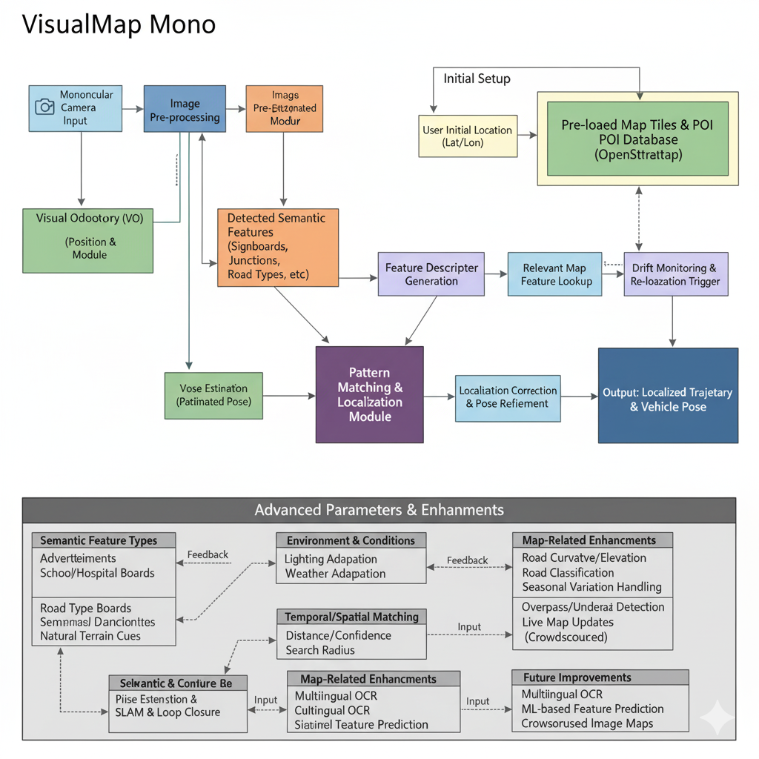
Architecture

Slide 7
Use Cases & Testing
Test Cases
Map Matching Accuracy & Precision
Static Feature Matching: Identify & match known semantic features (signboards, junctions) → measure localization error (position, heading).
Dynamic Feature Matching (Concept): Use dynamically updated POIs for re-localization.
Visual Odometry (VO) Drift Mitigation
Long-Term Trajectory Consistency: Measure VO drift reduction via continuous map matching.
Loop Closure (Future): Recognize revisited regions → globally optimize trajectory.
Environmental Robustness
Lighting Variations: Day, night, tunnels, shadows → ensure semantic feature detectability.
Weather Conditions: Rain, fog, glare → test stability & accuracy.
Seasonal Changes: Vegetation/construction impact on detection & matching.
Infrastructure Variability
Road Network Complexity: Straight roads, turns, intersections, overpasses, underpasses → verify heading & lane-level accuracy.
Feature Density: Compare dense urban vs. sparse highways/rural roads.
Computational Efficiency & Real-time Capability
Resource Utilization: CPU/GPU load, memory, power usage on embedded hardware.
Processing Latency: End-to-end latency from image → pose output (real-time check).
Initial Localization & Re-localization
Initial Position Recovery: Refine rough initial position quickly via first semantic matches.
Re-localization from Loss: Simulate featureless zones (tunnels) → recover when features reappear.
Use Cases
Autonomous Driving & ADAS
GPS-Denied Navigation: Works in tunnels, car parks, forests, urban canyons.
Redundant Positioning: Low-cost fallback when GPS/sensors fail.
Enhanced Situational Awareness: Lane-level accuracy, road signs, junction layouts.
Smart Dashcams & Fleet Management
Detailed Route Logging: Trajectory + feature logs for incidents, optimization, proof of delivery.
Infrastructure Monitoring: Auto-detect & log new road signs, construction, defects → real-time map updates.
Mobile Robotics & Delivery Systems
Last-Mile Delivery: Navigate complex urban/suburban routes, GPS blackouts.
Indoor–Outdoor Transition: Seamless handover between GPS and visual localization.
Precision Agriculture & Off-Road Navigation
Autonomous Machinery: Guide tractors/harvesters in low-GPS fields with visual cues.
Resource Exploration: Navigate unmapped/remote terrains with natural features.
Augmented Reality (AR) Navigation
Persistent AR Overlays: Stable, drift-free localization → accurate virtual anchoring for navigation, tourism, or maintenance.

Slide 8
Conclusion & Future Work
Summary and Conclusion
VisualMap Mono is a GPS-independent localization and path reconstruction system.
It uses a monocular camera for visual odometry and semantic feature matching with digital maps.
The system detects and matches visual features against map data for localization.
It addresses challenges like VO scale drift, computational demands, and environmental variability.
The project provides a strong foundation for future research in autonomous navigation.
Future Work
Robust Semantic Feature Integration:
Enhance semantic feature extraction using advanced deep learning models.
Develop sophisticated feature descriptors fusing visual characteristics and spatial context.
Advanced Pattern Matching & Localization:
Implement probabilistic filtering techniques to combine VO estimates with map-matched features.
Develop dynamic search radii and confidence-based re-localization triggers.
Integrate complex map enhancements like road curvature and elevation.
Trajectory Optimization & Consistency:
Develop algorithms for global trajectory optimization to ensure long-term consistency.
Explore techniques to re-align low-confidence VO estimates with high-confidence map regions.
Real-time Performance Optimization:
Implement strategies to reduce computational load using model pruning and quantization.
Optimize image processing and feature tracking pipelines for embedded systems.
Integration of External Sensors (Optional but beneficial):
Integrate Inertial Measurement Unit (IMU) data to improve short-term pose prediction.
Dataset Expansion & Validation:
Test the system on more diverse real-world datasets with varied environments and conditions.
Conduct extensive validation using ground truth data to benchmark accuracy and robustness.
Adaptive Learning for Generalization:
Research and develop adaptive learning models for unstructured and dynamic environments.
Deployment & Benchmarking:
Deploy the full system on a real vehicle platform for live indoor-outdoor navigation testing.
Rigorously benchmark performance against state-of-the-art visual localization systems.

Slide 9
THANK YOU
Have a Great Day !

