Slide 1
How To Make a Web Application Using Flask in Python 3

Slide 2
Flask uses the Jinja template engine to dynamically build HTML pages using familiar Python concepts such as variables, loops, lists, and so on. You’ll use these templates as part of this project.
Bootstrap will help you incorporate responsive web pages in your web application so that it also works well on mobile browsers without writing your own HTML, CSS, and JavaScript code to achieve these goals.

Slide 3
Step 1 — Installing Flask
To install Flask, run the following command:
pip install flask
Step 2 — Creating a Base Application
from flask import Flask
app = Flask(__name__)
@app.route('/')
def hello():
return 'Hello, World!'
you first import the Flask object from the flask package.
You then use it to create your Flask application instance with the name app.
You pass the special variable __name__ that holds the name of the current Python module. It’s used to tell the instance where it’s located—you need this because Flask sets up some paths behind the scenes.
Once you create the app instance, you use it to handle incoming web requests and send responses to the user. @app.route is a decorator that turns a regular Python function into a Flask view function, which converts the function’s return value into an HTTP response to be displayed by an HTTP client, such as a web browser. You pass the value '/' to @app.route() to signify that this function will respond to web requests for the URL /, which is the main URL.
The hello() view function returns the string 'Hello, World!' as a response.

Slide 4
Step 3 — Using HTML templates
Currently your application only displays a simple message without any HTML. Web applications mainly use HTML to display information for the visitor, so you’ll now work on incorporating HTML files in your app, which can be displayed on the web browser.
Flask provides a render_template() helper function that allows use of the Jinja template engine. This will make managing HTML much easier by writing your HTML code in .html files as well as using logic in your HTML code. You’ll use these HTML files, (templates) to build all of your application pages, such as the main page where you’ll display the current blog posts, the page of the blog post, the page where the user can add a new post, and so on.

Slide 5
In this step, you’ll create your main Flask application in a new file.
from flask import Flask, render_template
app = Flask(__name__)
@app.route('/')
def index():
return render_template('index.html')
You’ll also import the render_template() helper function that lets you render HTML template files that exist in the templates folder you’re about to create.
The file will have a single view function that will be responsible for handling requests to the main / route.
The index() view function returns the result of calling render_template() with index.html as an argument, this tells render_template() to look for a file called index.html in the templates folder. Both the folder and the file do not yet exist, you will get an error if you were to run the application at this point.

Slide 6
flask_blog/templates/index.html
<!DOCTYPE html>
<html lang="en">
<head>
<meta charset="UTF-8">
<title>FlaskBlog</title>
</head>
<body>
<h1>Welcome to FlaskBlog</h1>
</body>
</html>
In addition to the templates folder, Flask web applications also typically have a static folder for hosting static files, such as CSS files, JavaScript files, and images the application uses.
You can create a style.css style sheet file to add CSS to your application. First, create a directory called static inside your main flask_blog directory:
flask_blog/static/css/style.css
h1 {
border: 2px #eee solid;
color: brown;
text-align: center;
padding: 10px;
}

Slide 7
You’ll add a link to the style.css file inside the <head> section of the index.html template file:
<head>
<meta charset="UTF-8">
<link rel="stylesheet" href="{{ url_for('static', filename= 'css/style.css') }}">
<title>FlaskBlog</title>
</head>
the url_for() helper function to generate the appropriate location of the file.
The first argument specifies that you’re linking to a static file and the second argument is the path of the file inside the static directory.
Save and close the file.
Upon refreshing the index page of your application, you will notice that the text Welcome to FlaskBlog is now in brown, centered, and enclosed inside a border.

Slide 8
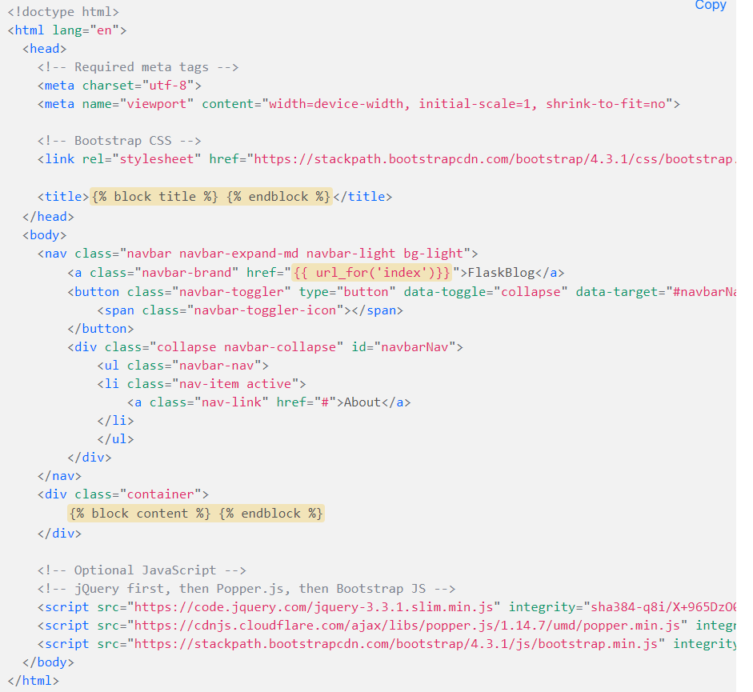
You can avoid unnecessary code repetition with the help of a base template file, which all of your HTML files will inherit from. See Template Inheritance in Jinja for more information.
To make a base template, first create a file called base.html inside your templates directory:

Slide 9
Most of the code in the preceding block is standard HTML and code required for Bootstrap.
The <meta> tags provide information for the web browser,
the <link> tag links the Bootstrap CSS files, and
the <script> tags are links to JavaScript code that allows some additional Bootstrap features, check out the Bootstrap documentation for more.
However, the following highlighted parts are specific to the Jinja template engine:
{% block title %} {% endblock %}: A block that serves as a placeholder for a title, you’ll later use it in other templates to give a custom title for each page in your application without rewriting the entire <head> section each time.
{{ url_for('index')}}: A function call that will return the URL for the index() view function. This is different from the past url_for() call you used to link a static CSS file, because it only takes one argument, which is the view function’s name, and links to the route associated with the function instead of a static file.
{% block content %} {% endblock %}: Another block that will be replaced by content depending on the child template (templates that inherit from base.html) that will override it.

Slide 10
Now that you have a base template, you can take advantage of it using inheritance. Open the index.html file:
{% extends 'base.html' %}
{% block content %}
<h1>{% block title %} Welcome to FlaskBlog {% endblock %}</h1>
{% endblock %}

Slide 11
In this new version of the index.html template, you use the {% extends %} tag to inherit from the base.html template. You then extend it via replacing the content block in the base template with what is inside the content block in the preceding code block.
This content block contains an <h1> tag with the text Welcome to FlaskBlog inside a title block, which in turn replaces the original title block in the base.html template with the text Welcome to FlaskBlog. This way, you can avoid repeating the same text twice, as it works both as a title for the page and a heading that appears below the navigation bar inherited from the base template.
Template inheritance also gives you the ability to reuse the HTML code you have in other templates (base.html in this case) without having to repeat it each time it is needed.

Slide 12
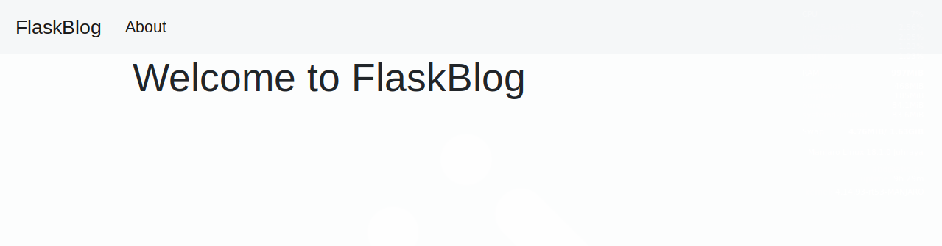
Save and close the file and refresh the index page on your browser. You’ll see your page with a navigation bar and styled title.

Slide 13
Step 4 — Setting up the Database
In this step, you’ll set up a database to store data, that is, the blog posts for your application. You’ll also populate the database with a few example entries.
You’ll use a SQLite database file to store your data because the sqlite3 module, which we will use to interact with the database, is readily available in the standard Python library. For more information about SQLite, check out this tutorial.
First, because data in SQLite is stored in tables and columns, and since your data mainly consists of blog posts, you first need to create a table called posts with the necessary columns. You’ll create a .sql file that contains SQL commands to create the posts table with a few columns. You’ll then use this file to create the database.

Slide 14
Open a file called schema.sql inside your flask_blog directory:
Type the following SQL commands inside this file:
The first SQL command is DROP TABLE IF EXISTS posts;, this deletes any already existing tables named posts so you don’t get confusing behavior. Note that this will delete all of the content you have in the database whenever you use these SQL commands, so ensure you don’t write any important content in the web application until you finish this tutorial and experiment with the final result. Next, CREATE TABLE posts is used to create the posts table with the following columns:
id: An integer that represents a primary key, this will get assigned a unique value by the database for each entry (that is a blog post).
created: The time the blog post was created at. NOT NULL signifies that this column should not be empty and the DEFAULT value is the CURRENT_TIMESTAMP value, which is the time at which the post was added to the database. Just like id, you don’t need to specify a value for this column, as it will be automatically filled in.
title: The post title.
content: The post content.
DROP TABLE IF EXISTS posts;
CREATE TABLE posts (
id INTEGER PRIMARY KEY AUTOINCREMENT,
created TIMESTAMP NOT NULL DEFAULT CURRENT_TIMESTAMP,
title TEXT NOT NULL,
content TEXT NOT NULL
);

Slide 15
flask_blog/init_db.py
import sqlite3
connection = sqlite3.connect('database.db')
with open('schema.sql') as f:
connection.executescript(f.read())
cur = connection.cursor()
cur.execute("INSERT INTO posts (title, content) VALUES (?, ?)",
('First Post', 'Content for the first post')
)
cur.execute("INSERT INTO posts (title, content) VALUES (?, ?)",
('Second Post', 'Content for the second post')
)
connection.commit()
connection.close()
You first import the sqlite3 module and then open a connection to a database file named database.db, which will be created once you run the Python file. Then you use the open() function to open the schema.sql file. Next you execute its contents using the executescript() method that executes multiple SQL statements at once, which will create the posts table. You create a Cursor object that allows you to use its execute() method to execute two INSERT SQL statements to add two blog posts to your posts table. Finally, you commit the changes and close the connection.

Slide 16
Step 5 — Displaying All Posts
flask_blog/app.py
. . .
@app.route('/')
def index():
conn = get_db_connection()
posts = conn.execute('SELECT * FROM posts').fetchall()
conn.close()
return render_template('index.html', posts=posts)
. . .
from flask import Flask, render_template
def get_db_connection():
conn = sqlite3.connect('database.db')
conn.row_factory = sqlite3.Row
return conn
. . .

Slide 17
In this new version of the index() function, you first open a database connection using the get_db_connection() function you defined earlier. Then you execute an SQL query to select all entries from the posts table. You implement the fetchall() method to fetch all the rows of the query result, this will return a list of the posts you inserted into the database in the previous step.
In this new version of the index() function, you first open a database connection using the get_db_connection() function you defined earlier. Then you execute an SQL query to select all entries from the posts table. You implement the fetchall() method to fetch all the rows of the query result, this will return a list of the posts you inserted into the database in the previous step.

Slide 18
flask_blog/templates/index.html
{% extends 'base.html' %}
{% block content %}
<h1>{% block title %} Welcome to FlaskBlog {% endblock %}</h1>
{% for post in posts %}
<a href="#">
<h2>{{ post['title'] }}</h2>
</a>
<span class="badge badge-primary">{{ post['created'] }}</span>
<hr>
{% endfor %}
{% endblock %}

Slide 19
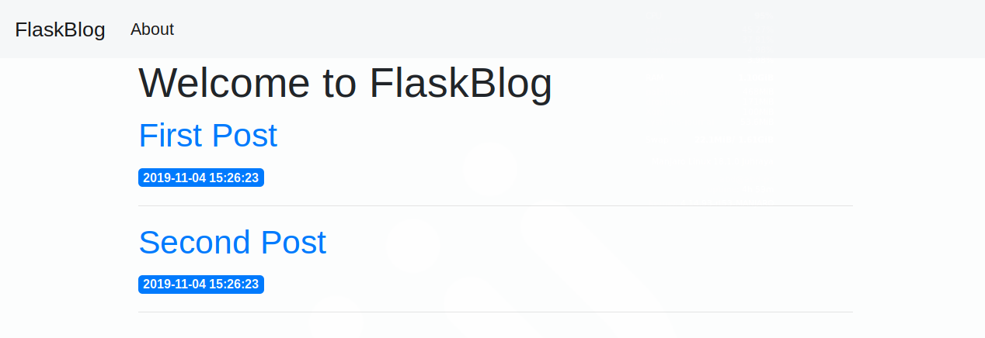
https://www.digitalocean.com/community/tutorials/how-to-make-a-web-application-using-flask-in-python-3

