Slide 1
How To Make a Web Application Using Flask in Python 3

Slide 2
Flask – Static Files
A web application often requires a static file such as a javascript file or a CSS file supporting the display of a web page. Usually, the web server is configured to serve them for you, but during the development, these files are served from static folder in your package or next to your module and it will be available at /static on the application.
A special endpoint ‘static’ is used to generate URL for static files.

Slide 3
In the following example, a javascript function defined in hello.js is called on OnClick event of HTML button in index.html, which is rendered on ‘/’ URL of the Flask application.
from flask import Flask, render_template
app = Flask(__name__)
@app.route("/")
def index():
return render_template("index.html")
if __name__ == '__main__':
app.run(debug = True)

Slide 4
The HTML script of index.html is given below.
hello.js contains sayHello() function.
function sayHello() {
alert("Hello World")
}
<html>
<head>
<script type = "text/javascript"
src = "{{ url_for('static', filename = 'hello.js') }}" ></script>
</head>
<body>
<input type = "button" onclick = "sayHello()" value = "Say Hello" />
</body>
</html>

Slide 5
The data from a client’s web page is sent to the server as a global request object. In order to process the request data, it should be imported from the Flask module.
Important attributes of request object are listed below −
Form − It is a dictionary object containing key and value pairs of form parameters and their values.
args − parsed contents of query string which is part of URL after question mark (?).
Cookies − dictionary object holding Cookie names and values.
files − data pertaining to uploaded file.
method − current request method.

Slide 6
We have already seen that the http method can be specified in URL rule. The Form data received by the triggered function can collect it in the form of a dictionary object and forward it to a template to render it on a corresponding web page.
In the following example, ‘/’ URL renders a web page (student.html) which has a form. The data filled in it is posted to the ‘/result’ URL which triggers the result() function.
The results() function collects form data present in request.form in a dictionary object and sends it for rendering to result.html.
The template dynamically renders an HTML table of form data.
Given below is the Python code of application −

Slide 7
from flask import Flask, render_template, request
app = Flask(__name__)
@app.route('/')
def student():
return render_template('student.html')
@app.route('/result',methods = ['POST', 'GET'])
def result():
if request.method == 'POST':
result = request.form
return render_template("result.html",result = result)
if __name__ == '__main__':
app.run(debug = True)

Slide 8
Given below is the HTML script of student.html.
<html>
<body>
<form action = "http://localhost:5000/result" method = "POST">
<p>Name <input type = "text" name = "Name" /></p>
<p>Physics <input type = "text" name = "Physics" /></p>
<p>Chemistry <input type = "text" name = "chemistry" /></p>
<p>Maths <input type ="text" name = "Mathematics" /></p>
<p><input type = "submit" value = "submit" /></p>
</form>
</body>
</html>

Slide 9
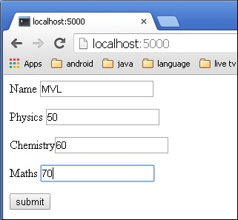
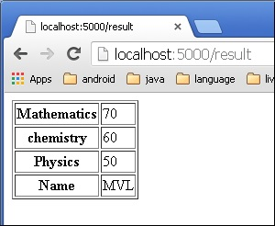
Code of template (result.html) is given below −
<!doctype html>
<html>
<body>
<table border = 1>
{% for key, value in result.items() %}
<tr>
<th> {{ key }} </th>
<td> {{ value }} </td>
</tr>
{% endfor %}
</table>
</body>
</html>

Slide 10
A cookie is stored on a client’s computer in the form of a text file. Its purpose is to remember and track data pertaining to a client’s usage for better visitor experience and site statistics.
A Request object contains a cookie’s attribute. It is a dictionary object of all the cookie variables and their corresponding values, a client has transmitted. In addition to it, a cookie also stores its expiry time, path and domain name of the site.
In Flask, cookies are set on response object. Use make_response() function to get response object from return value of a view function. After that, use the set_cookie() function of response object to store a cookie.
Reading back a cookie is easy. The get() method of request.cookies attribute is used to read a cookie.

Slide 11
In the following Flask application, a simple form opens up as you visit ‘/’ URL.
@app.route('/')
def index():
return render_template('index.html’)
This HTML page contains one text input.
<html>
<body>
<form action = "/setcookie" method = "POST">
<p><h3>Enter userID</h3></p>
<p><input type = 'text' name = 'nm'/></p>
<p><input type = 'submit' value = 'Login'/></p>
</form>
</body>
</html>

Slide 12
The Form is posted to ‘/setcookie’ URL. The associated view function sets a Cookie name userID and renders another page.
@app.route('/setcookie', methods = ['POST', 'GET'])
def setcookie():
if request.method == 'POST':
user = request.form['nm']
resp = make_response(render_template('readcookie.html'))
resp.set_cookie('userID', user)
return resp
‘readcookie.html’ contains a hyperlink to another view function getcookie(), which reads back and displays the cookie value in browser.
@app.route('/getcookie')
def getcookie():
name = request.cookies.get('userID')
return '<h1>welcome '+name+'</h1>

Slide 13
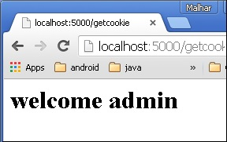
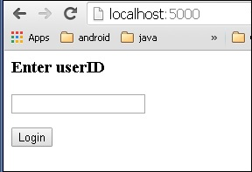
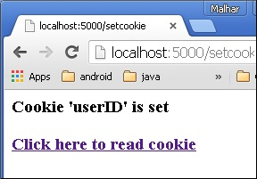
The output of read back cookie is shown below.
Run the application and visit http://localhost:5000/
The result of setting a cookie is displayed like this −

Slide 14
Like Cookie, Session data is stored on client. Session is the time interval when a client logs into a server and logs out of it. The data, which is needed to be held across this session, is stored in the client browser.
A session with each client is assigned a Session ID. The Session data is stored on top of cookies and the server signs them cryptographically. For this encryption, a Flask application needs a defined SECRET_KEY.
Session object is also a dictionary object containing key-value pairs of session variables and associated values.

Slide 15
For example, to set a ‘username’ session variable use the statement −
Session[‘username’] = ’admin’
To release a session variable use pop() method.
session.pop('username', None)
The following code is a simple demonstration of session works in Flask. URL ‘/’ simply prompts user to log in, as session variable ‘username’ is not set.
@app.route('/')
def index():
if 'username' in session:
username = session['username']
return 'Logged in as ' + username + '<br>' + \
"<b><a href = '/logout'>click here to log out</a></b>"
return "You are not logged in <br><a href = '/login'></b>" + \
"click here to log in</b></a>"

Slide 16
As user browses to ‘/login’ the login() view function, because it is called through GET method, opens up a login form. A Form is posted back to ‘/login’ and now session variable is set. Application is redirected to ‘/’. This time session variable ‘username’ is found.
@app.route('/login', methods = ['GET', 'POST'])
def login():
if request.method == 'POST':
session['username'] = request.form['username']
return redirect(url_for('index'))
return '''
<form action = "" method = "post">
<p><input type = text name = username/></p>
<p<<input type = submit value = Login/></p>
</form>
'''
The application also contains a logout() view function, which pops out ‘username’ session variable. Hence, ‘/’ URL again shows the opening page.
@app.route('/logout')
def logout():
# remove the username from the session if it is there
session.pop('username', None)
return redirect(url_for('index'))

Slide 19
Fask class has a redirect() function. When called, it returns a response object and redirects the user to another target location with specified status code.
Prototype of redirect() function is as below −
Flask.redirect(location, statuscode, response)
In the above function −
location parameter is the URL where response should be redirected.
statuscode sent to browser’s header, defaults to 302.
response parameter is used to instantiate response.
The following status codes are standardized −
HTTP_300_MULTIPLE_CHOICES
HTTP_301_MOVED_PERMANENTLY
HTTP_302_FOUND
HTTP_303_SEE_OTHER
HTTP_304_NOT_MODIFIED
HTTP_305_USE_PROXY
HTTP_306_RESERVED
HTTP_307_TEMPORARY_REDIRECT

Slide 20
In the following example, the redirect() function is used to display the login page again when a login attempt fails.
from flask import Flask, redirect, url_for, render_template, request
# Initialize the Flask application
app = Flask(__name__)
@app.route('/')
def index():
return render_template('log_in.html')
@app.route('/login',methods = ['POST', 'GET'])
def login():
if request.method == 'POST' and request.form['username'] == 'admin' :
return redirect(url_for('success'))
else:
return redirect(url_for('index'))
@app.route('/success')
def success():
return 'logged in successfully'
if __name__ == '__main__':
app.run(debug = True)

Slide 21
flash() method
In order to remove message from session, template calls get_flashed_messages().
get_flashed_messages(with_categories, category_filter)
A good GUI based application provides feedback to a user about the interaction. For example, the desktop applications use dialog or message box and JavaScript uses alerts for similar purpose.
Generating such informative messages is easy in Flask web application. Flashing system of Flask framework makes it possible to create a message in one view and render it in a view function called next.
A Flask module contains flash() method. It passes a message to the next request, which generally is a template.
Here,
message parameter is the actual message to be flashed.
category parameter is optional. It can be either ‘error’, ‘info’ or ‘warning’.
flash(message, category)

Slide 27
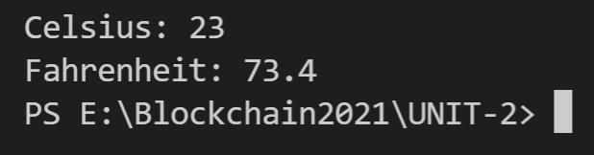
Convert a Script Into a Web Application
def fahrenheit_from(celsius):
"""Convert Celsius to Fahrenheit degrees."""
try:
fahrenheit = float(celsius) * 9 / 5 + 32
fahrenheit = round(fahrenheit, 3) # Round to three decimal places
return str(fahrenheit)
except ValueError:
return "invalid input"
if __name__ == "__main__":
celsius = input("Celsius: ")
print("Fahrenheit:", fahrenheit_from(celsius))
Save the code as a Python script and give it a spin. Make sure that it works as expected and that you understand what it does. Feel free to improve the code.

Slide 28
Add Code as a Function
Flask separates different tasks into different functions that are each assigned a route through the @app.route decorator.
When the user visits the specified route via its URL, the code inside the corresponding function gets executed.
Start by adding fahrenheit_from() to your main.py file and wrapping it with the @app.route decorator:

Slide 29
from flask import Flask
app = Flask(__name__)
@app.route("/")
def index():
return "Congratulations, it's a web app!"
@app.route("/")
def fahrenheit_from(celsius):
"""Convert Celsius to Fahrenheit degrees."""
try:
fahrenheit = float(celsius) * 9 / 5 + 32
fahrenheit = round(fahrenheit, 3) # Round to three decimal places
return str(fahrenheit)
except ValueError:
return "invalid input"
if __name__ == "__main__":
app.run(host="127.0.0.1", port=8080, debug=True)
Currently, both of your functions are triggered by the same route ("/"). When a user visits that route, Flask picks the first function that matches it and executes that code. In your case, this means that fahrenheit_from() never gets executed because index() matches the same route and gets called first.
Your second function will need its own unique route to be accessible. Additionally, you still need to allow your users to provide input to your function.

Slide 30
Pass Values to Your Code
You can solve both of these tasks by telling Flask to treat any remaining part of the URL following the base URL as a value and pass it on to your function.
This requires only a small change to the parameter of the @app.route decorator before fahrenheit_from():
@app.route("/<celsius>")
def fahrenheit_from(celsius):
# -- snip --
Note: Make sure that the URL path component you’re capturing has the same name as the parameter you’re passing to your function. Otherwise, Flask will be confused and will let you know about it by presenting you with an error message.

Slide 31
Head back to your web browser and try out the new functionality using Flask’s development server. You’re now able to access both of your functions through your web app using different URL endpoints:
Index (/): If you go to the base URL, then you’ll see the short encouraging message from before.
Celsius (/42): If you add a number after the forward slash, then you’ll see the converted temperature appear in your browser.

Slide 32
from flask import Flask
app = Flask(__name__)
@app.route("/")
def index():
return "Congratulations, it's a web app!"
@app.route("/<int:celsius>")
def fahrenheit_from(celsius):
"""Convert Celsius to Fahrenheit degrees."""
fahrenheit = float(celsius) * 9 / 5 + 32
fahrenheit = round(fahrenheit, 3) # Round to three decimal places
return str(fahrenheit)
if __name__ == "__main__":
app.run(host="127.0.0.1", port=8080, debug=True)

Slide 33
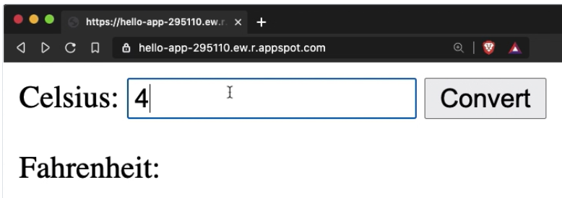
Refactor index(). It should return text that explains how to use the temperature converter web app. Keep in mind that you can use HTML tags in the return string. The HTML will render properly on your landing page.

Slide 34
Collect User Input
Start by creating a <form> element on your landing page. Copy the following few lines of HTML into the return statement of index(), replacing the text message from before:
@app.route("/")
def index():
return """<form action="" method="get">
<input type="text" name="celsius">
<input type="submit" value="Convert">
</form>"""

Slide 35
Receive User Input
In the action attribute of your <form> element, you specified that the data of your HTML form should be sent back to the same URL it came from. Now you need to include the functionality to fetch the value in index(). For this, you need to accomplish two steps:
Import Flask’s request object: Like many web frameworks, Flask passes HTTP requests along as global objects. In order to be able to use this global request object, you first need to import it.
Fetch the value: The request object contains the submitted value and gives you access to it through a Python dictionary syntax. You need to fetch it from the global object to be able to use it in your function.

Slide 36
@app.route("/<int:celsius>")
def fahrenheit_from(celsius):
"""Convert Celsius to Fahrenheit degrees."""
fahrenheit = float(celsius) * 9 / 5 + 32
fahrenheit = round(fahrenheit, 3) # Round to three decimal places
return str(fahrenheit)
if __name__ == "__main__":
app.run(host="127.0.0.1", port=8080, debug=True)
from flask import Flask
from flask import request
app = Flask(__name__)
@app.route("/")
def index():
celsius = request.args.get("celsius", "")
return (
"""<form action="" method="get">
<input type="text" name="celsius">
<input type="submit" value="Convert">
</form>"""
+ celsius
)

Slide 37
The request.args dictionary contains any data submitted with an HTTP GET request.
If your base URL gets called initially, without a form submission, then the dictionary will be empty and you’ll return an empty string as the default value instead.
If the page gets called through submitting the form, then the dictionary will contain a value under the celsius key, and you can successfully fetch it and add it to the returned string.
Give it a spin! You’re now able to enter a number and see it displayed right underneath the form’s button.
If you enter a new number, then the old one gets replaced. You’re correctly sending and receiving the data that your users are submitting.

Slide 38
Process User Input
Since this approach uses only one URL endpoint, you can’t rely on Flask to type check the user input via URL path component capturing as you did earlier on. This means you’ll want to reintroduce your try … except block from the initial fahrenheit_from() of the original code.
This time, fahrenheit_from() won’t be associated with an @app.route decorator. Go ahead and delete that line of code. You’ll call fahrenheit_from() explicitly from index() instead of asking Flask to execute it when a specific URL endpoint is accessed.
After deleting the decorator from fahrenheit_from() and reintroducing the try … except block, you’ll next add a conditional statement to index() that checks whether the global request object contains a celsius key. If it does, then you want to call fahrenheit_from() to calculate the corresponding Fahrenheit degrees. If it doesn’t, then you assign an empty string to the fahrenheit variable instead.
Doing this allows you to add the value of fahrenheit to the end of your HTML string. The empty string won’t be visible on your page, but if the user submitted a value, then it’ll show up underneath the form.

Slide 39
from flask import Flask
from flask import request
app = Flask(__name__)
@app.route("/")
def index():
celsius = request.args.get("celsius", "")
if celsius:
fahrenheit = fahrenheit_from(celsius)
else:
fahrenheit = ""
return (
"""<form action="" method="get">
Celsius temperature: <input type="text" name="celsius">
<input type="submit" value="Convert to Fahrenheit">
</form>"""
+ "Fahrenheit: "
+ fahrenheit
)
def fahrenheit_from(celsius):
"""Convert Celsius to Fahrenheit degrees."""
try:
fahrenheit = float(celsius) * 9 / 5 + 32
fahrenheit = round(fahrenheit, 3) # Round to three decimal places
return str(fahrenheit)
except ValueError:
return "invalid input"
if __name__ == "__main__":
app.run(host="127.0.0.1", port=8080, debug=True)

Slide 40
here’s a step-by-step review of the edited lines:
Line 2: You’re not using flask.escape() anymore, so you can remove it from the import statement.
Lines 8, 11, and 12: As before, you’re fetching the user-submitted value through Flask’s global request object. By using the dictionary method .get(), you assure that an empty string gets returned if the key isn’t found. That’ll be the case if the page is loaded initially and the user hasn’t submitted the form yet. This is implemented in lines 11 and 12.
Line 19: By returning the form with the default empty string stuck to the end, you avoid displaying anything before the form has been submitted.
Lines 9 and 10: After your users enter a value and click Convert, the same page gets loaded again. This time around, request.args.get("celsius", "") finds the celsius key and returns the associated value. This makes the conditional statement evaluate to True, and the user-provided value is passed to fahrenheit_from().

Slide 41
Lines 24 to 29: fahrenheit_from() checks if the user supplied a valid input. If the provided value can be converted to a float, then the function applies the temperature conversion code and returns the temperature in Fahrenheit. If it can’t be converted, then a ValueError exception is raised, and the function returns the string "invalid input" instead.
Line 19: This time, when you concatenate the fahrenheit variable to the end of the HTML string, it points to the return value of fahrenheit_from(). This means that either the converted temperature or the error message string will be added to your HTML.
Lines 15 and 18: To make the page easier to use, you also add the descriptive labels Celsius temperature and Fahrenheit to this same HTML string.
https://realpython.com/python-web-applications/#convert-a-script-into-a-web-application

Slide 42
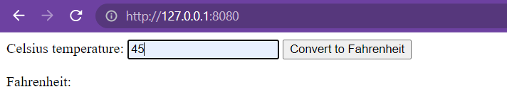
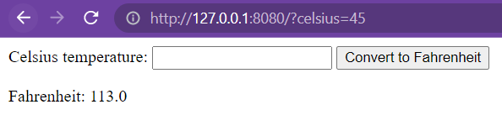

Slide 45
Flask uses the Jinja template engine to dynamically build HTML pages using familiar Python concepts such as variables, loops, lists, and so on. You’ll use these templates as part of this project.
Bootstrap will help you incorporate responsive web pages in your web application so that it also works well on mobile browsers without writing your own HTML, CSS, and JavaScript code to achieve these goals.

Slide 46
Step 1 — Installing Flask
To install Flask, run the following command:
pip install flask
Step 2 — Creating a Base Application
from flask import Flask
app = Flask(__name__)
@app.route('/')
def hello():
return 'Hello, World!'
you first import the Flask object from the flask package.
You then use it to create your Flask application instance with the name app.
You pass the special variable __name__ that holds the name of the current Python module. It’s used to tell the instance where it’s located—you need this because Flask sets up some paths behind the scenes.
Once you create the app instance, you use it to handle incoming web requests and send responses to the user. @app.route is a decorator that turns a regular Python function into a Flask view function, which converts the function’s return value into an HTTP response to be displayed by an HTTP client, such as a web browser. You pass the value '/' to @app.route() to signify that this function will respond to web requests for the URL /, which is the main URL.
The hello() view function returns the string 'Hello, World!' as a response.

Slide 47
Step 3 — Using HTML templates
Currently your application only displays a simple message without any HTML. Web applications mainly use HTML to display information for the visitor, so you’ll now work on incorporating HTML files in your app, which can be displayed on the web browser.
Flask provides a render_template() helper function that allows use of the Jinja template engine. This will make managing HTML much easier by writing your HTML code in .html files as well as using logic in your HTML code. You’ll use these HTML files, (templates) to build all of your application pages, such as the main page where you’ll display the current blog posts, the page of the blog post, the page where the user can add a new post, and so on.

Slide 48
In this step, you’ll create your main Flask application in a new file.
from flask import Flask, render_template
app = Flask(__name__)
@app.route('/')
def index():
return render_template('index.html')
You’ll also import the render_template() helper function that lets you render HTML template files that exist in the templates folder you’re about to create.
The file will have a single view function that will be responsible for handling requests to the main / route.
The index() view function returns the result of calling render_template() with index.html as an argument, this tells render_template() to look for a file called index.html in the templates folder. Both the folder and the file do not yet exist, you will get an error if you were to run the application at this point.

Slide 49
flask_blog/templates/index.html
<!DOCTYPE html>
<html lang="en">
<head>
<meta charset="UTF-8">
<title>FlaskBlog</title>
</head>
<body>
<h1>Welcome to FlaskBlog</h1>
</body>
</html>
In addition to the templates folder, Flask web applications also typically have a static folder for hosting static files, such as CSS files, JavaScript files, and images the application uses.
You can create a style.css style sheet file to add CSS to your application. First, create a directory called static inside your main flask_blog directory:
flask_blog/static/css/style.css
h1 {
border: 2px #eee solid;
color: brown;
text-align: center;
padding: 10px;
}

Slide 50
You’ll add a link to the style.css file inside the <head> section of the index.html template file:
<head>
<meta charset="UTF-8">
<link rel="stylesheet" href="{{ url_for('static', filename= 'css/style.css') }}">
<title>FlaskBlog</title>
</head>
the url_for() helper function to generate the appropriate location of the file.
The first argument specifies that you’re linking to a static file and the second argument is the path of the file inside the static directory.
Save and close the file.
Upon refreshing the index page of your application, you will notice that the text Welcome to FlaskBlog is now in brown, centered, and enclosed inside a border.

Slide 51
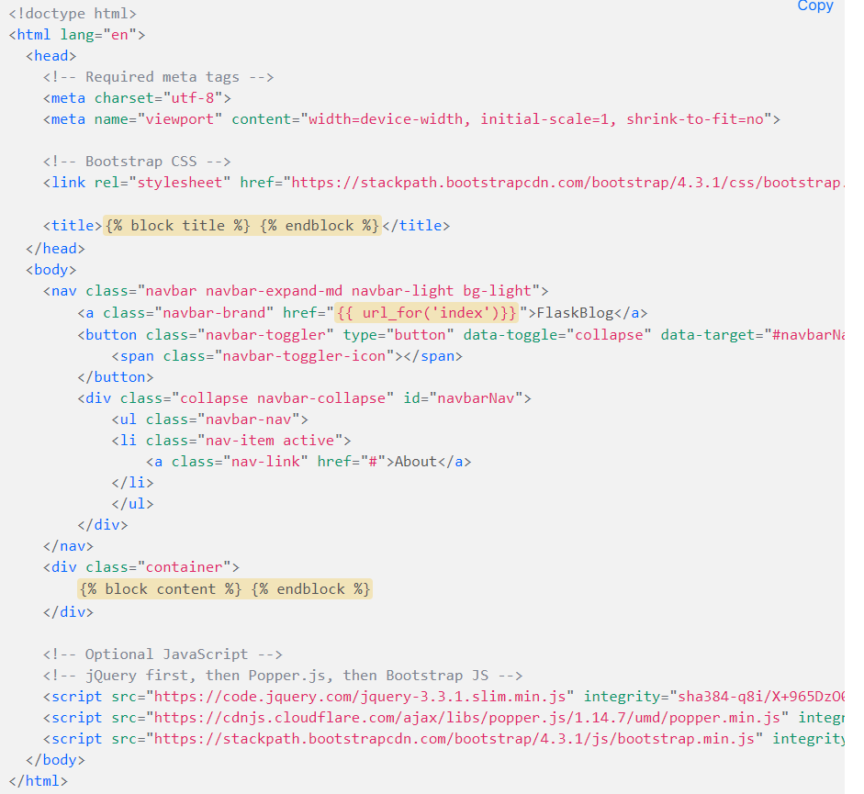
You can avoid unnecessary code repetition with the help of a base template file, which all of your HTML files will inherit from. See Template Inheritance in Jinja for more information.
To make a base template, first create a file called base.html inside your templates directory:

Slide 52
Most of the code in the preceding block is standard HTML and code required for Bootstrap.
The <meta> tags provide information for the web browser,
the <link> tag links the Bootstrap CSS files, and
the <script> tags are links to JavaScript code that allows some additional Bootstrap features, check out the Bootstrap documentation for more.
However, the following highlighted parts are specific to the Jinja template engine:
{% block title %} {% endblock %}: A block that serves as a placeholder for a title, you’ll later use it in other templates to give a custom title for each page in your application without rewriting the entire <head> section each time.
{{ url_for('index')}}: A function call that will return the URL for the index() view function. This is different from the past url_for() call you used to link a static CSS file, because it only takes one argument, which is the view function’s name, and links to the route associated with the function instead of a static file.
{% block content %} {% endblock %}: Another block that will be replaced by content depending on the child template (templates that inherit from base.html) that will override it.

Slide 53
Now that you have a base template, you can take advantage of it using inheritance. Open the index.html file:
{% extends 'base.html' %}
{% block content %}
<h1>{% block title %} Welcome to FlaskBlog {% endblock %}</h1>
{% endblock %}

Slide 54
In this new version of the index.html template, you use the {% extends %} tag to inherit from the base.html template. You then extend it via replacing the content block in the base template with what is inside the content block in the preceding code block.
This content block contains an <h1> tag with the text Welcome to FlaskBlog inside a title block, which in turn replaces the original title block in the base.html template with the text Welcome to FlaskBlog. This way, you can avoid repeating the same text twice, as it works both as a title for the page and a heading that appears below the navigation bar inherited from the base template.
Template inheritance also gives you the ability to reuse the HTML code you have in other templates (base.html in this case) without having to repeat it each time it is needed.

Slide 55

Save and close the file and refresh the index page on your browser. You’ll see your page with a navigation bar and styled title.

Slide 56
Step 4 — Setting up the Database
In this step, you’ll set up a database to store data, that is, the blog posts for your application. You’ll also populate the database with a few example entries.
You’ll use a SQLite database file to store your data because the sqlite3 module, which we will use to interact with the database, is readily available in the standard Python library. For more information about SQLite, check out this tutorial.
First, because data in SQLite is stored in tables and columns, and since your data mainly consists of blog posts, you first need to create a table called posts with the necessary columns. You’ll create a .sql file that contains SQL commands to create the posts table with a few columns. You’ll then use this file to create the database.

Slide 57
Open a file called schema.sql inside your flask_blog directory:
Type the following SQL commands inside this file:
The first SQL command is DROP TABLE IF EXISTS posts;, this deletes any already existing tables named posts so you don’t get confusing behavior. Note that this will delete all of the content you have in the database whenever you use these SQL commands, so ensure you don’t write any important content in the web application until you finish this tutorial and experiment with the final result. Next, CREATE TABLE posts is used to create the posts table with the following columns:
id: An integer that represents a primary key, this will get assigned a unique value by the database for each entry (that is a blog post).
created: The time the blog post was created at. NOT NULL signifies that this column should not be empty and the DEFAULT value is the CURRENT_TIMESTAMP value, which is the time at which the post was added to the database. Just like id, you don’t need to specify a value for this column, as it will be automatically filled in.
title: The post title.
content: The post content.
DROP TABLE IF EXISTS posts;
CREATE TABLE posts (
id INTEGER PRIMARY KEY AUTOINCREMENT,
created TIMESTAMP NOT NULL DEFAULT CURRENT_TIMESTAMP,
title TEXT NOT NULL,
content TEXT NOT NULL
);

Slide 58
flask_blog/init_db.py
import sqlite3
connection = sqlite3.connect('database.db')
with open('schema.sql') as f:
connection.executescript(f.read())
cur = connection.cursor()
cur.execute("INSERT INTO posts (title, content) VALUES (?, ?)",
('First Post', 'Content for the first post')
)
cur.execute("INSERT INTO posts (title, content) VALUES (?, ?)",
('Second Post', 'Content for the second post')
)
connection.commit()
connection.close()
You first import the sqlite3 module and then open a connection to a database file named database.db, which will be created once you run the Python file. Then you use the open() function to open the schema.sql file. Next you execute its contents using the executescript() method that executes multiple SQL statements at once, which will create the posts table. You create a Cursor object that allows you to use its execute() method to execute two INSERT SQL statements to add two blog posts to your posts table. Finally, you commit the changes and close the connection.

Slide 59
Step 5 — Displaying All Posts
flask_blog/app.py
. . .
@app.route('/')
def index():
conn = get_db_connection()
posts = conn.execute('SELECT * FROM posts').fetchall()
conn.close()
return render_template('index.html', posts=posts)
. . .
from flask import Flask, render_template
def get_db_connection():
conn = sqlite3.connect('database.db')
conn.row_factory = sqlite3.Row
return conn
. . .

Slide 60
In this new version of the index() function, you first open a database connection using the get_db_connection() function you defined earlier. Then you execute an SQL query to select all entries from the posts table. You implement the fetchall() method to fetch all the rows of the query result, this will return a list of the posts you inserted into the database in the previous step.
In this new version of the index() function, you first open a database connection using the get_db_connection() function you defined earlier. Then you execute an SQL query to select all entries from the posts table. You implement the fetchall() method to fetch all the rows of the query result, this will return a list of the posts you inserted into the database in the previous step.

Slide 61
flask_blog/templates/index.html
{% extends 'base.html' %}
{% block content %}
<h1>{% block title %} Welcome to FlaskBlog {% endblock %}</h1>
{% for post in posts %}
<a href="#">
<h2>{{ post['title'] }}</h2>
</a>
<span class="badge badge-primary">{{ post['created'] }}</span>
<hr>
{% endfor %}
{% endblock %}

Slide 62
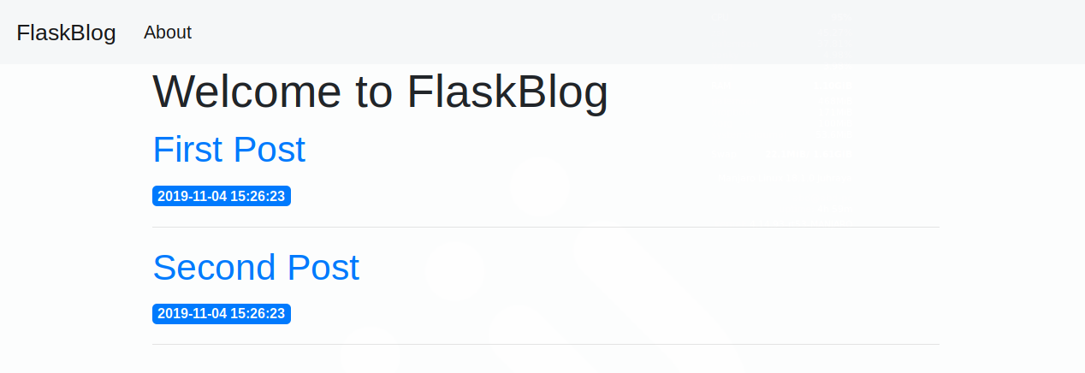
https://www.digitalocean.com/community/tutorials/how-to-make-a-web-application-using-flask-in-python-3

