Slide 1
BlockChain Fundamentals
Dr. Thippeswamy M N

Slide 2
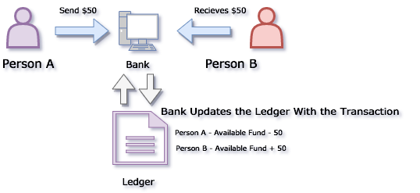
Let’s take an example where Person A is transferring $50 to Person B.
Person A sends a request to his Bank for initiating the transfer, Bank verifies the request and if everything is ok then subtracts $50 Person A ‘s account and adds $50 to the account of Person B. Then bank updates its ledgers to reflect these changes.

Slide 3
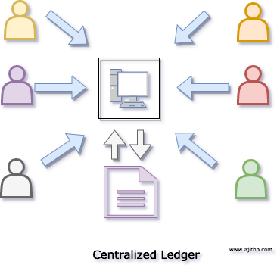
If you look at any of the transaction that we do these days are mostly handled by one or more servers managed by a single entity. This entity could be your bank, a social media or an online shop, and they all do a standard action, record your transactions in a centralized database.

Slide 4
There are few drawbacks for this type of transactions and ledgers.
The entity who owns the ledger has the full control over it and can manipulate the ledgers at it is on will without its customer’s permission.
The records in this ledger can be easily tampered with by someone who has access to it, means if someone makes some malicious changes to this ledger that can affect everybody who is relying on that ledger. (for example, someone can hack into the bank’s centralized ledger and modify transactions).
Another disadvantage is the single point of failure. For example, if the bank decides to shut down their service users will not be able to perform transactions.
In the extreme case where a natural disaster wipes out their all data centers, all the transactions from the ledgers will be lost.
Centralized Ledgers stores data in Silo’s, means, for example, your bank has its ledger, an auditor has his ledger, tax authorities have its ledgers, and they are never synchronized.
Though it is a centralized ledger from the general point of view, the organizations will have to spend too much of money to build redundancy and scaling to their ledgers. That makes this very expensive

Slide 5
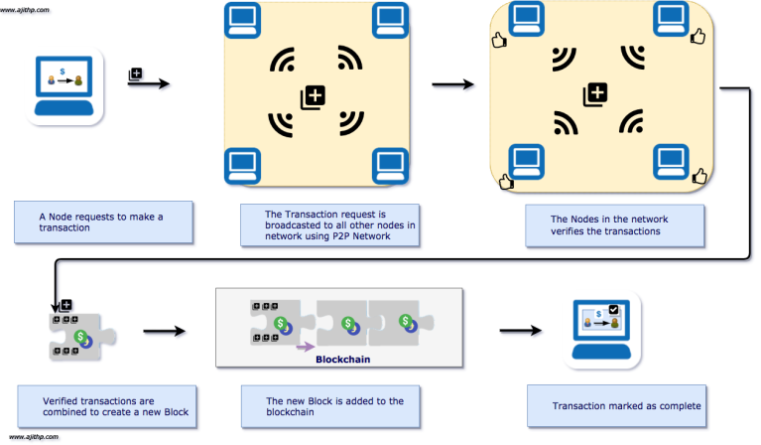
What is BlockChain: Blockchain is a distributed ledger of transactions. All the transactions in the blockchain are encrypted and synchronized between the participants
.

Slide 6
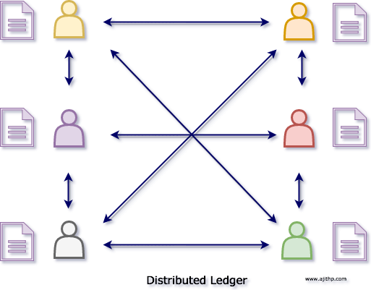
Distributed Ledgers (DLT)
In the Distributed ledger each participating member has a copy of the ledger, In simple terms during any transactions, it updates the ledger of the sender and receiver then broadcast the transaction, The transaction details are updated in the ledgers of all of its participants using peer to peer network.

Slide 7
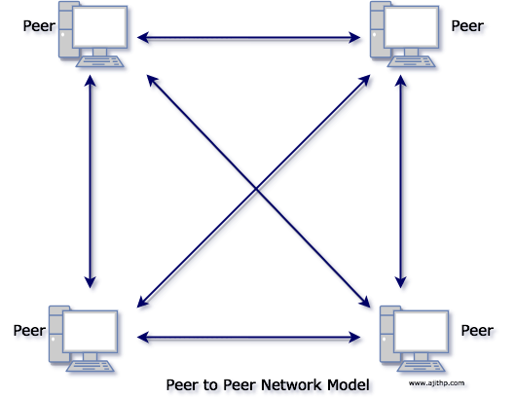
Peer to peer (P2P) network
Any peer can perform a transaction on the P2P network this means When one node can perform a similar transaction at the same time it will end up in conflicts

Slide 8
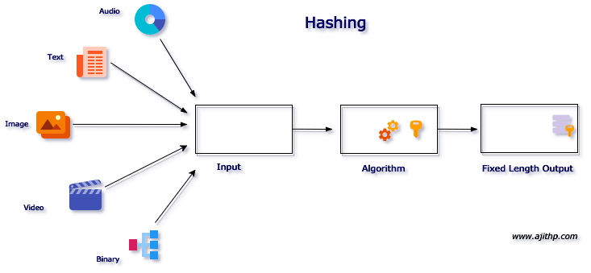
Cryptography in Blockchain
Blockchain leverages two cryptographic concepts in its implementation.
They are the following
Hashing
Digital Signature.
What is Hashing
Hashing is a mechanism where any input is transformed to a fixed size output using a hashing algorithm. The input could be of any file type, for example, you can generate a hash of an image, text, music, movie or a binary file.

Slide 9
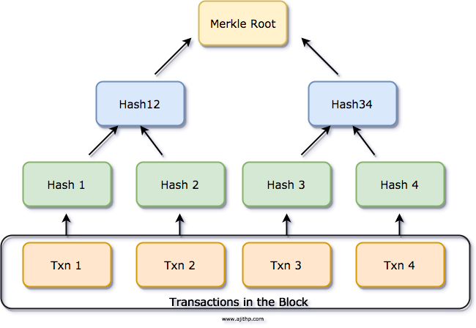
Merkle tree is a tree of hashes. Leaf nodes store data. Parent nodes contain their children’s hash as well as the hashed value of the sum of their children’s hashes. Since all the nodes except for leaf nodes contain a hash, the Merkle tree is also known as a hash tree.

Slide 10
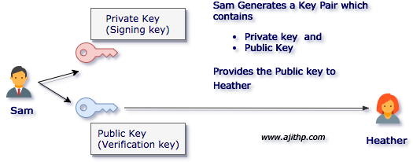
What is a Digital Signature
A classical example of Digital Signature is the website traffic using HTTPS protocol using SSL. SSL uses the digital signatures to ensure the authenticity of the server.
A User generates a digital signature by generating a Public and Private key Pair.

Slide 11
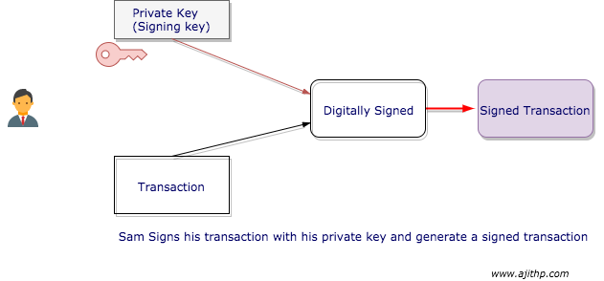
A Public key an a Private key has mathematical relations that tie each other. The private key should be kept as secret and should be used for signing messages digitally. A public key is intended to be distributed publically which should be used by the message recipient to validate the authenticity of the message.

Slide 12
A Public key an a Private key has mathematical relations that tie each other. The private key should be kept as secret and should be used for signing messages digitally. A public key is intended to be distributed publically which should be used by the message recipient to validate the authenticity of the message.

Slide 13
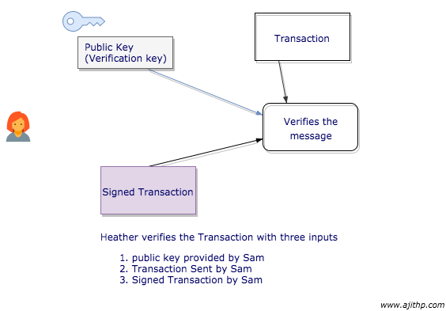
Sender signs all his transactions with his generated private key. This will ensure that only the owner of the account with the private key can do the transaction.

Slide 14
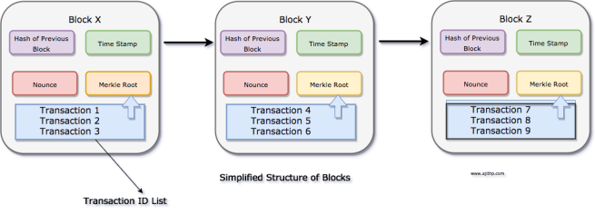
What is a Block
We saw that Blockchain is a group of blocks in sequential order, Let’s take a quick peek at what a block is? In simple terms Block is a group of valid and verified transactions. Each block in the blockchain is immutable. Block miners will continuously process new transactions, and new blocks will be added to end of the chain. Each block will have the Hash of the previous block thus ensuring the integrity of the chain.

Slide 15
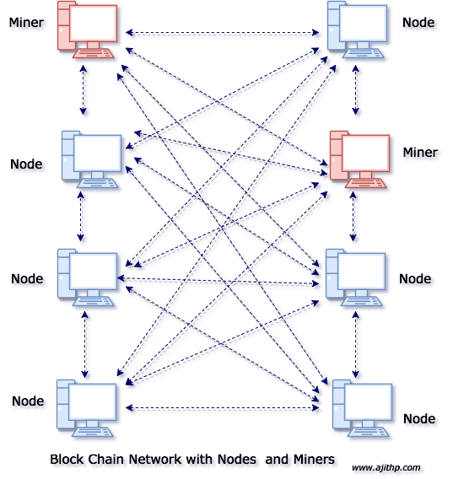
What is Block Mining
In simple words, Miners are the one who runs a specialized version of the Blockchain software which can add a Block to the Blockchain. The miners get rewarded each time when they add a block to the Blockchain. There may be multiple miners who will compete with each other to create a Block in the blockchain in a network.

