Slide 1







EDA with SQL results
Thippeswamy MN
25-06-2024

Slide 2
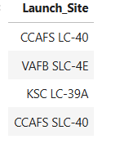
Display the names of the unique launch sites in the space mission

Slide 3
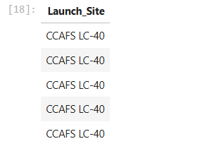
Display 5 records where launch sites begin with the string 'CCA'

Slide 4

Display the total payload mass carried by boosters launched by NASA (CRS)

Slide 5

Display average payload mass carried by booster version F9 v1.1

Slide 6

List the date when the first succesful landing outcome in ground pad was acheived

Slide 7
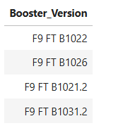
List the names of the boosters which have success in drone ship and have payload mass greater than 4000 but less than 6000

Slide 8
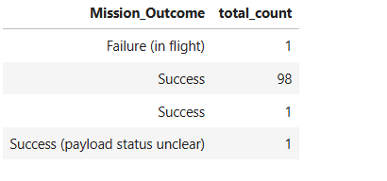
List the total number of successful and failure mission outcomes

Slide 9
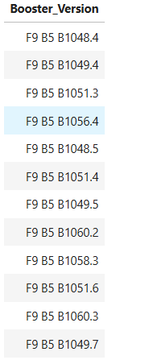
List the names of the booster_versions which have carried the maximum payload mass. Use a subquery

Slide 10
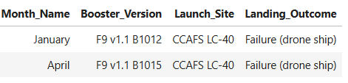
List the records which will display the month names, failure landing_outcomes in drone ship ,booster versions, launch_site for the months in year 2015.

Slide 11
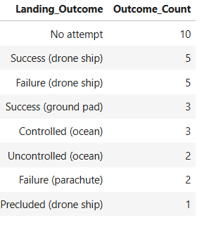
Rank the count of landing outcomes (such as Failure (drone ship) or Success (ground pad)) between the date 2010-06-04 and 2017-03-20, in descending order.

