Slide 1







EDA with visualization results
Thippeswamy MN
25-06-2024

Slide 2
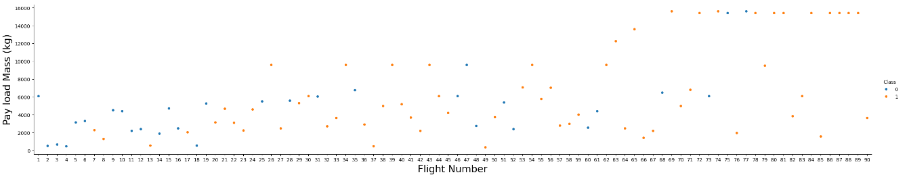
FlightNumber vs. PayloadMass

Slide 3
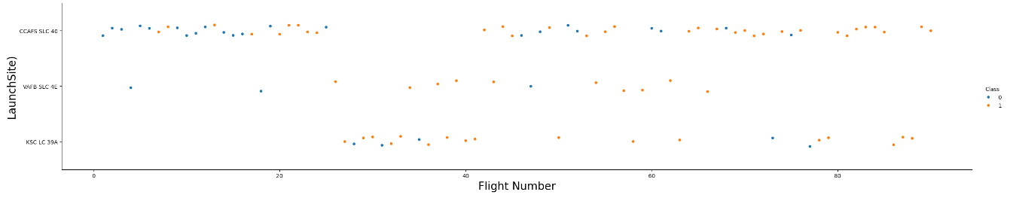
Visualize the relationship between Flight Number and Launch Site

Slide 4
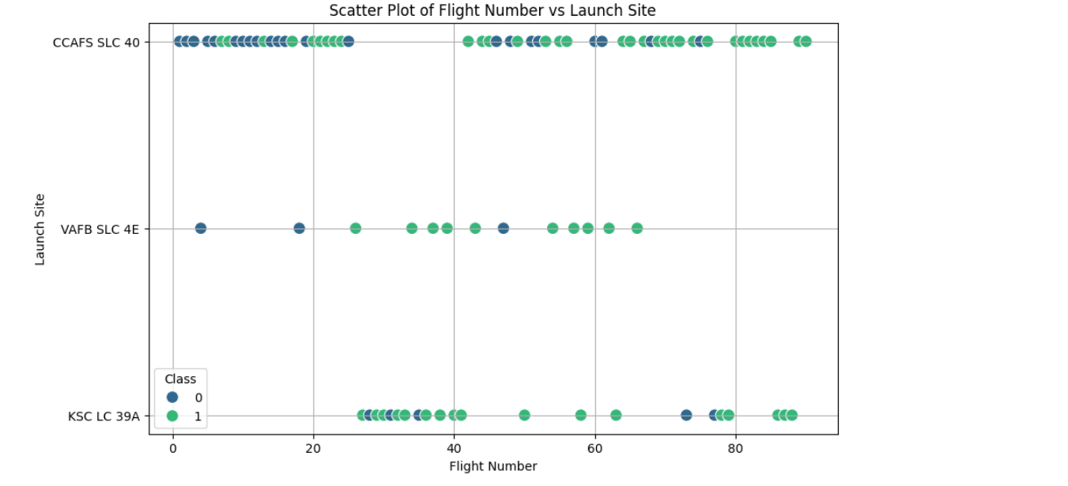
Plot a scatter point chart with x axis to be Flight Number and y axis to be the launch site, and hue to be the class value

Slide 5
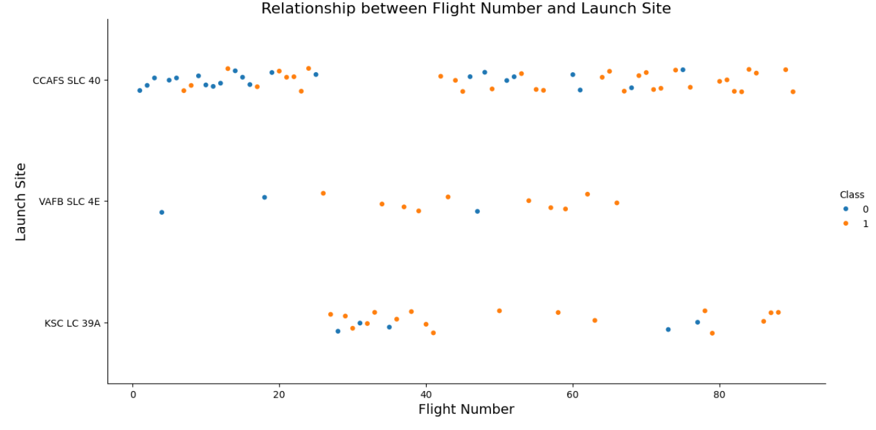
Visualize the relationship between Payload and Launch Site

Slide 6
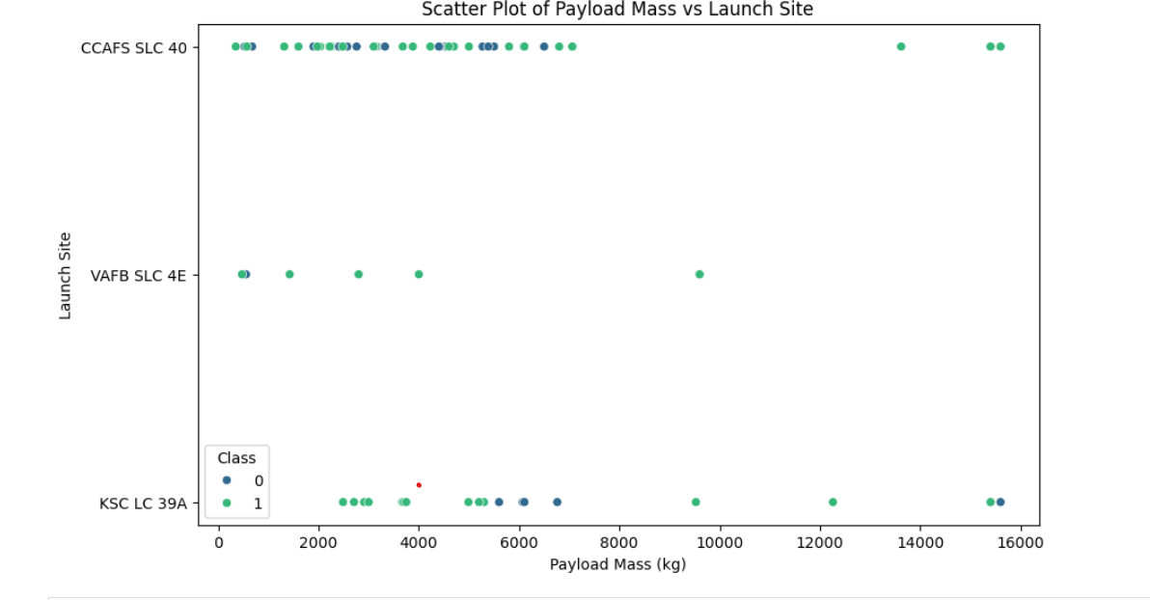
Plot a scatter point chart with x axis to be Pay Load Mass (kg) and y axis to be the launch site, and hue to be the class value

Slide 7
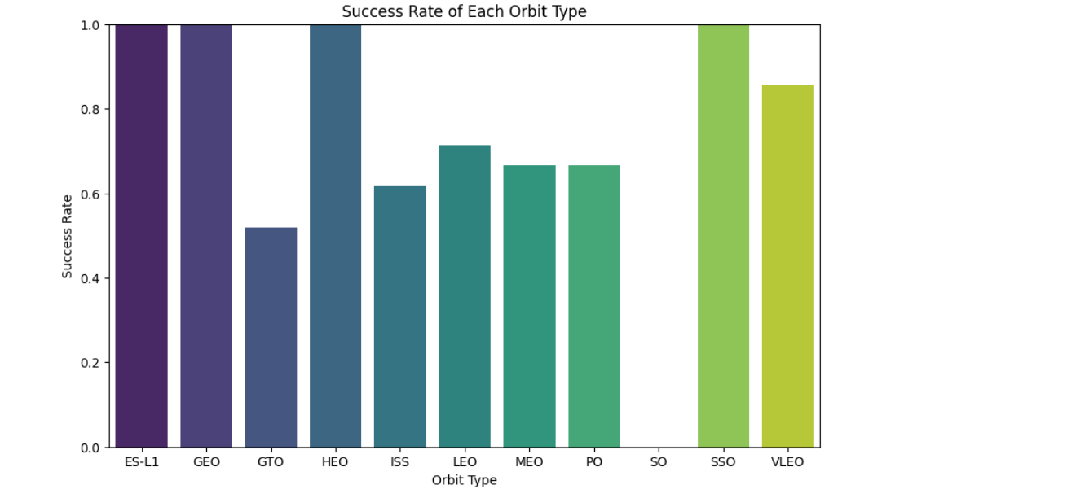
Visualize the relationship between success rate of each orbit type

Slide 8
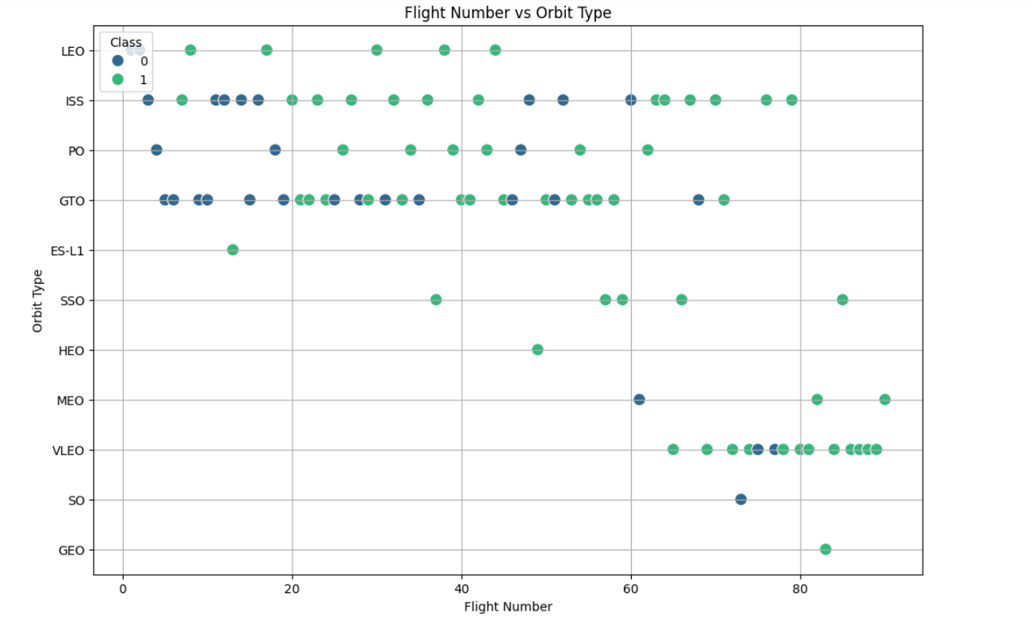
Visualize the relationship between FlightNumber and Orbit type

Slide 9
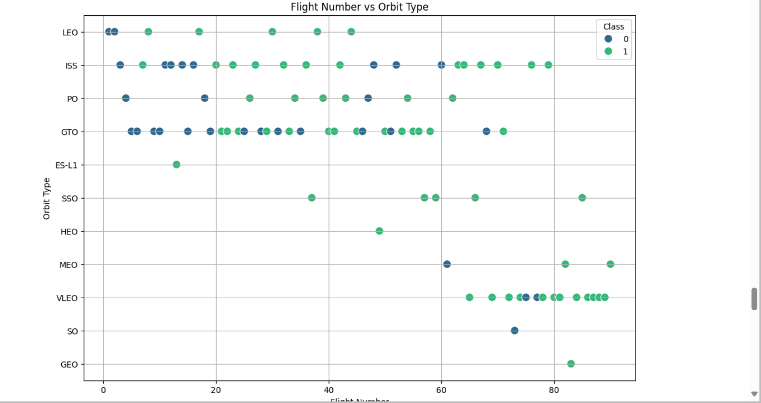
Plot a scatter point chart with x axis to be FlightNumber and y axis to be the Orbit, and hue to be the class value

Slide 10
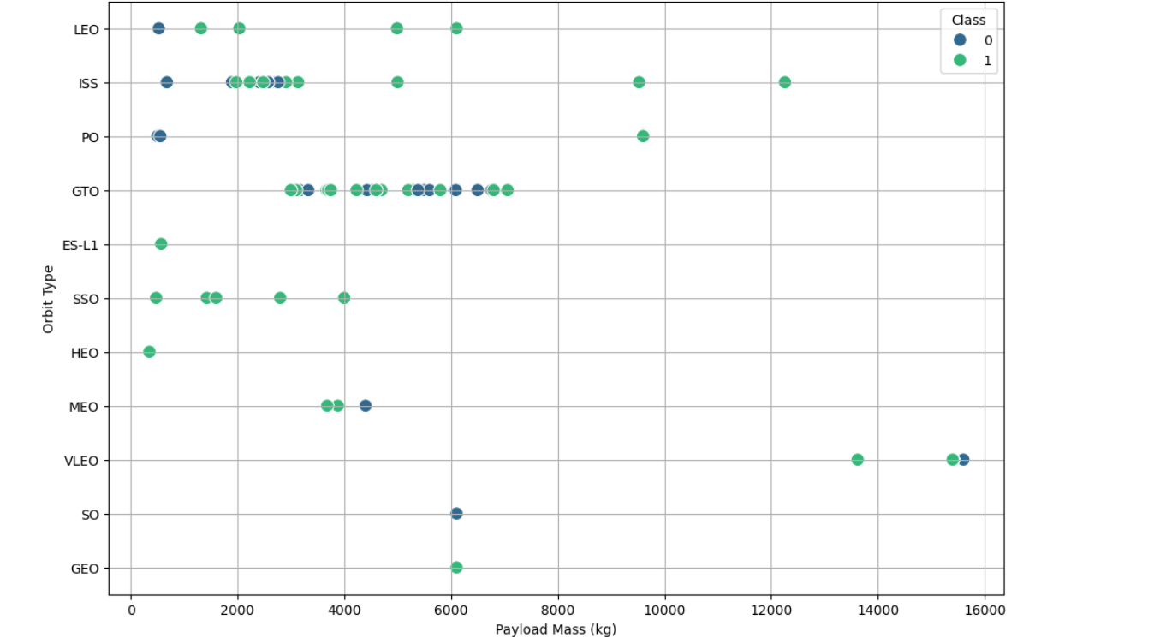
Visualize the relationship between Payload and Orbit type

Slide 11
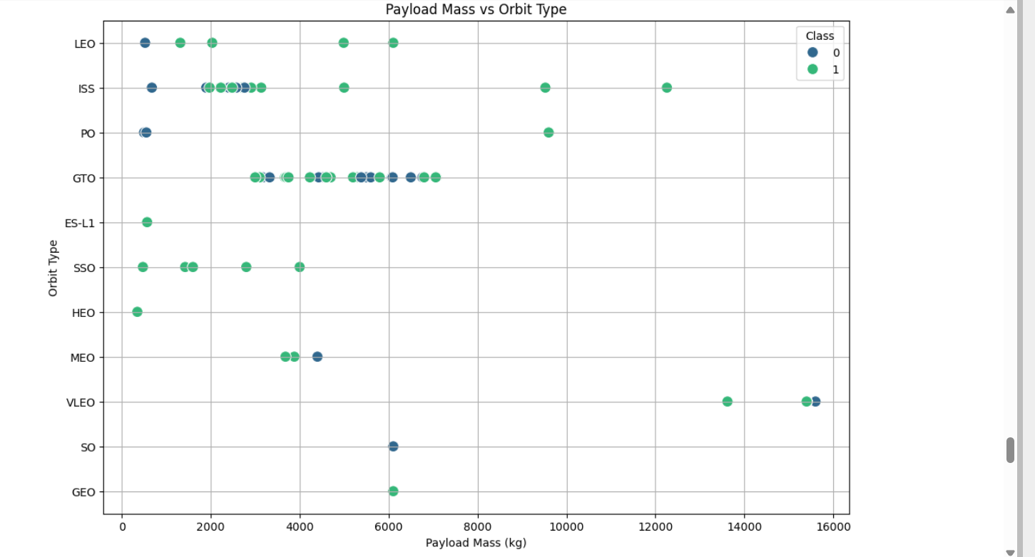
Plot a scatter point chart with x axis to be Payload and y axis to be the Orbit, and hue to be the class value

Slide 12
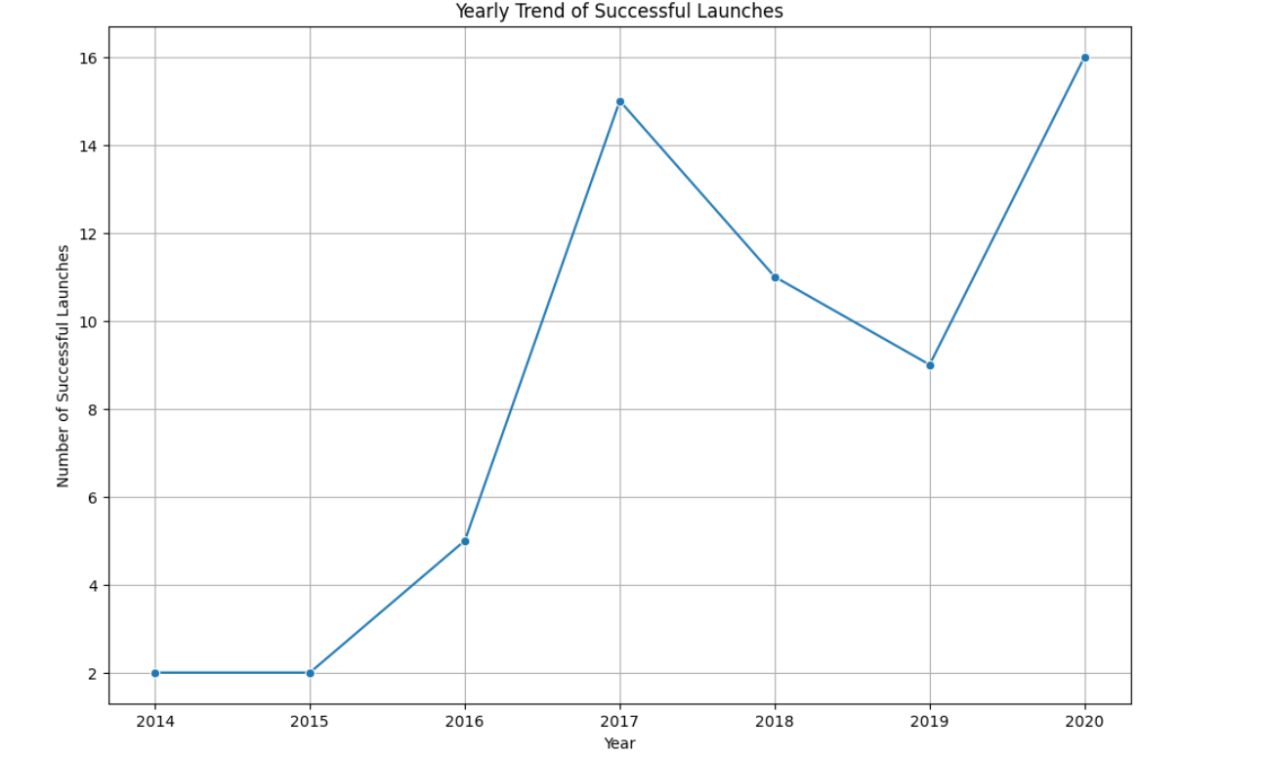
Visualize the launch success yearly trend

Slide 13
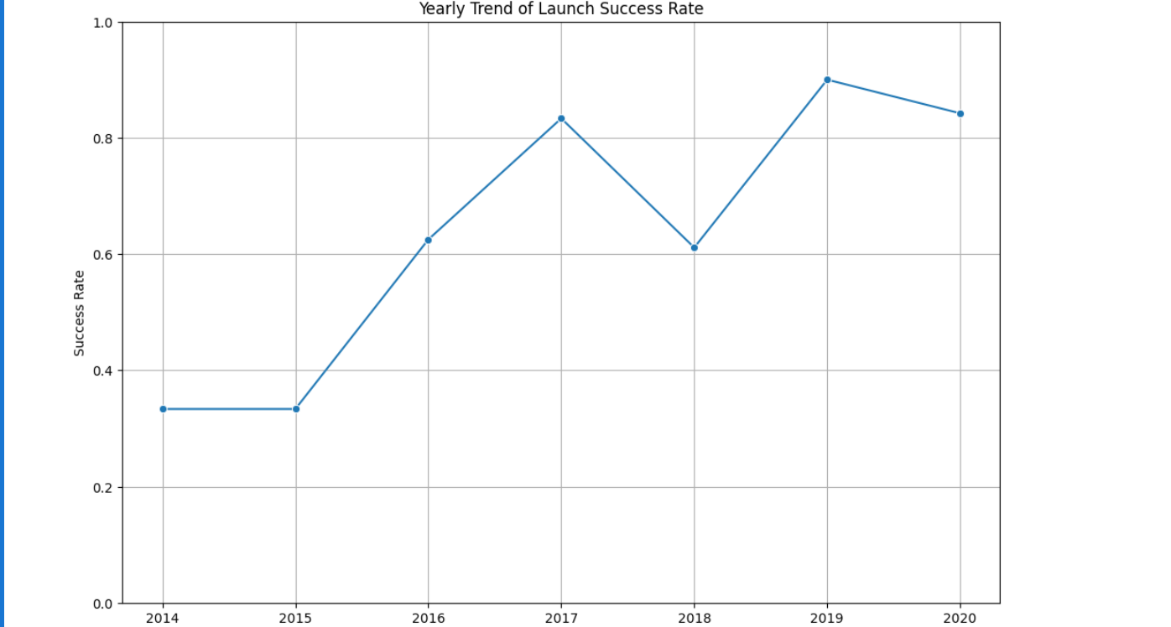
Plot a line chart with x axis to be the extracted year and y axis to be the success rate

Slide 14
Plot a line chart with x axis to be the extracted year and y axis to be the success rate

