Slide 1







Interactive map with Folium
Thippeswamy MN
26-06-2024

Slide 2
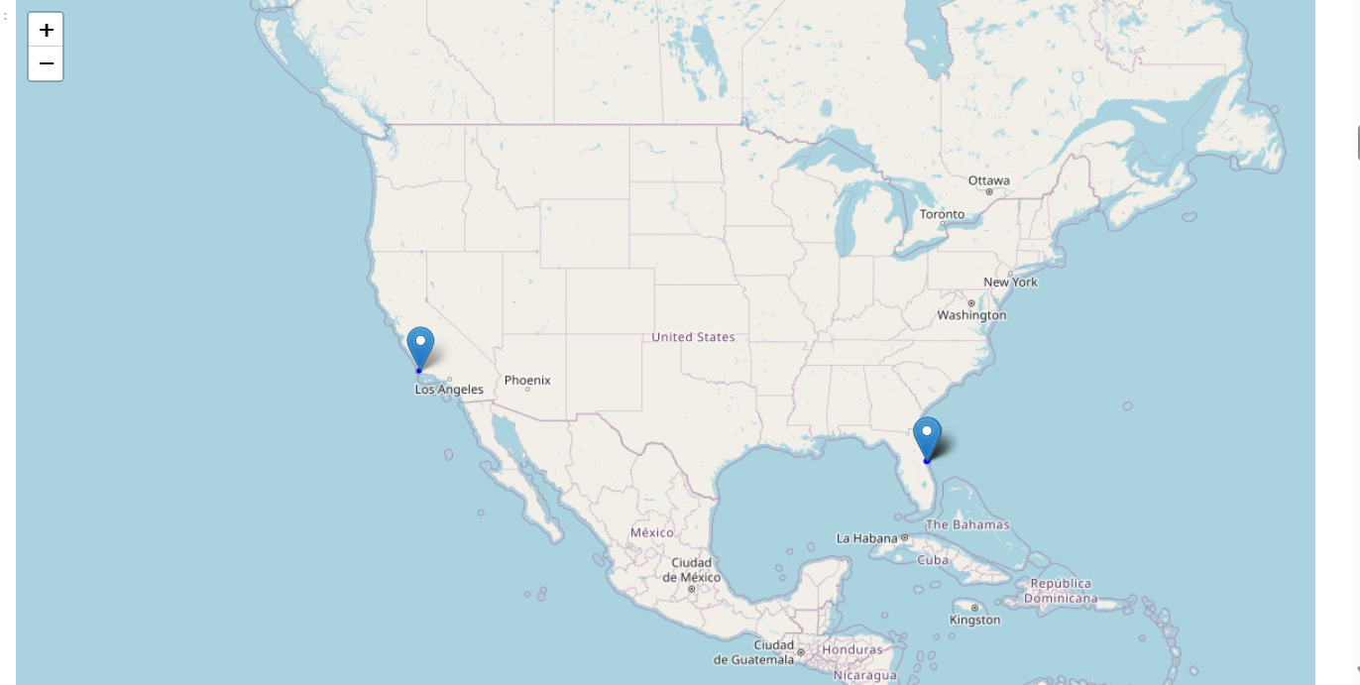
Mark all launch sites on a map

Slide 3
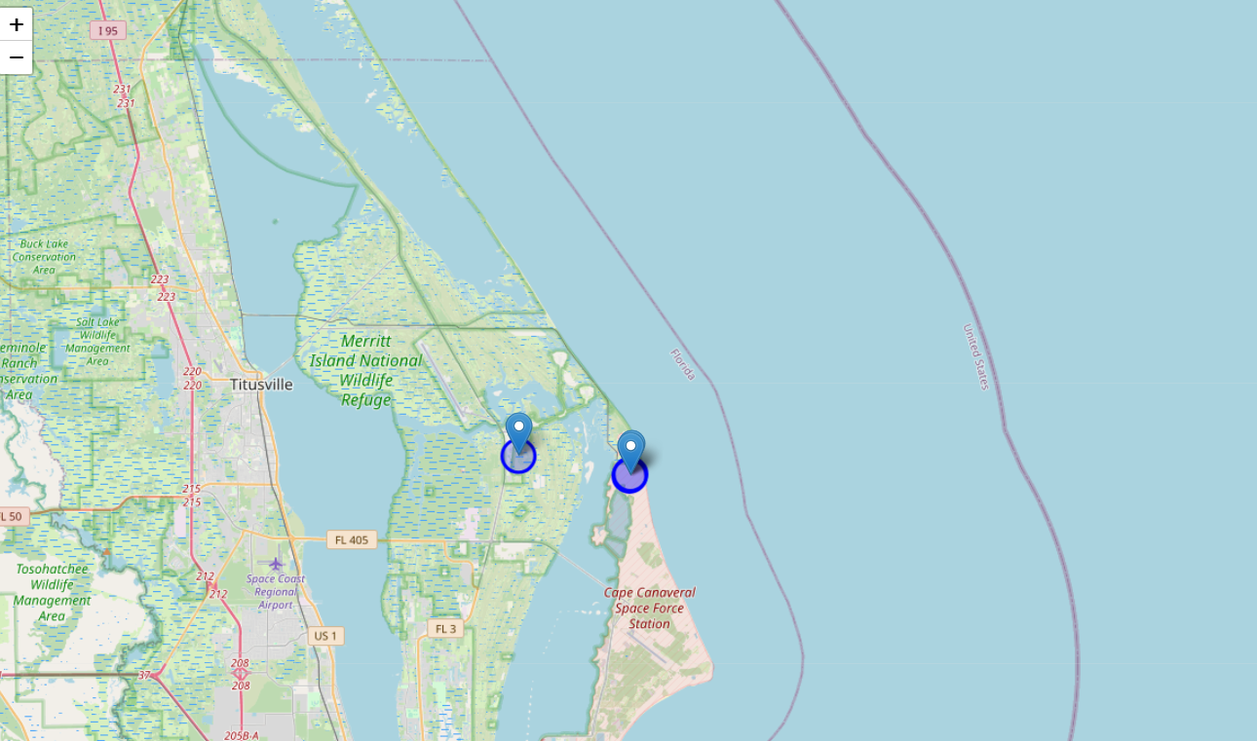
KSC LC-39A,CCAFS LC-40 and CCAFS SLC-40

Slide 4
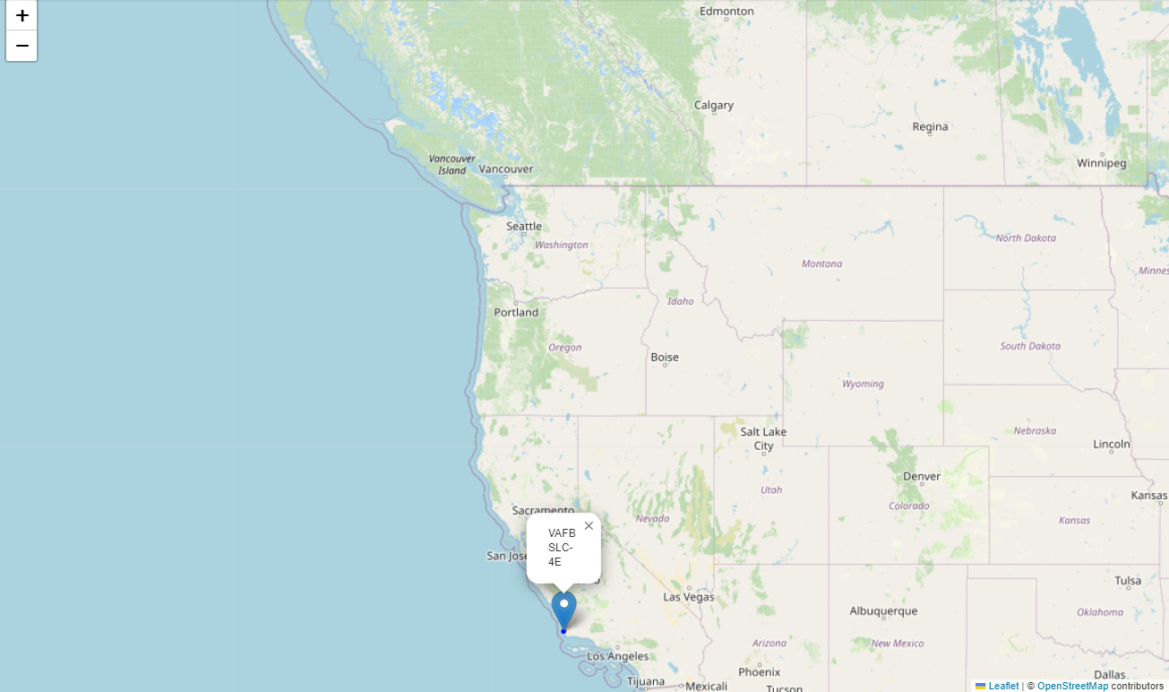
VAFB SLC-4E

Slide 5
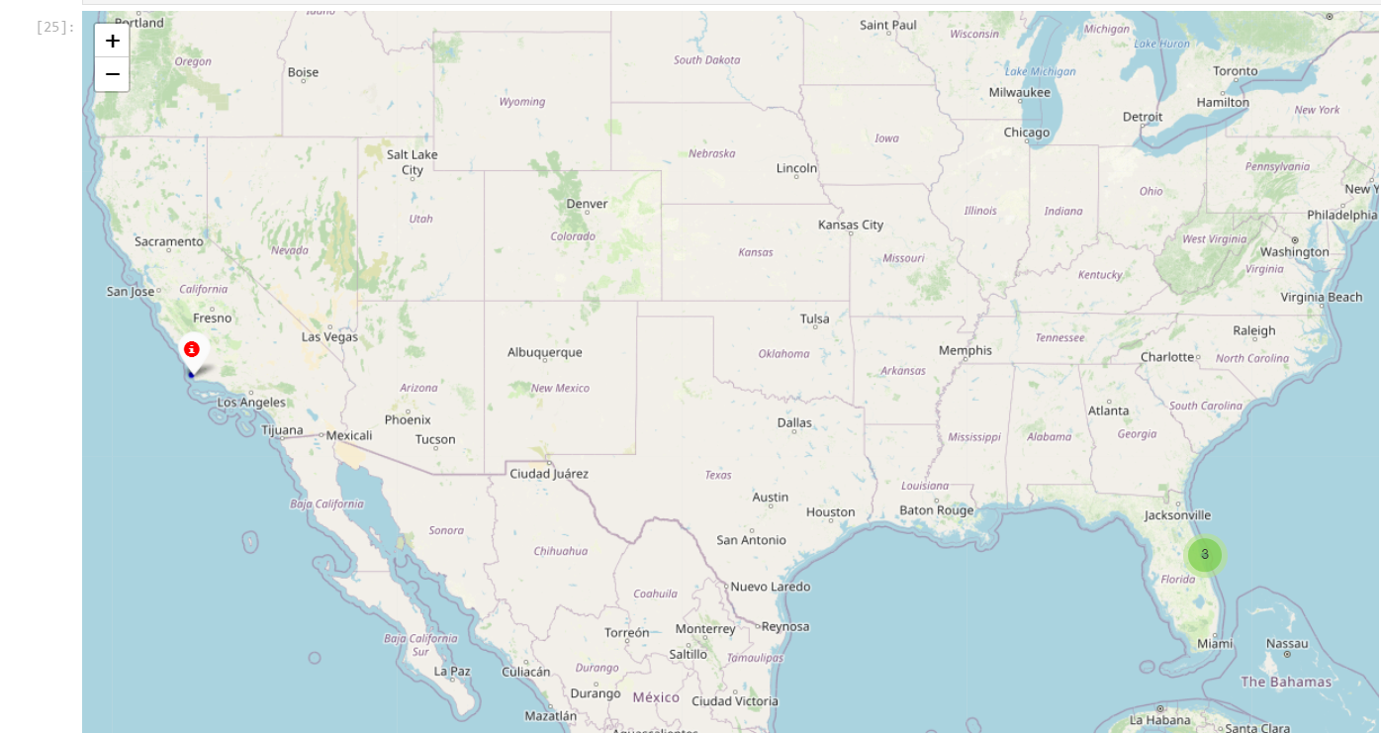
Mark the success/failed launches for each site on the map

Slide 6
Mark the success/failed launches for each site on the map

Slide 7
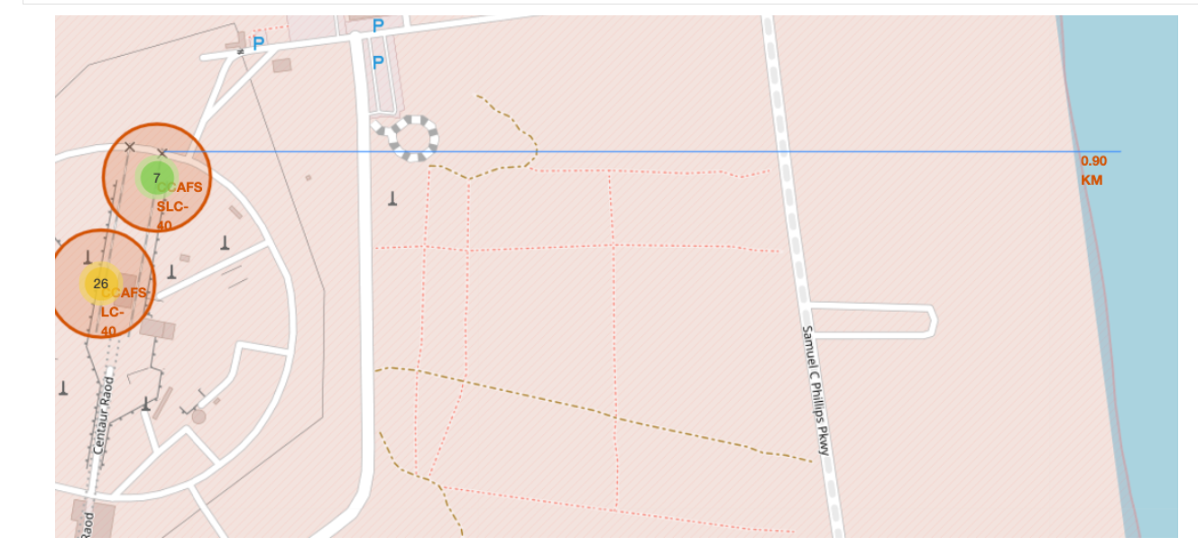
Mark the success/failed launches for each site on the map

